Slide 1
Technical Activities Yao-Wen Chang November 2015

Slide 2
TA Tasks
Chapter
Contest
Distinguished Lecture
Workshop

Slide 3
Chapters
Strategy | Conduct self organizing local outreach programs
Action | Create long lasting Chapters Hold annual review meeting at DAC Provide basic funding support
Goal | 10 active WW geo-diverse chapters Group ownership with rotating chairs Chair networking for joint activities
Current status | 9 chapters: 5 are thriving (Central Texas, East PA, Korea, Japan, Taiwan) & 1 stable (Shanghai), less responsive (Brazil) & 2 lost (Benelux & Tunisia) In process: China-Beijing, India, HK More: Mexico, Abu Dhabi, Midwest?
Current issue | No right to replace an inactive chapter chair (or to force a chair to organize a slate of officers)
Owner | Yao-Wen Chang

Slide 4
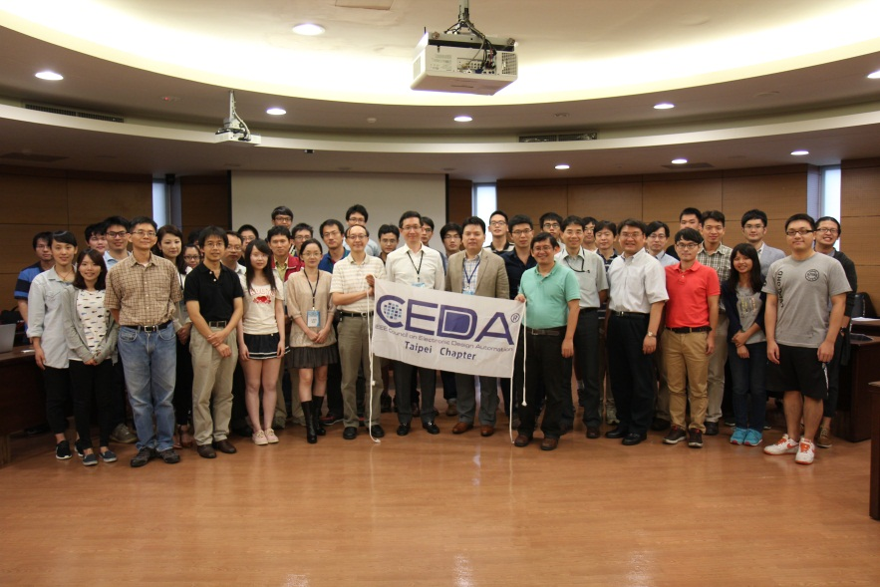
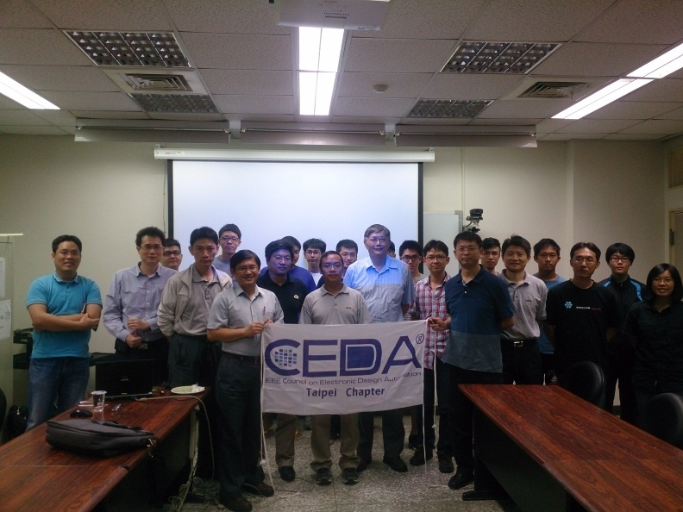
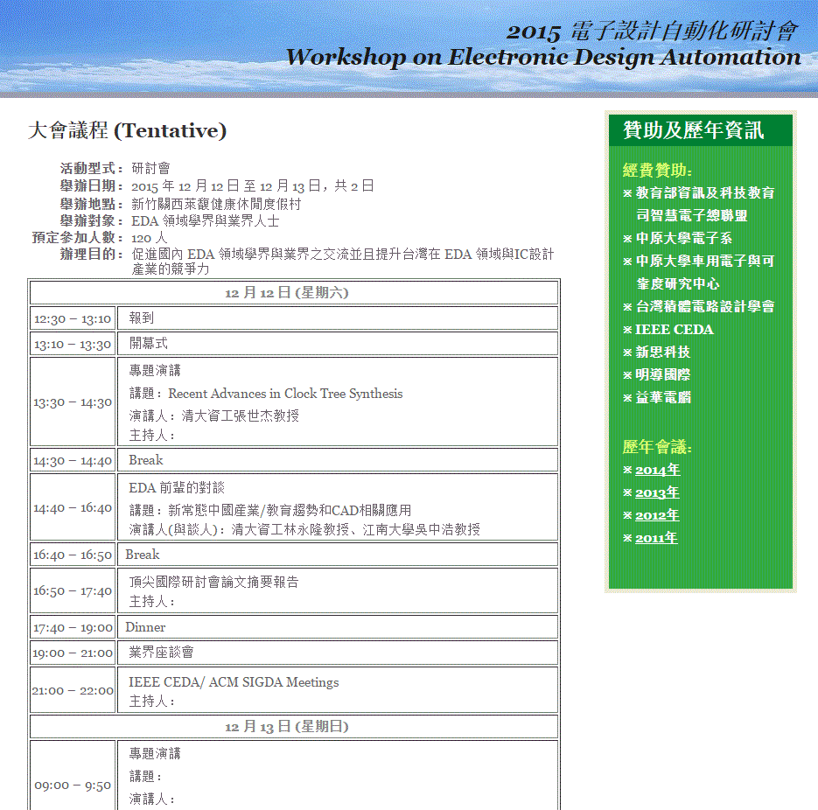
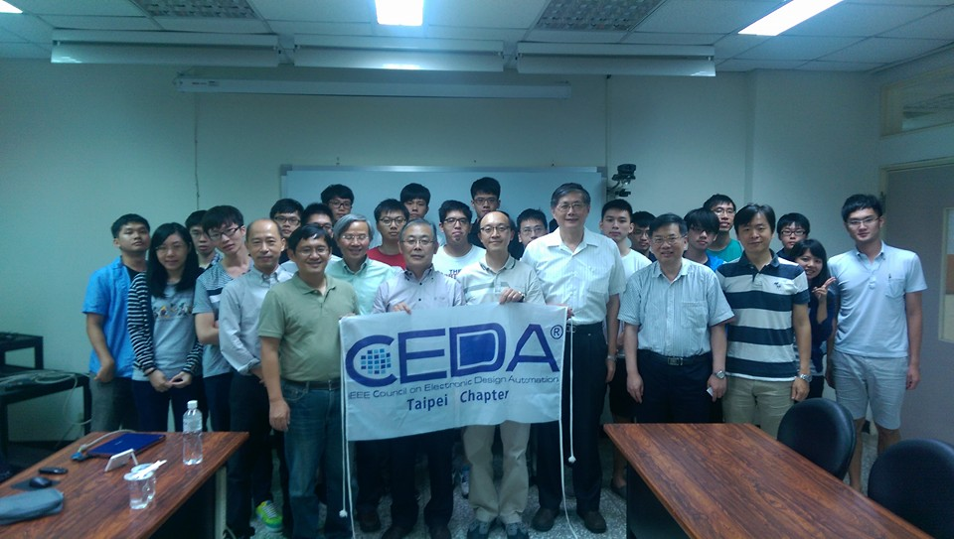
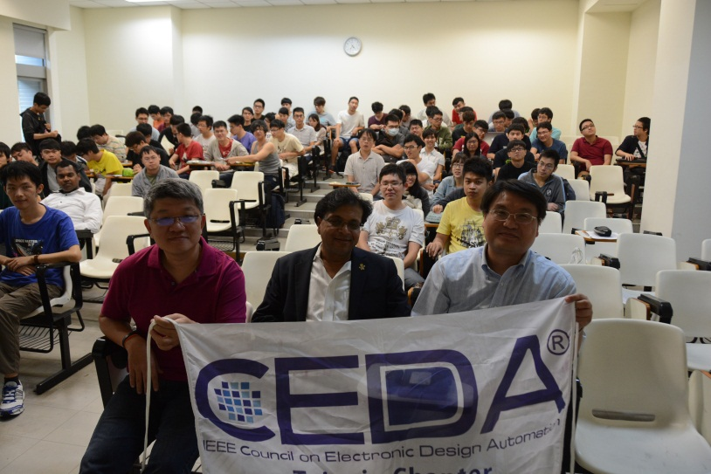
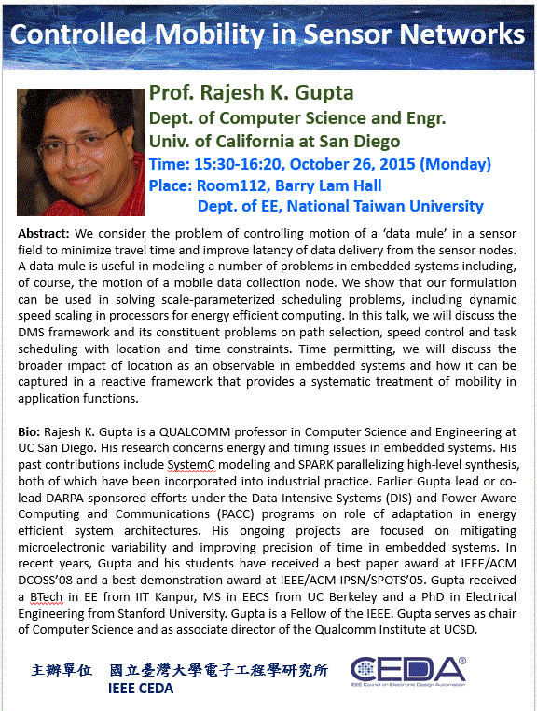
Taipei Chapter: Invited Talks
4

Slide 5
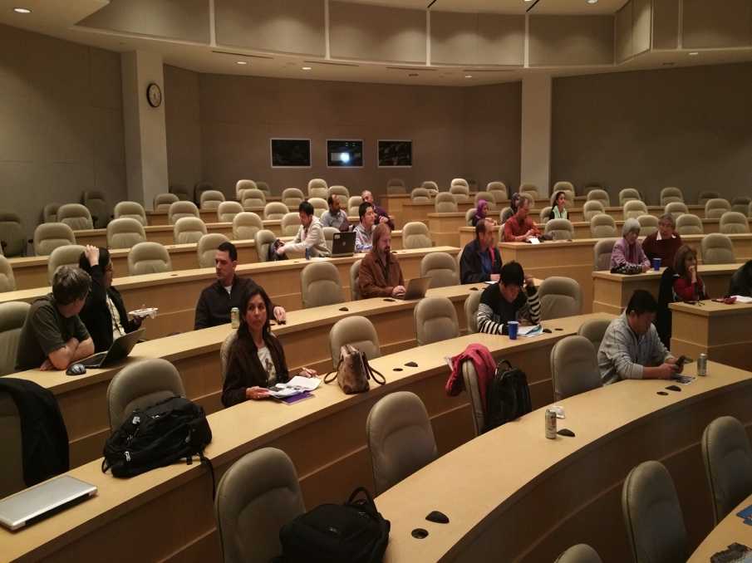
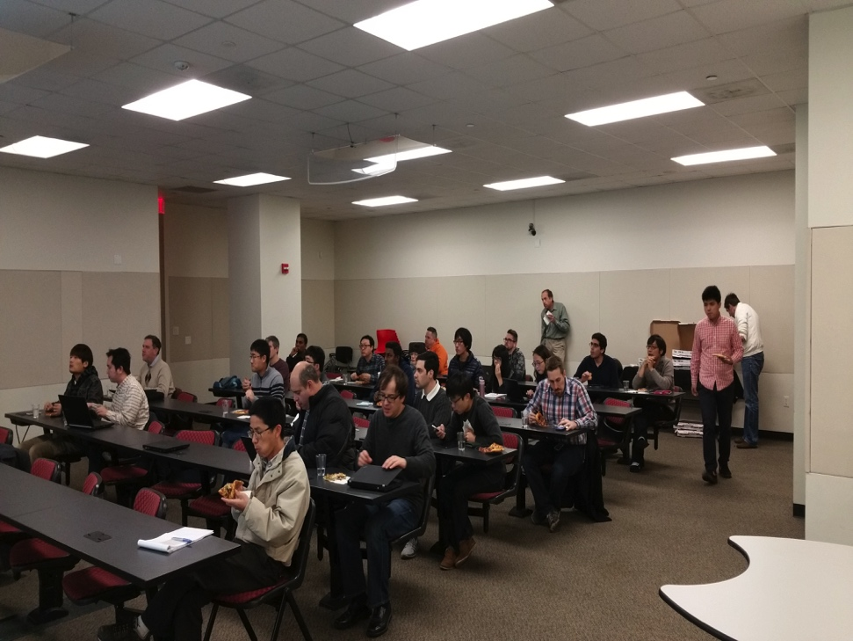
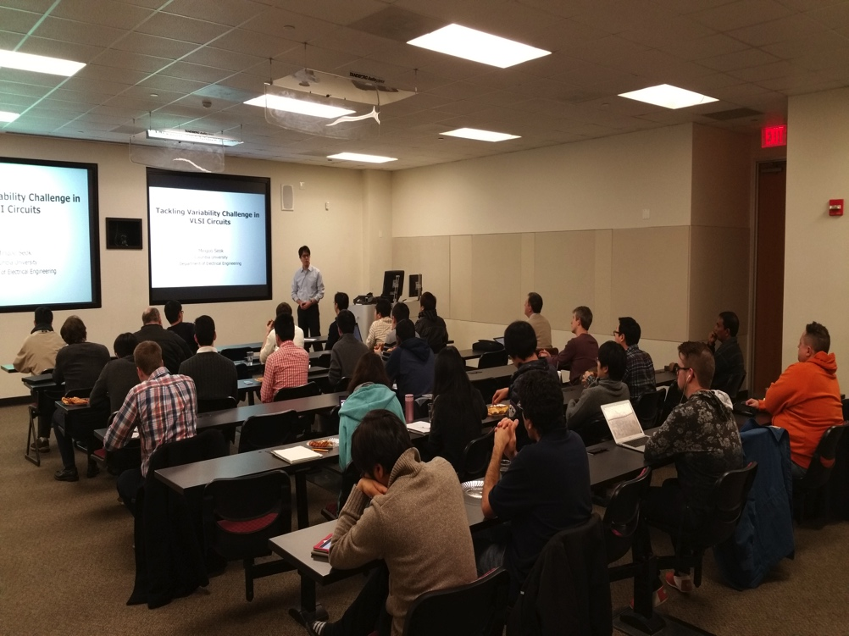
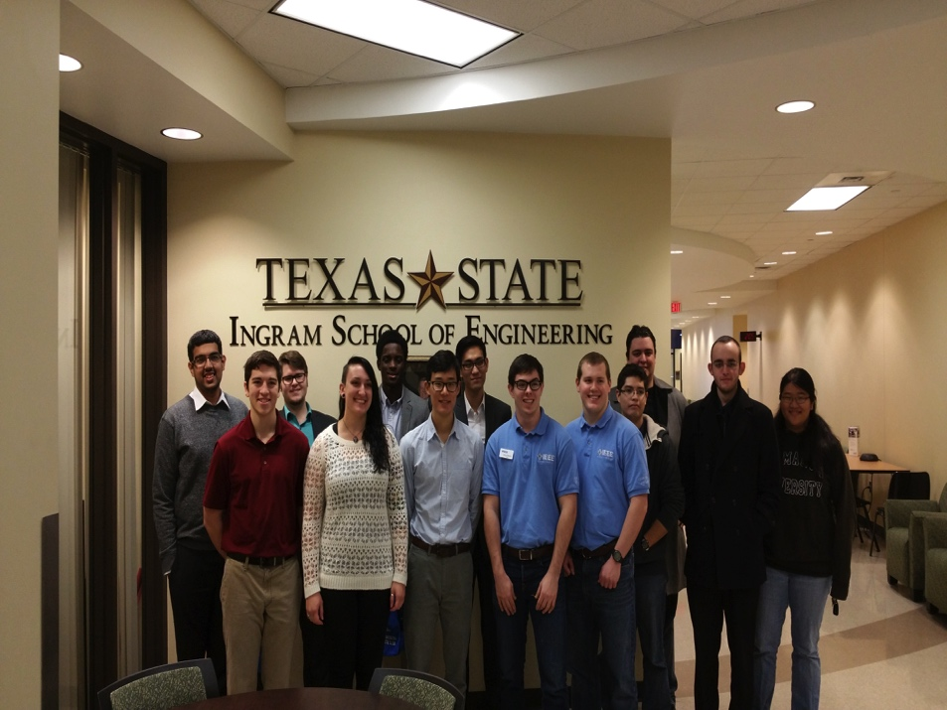
Central Texas Chapter

Slide 6
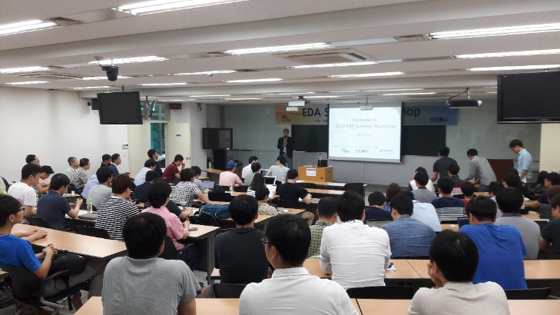
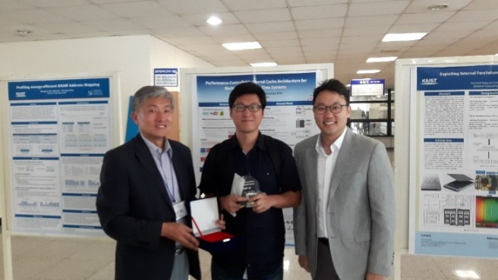
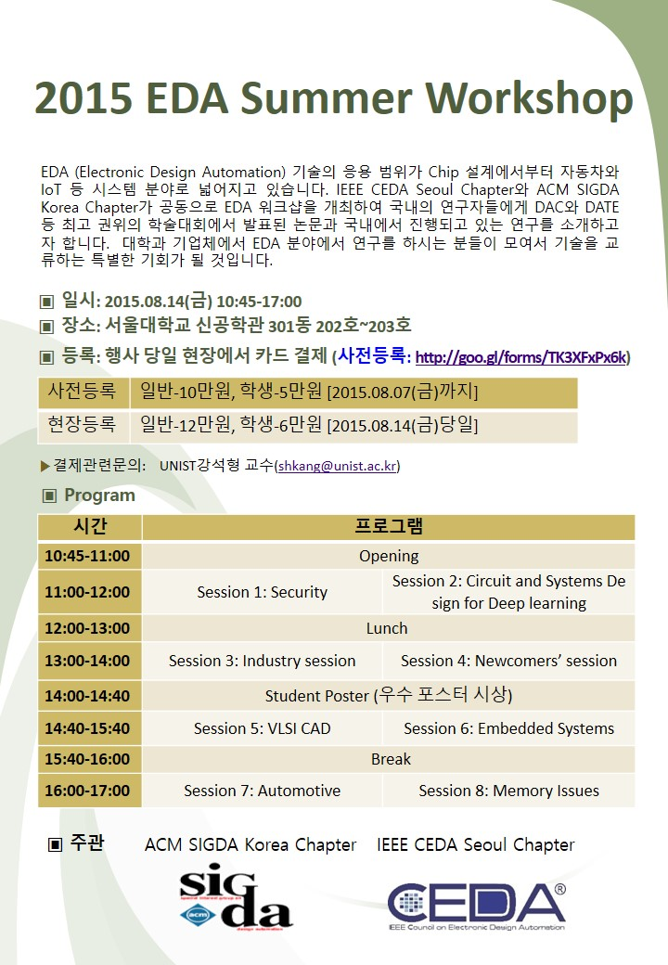
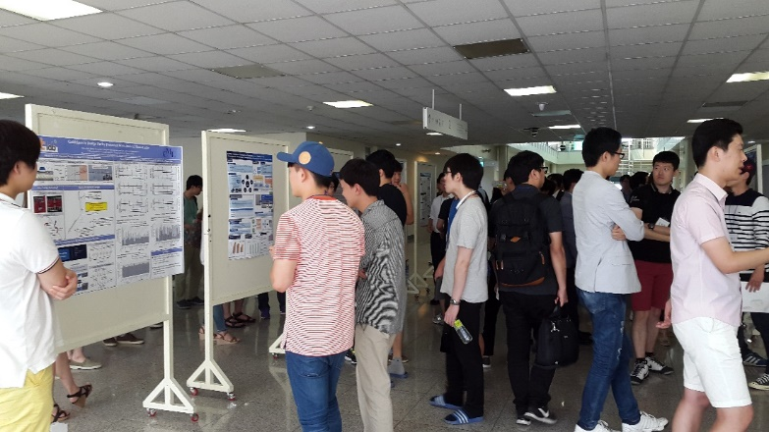
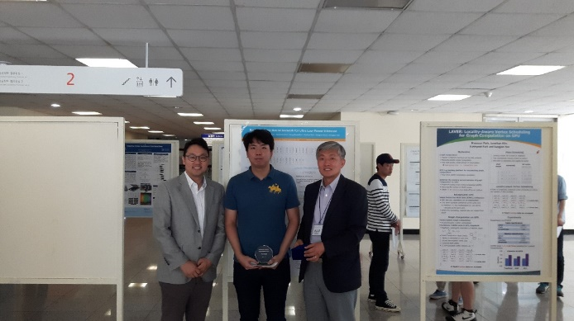
Korea Chapter

Slide 7
CAD Contest @ ICCAD
Strategy | Nurse EDA new blood & promote industry-academia research interactions
Action | Hold annual CAD Contest Release benchmarks
Goal | Increase geographical diversity (10+ regions) & participating teams (100+ teams) Work on broader topics (3+ areas) Consolidate EDA sister contests
Current status | Thrived with 112 teams in 2015 (56, 87, 93, 112) & highest ICCAD attendance & sufficient Taiwan MOE financial ($110K per year) Gained higher geographical diversity (12 regions, 60% from Taiwan now) Published 16+ DAC/ICCAD papers based on past contests
Current issue | Taiwan MOE will reduce the financial support from $110K to ~ $60K; need to find more financial support ($6K from CEDA??)
Owner | Yao-Wen Chang
Notes:
The largest worldwide EDA research and development contest
Goal: Boost EDA research in advanced real-world problems; Foster industry-academia collaboration

Slide 8
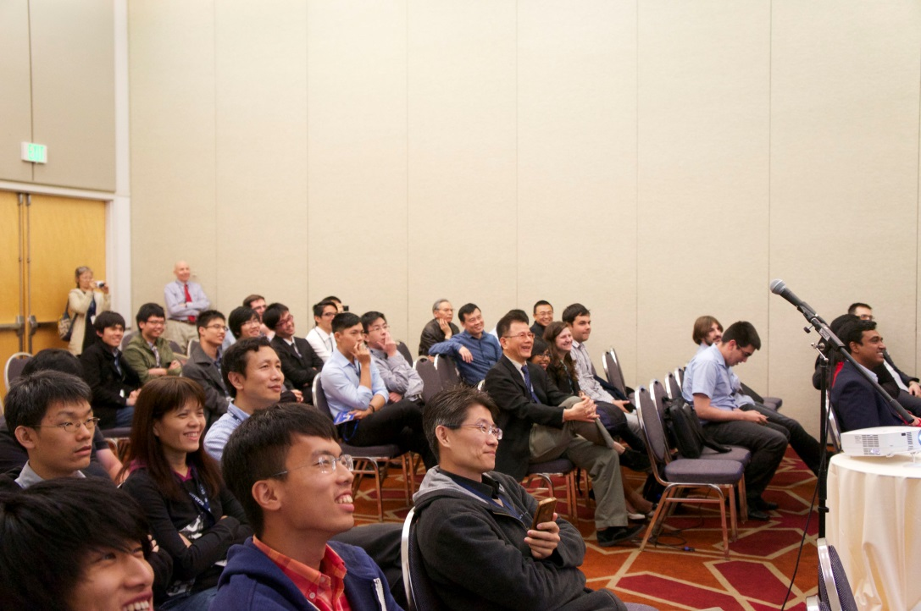
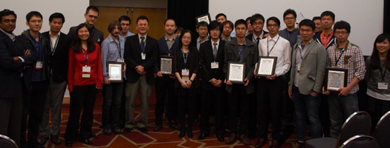
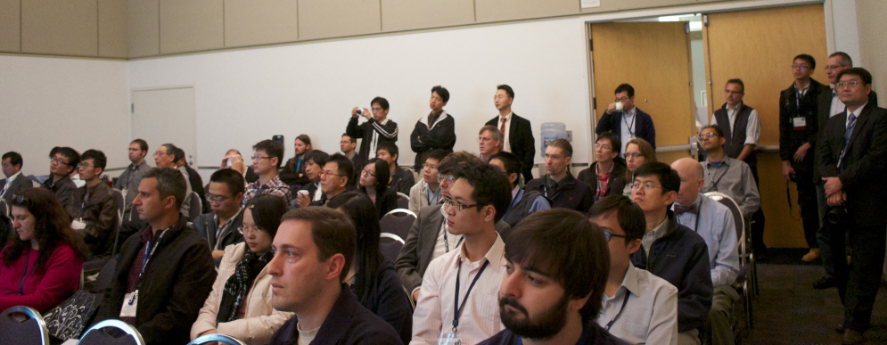
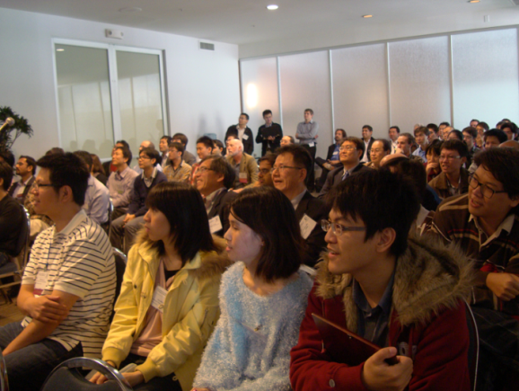
ICCAD Contest Sessions
Always attract a large audience!
Highest attendance; above all regular sessions at ICCAD 2012, 2013 and 2014
2014
2014
2013
2012

Slide 9
Registration Statistics
2012 CAD Contest
56 teams from 7 regions
USA, Japan, Mainland
China, Hong Kong,
Korea, Italy and Taiwan
2013 CAD Contest
87 teams from 9 regions
USA, Canada, Brazil,
India, Russia, Japan,
Mainland China, Hong
Kong and Taiwan
2014 CAD Contest
93 teams from 9 regions
USA, Canada, Brazil,
Russian Federation,
India, Singapore,
Mainland China, Hong
Kong and Taiwan
2015 CAD Contest at ICCAD
112 teams from 12 regions/countries
Asia: Taiwan, Mainland China, Hong Kong, Korea, India, Iran
North America: USA
South America: Brazil
Europe: Belgium, Sweden, Russian Federation
Africa: Egypt

Slide 10
Contest Problems
Contributor(s) | Topic (area)
Stanford University, IBM Research and ESL-EPFL Mohamed M. Sabry, Arvind Sridhar and David Atienza | 3D-ICON: 3D Interlayer Cooling Optimized Network (System Level Design)
Cadence Jacky Chih-Jen Hsu | Large-Scale Equivalence Checking and Function Correction (Logic Synthesis & Verification)
IBM Systems Myung-Chul Kim and Jin Hu | Incremental Timing-Driven Placement (Physical Design)

Slide 11
Handling the Financial Support Reduction
Issue
Taiwan MOE will reduce the support for this contest to only about $60K in 2016
Current status
Taiwan MOE invested about $110K per year to cover all expenses
Solutions
Cut costs such as the travel grants of topic chairs, prize awards, and review expenses to run a healthy contest with three topics like it is
Find financial sponsorships from industry ($6K)?
Shrink to only two topics each year (front-end + back-end)?
Find co-sponsorship from ACM/SIGDA?
Request $6K from CEDA for monetary awards for student winners

Slide 12
Awards for Contest Winners
Currently contest winners receive monetary awards (students only) and certificates
Suggestion: Give a $6K sponsorship, $1K for every 1st-place team and $500 for every 2nd-/3rd-place team
Rank | Award
1st Place One team for each topic | Certificate of 1st Place NTD50,000/team (approx. US$1650)
2nd Place / 3rd Place Two teams for each topic | Certificate of 2nd / 3rd Place NTD30,000/team (approx. US$1000)

Slide 13
Distinguished Lecture
Strategy | Engage community across societies/councils
Action | Talks at major conferences Distinguished Lectures to chapters and other organizations
Goal | Increase CEDA impacts Explore emerging EDA areas
Current status | Arrange two luncheon talks per year, one at DAC, and one at ICCAD; typically attract high attendance Change to audio recording w. slides for lower cost, post audio & slides at CEDA web site, enrich web contents, but download/click count?
Current issue | Follow the CASS, etc. format/rules to select 2-4 distinguished lecturers with geographical diversity, each with a 2-year term?? Committee: Ulf Schlichtmann (chair), Naehyuck Chang, and David Pan
Owner | Ulf Schlichtmann & Yao-Wen Chang

Slide 14
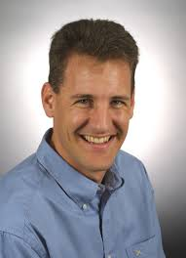
Distinguished Lecture at ICCAD
Time: 12:10pm-1:20pm, Nov. 3 (Tuesday)
Room: Phoenix Central
Title: The Future of Energy-efficient Computing
Speaker: Dr. Stephen W. Keckler, Sr. Director of Architecture Research, NVIDIA
Adjunct Professor of UT-Austin
BS of Stanford; M.S./Ph.D. of MIT
ACM/IEEE Fellow
Research areas: parallel computer architectures, high-performance computing

Slide 15
Workshops
Strategy | Nurse new events across societies/councils
Action | Provide necessary financial support
Goal | Nurse continuously running workshops/events for human resource cultivation
Current status | Scattered requests for support, discontinued events 2015: Frontiers in Analog CAD Workshop at ICCAD (all EC members are invited for its lunch), DATE support for new initiatives, SMACD competition
Current Issue | Provide not only financial support, but also direct involvement
Owner | Yao-Wen Chang

Slide 16
Technical Activities Detail Material

Slide 17
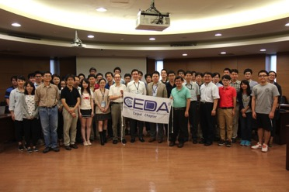
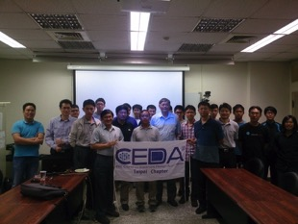
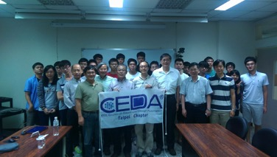
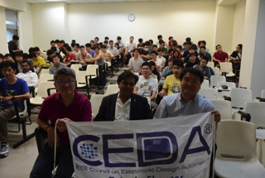
Taipei Chapter: Invited Talks
17

Slide 18
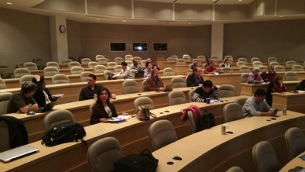
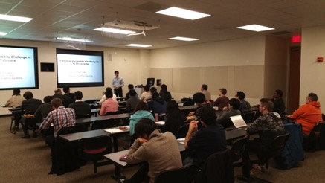
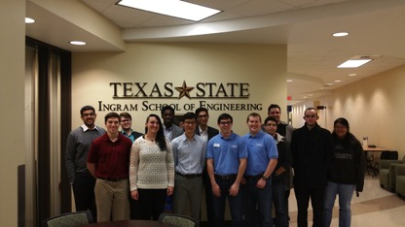
Central Texas Chapter

Slide 19
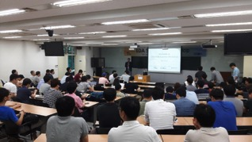
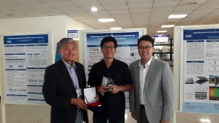
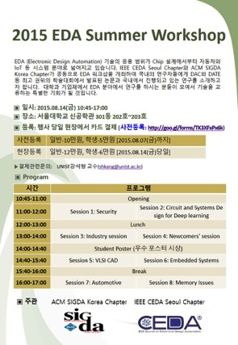
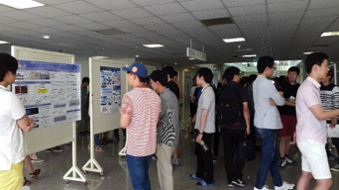
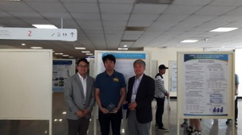
Korea Chapter

Slide 20
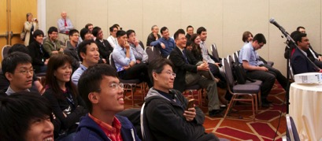
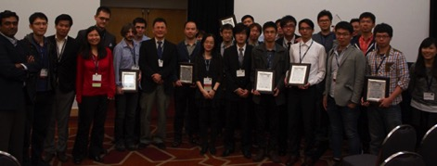
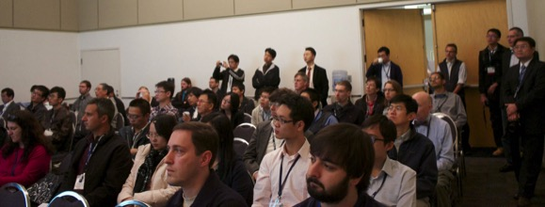
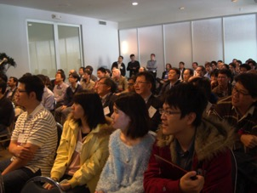
ICCAD Contest Sessions
Always attract a large audience!
Highest attendance; above all regular sessions at ICCAD 2012, 2013 and 2014
2014
2014
2013
2012

Slide 21
Handling the Financial Support Reduction
Issue
Taiwan MOE will reduce the support for this contest to only about $60K in 2016
Current status
Taiwan MOE invested about $110K per year to cover all expenses
Solutions
Cut costs such as the travel grants of topic chairs, prize awards, and review expenses to run a healthy contest with three topics like it is
Find financial sponsorships from industry ($6K)?
Shrink to only two topics each year (front-end + back-end)?
Find co-sponsorship from ACM/SIGDA?
Request $6K from CEDA for monetary awards for student winners

Slide 22
Awards for Contest Winners
Currently contest winners receive monetary awards (students only) and certificates
Suggestion: Give a $6K sponsorship, $1K for every 1st-place team and $500 for every 2nd-/3rd-place team
Rank | Award
1st Place One team for each topic | Certificate of 1st Place NTD50,000/team (approx. US$1650)
2nd Place / 3rd Place Two teams for each topic | Certificate of 2nd / 3rd Place NTD30,000/team (approx. US$1000)

