Slide 1
Embedded Systems Week SIGDA Report
ESWEEK 2018
General Chair: Soonhoi Ha (SNU, Korea)
Vice General Chair: Petru Eles (Linköping, Sweden)
ESWEEK 2019
General Chair: Petru Eles (Linköping, Sweden)
Vice General Chair: Tulika Mitra (NUS, Singapore)

Slide 2
ESWEEK General Information
Sponsored by ACM and IEEE (alternating administrative support)
Structure
3 conferences (CASES, CODES+ISSS, EMSOFT): Monday ~ Wednesday
Tutorials: Sunday
Workshop and Symposia: Thursday ~ Friday
Rotation Rule
2017: Asia + South Pacific (Korea)
2018: Europe (Italy)
2019: America (U.S.A)
Dual publication model since 2017
Journal track paper: 2 phase review process
WIP paper

Slide 3
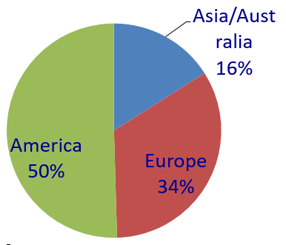
ESWEEK Recent History
~363 attendees
~510 attendees
~379 attendees
America
Asia
Asia (30%)
Europe
(47%)
Europe
America (22%)
2016
2017
2018
Net conference attendants: 272 (in 2018)
Notes:
The total number includes workshop-only and symposia-only registrations.
The number of conference registrants keeps increasing. A single registrant may select multiple conferences.

Slide 4
CASES Overview
 | Submissions | Accepted | Accept. rate
Journal-track | 74 | 18 | 24.3%
WiP-track | 24 | 15 | 62.5%
CODES+ISSS Overview
 | Submissions | Accepted | Accept. rate
Journal-track | 86 | 22 | 25.5%
WiP-track | 28 | 17 | 60.7%
EMSOFT Overview
 | Submissions | Accepted | Accept. rate
Journal-track | 111 | 27 | 24.3%
WiP-track | 17 | 15 | 88.2%

Slide 5
Summary of ESWEEK 2018
What worked well
Journal-integrated model (IEEE TCAD)
Student supports from ACM SIGBED and IEEE CEDA
New events
F1/10 challenge
Women in ESWEEK (Wednesday lunch meeting)
Industry tutorials from sponsoring companies
Items for improvement or discussion
Different paper formats for submission and publication
Low attendance for some tutorials and workshops
TMRF preparation: number of registrations are hard to predict. VAT issue in Europe is very complicated (MPA does not understand it)

Slide 6
ESWEEK 2019
Venue: New York University, US
Dates: October 13 ~ October 18
Main sponsor: ACM
Local arrangement chairs
Ramesh Karri, New York University, US
Siddharth Garg, New York University, US
CASES
Akash Kumar, Technical University of Dresden, Germany
Partha Pande, Washington State University, US
CODES+ISSS
Sudeep Pasricha, Colorado State University, US
Roman Lysecky, University of Arizona, US
EMSOFT
Sriram Sankaranarayanan, University of Colorado Boulder, US
Timothy Bourke, INRIA, France

