Slide 1
Finance update
Many “housekeeping” activities since beginning of the year
2022 Budget and Forecast Updates (in the post-COVID era)
2023 Budget elaboration dates and timeline

Slide 2
Finance update
Many “housekeeping” activities since beginning of the year
NextGen and Concur access (and NextGen training…)
Getting up-to-speed with recent changes (CCs, ACs)
Setting up all VP of Finance rights correctly (some approvals got delayed…)
CEDA Credit card
2022 Budget vs Forecast Updates (in the post-COVID era)
2023 Budget dates and timeline

Slide 3
2022 Budget vs Forecast updates
Forecast updates: the opportunity to adjust for the deviations of the 2022 budget
1st quarter (mid-May)
2nd quarter (mid-August)
3rd quarter (mid-November)
Main items to adjust:
Periodical products (changes to page counts for 2022) → can still be submitted
Conference products → changes due to COVID expected (we seem back to 2019 data)
Initiatives (see next slide)

Slide 4
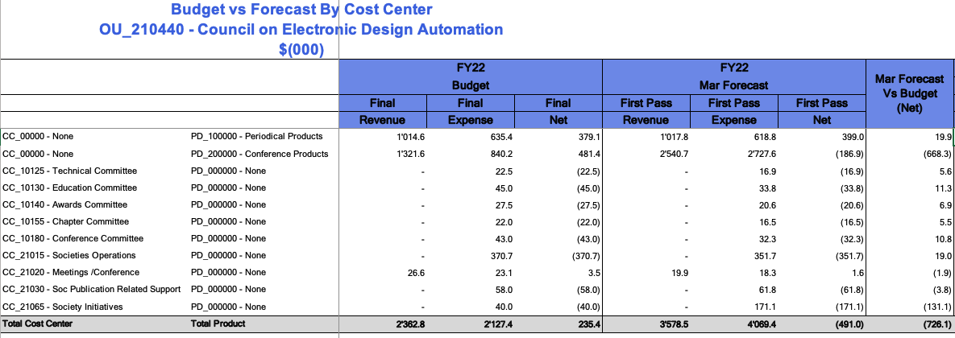
2022 Budget vs Forecast updates

Slide 5
2022 Initiatives Project budget
Approved 3% amount in 2022 budget → 40k
Current forecast overview for projects (CC_21065 – Society initiatives):
Current 50% spending in forecast → 131.1K
~2022 50% spending in forecast → 157.0K
Still available to apply for 25.9K
Updates/changes can be still incorporated into Q1 forecast (to be informed ASAP)

Slide 6
2023 Budget elaboration
First-pass updates from July 20th to August 11th.
First view available on Nextgen on July 14th
Ideally to be discussed internally at some point between those dates
Discussion during July 10th DAC meeting instead

