Slide 1
ieee-ceda.org

Slide 2
About IEEE Council on Electronic Design Automation (CEDA)
Formed in 2005
Field of Interest. The theory, implementation, and use of EDA/CAD tools to design integrated electronic circuits and systems. This includes tools that automate all levels of the design, analysis, and verification of hardware and embedded software up to and including complete working systems.
Vision. To be the leading provider in IEEE of technical information and community services in Design and Automation of Electronic and Embedded Systems.

Slide 3
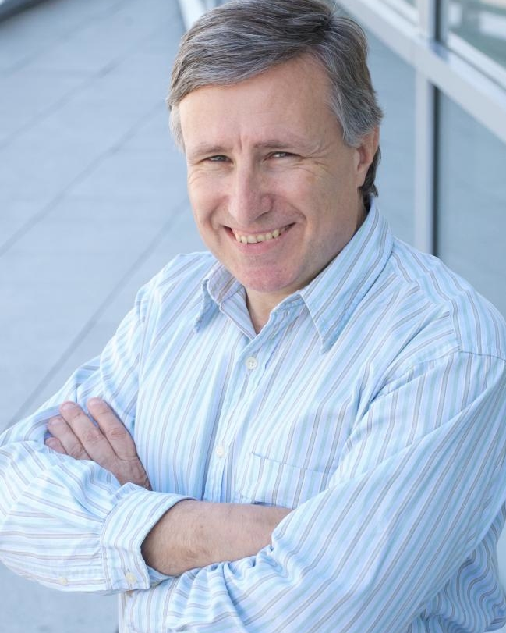
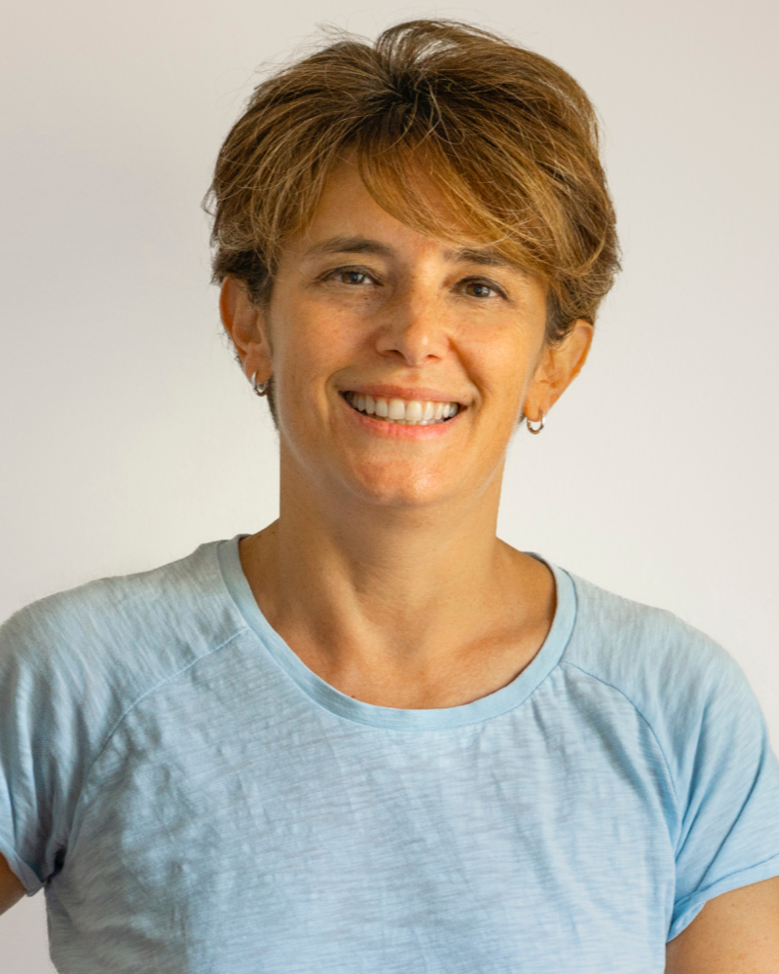
CEDA Executive Committee
President L. Miguel Silveira INESC-ID, IST, Universidade de Lisboa
President-Elect Cristiana Bolchini Politecnico di Milano
2023-2024 CEDA Officers
Past-President Gi-Joon Nam
Secretary Elena-Ioana Vatajelu
VP Conferences Tsung-Yi Ho
VP Finance Marina Zapater
VP Publications Jörg Henkel
VP Activities Ian O’Connor
VP Awards Deming Chen
VP Publicity Sri Parameswaran
VP Initiatives Qi Zhu
VP Standards Aparna Dey
VP Strategy Georges Gielen
YP Coordinator Iris Hui-Ru Jiang

Slide 4
Member Societies

Slide 5
Technical Committees
Design Automation
Test Technology
Cyber-Physical Systems
Hardware Security and Trust
System Validation and Debug
To assure grounding in the major technology activities of the electronic design automation field, CEDA has Member Technology Organizations from various conferences, publications, and organizations.

Slide 6
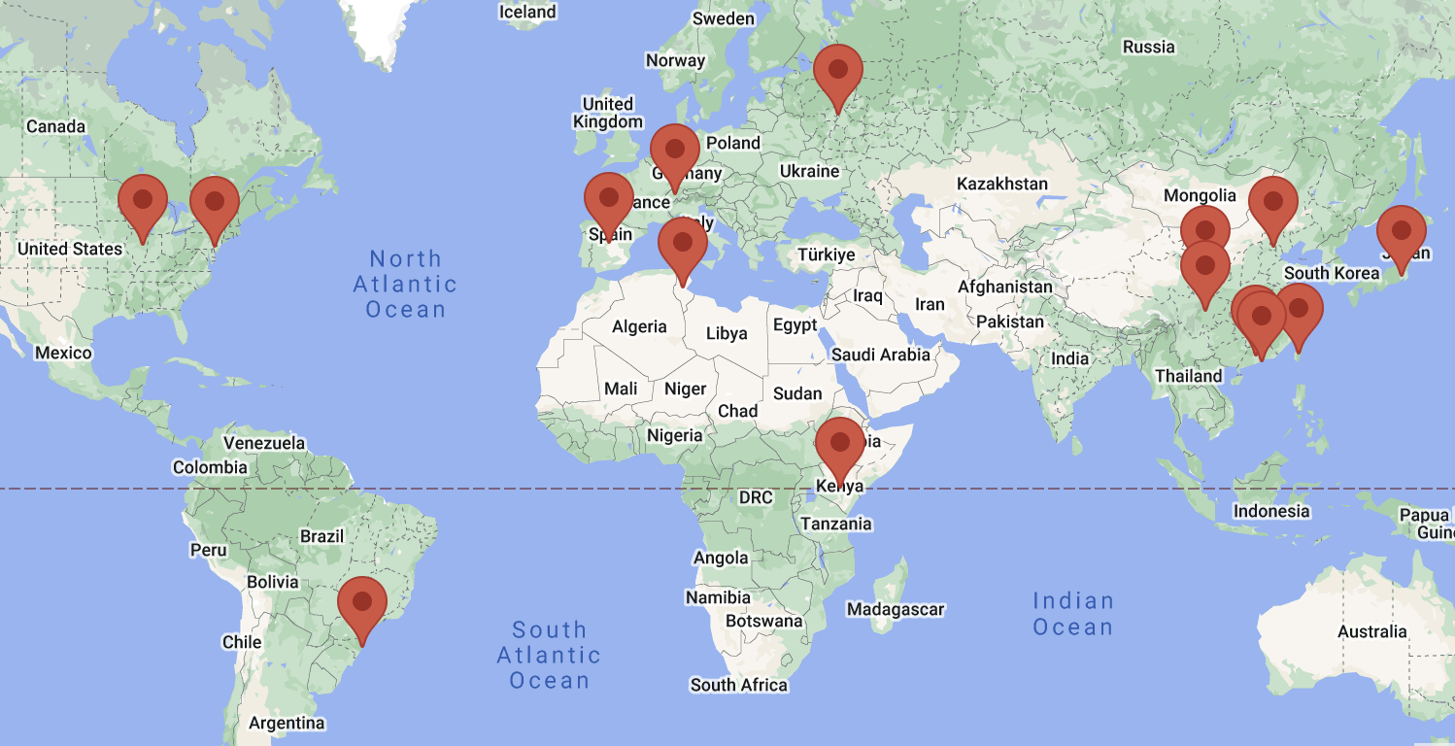
Chapters
The goal of CEDA chapters is to facilitate CEDA-relevant activities locally. Chapters serve IEEE members by holding meetings at the local level. These meetings may include invited lectures or regular discussion meetings on recent EDA topics.

Slide 7
Conferences
CEDA financially and technically sponsors and co-sponsors many different conferences and workshops to foster design automation of electronic circuits and systems.
Full list of events available on ieee-ceda.org

Slide 8
Sponsorship Opportunities
Conferences
If you are organizing a conference, CEDA can help!
Organizing, financing, publishing, advertising
Contact VP Conferences at vp.conferences@ieee-ceda.org
Meetings, Workshops, Contests, Etc.
Events with no “proceedings” to be published
Contact VP Activities at admin@ieee-ceda.org
All other sponsorship opportunities should contact the CEDA President admin@ieee-ceda.org

Slide 9
CEDA Awards
CEDA recognizes the scientific activities of the members of the EDA community by sponsoring numerous awards in the field. The honors recognize a wide range of contributions, including individuals who have had demonstrable impact on the field of electronic design, made substantial technical contributions to EDA in the early stages of her or his career, those whose impact is recognized over a significant period of time, outstanding publications, and volunteers with outstanding service to the benefit and advancement of CEDA.
All awards, forms, and previous winners are available on ieee-ceda.org
Phil Kaufman Award for Distinguished Contributions to EDA and Hall of Fame
A. Richard Newton Technical Impact Award in Electronic Design Automation
IEEE Transactions on Computer-Aided Design Donald O. Pederson Best Paper Award
Ernest S. Kuh Early Career Award
William J. McCalla ICCAD Best Paper Award
Distinguished Service Award
Outstanding Service Recognition
IEEE Fellows elevated by CEDA

Slide 10
Publications
Financially Sponsored Publications
IEEE Transactions on Computer Aided Design of Integrated Circuits & Systems (TCAD)
IEEE Embedded Systems Letters (ESL)
IEEE Design&Test (D&T)
IEEE Journal on Exploratory Solid-State Computational Devices and Circuits (JxCDC)
Technically Sponsored Publications
IEEE Internet of Things Magazine
IEEE Transactions on Signal and Power Integrity (TSPI)
IEEE Transactions on Sustainable Computing (T-SUSC)
Currents - CEDA’s Online Newsletter
ieee-ceda.org/publications

Slide 11
CEDA Presentation Library Launched in 2020
Educational Resources
Constantly pursuing new ways to accomplish its mission and considering the effects that the pandemic has in the communication among its members, CEDA added a new web feature to facilitate knowledge dissemination within and beyond the EDA community. The Presentation Library includes talks from conferences, workshops, plenary talks, lectures, etc. that are of significant interest to the community.

Slide 12
Design Automation WebiNar
Educational Resources
Design Automation WebiNar (DAWN) is designed to drive research momentum and ensure our community remains at the cutting edge. Different from conventional keynote and individual speaker webinars, DAWN is a special-session-style webinar. DAWN is formed by multiple presentations on focused topics by leading experts in our community.
All DAWN talks are available on the CEDA YouTube page

Slide 13
CAD for Assurance
Educational Resources
The CAD for Trust and Assurance website is an academic dissemination effort by researchers in the field of hardware security. The goal is to assemble information on all CAD for trust/assurance activities in academia and industry in one place and share them with the broader community of researchers and practitioners in a timely manner, with an easy-to-search and easy-to-access interface. We’re including information on many major CAD tools the research community has developed over the past decade, including open-source license-free or ready-for-licensing tools, associated metrics, relevant publications, and video-demos.
All webinars are available on the CEDA YouTube page

Slide 14
CEDA Distinguished Lecturers Program
Established in 2016
Objective
Highlights
Information
Access to experts promoting the field of electronic design automation
Currently, 5 DLs with various backgrounds and geo-locations
Online Biography and Talk Titles
ieee-ceda.org
Request a Distinguished Lecture for your event by visiting the website ieee-ceda.org/distinguished-lecturer-program and filling out the form.
Calls for new DL’s are announced on the website and social media.

Slide 15
What Can the Council Do For You?
As CEDA is an IEEE Technical Council and unlike Member Societies, individuals cannot be members of a council. However, IEEE Members can register as CEDA participants, receive newsletters, attend CEDA sponsored events, and volunteer.
Conferences
Standards
Publications
Education
Technical Activities
Networking

Slide 16
CEDA Distinguished Lecturers | 2023-2024
Vivek De | Intel Corp.
Variation-Tolerant and Error-Resilient Many-Core SoCs with Fine-Grain Power Management Attack-Resistant Energy-Efficient SoCs for Smart and Secure Cyberphysical Systems
Rolf Drechsler | University of Bremen
Polynomial Formal Verification: Ensuring Correctness under Resource Constraints
Prabhat Mishra | University of Florida
Securing Hardware for Designing Trustworthy Systems
Design Automation for Quantum Computing
Explainable AI for Cybersecurity

Slide 17
CEDA Distinguished Lecturers | 2023-2024
Qinru Qiu | Syracuse University
A Journey into Neuromorphic Computing: Models, Algorithms, and Implementations
Energy Efficient Learning and Adaptation of Multivariate Time Series Using Neuromorphic Computing
Cheng Zhuo | Zhejiang University
Hardware/Software Co-Design for Computing-in-Memory Using Non-Volatile Memory
Energy Efficient Approximate Multiplier Design: From A Cross-Layer Perspective
Machine Learning Assisted Sign-Off: Cost and Effect

Slide 18
How to Get Involved?
Become a CEDA Participant
For free on the IEEE website
Subscribe to CEDA Mailing List
bit.ly/currents-subscribe
Conferences and Events
Organize a meeting, workshop or conference.
Review for CEDA conferences and Journals
Get involved with local chapters and volunteer to organize activities Volunteer to organize activities
Volunteer to Serve on CEDA Committees
Calls are announced on the website and social media
Distinguished Lecturers Program
Request a DL at your next event Apply to become a DL

Slide 19
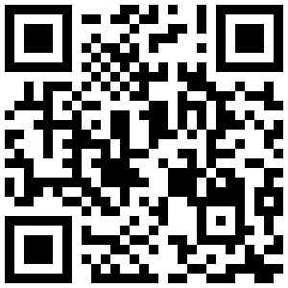
Website
ieee-ceda.org
Facebook
Stay up to date on all CEDA news and events!
facebook.com/ieeeceda
Twitter
@IEEECEDA
LinkedIn
linkedin.com/company/ieee-ceda
YouTube
youtube.com/IEEECouncilonElectronicDesignAutomation

