Slide 1

ieee-ceda.org

Slide 2


About IEEE Council on Electronic Design Automation (CEDA)
Formed in 2005
Field of Interest. The theory, implementation, and use of EDA/CAD tools to design integrated electronic circuits and systems. This includes tools that automate all levels of the design, analysis, and verification of hardware and embedded software up to and including complete working systems.
Vision. To be the leading provider in IEEE of technical information and community services in Design and Automation of Electronic and Embedded Systems.

Slide 3
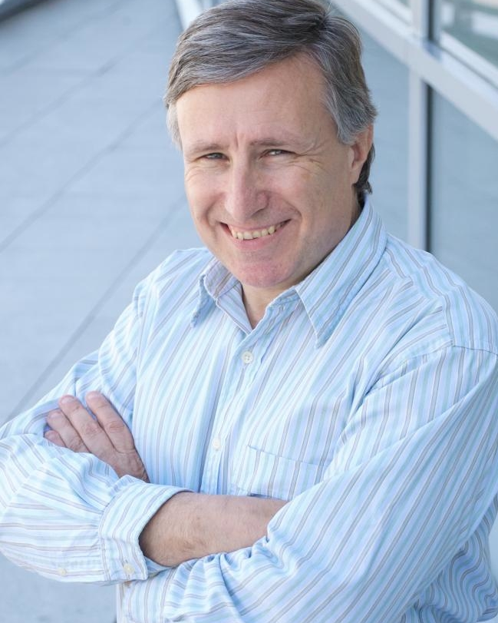
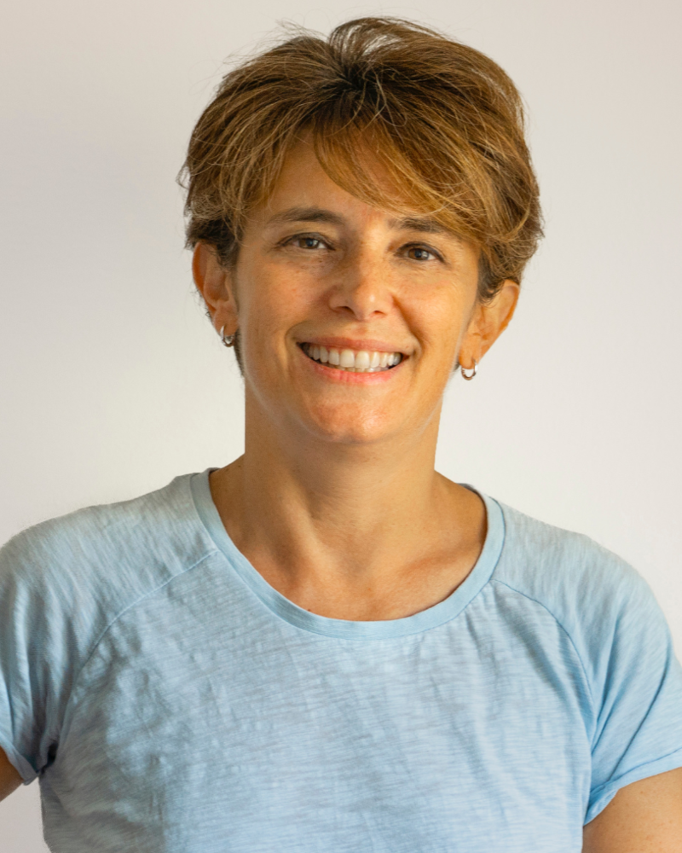
CEDA Executive Committee
President
L. Miguel Silveira
INESC-ID, IST, Universidade de Lisboa
President-Elect
Cristiana Bolchini
Politecnico di Milano
2023-2024 CEDA Officers
Past-President
Gi-Joon Nam
Secretary
Elena-Ioana Vatajelu
VP Conferences
Tsung-Yi Ho
VP Finance
Marina Zapater
VP Publications
Jörg Henkel
VP Activities
Ian O’Connor
VP Awards
Deming Chen
VP Publicity
Sri Parameswaran
VP Initiatives
Qi Zhu
VP Standards
Aparna Dey
VP Strategy
Georges Gielen
YP Coordinator
Iris Hui-Ru Jiang

Slide 4







Member Societies

Slide 5

Technical Committees
Design Automation
Test Technology
Cyber-Physical Systems
Hardware Security and Trust
System Validation and Debug
To assure grounding in the major technology activities of the electronic design automation field, CEDA has Member Technology Organizations from various conferences, publications, and organizations.

Slide 6
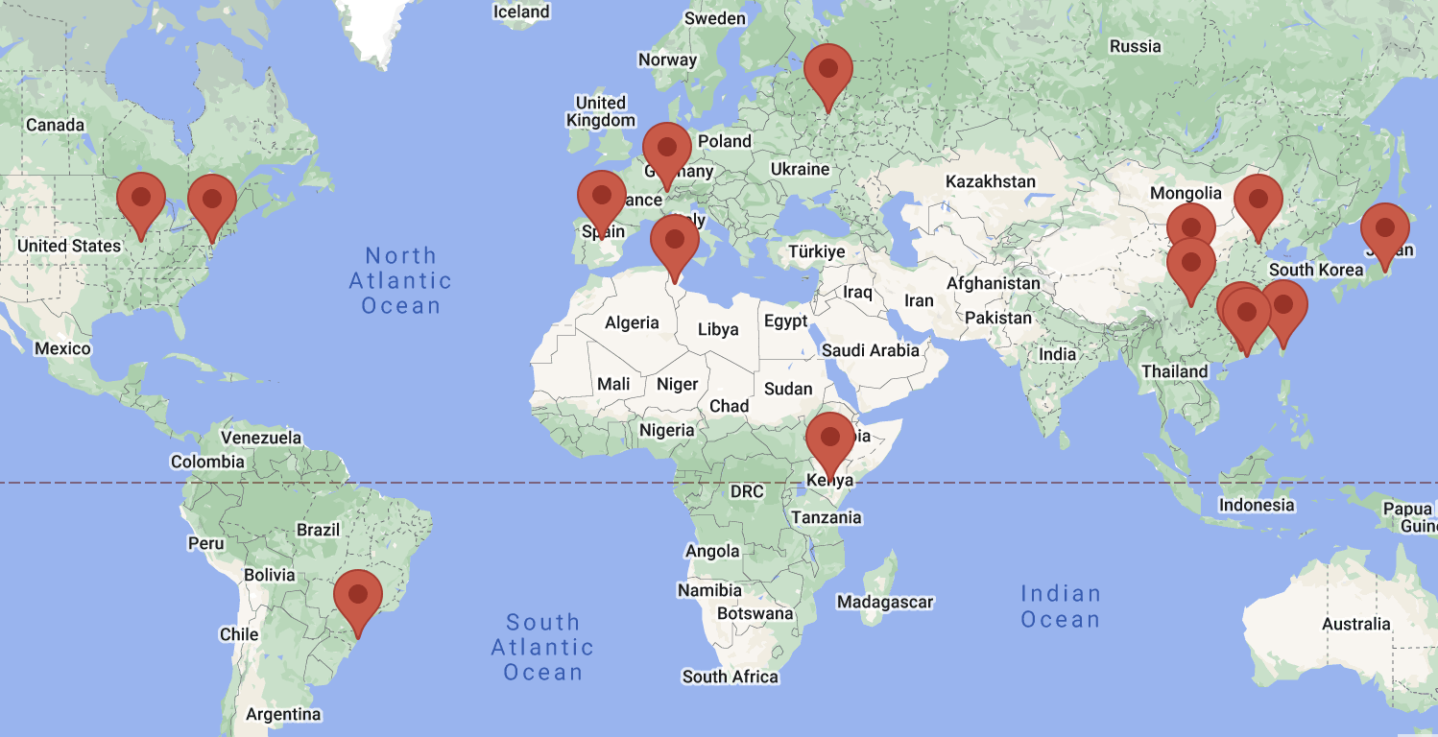
Chapters
The goal of CEDA chapters is to facilitate CEDA-relevant activities locally. Chapters serve IEEE members by holding meetings at the local level. These meetings may include invited lectures or regular discussion meetings on recent EDA topics.

Slide 7




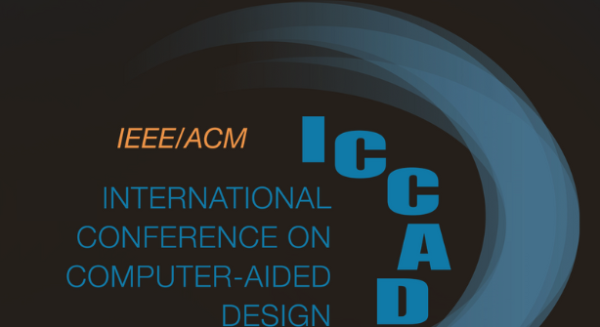
Conferences
CEDA financially and technically sponsors and co-sponsors many different conferences and workshops to foster design automation of electronic circuits and systems.
Full list of events available on ieee-ceda.org

Slide 8



Sponsorship Opportunities
Conferences
If you are organizing a conference, CEDA can help!
Organizing, financing, publishing, advertising
Contact VP Conferences at vp.conferences@ieee-ceda.org
Meetings, Workshops, Contests, Etc.
Events with no “proceedings” to be published
Contact VP Activities at admin@ieee-ceda.org
All other sponsorship opportunities should contact
the CEDA President admin@ieee-ceda.org

Slide 9

CEDA Awards
CEDA recognizes the scientific activities of the members of the EDA community by sponsoring numerous awards in the field. The honors recognize a wide range of contributions, including individuals who have had demonstrable impact on the field of electronic design, made substantial technical contributions to EDA in the early stages of her or his career, those whose impact is recognized over a significant period of time, outstanding publications, and volunteers with outstanding service to the benefit and advancement of CEDA.
All awards, forms, and previous winners are available on ieee-ceda.org
Phil Kaufman Award for Distinguished Contributions to EDA and Hall of Fame
A. Richard Newton Technical Impact Award in Electronic Design Automation
IEEE Transactions on Computer-Aided Design Donald O. Pederson Best Paper Award
Ernest S. Kuh Early Career Award
William J. McCalla ICCAD Best Paper Award
Distinguished Service Award
Outstanding Service Recognition
IEEE Fellows elevated by CEDA

Slide 10


Publications
Financially Sponsored Publications
IEEE Design&Test (D&T)
IEEE Embedded Systems Letters (ESL)
IEEE Journal on Exploratory Solid-State Computational Devices and Circuits (JxCDC)
IEEE Transactions on Computer Aided Design of Integrated Circuits & Systems (TCAD)
IEEE Transactions on Circuits and Systems for Artificial Intelligence (TCASAI)
Technically Sponsored Publications
IEEE Internet of Things Magazine
IEEE Transactions on Signal and Power Integrity (TSPI)
IEEE Transactions on Sustainable Computing (T-SUSC)
Currents - CEDA’s Online Newsletter
ieee-ceda.org/publications

Slide 11
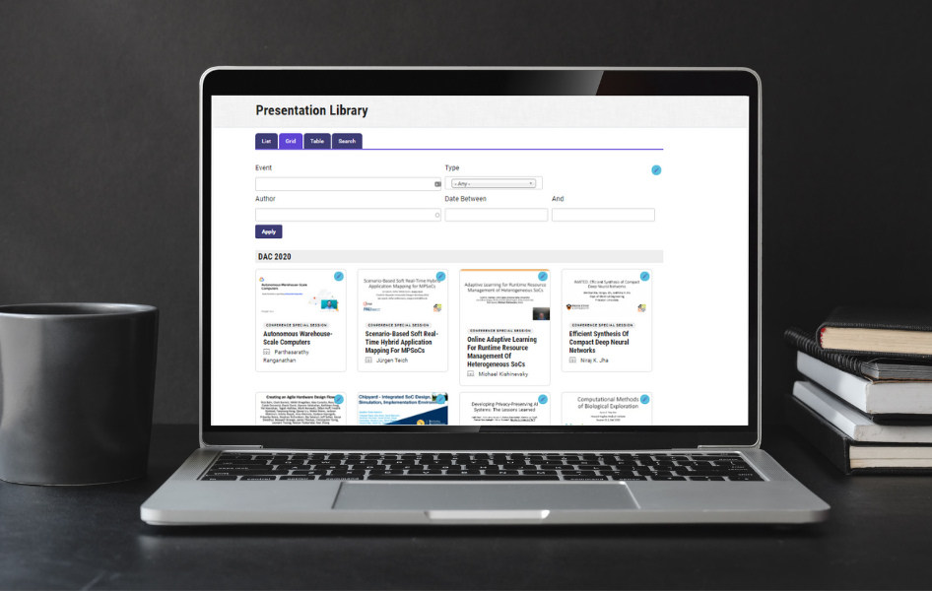
CEDA Presentation Library
Launched in 2020
Educational Resources
Constantly pursuing new ways to accomplish its mission and considering the effects that the pandemic has in the communication among its members, CEDA added a new web feature to facilitate knowledge dissemination within and beyond the EDA community. The Presentation Library includes talks from conferences, workshops, plenary talks, lectures, etc. that are of significant interest to the community.

Slide 12


CAD for Assurance
Educational Resources
The CAD for Trust and Assurance website is an academic dissemination effort by researchers in the field of hardware security. The goal is to assemble information on all CAD for trust/assurance activities in academia and industry in one place and share them with the broader community of researchers and practitioners in a timely manner, with an easy-to-search and easy-to-access interface. We’re including information on many major CAD tools the research community has developed over the past decade, including open-source license-free or ready-for-licensing tools, associated metrics, relevant publications, and video-demos.
All webinars are available on the CEDA YouTube page

Slide 13


CEDA Distinguished Lecturers Program
Established in 2016
Objective
Highlights
Information
Access to experts promoting the field of electronic design automation
  Currently, 4 DLs with various backgrounds and geo-locations
  Online Biography and Talk Titles
ieee-ceda.org
Request a Distinguished Lecture for your event by visiting the website
ieee-ceda.org/distinguished-lecturer-program and filling out the form.
Calls for new DL’s are announced on the website and social media.

Slide 14





What Can the Council Do For You?
As CEDA is an IEEE Technical Council and unlike Member Societies, individuals cannot be members of a council. However, IEEE Members can register as CEDA participants, receive newsletters, attend CEDA sponsored events, and volunteer.
Conferences
Standards
Publications
Education
Technical Activities
Networking

Slide 15
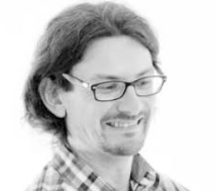
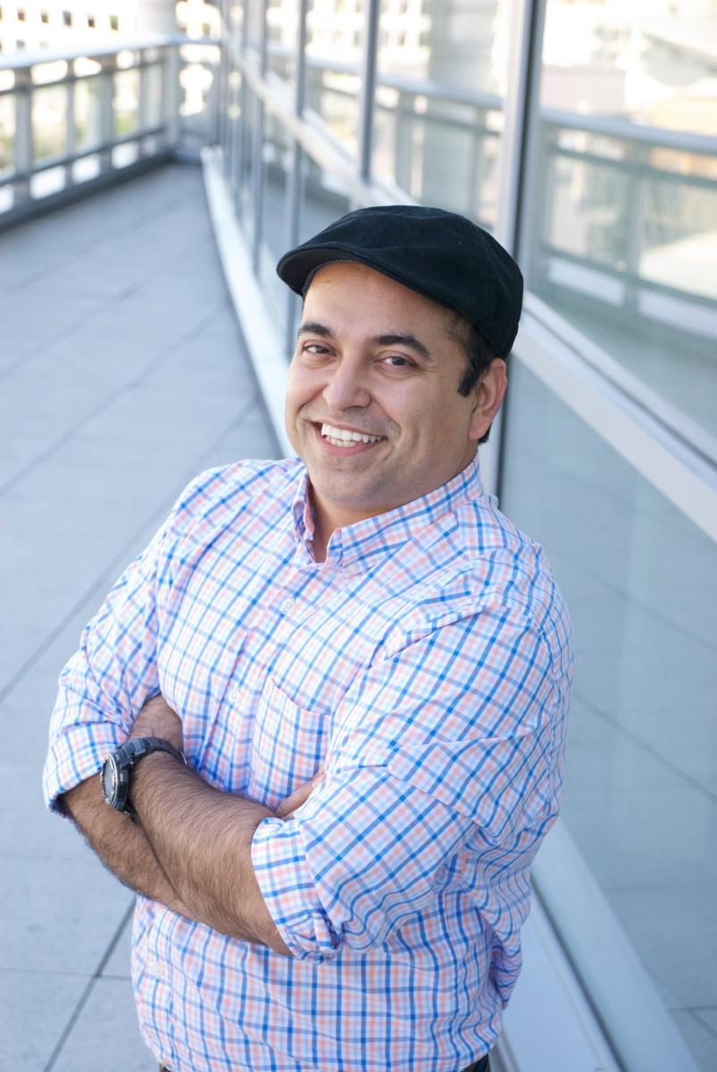
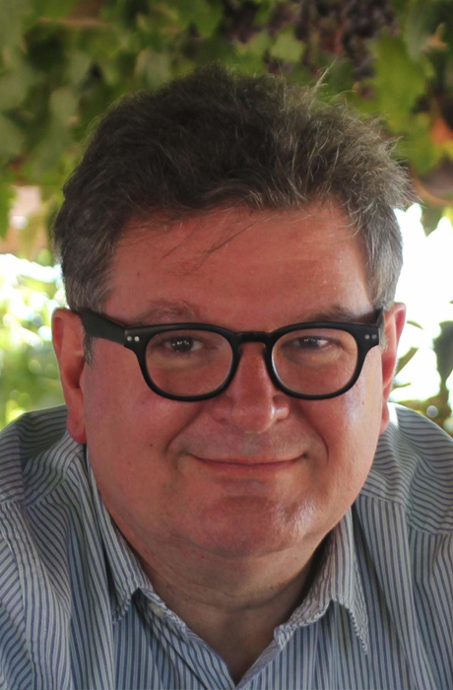
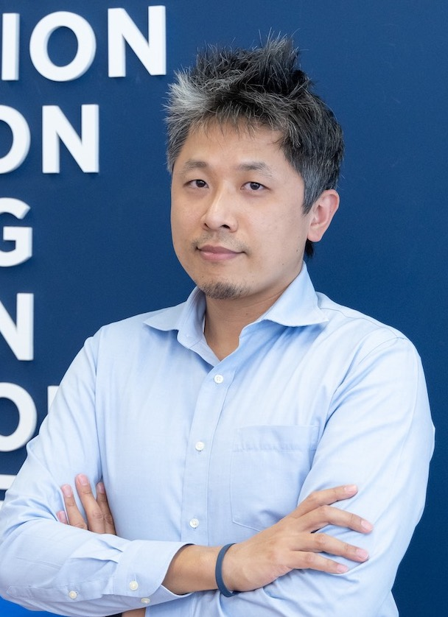
CEDA Distinguished Lecturers | 2024-2025
Alberto Bosio | ECL
AI Hardware Accelerator for Safety-Critical Applications
Trustworthy AI: The role of the Hardware
Sudeep Pasricha | Colorado State University
Artificial Intelligence at the Speed of Light
Robust and Secure Design for Connected and Autonomous Vehicles
Sustainability Challenges with Computing: from Internet-of-Things to Datacenters
Ricardo Reis | Universidade Federal do Rio Grande do Sul
Physical Design Automation of Transistor Networks
Trends on EDA
Visualization Tools
Bei Yu | The Chinese University of Hong Kong
Machine Learning in EDA: When and How
Large Scale VLSI Mask Optimization
Large Language Model in EDA

Slide 16
How to Get Involved?
Become a CEDA Participant
For free on the IEEE website
Subscribe to CEDA Mailing List
bit.ly/currents-subscribe
Conferences and Events
Organize a meeting, workshop or conference.
Review for CEDA conferences and Journals
Get involved with local chapters and volunteer to organize activities
Volunteer to organize activities
Volunteer to Serve on CEDA Committees
Calls are announced on the website and social media
Distinguished Lecturers Program
Request a DL at your next event
Apply to become a DL

Slide 17







Website
ieee-ceda.org
Facebook
Stay up to date on all CEDA news and events!
facebook.com/ieeeceda
Twitter
@IEEECEDA
LinkedIn
linkedin.com/company/ieee-ceda
YouTube
youtube.com/IEEECouncilonElectronicDesignAutomation

