Slide 1
ASP-DAC rep.
Kazutoshi, Wakabayashi, Ph.D
NEC Corp.

Slide 2
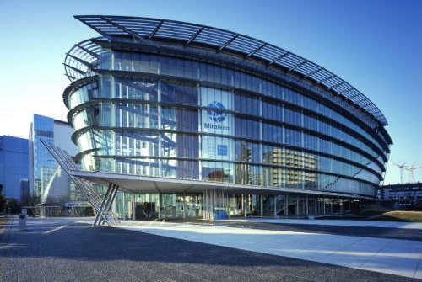
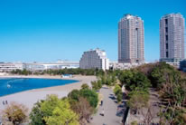
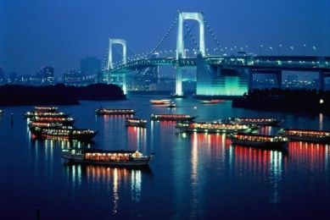
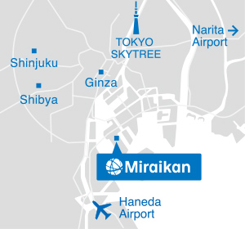
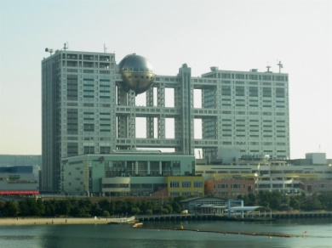
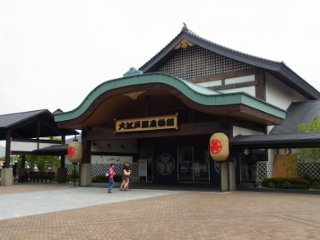
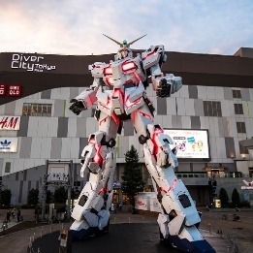
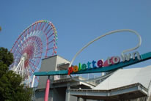
ASPDAC 2019 Conference Overview
Date: January 21-24, 2019
Place: Miraikan - The National Museum of
Emerging Science and Innovation,
Tokyo Odaiba Waterfront, Japan
First in Tokyo for ASPDAC!

Slide 3
Sponsors & Supporters

Slide 4
Attendees: Japanese attendants are decreasing
 | 2013 Yokohama,JP | 2014 Singapore | 2015 Makuhari,JP | 2016 Macau | 2017 Makuhari, JP | 2018 Jeju, Korea | 2019 Tokyo, JP
Total | 462 | 270 | 433 | 233 | 397 | 373 | 346
Host Country | 287 | 31 | 235 | 18 | 176 | 147+ | 108
ASP(except host) | 101 | 147 | 130 | 148 | 127 | 100+ | 150
NA | 43 | 51 | 40 | 46 | 57 | 49+ | 55
EU & Mid East | 31 | 41 | 28 | 21 | 37 | 8+ | 33

Slide 5
Session Organization
Plenary Sessions
3 Keynotes
Regular Sessions
29 Sessions
Special Sessions
Invited Talks, 5 Sessions
Designers’ Forum
Invited Talks, 4 Sessions
University LSI Design Contest
Short Talks & Poster Exhibition, 2 Sessions
Tutorials
9 half-day tutorials
Student Research Forum by ACM SIGDA
Supporters’ Session

Slide 6
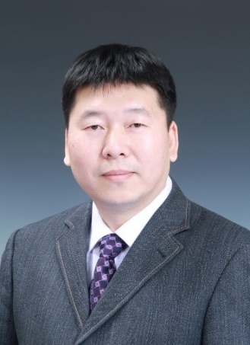
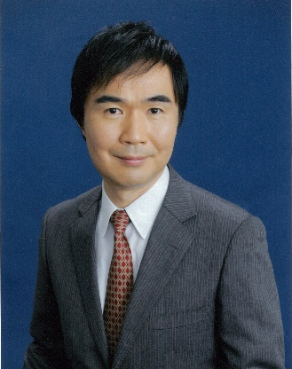
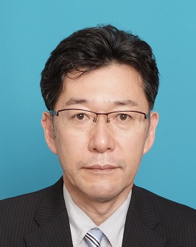
Keynotes
I.
“Development Trend of Artificial Intelligence Technology and its Application in the Field of Robotics”
Prof. Tao Zhang (Tsinghua University)
II.
“Post-K: A Game-changing Supercomputer with Groundbreaking A64fx High Performance Arm Processor”
Prof. Satoshi Matsuoka
(RIKEN Center for Computational Science)
III.
“Hardware and Software Security Technologies to Enable Future Connected Cars”
Dr. Yasuhisa Shimazaki (Renesas Electronics Corp.)

Slide 7
Designers’ Forum
4 oral sessions
Session 5A: “Robotics: From System Design to Application”
Computer-Aided Support System for Minimally Invasive Surgery Using 3D Organ Shape Models
ROS and mROS: How to accelerate the development of robot systems and integrate embedded devices
Rapid Development of Robotics technology using Robot Contest and Open Collaboration
Session 6A: “Advanced Imaging Technologies and Applications”
NIR Lock-in Pixel Image Sensors for Remote Heart Rate Detection
A TDC/ADC Hybrid LiDAR SoC for 200m Range Detection with High Image Resolution under 100klux Sunlight
A 1/4-inch 3.9Mpixel Low Power Event-driven Back-illuminated Stacked CMOS Image sensor
Next-Generation Fundus Camera with Full-Color Image Acquisition in 0-lx Visible Light using BSI CMOS Image Sensor with Advanced NIR Multi-Spectral Imaging System

Slide 8
Designers’ Forum
4 oral sessions (cont.)
Session 8A: “Emerging Technologies for Tokyo Olympic 2020”
Walking Assistive Powered-wear 'HIMICO' with Wire-driven Assist
Deep Scene Recognition with Object Detection
Spatial and Battery Sensing Solutions for Smart Cities Leading to 2020 Olympics
Session 9A: “Beyond the Virtual Reality World”
The World of VR2.0
Optical Fiber Scanning System for Ultra-lightweight Wearable Display
Superreal Video Representation for Enhanced Sports Experiences

Slide 9
University LSI Design Contest
13 excellent designs are accepted out of 15 submissions from five countries/areas
Three awards will be given soon after
Oral Presentations (Session 1A) are scheduled after Keynote I
Then, Poster Presentations are held with snacks during lunch time

Slide 10
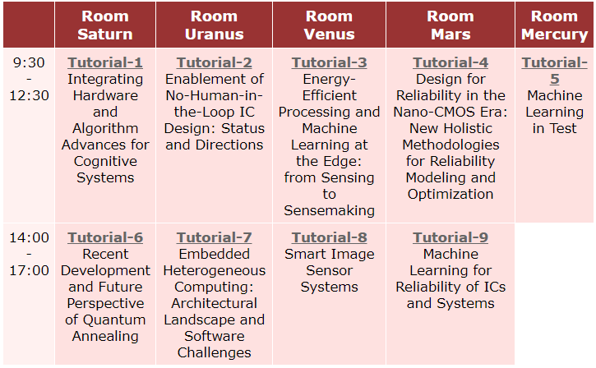
Tutorial Attendances: Not profitable
10 | 14 | 21 | 5 | 15
7 | 20 | 9 | 20

Slide 11
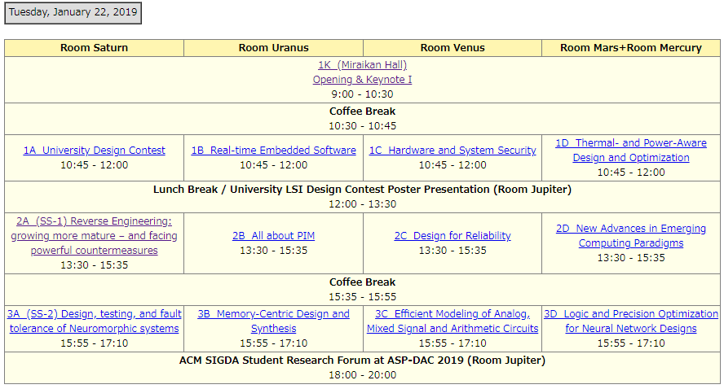
# of Attendees (Jan 22)
181
21 | 42 | 35 | 49
62
35 | 72 | 26 | 45
26 | 17 | 23 | 54
55+

Slide 12
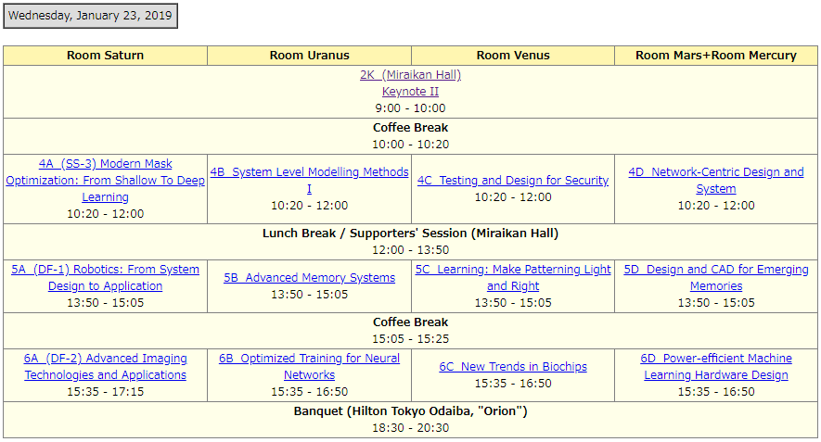
# of Attendees (Jan 23)
154
25 | 48 | 21 | 21
160
28 | 45 | 22 | 15
17 | 37 | 19 | 54
180

Slide 13
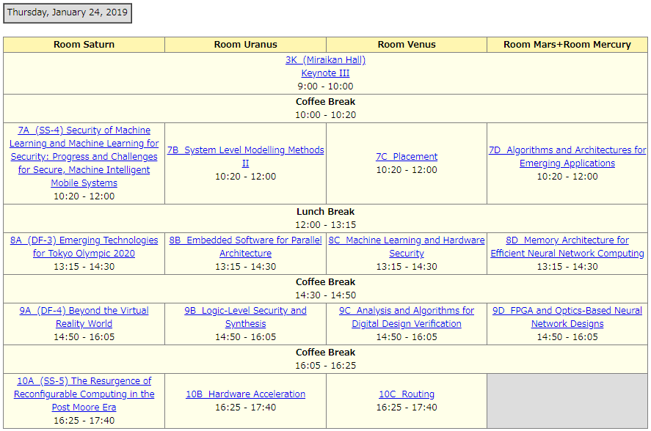
# of Attendees (Jan 24)
111
34 | 24 | 24 | 24
29 | 17 | 21 | 33
19 | 20 | 8 | 37
- | - | -

Slide 14
Industrial Supporters
Supporters’ Session &
Student Carrier Luncheon (Fujitsu, NEC, Renesas)
Miraikan Hall
Hours: Jan 23 12:00 – 13:50 with Lunch & Drink
Exhibition
Lobby
Exhibit Hours: 10:00 - 17:30 (Jan 24 -16:00)

Slide 15
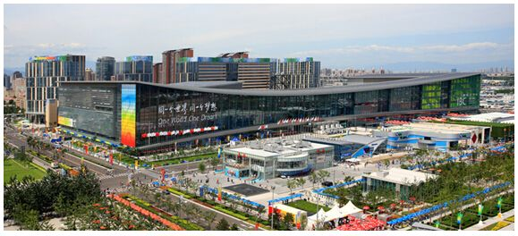
Future Plan
1. ASPDAC 2010 Beijing, China Jan. 13-16
China National Convention Center (close to Stadium, bird nest)
Financial Suport
- Academic Support US$50K?
- Industrial Support US$100K?
2. ASPDAC 2021 Tokyo, Japan
Miraikan(same as 2019) or KFC Hall at Nippori
More promotion will be required to attract Japanese participants

Slide 16
Thank You

Slide 17
OC Members
General Chair
Toshiyuki Shibuya (Fujitsu Laboratories)
Past Chair
Youngsoo Shin (KAIST)
GC Secretaries
Yutaka Tamiya (Fujitsu Laboratories)
Izumi Nitta (Fujitsu Laboratories)
Kazuyoshi Takagi (Kyoto University)
GC Advisor
Nozomu Togawa (Waseda University)
Technical Program Chair
Taewhan Kim (Seoul National University)
TPC Vice Chair
Masanori Hashimoto (Osaka University)
Tutorial Co-Chairs
Takashi Sato (Kyoto University)
Takahide Yoshikawa (Fujitsu)
Design Contest Co-Chairs
Akira Tsuchiya (The Univ of Shiga Pref.)
Kousuke Miyaji (Shinshu University)
Designer's Forum Co-Chairs
Masaitsu Nakajima (Socionext)
Koji Inoue (Kyushu University)
Finance Co-Chairs
Kenshu Seto (Tokyo City University)
Hideki Takase (Kyoto University)
Publication Co-Chairs
Shinobu Nagayama (Hiroshima City Univ.)
Hiroki Nakahara (Tokyo Inst. of Tech.)
Publicity Co-Chairs
Atsushi Takahashi (Tokyo Inst. of Tech.)
Kazuyuki Iwaguro (Renesas System Design)
Web Publicity Co-Chairs
Takeshi Matsumoto (National Inst. of Tech., Ishikawa College)
Hiromitsu Awano (University of Tokyo)
Promotion Co-Chairs
Daisuke Fukuda (Fujitsu Laboratories)
Takashi Takenaka (NEC)
Yuichi Nakamura (NEC)
ASP-DAC Liaison at ACM SIGDA Student Research Forum
Yukihide Kohira (The University of Aizu)
Masashi Tawada (Waseda University)
Secretariat
Yoshinori Ishizaki (JESA)
Mieko Mori (JESA)
Kayoko Oda (JESA)

Slide 18
Attendees (against 2017@Makuhari, Japan)
Total Number: 346 (←368)
Academia: 260(←271)(incl. 60 (←48)students)
Industries: 76 (←95)
Others: 3 (←2)
Tutorials: 60 (←70)
International participation
Japan: 108 (←176)
Overseas: 231 (←221)
・ASP 150 (←127) ・Americas 55 (←57)
・EU 30 (←31) ・Mid-East 3 (←6)

Slide 19
Tutorials
Integrating Hardware and Algorithm Advances for Cognitive Systems
Organizer: Hai Li (Duke University)
Speakers: Kaushik Roy (Purdue University)
Hai Li (Duke University)
Enablement of No-Human-in-the-Loop IC Design: Status and Directions
Organizer:Andrew B. Kahng (University of California, San Diego)
Speakers: Shankar Sadasivam (Qualcomm Inc.)
Shankar Sadasivam (Qualcomm Inc.)
Andrew B. Kahng (University of California, San Diego)
Energy-Efficient Processing and Machine Learning at the Edge: from Sensing to Sensemaking
Organizer: Massimo Alioto (National University of Singapore)

Slide 20
Tutorials (2)
Design for Reliability in the Nano-CMOS Era: New Holistic Methodologies for Reliability Modeling and Optimization
Organizer & Speakers:
Sheldon Tan (University of California, Riverside)
Hussam Amrouch (Karlsruhe Institute of Technology)
Machine Learning in Test
Organizer & Speakers:
Yu Huang (Mentor, A Siemens Business)
Recent Development and Future Perspective of Quantum Annealing
Organizer: Shu Tanaka (Waseda University)
Speakers: Shu Tanaka (Waseda University)
Yoshiki Matsuda (Fixstars Corporation)
Kotaro Tanahashi (Recruit Communications Co., Ltd.)
Yuya Seki (National Institute of Advanced Industrial Science and Technology, Japan)

Slide 21
Tutorials (3)
Embedded Heterogeneous Computing: Architectural Landscape and Software Challenges
Organizer & Speakers:
Tulika Mitra (National University of Singapore, Singapore)
Smart Image Sensor Systems
Organizer & Speakers:
Marilyn Wolf (Georgia Institute of Technology)
Saibal Mukhopodhyay (Georgia Institute of Technology)
Jong Hwan Ko (Agency for Defense Development, Korea)
Machine Learning for Reliability of ICs and Systems
Organizer: Mehdi B. Tahoori (Karlsruhe Institute of Technology)
Speakers: Mehdi B. Tahoori (Karlsruhe Institute of Technology)
Krishnendu Chakrabarty (Duke University)

Slide 22
Attendees
Total Number: 346
Academia: 260 (incl. 60 students)
Industries: 76
Others: 3
Tutorials: 60
International participation
Japan: 108
Overseas: 231
・ASP 150 ・Americas 55
・EU 30 ・Mid-East 3

