Slide 1
Activities
Gi-Joon Nam (gnam@us.ibm.com)
Committee Members
All CEDA local chapter chairs

Slide 2
Council Activity Overview
Local Chapters
Distinguished Lecture Program
Sponsored Workshops & Contests
Member Technology Organizations

Slide 3
CEDA Local Chapters & Outreach Program
2019 Status
15 chapters in US, Asia, Europe, South America and Africa
7 chapters made requests for 2019 chapter funding
~ $3K per chapter on average
Need to resurrect a few chapters
Morocco / Tunisia chapters : David’s visit to chapters
Central Texas chapter : Gi-Joon working with IEEE Central Texas section
Nurturing Vehicles
Distinguished lecture program / local seminars
Hosting local workshops (co-located with conferences)
EDA student summer camp by Taipei chapter
EDAtholon 2019 by Hongkong chapter

Slide 4
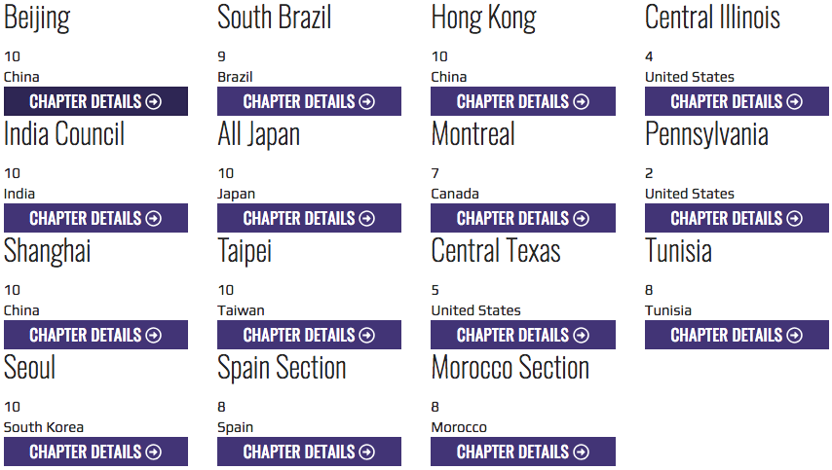

Slide 5
CEDA Distinguished Lecture Program (DLP)
Placeholder for slides from Tsung-Yi

Slide 6
Sponsored Workshops & Contests
DATE’19
PhD Forum 03/25 (Mon)
CEDA Luncheon Keynote by David Pellerin, Amazon, US
“Heterogeneous Computing: Embedded meets Hyperscale and HPC”
International F1/10 Autonomous Racing Demo 03/29 (Fri)
DAC’19
Early Career Workshop (Prof. Marco Santambrogio from Politecnico di Milano)
DivEDA (Ayse Coskun)
Ph.D Forum
CEDA Luncheon Keynote
Looking for a speaker candidate; Honoring event for Larry Nagel (creator of Spice) who just got the IEEE Peterson Award @ ISSCC
ICCAD’19
ICCAD CAD Contest
CEDA Luncheon Keynote
SMCAD Competition in July 2019, Lausanne, Switzerland
CPS (Cyber-Physical Systems) Summer School 2019, Alghero, Sardinia, Italy

Slide 7
Member Technology Organizations
DATC (Design Automation Technical Committee)
Chair: Iris Hui-Ru Jiang (huiru.jiang@gmail.com)
TCCPS (Technical Committee on Cyber-Physical Systems)
Chair: Shiyan Hu (shiyan@mtu.edu)
SVDTC (System Validation and Debug Technology Committee)
Chair: Chinna Prudvi (china.prudvi@intel.com)
TTTC (Test Technology Technical Council)
Chair: Yervant Zorian (Yervant.Zorian@synopsys.com)

Slide 8
IEEE CEDA Technical Committee on Cyber-Physical Systems: Activities in 2018
For IEEE CEDA Meeting on March 25, 2019
Professor Shiyan Hu, TCCPS Chair

Slide 9
TC Membership Growth
The membership page is at http://www.ieee-cps.org/member.html
In 2017, there were only 40+ members.
We now have more than 60+ members-at-large (from all of the world such as US, Canada, UK, Switzerland, Germany, Italy, Sweden, Denmark, France, Belgium, Turkey, Australia, China, Japan, etc), and the number of total members (see http://www.ieee-cps.org/list.html) reaches 120+. We are 3X bigger now.
30+ IEEE Fellows
About 15 current or former Editors-in-Chief of IEEE/ACM Transactions in different fields
Our members span different societies and councils within IEEE such as CEDA, Systems Council, Computer Society, Industrial Electronics Society, Power and Engineering Society, SMC, Control Systems Society, etc.

Slide 10
Journal/Conference Activities in 2018
Organized special Issue on Design Automation for Cyber-Physical Systems in Proceedings of the IEEE, published in September 2018, where all of the four guest editors Alberto Sangiovanni-Vincentelli, Shiyan Hu, Xin Li, and Qi Zhu are TC members (or advisory board member).
Organized DAC Workshop on Design Automation for Cyber-Physical Systems (DACPS), 2018, chaired by Qi Zhu. DACPS workshop was founded by the TC since 2016 and 2019 DACPS chair is Mohammad Al Faruque.
IEEE ICESS 2019 (technical co-sponsor) will be collocated with DAC 2019 and chaired by Qi Zhu, our TC conference chair.
IEEE AsianHost 2018, technical co-sponsor.
IEEE NVMSA 2018, financial co-sponsor.
IEEE RTCSA 2018, technical co-sponsor.
10

Slide 11
Outreach
General impact: the TC is becoming very popular in the broader CPS academic community. The visit to our TCCPS website since 2017 reaches 35,458 (as of March 17, 2019). The counter is shown in the main page of the TC at http://www.ieee-cps.org/index.html, maintained by Bei Yu, our web chair and newsletter editor.
For outreach to CPS-IoT Week, the TC conference chair Qi Zhu is the program chair for First Workshop on Design Automation for CPS and IoT (DESTION) 2019 at CPS-IoT Week. The general chairs are Alberto Sangiovanni-Vincentelli and Janos Sztipanovits, and a few TC members are in the TPC including Xin Li, Rolf Dresler, Shiyan Hu, Miroslav Pajic, etc. As of March 15, DESTION has the second most registrations among the 13 workshops in CPS-IoT Week 2019. In the future, DESTION will be in CPS-IoT Week while DACPS workshop will be in DAC. The details of how we can grow these two “sister workshops” are under discussion.
We are strengthening the collaboration with IET where Shiyan Hu is Editor-in-Chief of IET CPS: Theory & Application and a number of TC members are AEs. We are thinking of the possibility to establish IEEE/IET joint conferences.
We are strengthening the collaboration with ACM Transactions on CPS. Its Editor-in-Chief is Kei-Wei Kuo, who is one of the five executive committee members of our TC.
We are establishing the close collaboration with IEEE IES Technical Committee on Industrial Cyber-Physical Systems chaired by Prof. Armando Walter Colombo (our TC member-at-large), esp. in their initiatives of Cyber-Physical-Systems-of-Systems.

Slide 12
Awards
Several CPS related awards have been established by since 2017. These include Technical Achievement Award, Distinguished Leadership Award, Middle Career Award, Early Career Award, Most Influential Paper Award, and Industrial Excellence Award. Experts who received the distinctive recognition (in various categories) include Alberto Sangiovanni-Vincentelli, Tei-Wei Kuo, David Atienza, Alex Bayen, Qi Zhu, Mohammad Al Faruque, etc.
TCCPS Award Chairs:
2019: Prof. Xin Li
2018: Prof. Jamal Deen (President of Royal Society of Canada, Academy of Science for 2015-2017, he is a TCCPS advisory board member)
2017: Prof. Xin Li
Professor Edward Lee has been nominated for the 2019 Technical Achievement Award and he has agreed to attend DAC 2019 to receive the award if elected.
12

Slide 13
Task Force
Through our collaboration with IEEE power and engineering society (PES), we have established a task force (i.e., a working group) under the umbrella of TCCPS, called Smart Distribution and Utility Task Force. See http://www.ieee-cps.org/task-force-sdu.html. This group of people have already published a white paper titled “The Active Control Theory of Safe Operation for Self-healing Power Distribution Networks” and they plan to actively perform more activities (e.g., organizing task force level workshops) in 2019.
We are discussing with a couple of groups of experts to establish more task forces.

Slide 14
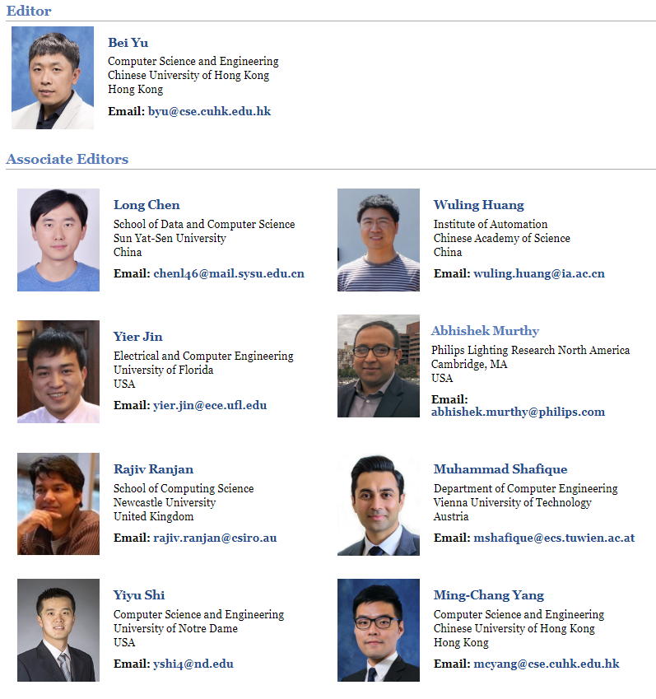
CPS Newsletter
http://www.ieee-cps.org/letter.html. The newsletter is published twice a year since 2016. The former Editors-in-Chief are Xin Li and Helen Li. Its new Editor-in-Chief is Bei Yu.
14

Slide 15
DATC
Iris Hui-Ru Jiang
Victor Kravets
Jianli Chen
Yi-Lang Li
Jinwook Jung
Andrew Kahng

Slide 16
Design Automation Technical Committee
Design Library
Liberty, DEF/LEF,
Verilog, SDC
Construct an academic reference design flow
Goal in 2016:
OpenDesign Flow Database v1.0
Goal in 2017:
Robust Design Flow: from logic synthesis to physical design
Goal in 2018:
Robust Design Flow v2.0: extended to detailed placement and detailed routing
Goal in 2019:
Robust Design Flow v3.0: linking to ISPD contest and extended to cloud
Verilog
Liberty
Logic synthesis
Verilog’
Floorplanning
LEF/DEF
Global placement
Detailed placement
RC extraction
Verilog’, DEF’, SPEF
Timing analysis
Liberty, SDC
Gate sizing
Legalization
Verilog’’, DEF’’
LEF
Global routing
Routing guide
Detailed routing
Design result (Verilog, DEF)

Slide 17
Execution Plan in 2019
Meetings
Regular skype meetings
Status meeting at DAC 2019 and ICCAD 2019
Special session at ICCAD 2019 (with CAD Contest)
Put the flow in cloud (to rent a public space)
Link with EDA research contest (with ISPD Contest, CAD Contest)
Seek collaboration with other “open” EDA projects (ERI)
Notes:
3.
Currently on a private server
4.
Link with 2019 ISPD contest: done
Link with 2019 CAD contest: on-going discussion
5.
Collaboration with ERI: scheduled on March 21 (EDA Workshop, Hsinchu, Taiwan)

Slide 18
2019 DATC Members
First | Last | Affiliation | Role
Iris Hui-Ru | Jiang | National Taiwan Univ., Taiwan | Chair / Timer
Victor | Kravets | IBM, USA | Logic synthesis
Jianli | Chen | Fuzhou Univ., China | Placement
Yih-Lang | Li | National Chiao Tung Univ., Taiwan | Routing
Jinwook | Jung | IBM, USA | Integration
Andrew | Kahng | UCSD, USA | Vice chair / Flow
Integration: cloud
Flow: collaboration with ERI
Impact: link with 2019 ISPD Contest and more
NEW

