Slide 1
Finance
Cristiana Bolchini/Politecnico di Milano

Slide 2
Status 2019
Financial reserve as of Sep 2018: ~$2.5M
Regular budget trend in line w/ past, more sponsored activities
Based on the results of 2018 ($85.7K to spend beyond the budget)
The DL program as a standard technical activity
Some additional activities
Additional Executive Committee expenses to travel
However the final net will be heavily affected by
$150K penalties for canceling hotel contracts for DAC2020

Slide 3
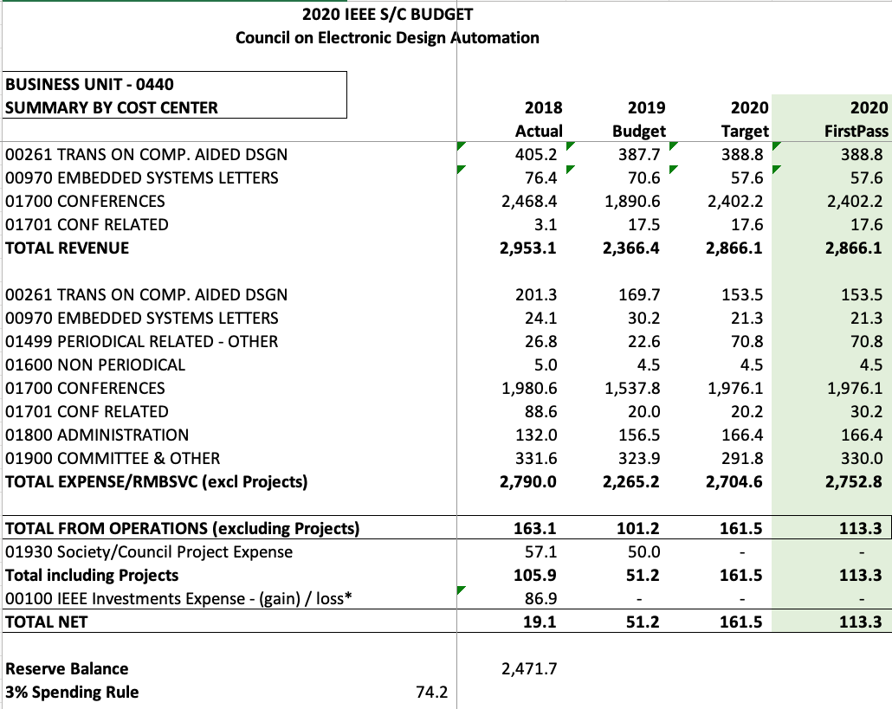
Budget 2020 - approved
Optimistic net on conferences
Sara Dailey’s change of
contract type
overestimated

Slide 4
Budget 2020 – Expenses details
Local chapters 25K
Distinguished Lecturers 20K
CEDA Luncheons @ 43K ASP-DAC | DAC | DATE | ICCAD
Awards 17K Phil Kaufman 28K
Technical committees 25K
Student events 25K DAC | DATE | ICCAD
Secretarial Services ~ 60K
Committee Travels ~ 45K
Web & Promotion ~ 10K
Student grants 20K
DivEDA 5K
DAPE workshop 5K
CPS Summer school 5K
ML-CAD workshop 5K

Slide 5
Activities sponsored by CEDA
Local chapters: ~ 22K
Distinguished Lecturers ~ 10K
CEDA Luncheons @ ~ 42K ASP-DAC | DAC | DATE | ICCAD
Awards ~ 15K Phil Kaufman ~ 30K
Student contests ~ 30K
Technical committees ~ 20K DATC | SVDTC | TCCP
ML-CAD Workshop
Workshop on Logic and Synthesis
International Seasonal School on Physical Design Automation
CPS Summer School
ESWeek Student Support
DAPE Workshop
Diversity in EDA
DAC Student Demo
P R O J E C T S
Students grants: 50

Slide 6
Looking to 2020
Students’ sponsorship as a project (on 50% net surplus from 2019)
DL program adjustments – several opportunities for DLs but limited funds
Activities that cannot be «projects» anymore need a new context

