Slide 1
Finance Report (2011 Budget and CEDA Reserves) CEDA BoG Meeting at DAC, June 2011 David Atienza, VP Finance
06/01/11

Slide 2
2011 Budget Comments
Close cooperation with IEEE financial analysts has helped to prevent having very pessimistic forecast
The positive evolution of main EDA conferences surplus (DAC, DATE, ICCAD) has allowed CEDA to improve the initial forecast
Efforts done in all committees to keep the same costs as in 2010 (or even less)
Reserves evolution checked with IEEE and outlined a very positive trend by CEDA to reach its projected reserves in less than 10 years from its creation
$1M of reserves to target initially by end of 2015
© 2006 IBM Corporation

Slide 3
2011 Budget Forecast (November 2010)
 | 2011 Budget Forecast |  |  | 2010 budget |  |  | 2009
 | Income | Expense | Net | Income | Expense | Net | Income | Expense | Net
Interest income | 0.0 | 0.0 | 0.0 | 0.0 | 0.0 | 0.0 | 0.0 | 0.0 | 0.0
TCAD | 499.0 | 305.1 | 193.9 | 495.0 | 303.8 | 191.2 | 491.6 | 320.3 | 171.3
ESL | 63.1 | 61.6 | 1.5 | 61.2 | 62.5 | (1.3) | 63.0 | 80.9 | (17.9)
Periodical related other | 0.0 | 17.1 | (17.1) | 0.0 | 8.9 | (8.9) | 0.0 | 21.2 | (21.2)
Newsletters | 0.0 | 3.9 | (3.9) | 0.0 | 3.9 | (3.9) | 0.0 | 3.9 | (3.9)
Non periodical sales | 0.0 | 7.6 | (7.6) | 0.0 | 3.2 | (3.2) | 0.0 | 0.0 | 0.0
Meetings/conferences | 1,302.1 | 1,170.3 | 131.8 | 1,421.9 | 1,193.4 | 228.5 | 1,628.1 | 1,527.1 | 101
Conf related | 11.7 | 6.3 | 5.4 | 5.8 | 0.9 | 4.9 | 3.7 | 1.3 | 2.4
IEEE administration | 0.0 | 134.3 | (134.5) | 0.0 | 134.5 | (134.5) | 0.0 | 29.2 | (29.2)
Committee/other | 0.0 | 104.3 | (104.3) | 0.0 | 119.0 | (119.0) | 0.0 | 150.0 | (150.0)
TOTAL | 1,875.9 | 1,810.5 | 65.4 | 2,000.0 | 1,841.7 | 162.7 | 2,186.4 | 2,133.9 | 52.5
© 2006 IBM Corporation

Slide 4
April 2011- IEEE Recalculates Year End Forecast
Decline in non-member sales and revenues of IEEE periodicals applied globally for all societies/councils due (in part) to one of the 3rd party resellers in India.
Significant reduction of income from CEDA related conferences.
Consequences in the budget (cf. next slide)
$22K reduction income from CEDA periodicals: TCAD and L-ES
$100K reduction of surplus for CEDA from DAC 2011, also small reductions in surplus from DATE, ICCAD, etc.
© 2006 IBM Corporation

Slide 5
2011 Year End Forecast by IEEE (April 2011)
 | 2011 Budget Forecast |  |  | 2010 budget |  |  | 2009 actuals
 | Income | Expense | Net | Income | Expense | Net | Income | Expense | Net
Interest income | 0.0 | 0.0 | 0.0 | 0.0 | 0.0 | 0.0 | 0.0 | 0.0 | 0.0
TCAD | 499.0 | 327.1 | 166.9 | 495.0 | 303.8 | 191.2 | 491.6 | 320.3 | 171.3
ESL | 63.1 | 61.6 | 1.5 | 61.2 | 62.5 | (1.3) | 63.0 | 80.9 | (17.9)
Periodical related other | 0.0 | 17.1 | (17.1) | 0.0 | 8.9 | (8.9) | 0.0 | 21.2 | (21.2)
Newsletters | 0.0 | 3.9 | (3.9) | 0.0 | 3.9 | (3.9) | 0.0 | 3.9 | (3.9)
Non periodical sales | 0.0 | 7.6 | (7.6) | 0.0 | 3.2 | (3.2) | 0.0 | 0.0 | 0.0
Meetings/conferences | 1,202.1 | 1,170.3 | 31.8 | 1,421.9 | 1,193.4 | 228.5 | 1,628.1 | 1,527.1 | 101
Conf related | 11.7 | 6.3 | 5.4 | 5.8 | 0.9 | 4.9 | 3.7 | 1.3 | 2.4
IEEE administration | 0.0 | 134.3 | (134.5) | 0.0 | 134.5 | (134.5) | 0.0 | 29.2 | (29.2)
Committee/other | 0.0 | 104.3 | (104.3) | 0.0 | 119.0 | (119.0) | 0.0 | 150.0 | (150.0)
TOTAL | 1,775.9 | 1,832.5 | (56.6) | 2,000.0 | 1,841.7 | 162.7 | 2,186.4 | 2,133.9 | 52.5
© 2006 IBM Corporation

Slide 6
2011 Year End Forecast Re-discussed with IEEE accurately estimate DAC surplus and reduced miscellaneous (contingency: 15K -> 10K)
 | 2011 Budget Forecast |  |  | 2010 budget |  |  | 2009 actuals
 | Income | Expense | Net | Income | Expense | Net | Income | Expense | Net
Interest income | 0.0 | 0.0 | 0.0 | 0.0 | 0.0 | 0.0 | 0.0 | 0.0 | 0.0
TCAD | 499.0 | 327.1 | 166.9 | 495.0 | 303.8 | 191.2 | 491.6 | 320.3 | 171.3
ESL | 63.1 | 61.6 | 1.5 | 61.2 | 62.5 | (1.3) | 63.0 | 80.9 | (17.9)
Periodical related other | 0.0 | 17.1 | (17.1) | 0.0 | 8.9 | (8.9) | 0.0 | 21.2 | (21.2)
Newsletters | 0.0 | 3.9 | (3.9) | 0.0 | 3.9 | (3.9) | 0.0 | 3.9 | (3.9)
Non periodical sales | 0.0 | 7.6 | (7.6) | 0.0 | 3.2 | (3.2) | 0.0 | 0.0 | 0.0
Meetings/conferences | 1,367.3 | 1,184.2 | 197.0 | 1,421.9 | 1,193.4 | 228.5 | 1,628.1 | 1,527.1 | 101
Conf related | 11.7 | 6.3 | 5.4 | 5.8 | 0.9 | 4.9 | 3.7 | 1.3 | 2.4
IEEE administration | 0.0 | 134.3 | (134.5) | 0.0 | 134.5 | (134.5) | 0.0 | 29.2 | (29.2)
Committee/other | 0.0 | 99.3 | (99.3) | 0.0 | 119.0 | (119.0) | 0.0 | 150.0 | (150.0)
TOTAL | 1,941.1 | 1,846.3 | 98.7 | 2,000.0 | 1,841.7 | 162.7 | 2,186.4 | 2,133.9 | 52.5
© 2006 IBM Corporation

Slide 7
2010/2011 Committee Expenses: Technical Activities
Type | Budget 2010 | 2011 Year End Forecast | Budget 2011
Events | $7,000 | $7,000 | $7,000
Education (Young Faculty, EDA career) | $11,000 | $11,000 | $9,000
Distinguished lecturers | $13,000 | $13,000 | $13,000
Contests | $7,000 | $7,000 | $7,000
Standards | 0 | 0 | 0
Miscellaneous | $1,000 | $1,000 | $500
China certification | 0 | 0 | 0
Local chapter init. | $1,308 | $1,500 | $1,500
© 2006 IBM Corporation

Slide 8
2010/2011 Committee Expenses: Committee
Type | Budget 2010 | 2011 Year End Forecast | Budget 2011
Administrator | $16,000 | $16,000 | $16,000
Adcom | $7,000 | $7,000 | $7,000
President | $7,000 | $6,000 | $6,000
Executive committee | $10,000 | $10,000 | $10,000
Other committee | $5,000 | $3,000 | $3,000
Awards | $14,000 | $14,000 | $14,000
Other awards | $5,000 | $0 | 0
Miscellaneous | $25,000 | $10,000 | $5,500
Promotion & Publicity | $12,000 | $18,000 | $18,000
© 2006 IBM Corporation
Notes:
DTC meeting at DAC: $825, calls from different committees: $50

Slide 9
2010/2011 Committee Expenses: Pubs
Type | Budget 2010 | 2011 Year End Forecast | Budget 2011
Pub. Admin fixed costs | $4,500 | $5,000 | $5,000
Pub. Admin var. costs | $5,300 | $5,300 | $10,300
ESL editorial office | $5,000 | $5,000 | $5,000
Newsletter distribution DATE | $1,000 | $1,000 | $1,000
Newsletter distribution DAC | $1,000 | $1,400 | $1,400
Newsletter distribution ICCAD | $1,000 | $1,000 | $1,000
Pubs meeting | $500 | $1,000 | $1,000
Newsletter graphics | $500 | $500 | $500
TCAD editorial office and extra page charges | $55,800 | $30,000 | $30,000
© 2006 IBM Corporation

Slide 10
2011 Budget April – More Positive than Expected
 | 2011 Budget Forecast |  |  | 2011 budget |  |  | 2010 actuals
 | Income | Expense | Net | Income | Expense | Net | Income | Expense | Net
Interest income | 0.0 | 0.0 | 0.0 | 0.0 | 0.0 | 0.0 | 0.0 | 0.0 | 0.0
TCAD | 499.0 | 327.1 | 166.9 | 499.0 | 327.1 | 166.9 | 495.0 | 303.8 | 191.2
ESL | 63.1 | 61.6 | 1.5 | 63.1 | 61.6 | 1.5 | 61.2 | 62.5 | (1.3)
Periodical related other | 0.0 | 17.1 | (17.1) | 0.0 | 17.1 | (17.1) | 0.0 | 8.9 | (8.9)
Newsletters | 0.0 | 3.9 | (3.9) | 0.0 | 3.9 | (3.9) | 0.0 | 3.9 | (3.9)
Non periodical sales | 0.0 | 7.6 | (7.6) | 0.0 | 7.6 | (7.6) | 0.0 | 3.2 | (3.2)
Meetings/conferences | 1,367.3 | 1,184.2 | 197.0 | 1,367.3 | 1,184.2 | 197.0 | 1,421.9 | 1,193.4 | 228.5
Conf related | 11.7 | 6.3 | 5.4 | 11.7 | 6.3 | 5.4 | 5.8 | 0.9 | 4.9
IEEE administration | 0.0 | 134.3 | (134.5) | 0.0 | 134.3 | (134.5) | 0.0 | 134.5 | (134.5)
Committee/other | 0.0 | 99.3 | (99.3) | 0.0 | 90.3 | (90.3) | 0.0 | 119.0 | (119.0)
TOTAL | 1,941.1 | 1,846.3 | 98.7 | 1,941.1 | 1,836.3 | 108.7 | 2,000.0 | 1,841.7 | 162.7
© 2006 IBM Corporation

Slide 11
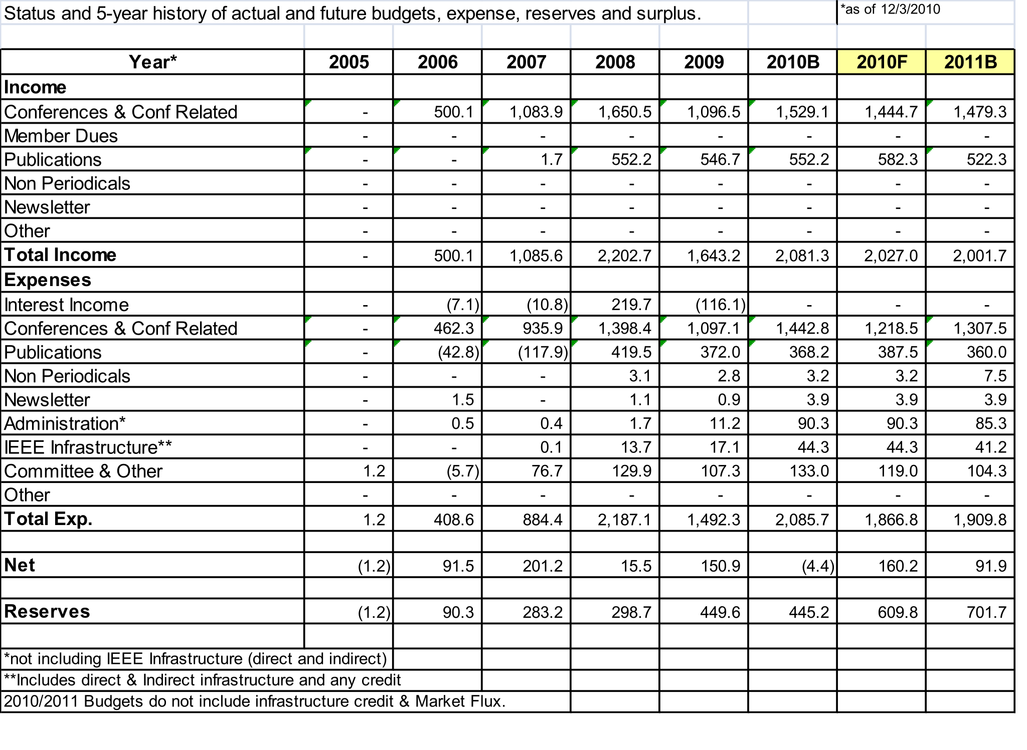
CEDA Status and 5-Year History actual and future budgets, expense, reserves and surplus (as of 25/04/2011)
© 2006 IBM Corporation

Slide 12
Conclusions
More work with IEEE (still) needed for better forecasts
Lack of visibility of overall projected surplus of IEEE until it is too late (cf. December of the current year, or January of year after)
Keep watching the trend of conferences surplus, as they are the main revenue for CEDA
Availability of surplus to be able to keep scheduled activities in 2011 and carry on new investments
In Dec. 2010: investment part of surplus to buy 26.45% DATE shares from IEEE Computer Society
Pending issues:
There are still few open conferences since 2008 for which CEDA keeps getting charges by IEEE
© 2006 IBM Corporation

