Slide 1


Publications Update to BOG & EXCOM, DAC 2011
Jose L. Ayala, Madrid
David Atienza, EPFL
Krish Chakrabarty, Duke
Shih-Chieh Chang, NTHU, Taiwan
Pai Chou, UC Irvine
Patrick Groeneveld, Magma
Rajesh Gupta, UC San Diego
Farinaz Koushenfar, Rice
Rakesh Kumar, UIUC
Enrico Macii, Torino, Italy
Anand Raghunathan, Purdue
Vijay Raghunathan, Purdue
Sachin Sapatnekar,
U Minnesota
Sandeep Shukla,
Virginia Tech
Gang Qu,
University of Maryland
Norbert When,
Uni Kaiserslautern
Currents

Slide 2

Outline
What is new?
Publication Budget
Publication Updates
  Currents Newsletter
  IEEE ESL
  IEEE TCAD
IEEE Design & Test
  Recap and Status
  Going Forward
Outlook

Slide 3
What is New (Since ICCAD 2010)?
Wow! What a year!? Yours truly almost resigned...
IEEE D&T transition firmed
ESL submissions and publications on target
  ESL completely on track for publication schedule
EIC selection process completed for ESL
I am getting ready to relax.

Slide 4
Publications in the Budget
 | 2011 Budget Forecast |  |  | 2011 budget |  |  | 2010 actuals
 | Income | Expense | Net | Income | Expense | Net | Income | Expense | Net
Interest income | 0.0 | 0.0 | 0.0 | 0.0 | 0.0 | 0.0 | 0.0 | 0.0 | 0.0
TCAD | 499.0 | 327.1 | 166.9 | 499.0 | 327.1 | 166.9 | 495.0 | 303.8 | 191.2
ESL | 63.1 | 61.6 | 1.5 | 63.1 | 61.6 | 1.5 | 61.2 | 62.5 | (1.3)
Periodical related other | 0.0 | 17.1 | (17.1) | 0.0 | 17.1 | (17.1) | 0.0 | 8.9 | (8.9)
Newsletters | 0.0 | 3.9 | (3.9) | 0.0 | 3.9 | (3.9) | 0.0 | 3.9 | (3.9)
Non periodical sales | 0.0 | 7.6 | (7.6) | 0.0 | 7.6 | (7.6) | 0.0 | 3.2 | (3.2)
Meetings/conferences | 1,367.3 | 1,184.2 | 197.0 | 1,367.3 | 1,184.2 | 197.0 | 1,421.9 | 1,193.4 | 228.5
Conf related | 11.7 | 6.3 | 5.4 | 11.7 | 6.3 | 5.4 | 5.8 | 0.9 | 4.9
IEEE administration | 0.0 | 134.3 | (134.5) | 0.0 | 134.3 | (134.5) | 0.0 | 134.5 | (134.5)
Committee/other | 0.0 | 99.3 | (99.3) | 0.0 | 90.3 | (90.3) | 0.0 | 119.0 | (119.0)
TOTAL | 1,941.1 | 1,846.3 | 98.7 | 1,941.1 | 1,846.3 | 108.7 | 2,000.0 | 1,841.7 | 162.7
Year | 2006 | 2007 | 2008 | 2009 | 2010B | 2010F | 2011B | 2012E
Publications Income |  | 1.70 | 552.20 | 546.7 | 552.2 | 582.3 | 522.3
Publications Expense | -42.8 | -117.9 | 419.5 | 372 | 368.2 | 387.5 | 360
Net | 42.8 | 119.6 | 132.7 | 174.7 | 184 | 194.8 | 162.3

Slide 5
Pubscom Budget
Type | Budget 2010 | 2011 Year End Forecast | Budget 2011
Pub. Admin fixed costs | $4,500 | $5,000 | $5,000
Pub. Admin var. costs | $5,300 | $5,300 | $10,300
ESL editorial office | $5,000 | $5,000 | $5,000
Newsletter distribution DATE | $1,000 | $1,000 | $1,000
Newsletter distribution DAC | $1,000 | $1,400 | $1,400
Newsletter distribution ICCAD | $1,000 | $1,000 | $1,000
Pubs meeting | $500 | $1,000 | $1,000
Newsletter graphics | $500 | $500 | $500
TCAD editorial office and extra page charges | $55,800 | $30,000 | $30,000

Slide 6
Publication Updates
Currents Newsletter
  Unsung Hero
IEEE ESL
  Settling down to a routine
IEEE TCAD
  Settled but Stirred
IEEE D&T
  Our Hot Date

Slide 7
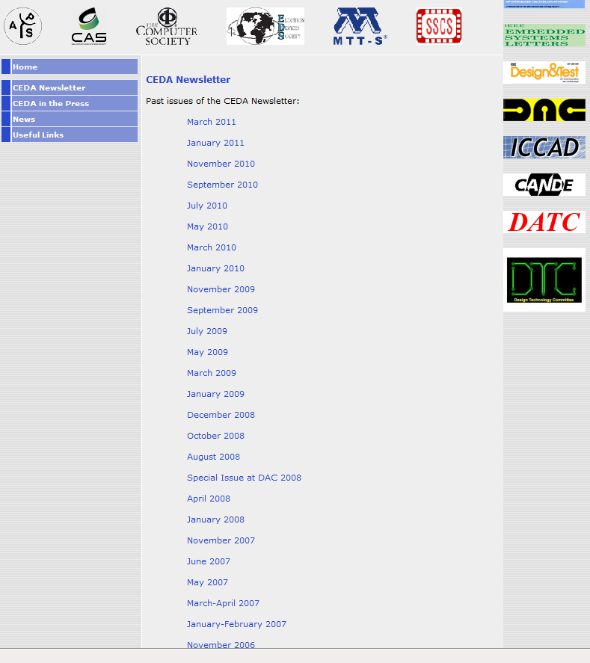
Currents Newsletter
30 issues published so far, one every two months
Longest continuously active volunteer activity
Applause to Jose Ayala, well deserved!

Slide 8
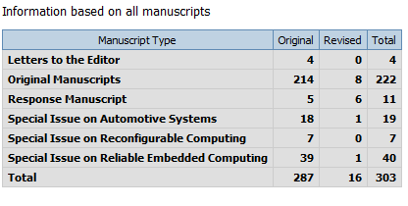
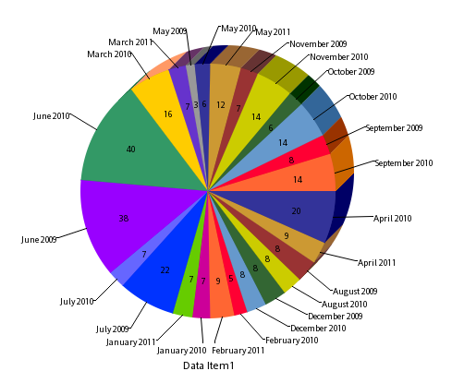
IEEE ESL Status
Submission Month | # Manuscripts
May 2009 | 3
June 2009 | 38
July 2009 | 22
August 2009 | 8
September 2009 | 8
October 2009 | 6
November 2009 | 7
December 2009 | 8
January 2010 | 7
February 2010 | 5
March 2010 | 16
April 2010 | 20
May 2010 | 6
June 2010 | 40
July 2010 | 7
August 2010 | 8
September 2010 | 14
October 2010 | 14
November 2010 | 14
December 2010 | 8
January 2011 | 7
February 2011 | 9
March 2011 | 7
April 2011 | 9
May 2011 | 12
60 papers YTD
  Pending manuscripts:27
  Acceptance ratio: 23.8% (was 31.2%)
Submission to decision: 58 days (was 45)
Review turnaround: 16 days
3/8/11 | Total # Copies
Electronic | 131
EPC | 54
Print | 137
Grand Total | 322

Slide 9
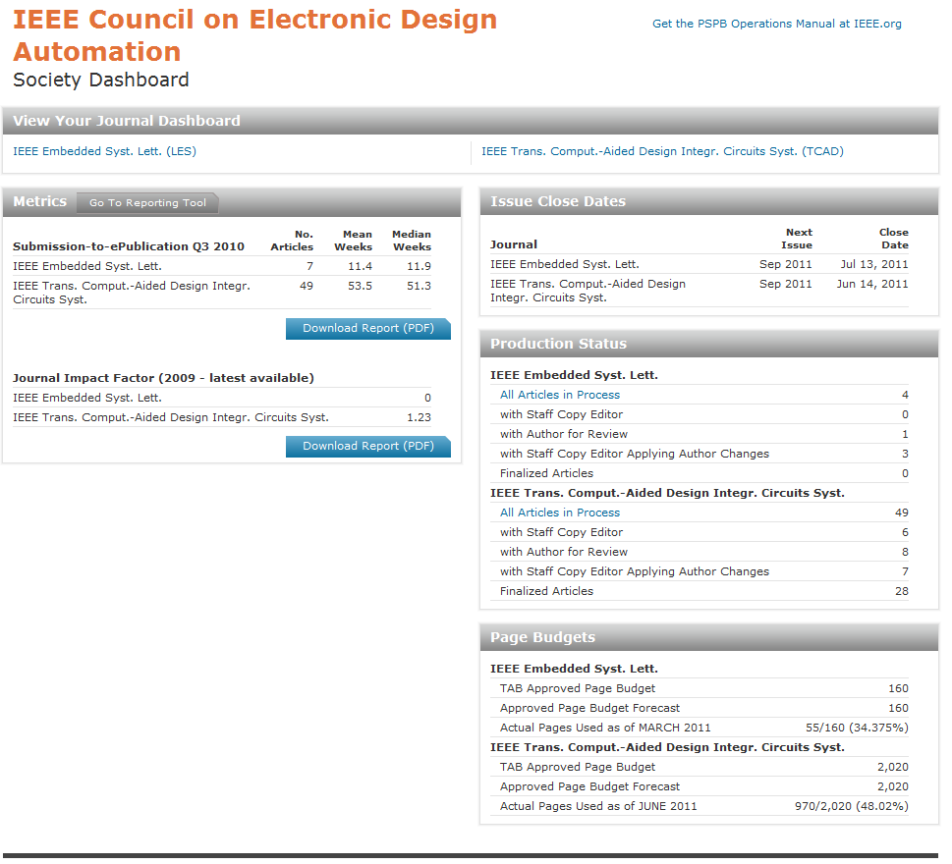
Production Report (Moved to POPP)
D&T 1.798

Slide 10
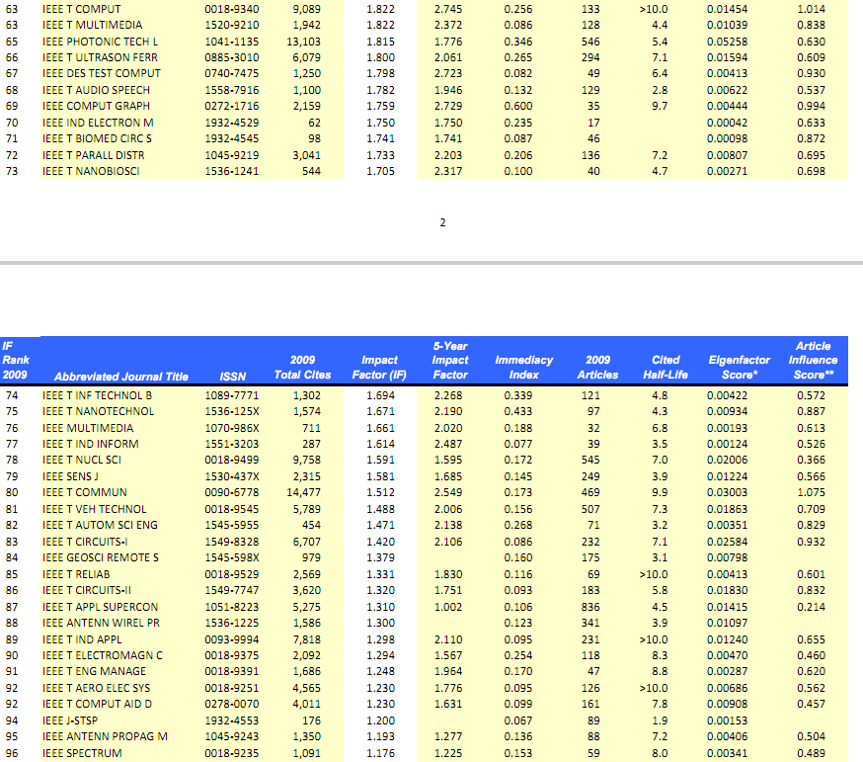
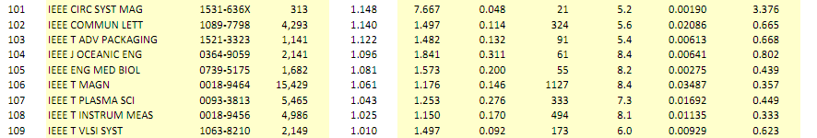

Slide 11
ESL Statistics
Submission Statistics | YTD | MTD | Prior 12 Months | Monthly Avg. Prior 12 Months
Original Manuscripts | 36 | 6 | 92 | 7.7
Special Issue on Reliable Embedded Computing | 0 | 0 | 39 | 3.2
Special Issue on Embedded Reconfigurable Computing | 19 | 19 | 19 | 1.6
Response Manuscript | 1 | 0 | 3 | 0.2
Special Issue on Automotive Systems | 0 | 0 | 1 | 0
Journal Statistics | Prior 12 Months
Avg. days from submission to first decision | 58.0
Avg. Reviewer turnaround time (days) - Original | 0.0
Avg. Default turnaround time (days) - Original | 0.0
Avg. Default turnaround time (days) - Resubmission | 0.0
Avg. Default turnaround time (days) - Revision | 0.0
Avg. Time to Assign Reviewer (days) - Original | 16.0
Avg. Time to Assign Reviewer (days) - Resubmission | 16.0
Avg. Time to Assign Reviewer (days) - Revision | 6.0
Avg. days from submission to final decision | 63.0

Slide 12
Where the papers are coming from?
Country | Accept | Reject | Total | Accept Ratio
Australia | 0 | 3 | 3 | 0.00%
Austria | 0 | 2 | 2 | 0.00%
Belgium | 0 | 1 | 1 | 0.00%
Brazil | 0 | 2 | 2 | 0.00%
Canada | 2 | 0 | 2 | 100.00%
China | 1 | 5 | 6 | 16.67%
Cyprus | 1 | 2 | 3 | 33.33%
Egypt | 1 | 1 | 2 | 50.00%
Finland | 0 | 3 | 3 | 0.00%
France | 2 | 11 | 13 | 15.38%
Germany | 4 | 14 | 18 | 22.22%
Greece | 2 | 6 | 8 | 25.00%
Hong Kong | 2 | 2 | 4 | 50.00%
Hungary | 0 | 1 | 1 | 0.00%
India | 3 | 14 | 17 | 17.65%
Iran, Islamic Republic of | 0 | 1 | 1 | 0.00%
Ireland | 1 | 1 | 2 | 50.00%
Italy | 5 | 10 | 15 | 33.33%
Japan | 0 | 11 | 11 | 0.00%
Korea, Republic of | 0 | 3 | 3 | 0.00%
Country | Accept | Reject | Total | Accept Ratio
Malaysia | 0 | 2 | 2 | 0.00%
Malta | 0 | 1 | 1 | 0.00%
Netherlands | 1 | 2 | 3 | 33.33%
New Zealand | 1 | 0 | 1 | 100.00%
Portugal | 0 | 5 | 5 | 0.00%
Serbia | 0 | 1 | 1 | 0.00%
Singapore | 1 | 5 | 6 | 16.67%
Spain | 1 | 5 | 6 | 16.67%
Sweden | 0 | 2 | 2 | 0.00%
Switzerland | 3 | 2 | 5 | 60.00%
Taiwan, Province of China | 3 | 7 | 10 | 30.00%
Tunisia | 0 | 4 | 4 | 0.00%
United Arab Emirates | 0 | 1 | 1 | 0.00%
United Kingdom | 1 | 4 | 5 | 20.00%
United States | 21 | 55 | 76 | 27.63%
Total | 56 | 189 | 245 | 22.86%

Slide 13
Our Editors
Editor Name | Accepted | Accepted % | Rejected | Rejected % | Decided
Abdelzaher, Tarek | 5 | 41.7% | 7 | 58.3% | 12
Atienza, David | 3 | 21.4% | 11 | 78.6% | 14
Chou, Pai | 4 | 66.7% | 2 | 33.3% | 6
Conte, Tom | 0 | 0.0% | 3 | 100.0% | 3
Corke, Peter | 2 | 66.7% | 1 | 33.3% | 3
Di Natale, Marco | 0 | 0.0% | 2 | 100.0% | 2
Dutta, Prabal | 0 | 0.0% | 1 | 100.0% | 1
Ghosal, Arkadeb | 1 | 33.3% | 2 | 66.7% | 3
Giusto, Paolo | 1 | 50.0% | 1 | 50.0% | 2
Gupta, Rajesh | 4 | 80.0% | 1 | 20.0% | 5
Hoe, James | 0 | 0.0% | 2 | 100.0% | 2
Kastner, Ryan | 7 | 53.8% | 6 | 46.2% | 13
Kumar, Rakesh | 7 | 31.8% | 15 | 68.2% | 22
Mitra, Tulika | 1 | 14.3% | 6 | 85.7% | 7
No Editor | 0 | 0.0% | 8 | 100.0% | 8
Raghunathan, Anand | 4 | 40.0% | 6 | 60.0% | 10
S, Ramesh | 0 | 0.0% | 4 | 100.0% | 4
Sangiovanni Vincentelli, Alberto | 1 | 50.0% | 1 | 50.0% | 2
Sciuto, Donatella | 0 | 0.0% | 10 | 100.0% | 10
Seshia, Sanjit | 5 | 33.3% | 10 | 66.7% | 15
Shukla, Sandeep | 6 | 33.3% | 12 | 66.7% | 18
Tabuada, Paulo | 1 | 10.0% | 9 | 90.0% | 10
Tomiyama, Hiroyuki | 2 | 18.2% | 9 | 81.8% | 11
Watanabe, Yosinori | 1 | 100.0% | 0 | 0.0% | 1
Zeng, Haibo | 1 | 33.3% | 2 | 66.7% | 3
Summary | 56 | 29.9% | 131 | 70.1% | 187

Slide 14
Our Content: Top Downloads, 1H2010
Embedded Systems Letters, IEEE | Vol | Issue
Embedded Software Design of Scalable Low-Area Elliptic-Curve Cryptography | 1 | 2 | 292
Hardware Resource Virtualization for Dynamically Partially Reconfigurable Systems | 1 | 1 | 259
An Analyzable Memory Controller for Hard Real-Time CMPs | 1 | 4 | 253
SCoPE: Towards a Systolic Array for SVM Object Detection | 1 | 2 | 238
An FPGA-Based Framework for Technology-Aware Prototyping of Multicore Embedded Architectures | 2 | 1 | 223
Temperature Compensated Time Synchronization | 1 | 2 | 211

Slide 15
Some Calibration
Communications Letters, IEEE
Optimized distributed MIMO for cooperative relay networks | 14 | 1 | 786
Joint sensing time and power allocation in cooperatively cognitive networks | 14 | 2 | 497
A simple linear multiuser precoding technique in cellular relay networks | 14 | 1 | 490
A cache scheme for femtocell reselection | 14 | 1 | 459
Investigation on multiuser diversity in spectrum sharing based cognitive radio networks | 14 | 2 | 455
Electron Device Letters, IEEE
AlGaN/GaN HEMT With 300-GHz <formula formulatype="inline"> <img src="/images/tex/647.gif" alt="f_{\max }"> </formula> | 31 | 3 | 769
Dual-Gate Graphene FETs With <formula formulatype="inline"> <img src="/images/tex/17296.gif" alt="f_{T}"> </formula> of 50 GHz | 31 | 1 | 649
Enhancement-Mode GaN MIS-HEMTs With n-GaN/i-AlN/n-GaN Triple Cap Layer and High- <formula formulatype="inline"> <img src="/images/tex/348.gif" alt="k"> </formula> Gate Dielectrics | 31 | 3 | 596
Top-Gated Epitaxial Graphene FETs on Si-Face SiC Wafers With a Peak Transconductance of 600 mS/mm | 31 | 4 | 540
A Graphene Field-Effect Device | 28 | 4 | 527
Computer Architecture Letters
Power Management of Datacenter Workloads Using Per-Core Power Gating | 8 | 2 | 207
A High-Throughput Distributed Shared-Buffer NoC Router | 8 | 1 | 206
Proactive Use of Shared L3 Caches to Enhance Cache Communications in Multi-Core Processors | 7 | 2 | 193
Many-Core vs. Many-Thread Machines: Stay Away From the Valley | 8 | 1 | 192
Accurate Functional-First Multicore Simulators | 8 | 2 | 186

Slide 16

Dashboard Info
TCAD: ISI CITATION REPORT YEAR | 2007 Total Cites | Impact Factor | Immediacy Index | 2007 Articles | Cited Half-Life
2009 | 4011 | 1.23 | 0.099 | 161 | 7.8
2008 | 4370 | 1.466 | 0.176 | 204 | 7.6
2007 | 2352 | 0.776 | 0.053 | 169 | 8.1
2006 | 2357 | 0.838 | 0.077 | 234 | 8
2005 | 2468 | 1 | 0.108 | 157 | 7.7
2004 | 2214 | 0.913 | 0.118 | 152 | 7.8
2003 | 2253 | 1.071 | 0.098 | 153 | 7.5
2002 | 2096 | 1.047 | 0.135 | 133 | 7.3
INSTITUTIONAL DOWNLOADS
 | 2002 | 2003 | 2004 | 2005 | 2006 | 2007 | 2008
Transactions on Computer Aided Design | 66,104 | 133,022 | 163766 | 229309 | 248,505 | 229312
Overall Periodicals Instit. Downloads | 7,252,127 | 17,416,725 | 19,459,472 | 27,755,868 | 28,124,111 | 29,311,767

Slide 17
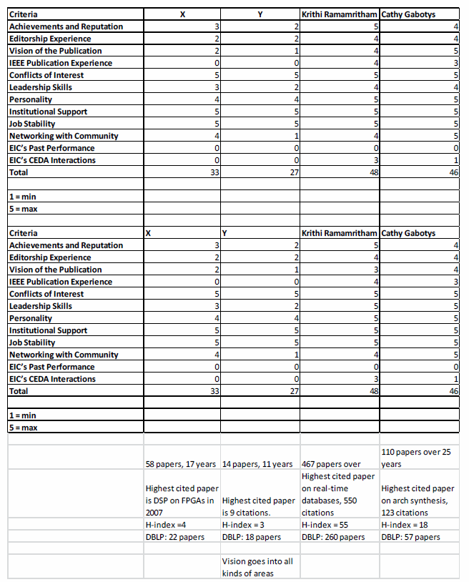
ESL EIC SEARCH
Report Provided 5/9/11
Committee:
  Nikil Dutt, David Atienza, Luciano Lavagno, R. Gupta
Four candidates, Selected two.
MOTION
“Adopt Search Committee Recommendations Report including Appointment of Krithi Ramamritham as EIC and Cathy Gebotys as Deputy EIC effective, July 1, 2011.”

Slide 18

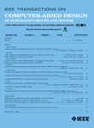
TCAD Report
Sachin S. Sapatnekar, EiC
Vijay Narayanan, DEiC
CEDA BoG Meeting
June 2011

Slide 19
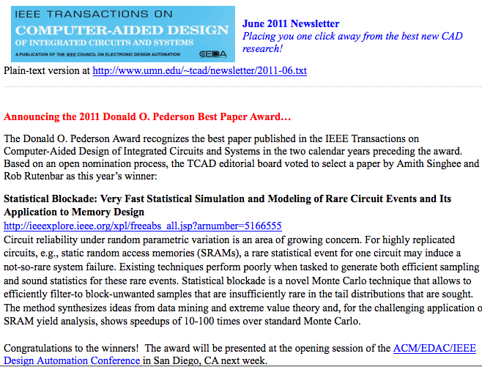
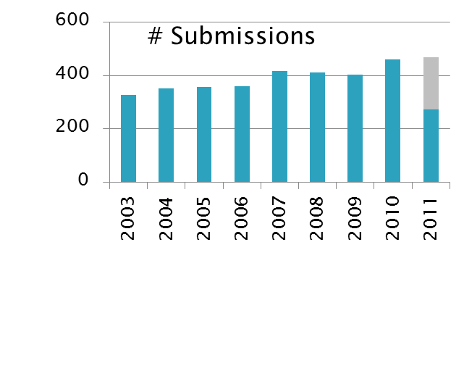
Key statistics and upcoming plans
New BPA process
  With external nominations
Nominations for “best-of-best” awards (Baker/Fink prizes) in process
New-look TCAD newsletter
Impact factor: 1.230
Acceptance rate
  In the last 12 mos: 37.2%
  Last year: 39.8%
Average review cycle
  In the last 12 mos: 62 days
  Last year: 62 days
Number of pages
  2010: 2128 used of 2145
  2011: 2016 allocated
  Backlog stable at ~5 months

Slide 20
(Semi-)invited Content
Initiatives driven by Vijay
Keynote papers
  Jason Cong: system-level design for FPGAs (April)
  David Brooks/Pradip Bose: system-level reliability (July)
  Upcoming quarterly – several in the pipe
    Architectural resilience (Brooks)
    Data center power management (Pedram)
    Handling variations in SW (Gupta, Srivastava)
    CNT technologies (Mitra)
    Reliability (Cao)
Special sections in process
  Parallel CAD
  ISPD
  3D (early stages of planning)

Slide 21
Administrative Miscellanea
Migration to ManuscriptCentral (MC)
  CEDA BoG approved move to MC in June 2010
  Migration completed Jan 2011 without any significant glitches
  Many thanks to Sara Dailey, corresponding editor
  Minor to-dos remain (DUDE, etc.) – should be done soon
Administrative support: shared between TCAD and ESL
  Working out extremely well, significantly lower cost than previous years with no loss in quality

Slide 22
Budget Highlights

Slide 23
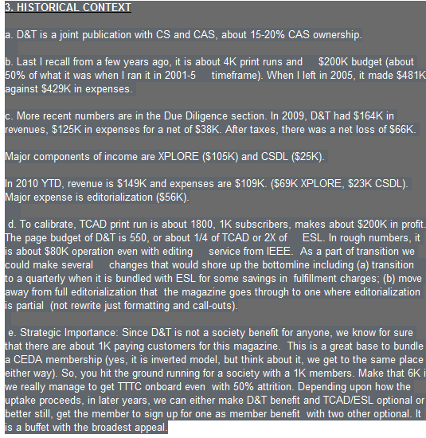
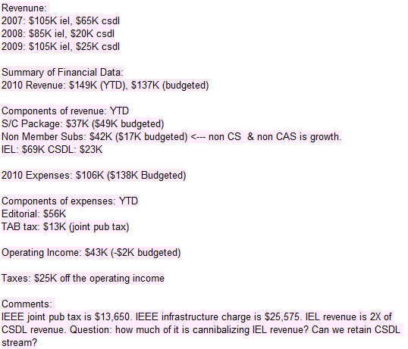
IEEE D&T: Historical Context
http://xor.ucsd.edu:9000/sc7pr1bCP2

Slide 24
Some More Details
Technical:
  joint pub with CASS (15-20% ownership), 600 pages, 6 issues/year, 800 subs, 70% turnover
2009: $164K revenue, $(66K) net loss
2010 YTD: $149K revenue, $106K expense
  $69K IEL, $23K CSDL, $37K member subs
Major income: XPLORE, Major expense: editorial $56K, taxes
$70K IEL revenue is pretty stable, $25K CSDL

Slide 25
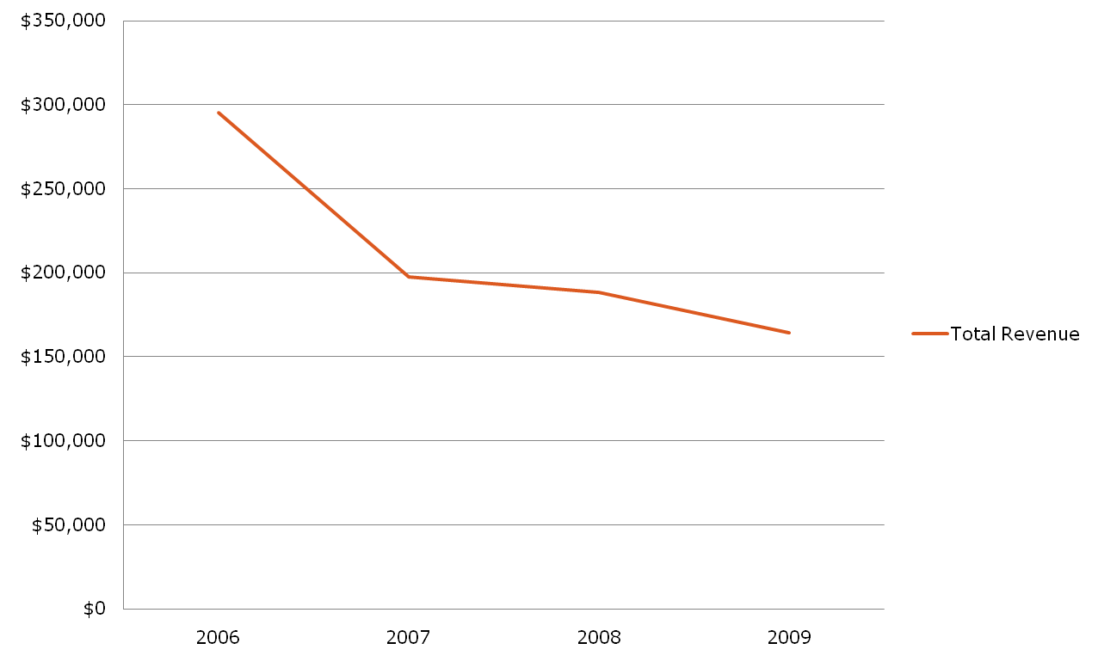
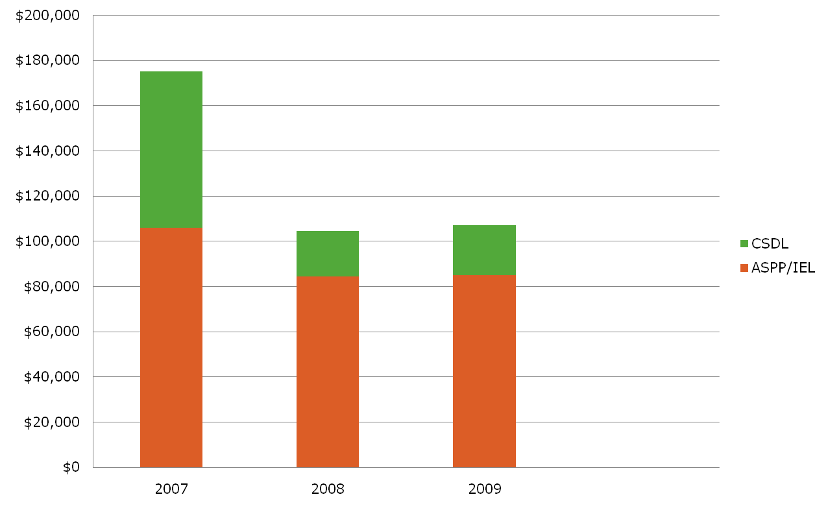
Why CS Wants Out
1. Community, 2. Financials

Slide 26
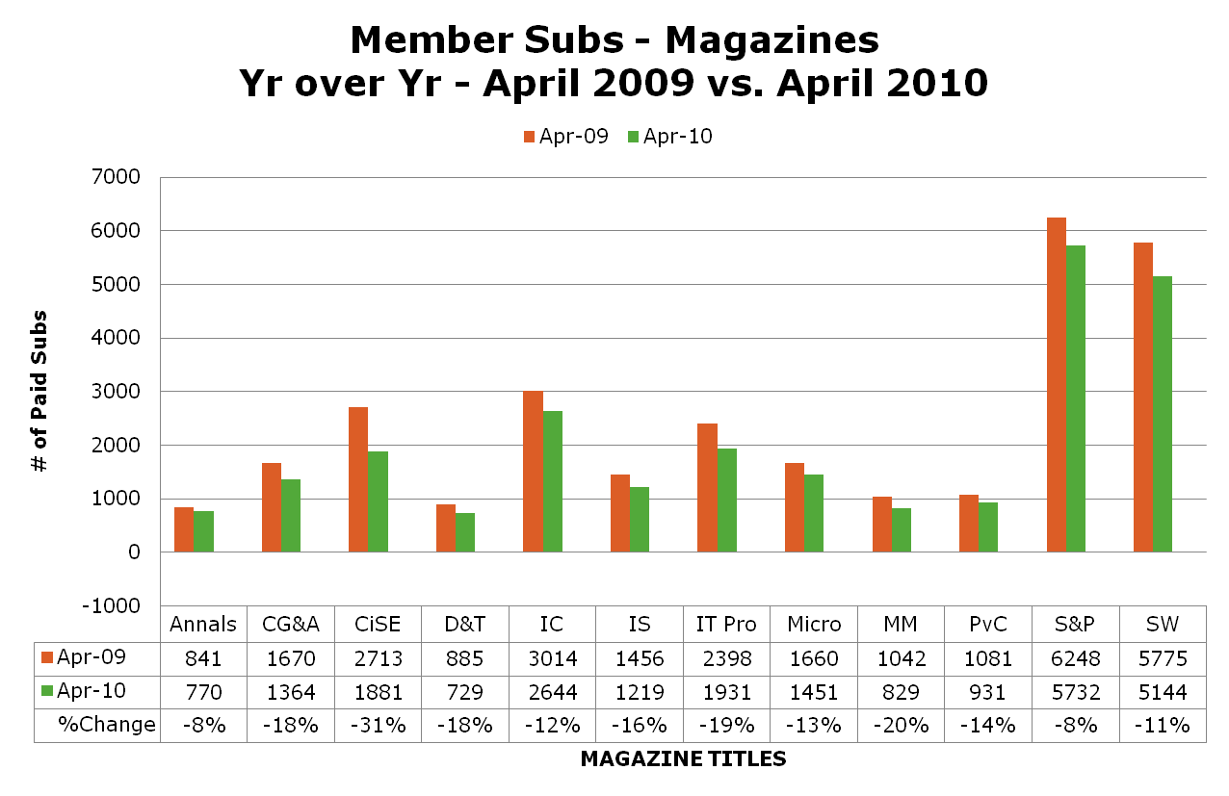
Reality Requires CS to Readjust
To Meet Its Competitive Challenges

Slide 27
Good, Bad and Ugly
661 Subs 2/7/11
=588 CS + 73 CASS
D&T Income:
2007 $197,559 70% retention
2008 $188,136 71% retention
2009 $164,168 72% retention
IEL USAGE: D&T content uptake has actually picked up this year. The numbers are showing about 4x increase in member use data (from 68 in 2008 to 271 in 2009, to 163 in 2010). This is bound to have an impact on their bottom-line. May be this is small component of their overall financial breakdown, but usually such bump is correlated with online access.
Member Use Jan-Jun 2010 Ordered by Publication Title
Publication: 93/94/95/96/97/98/99/00/01/02/03/04/05/06/07/08/09/10 Sum
D&T: 25, 11, 2, 10, 14, 9, 17, 7, 21, 35, 19, 42, 43, 45, 77, 68, 271, 163 920
TCAD: 31, 41, 38, 40, 31, 35, 36, 32, 32, 49, 45, 64, 60, 104, 95, 148, 147, 483 1,671

Slide 28
D&T/CEDA: no taxes, streamlined production, bundled products, less fulfillment costs
Cleaner, and Not So

Slide 30
CEDA with CASS and SSCS
MOU passed with unanimous vote of CEDA 4/27/2011
  Effective January 2012
  Acknowledge and support TTTC activities
  Equal financial partners
  3-year period for partnership renewal. CEDA starts as administrative partner
  Steering Committee.
Next Steps:
  Approvals from CASS, SSCS BOG
  CS Transfer.

Slide 31
Negotiated Settlement with CS
Computer Society transfers D&T to CEDA.
  Preliminary approval by unanimous vote by CS BOG 2/4/2011
  Final approval by unanimous vote by BOG 5/31/2011
MOU
  CEDA takes over D&T 1/1/2012
  CEDA maintains logo and look of D&T
  D&T included in CSDL 2012-2014, stop after that.
  No CSDL revenue effective 1/1/2012. All others to CEDA.
Adopted by CEDA 4/27/2011.
Next Steps: Form SC, EIC Search, Negotiate publisher.

Slide 32
Outlook Bright, Challenges Loom
Let us talk about it!

