Slide 1
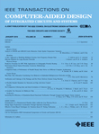
TCAD Report
Sachin S. Sapatnekar, EiC
Vijay Narayanan, DEiC
CEDA BoG Meeting
June 2011
1

Slide 2
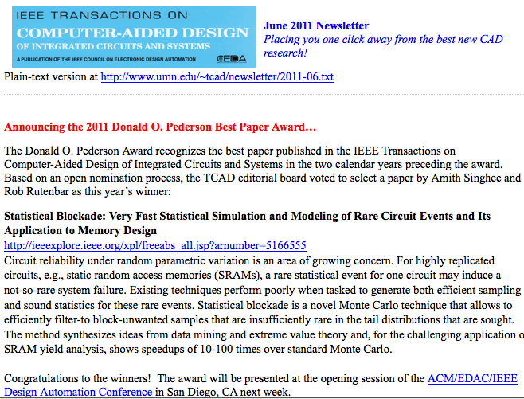
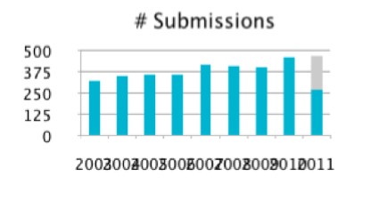
Key statistics and upcoming plans
New BPA process
With external nominations
Nominations for “best-of-best” awards (Baker/Fink prizes) in process
New-look TCAD newsletter
Impact factor: 1.230
Acceptance rate
In the last 12 mos: 37.2%
Last year: 39.8%
Average review cycle
In the last 12 mos: 62 days
Last year: 62 days
Number of pages
2010: 2128 used of 2145
2011: 2016 allocated
Backlog stable at ~5 months

Slide 3
(Semi-)invited content
Initiatives driven by Vijay
Keynote papers
Jason Cong: system-level design for FPGAs (April)
David Brooks/Pradip Bose: system-level reliability (July)
Upcoming quarterly – several in the pipe
Architectural resilience (Brooks)
Data center power management (Pedram)
Handling variations in SW (Gupta, Srivastava)
CNT technologies (Mitra)
Reliability (Cao)
Special sections in process
Parallel CAD
ISPD
3D (early stages of planning)

Slide 4
Administrative miscellanea
Migration to ManuscriptCentral (MC)
CEDA BoG approved move to MC in June 2010
Migration completed Jan 2011 without any significant glitches
Many thanks to Sara Dailey, corresponding editor
Minor to-dos remain (DUDE, etc.) – should be done soon
Administrative support: shared between TCAD and ESL
Working out extremely well, significantly lower cost than previous years with no loss in quality

