Slide 1
SSCS
Bryan Ackland

Slide 2
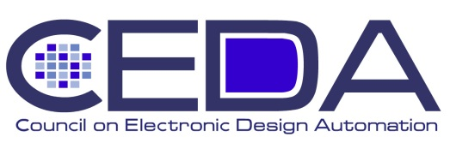
SSCS Highlights
Continuing concern over declining society membership
Society membership declining 4% per year while IEEE growing 4% per year
New Society membership benefits
$25k Student fellowships to attend conferences
$10 Starbucks card for ISSCC attendees
Financials strong
Income from conferences and JSSCC
Reserve/Expense ratio ~1.2 (Reserves almost back to ‘07 level)
Awards
13 (+100%) 2011 Fellows from 23 (+50%) nominations
ISSCC
Strong attendance 2980 (+12%) - generated surplus $550k
Continuing cost reductions – registration $695 (09) ⇨ $640 (10) ⇨ $595 (11)
Coffee breaks + ice-cream social
Industry demo session to encourage industrial participation
ISSCC/DAC Student Design Contest
DAC has withdrawn beginning 2012
For 2012, ISSCC not continue contest in current form
combine with Student Research Program (like DAC PhD Forum)
student demo sessions
D&T Magazine
Planning joint sponsorship with CAS & CEDA effective Jan. 2012
Expand scope to include RF and mixed signal test
Allocated $30k/year budget

