Slide 1
Conferences
Sani Nassif, VP Conferences

Slide 2
Conferences Sponsored by CEDA
Conference | Characterization | CEDA %
Design Automation Conference | Core EDA conference, oldest/largest. | 33%
Network-On-Chip Symposium | Emerging area where EDA plays an important enabling role. | 40%
VLSI-System-On-Chip | International conference with significant EDA component. | 25%
Embedded Systems Week | Collection of several conferences on embedded systems, an area of immense current and future importance. | 10%
International Conference on CAD | Core EDA conference, very influential, very research focused. | 66%
Design Automation and Test in Europe | Core EDA conference, largest in Europe. | 26%
Formal Methods for Co-Design | Targeted conference | 15%
Multi-Processor System-On-Chip | International conference with significant EDA component. | 33%
Computer-Aided Network Design | Targeted invitation-driven workshop | 100%

Slide 3
Common Themes/Issues
To: Society/Council Conference Officers,
Effective 1 November 2011, all conference related contracts with a value of US$25,000 and greater will no longer be executed by IEEE Strategic Sourcing until the conference has been approved by Conference Services. The standard process for approving a conference with IEEE is as follows:
A Conference Information Schedule (CIS) is submitted. http://www.ieee.org/web/conferences/organizers/required_documentation.html
Staff has validated and verified sponsorship (including receipt of an approved MOU if applicable)
Reminder
Contracts under US$25,000 must be submitted to conference-contracts@ieee.org for retention once executed by organizer.
Please share the above information with your current and future conference organizers.
Would it make sense to have a threshold below which we can skip this retention requirement?

Slide 4
Common Themes/Issues
With the increasing availability of smart phones and tablets, there is interest in having “online” proceedings during a conference (request from DAC).
Desirable that such online proceedings point to Xplore.
Bring new users, ensure Xplore is the repository of choice after the conference as well.
A number of issues to resolve…

Slide 5
The Fourth Leg
CEDA is currently a major sponsor of 3 of the 4 major EDA conferences worldwide.
CEDA is actively seeking involvement with ASPDAC to build a relationship and mutual trust.
Plan: Deepen involvement with ASPDAC by making an appropriate investment for ‘13.
ICCAD
DATE
DAC
ASPDAC

Slide 6
DAC Report to CEDA-BOG
Al Dunlop
DAC Rep to CEDA
CEDA Rep to DAC

Slide 7
Attendance History

Slide 8
2010/2011 Comparison

Slide 9
DAC’11: Mission of the Tech Program Committee
Maintain reputation as #1 conference in EDA
Best conference to publish top-notch work
Maintain high quality through thorough review process
Expand into Emerging/Adjacent Areas
Embedded Systems & Software (ESS)
New and Emerging Technologies
Establish DAC as focal point for entire EDA and ESS Ecosystem
Keynotes, Special Sessions, Panels, Tutorials
New initiatives: WIP, UT,…
Co-located events

Slide 10
DAC’11: Program components
‘Bottom-up’ Technical Program
Research paper submissions
‘Top-down’ Technical program
Special sessions
Panels
Keynotes
New for 2011:
15-min presentations for all research papers
Interactive posters at end of each session
Work-in-Progress (WIP) track for new/early ideas
Research Paper Acceptance Rate
156 of 690 submissions accepted: ~23% acceptance
TPC’s primary task

Slide 11
DAC’11 Paper Submissions
Submissions: 690 papers
Comparison: 611 (2010), 731 (2009), 665 (2008), 712 (2007), 867 (2006)
ESS/Front-End: 245 papers (35%)
EDA/Backend: 419 papers (61%)
TPC Size: 83
Average review load is between 25-30 papers per TPC member
Three tiers of review to generate ~5 expert reviews/paper
TPC members (min 3 per paper)
Average # reviews: 3.2
Expert-external reviews (goal: 2 per paper)
Average # reviews: 1.3
DAC-generated external reviews
Average # reviews: 1.9
Average total # reviews per paper: 6.3

Slide 12
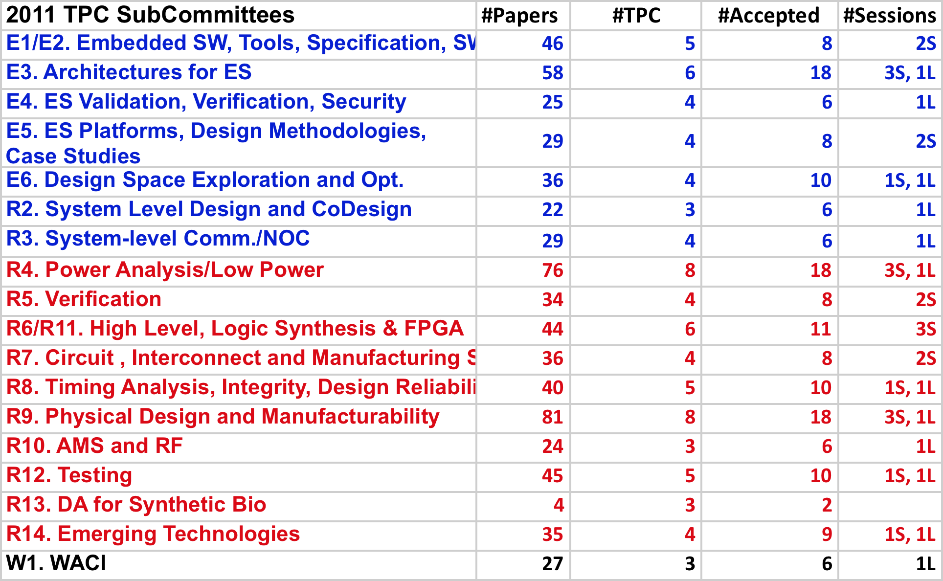
DAC’11: Paper submission details
Total Submissions: 690
TPC Size: 83
ESS/FE: 245 papers (35%)
EDA/Backend: 419 papers (61%)
Paper Acceptance Rate
156 of 690 submissions accepted: ~23% acceptance
(approx 40% ESS/Front-end)

Slide 13
Technical Program Formats
7 Parallel Tracks
4 Regular Papers
1 Special Session
1 Panel
1 User Track (UT)
Keynotes every day
Thurs: Best Paper Award
All presentations
12-minutes + poster
Pitch basic idea!
Poster fosters interactive discussions
Special Sessions: 30 min presentations
Receptions at end of Tues & Wed
Plus “Work-in-Progress” (WIP) Session
Tuesday
June 7
Wednesday
June 8
Thursday
June 9
keynote
keynote
4x 1.5h
4x 1.5h
4x 1.5h
BP/Keyn
lunch
lunch
lunch
4x 1.5h
4x 1.5h
4x 1.5h
4x 2hr
4x 2hr
4x 2hr
reception
reception

Slide 14
ICCAD
Alan Hu

Slide 15
ICCAD (International Conference on CAD)
Sole IEEE sponsor, with ACM/SigDA.
Long-Running event with deep history and focus on CAD research.
Year | Location | Attendance | Papers | Surplus
2006 | San Jose | 704 | 25% | $21,669
2007 | San Jose | 614 | 25% | $0.0
2008 | San Jose | 465 | 25% | $13,400
2009 | San Jose | 373 | 26% | $23,465
2010 | San Jose | 366 | 30% | $65,000
2011 | San Jose

Slide 16
ICCAD Future
Currently working to create a steering committee to provide long-term leadership.
Already starting on 2012.
Financial discipline to insure continued viability.
New areas:
System level design.
Embedded software.
Analog.

Slide 17
DATE
Sani Nassif

Slide 18
DATE (Design Automation Test Europe)
CEDA is now the sole IEEE sponsor.
Flagship European event with large exhibit component, on solid growth path.
Year | Location | Attendance | Papers | Surplus
2007 | Nice | 1641 | 25% | € 3,144
2008 | Munich | 1420 | 25% | € 0.0
2009 | Nice | 1415 | 25% | € 5926
2010 | Dresden | 1300 | 25% | € 850
2011 | Grenoble | 2300 | 27% | € 48336
2012 | Dresden |  | (785 submitted)

Slide 19
DATE Future
Focused on locations where significant local support and/or sponsorship is available.
Continued strength in technical program.
Separate finances for exhibit and technical program.

