Slide 1


Publications update to BOG & EXCOM, ICCAD 2011
Jose L. Ayala, Madrid
David Atienza, EPFL
Krish Chakrabarty, Duke
Shih-Chieh Chang, NTHU, Taiwan
Pai Chou, UC Irvine
Patrick Groeneveld, Magma
Rajesh Gupta, UC San Diego
Farinaz Koushenfar, Rice
Rakesh Kumar, UIUC
Enrico Macii, Torino, Italy
Anand Raghunathan, Purdue
Vijay Raghunathan, Purdue
Sachin Sapatnekar, U Minnesota
Sandeep Shukla, Virginia Tech
Gang Qu, University of Maryland
Norbert When, Uni Kaiserslautern
Currents

Slide 2
Outline
What is new?
Publication Updates
  Currents Newsletter
  IEEE ESL
  IEEE TCAD
IEEE Design & Test
  Recap and Status
  Going Forward
Outlook

Slide 3
What is New (Since ICCAD 2010)?
Latest JCR Data
IEEE ESL EIC and D-EIC are in place
IEEE D&T In Full Swing
  MOUs executed
  Steering Committee Formed
  Full speed on operation decisions – Need your approval

Slide 4
JCR Data (July 2011)
Journal | 2010 total Cites | Impact Factor | 5-year Impact Factor | Immediacy Index | 2010 Articles | Cited Half-life | Eigenfactor Score | Article Influence Score | IF Rank CS/HW/Arch
IEEE Micro | 1,321 | 2.5 | 3.0 | 0.244 | 45 | 6.5 | 0.00514 | 1.3 | 4
CACM | 11,393 | 2.4 | 2.49 | 0.386 | 158 | >10.0 | 0.01288 | 0.829 | 5
Computer | 3,383 | 1.8 | 2.28 | 0.226 | 84 | 8.2 | 0.00848 | 0.902 | 10
T COMP | 6,460 | 1.6 | 2.03 | 0.216 | 139 | >10.0 | 0.01125 | 0.842 | 12
T CAD | 3,551 | 1.3 | 1.50 | 0.159 | 182 | 7.3 | 0.00896 | 0.478 | 17
ACM TECS | 356 | 1.06 |  | 0.093 | 54 | 4.1 | 0.00174 |  | 24
D&T | 926 | 0.96 | 2.0 | 0.382 | 34 | 6.2 | 0.00354 | 0.829 | 26
T VLSI | 2,097 | 0.90 | 1.34 | 0.207 | 188 | 6.0 | 0.00820 | 0.558 | 27
ACM TACO | 133 | 0.824 |  | 0.000 | 21 | 5.3 | 0.00060 |  | 30
ACM TODAES | 376 | 0.484 | 0.799 | 0.031 | 32 | 5.7 | 0.00167 | 0.345 | 37
DAEM | 67 | 0.167 | 0.340 | 0.125 | 16 |  | 0.00014 | 0.137 | 47
TCAD IF: 2008/1.466; 2009/1.230. Variation mainly due to page purchases in 2006.

Slide 5
Publication Updates
Currents Newsletter
  To be absorbed in D&T?
IEEE ESL
  Transition to EIC/D-EIC Team
IEEE TCAD
  Settled
IEEE D&T
  Transition in progress.

Slide 6
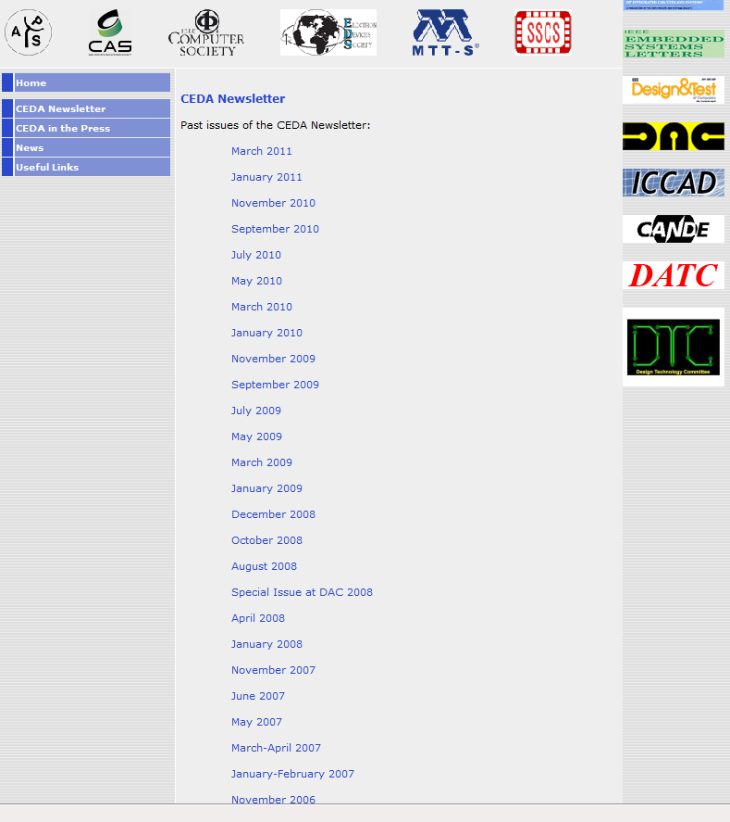
Currents Newsletter
32 issues published so far, one every two months
  Longest continuously active volunteer activity
  Applause to Jose Ayala, well deserved!
Beginning DAC 2012, provide D&T instead?

Slide 7
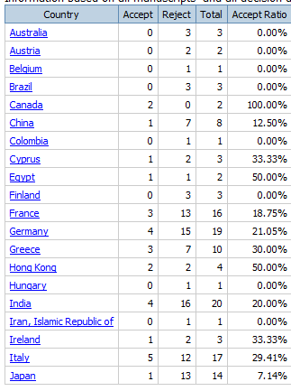
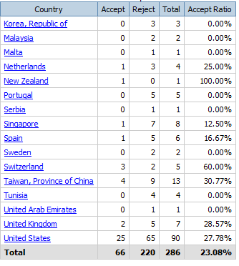
IEEE ESL Status
101 papers received YTD
  Pending manuscripts: 18
  Acceptance ratio: 22.5%
Submission to decision: 66 days / 68 final
Review turnaround: 20 days
Total Received: 360, Total Decided: 286
1/3rd of submissions from US, 1/4th accepted
~40% from Europe/Mid-east
~20% from Asia
  7% from India, 1/5th accepted

Slide 8
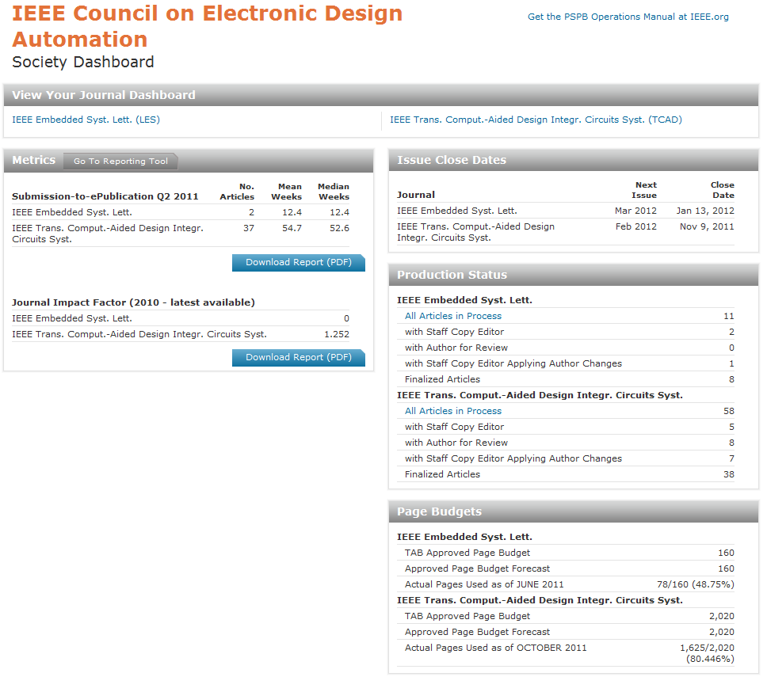
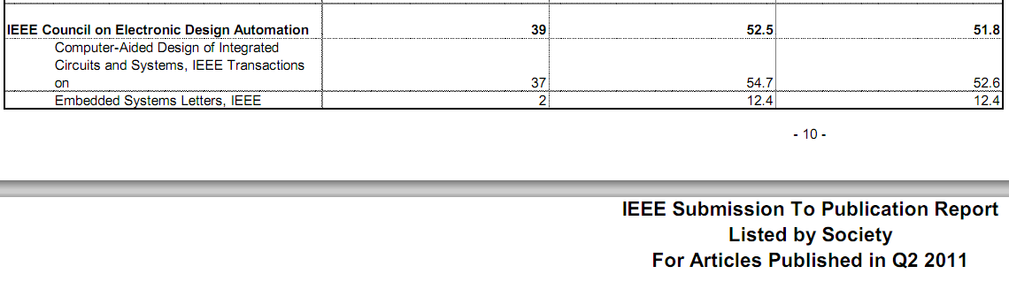
Production Report (Moved to POPP)

Slide 9
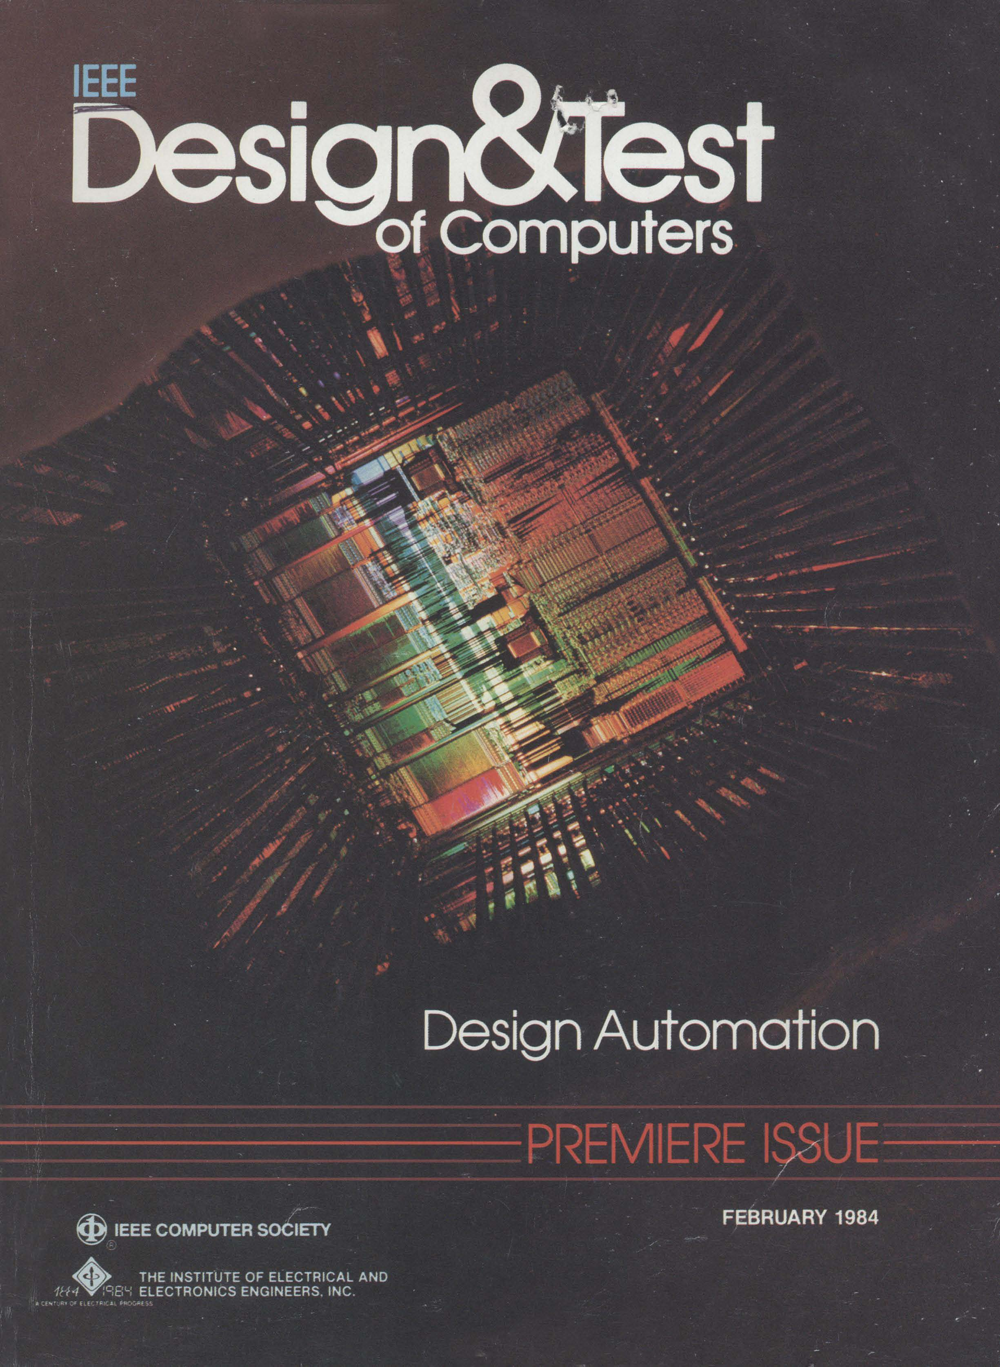
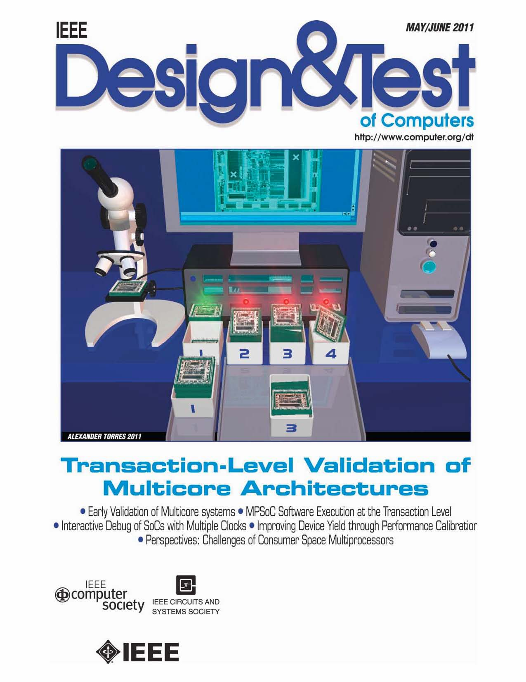
IEEE Design and Test: A Rich History

Slide 10
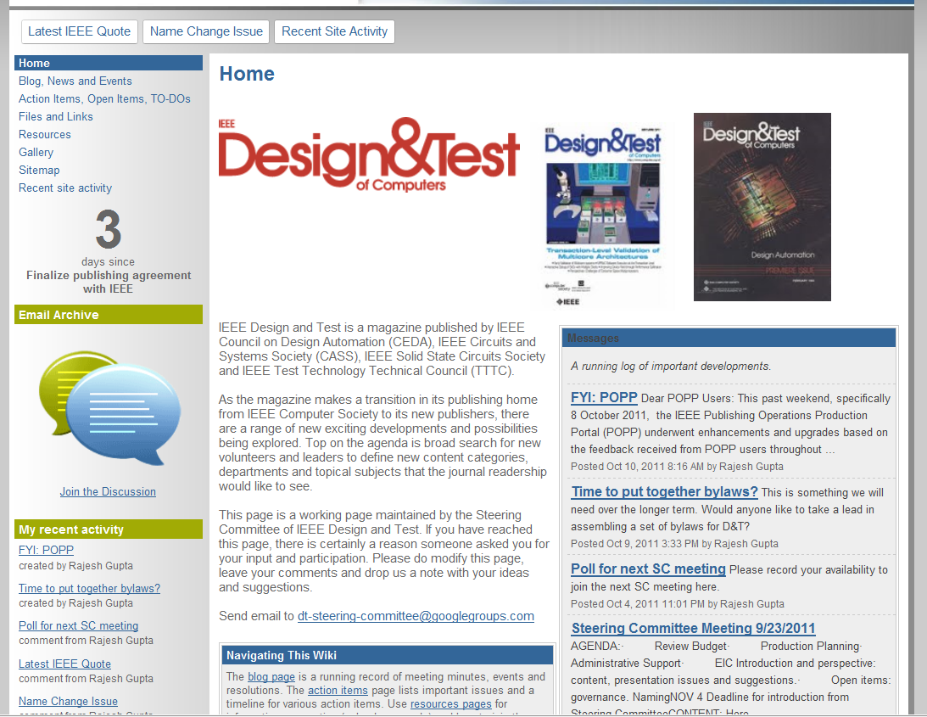
D&T
https://sites.google.com/site/designandtestmagazine/
All approvals in place: CAS, SSCS, TTTC, CEDA
  MOU passed with unanimous vote of CEDA 4/27/2011
  MOU passed by partners
    CEDA takes over D&T 1/1/2012
    CEDA maintains logo and look of D&T
    D&T included in CSDL 2012-2014, stop after that.
    No CSDL revenue effective 1/1/2012. All others to CEDA.
Steering Committee in place
  Gianluca Setti, Glen Gulak, Yervant Zorian, R. Gupta

Slide 11
An Exciting New Opportunity!
IEEE Design and Test of Computers makes a transition to IEEE Design and Test
  Name change issue under discussion to be decided 12/5
    https://sites.google.com/site/designandtestmagazine/to-dos/name-change-issue
Expand the community (read scope) to include
  Advances being seen in forums such as ISSCC, CASS forums
    SOCs, Circuits, Devices, EDA
  New departments and technical areas being created
    Current EIC in charge, term extended by 1-year

Slide 12
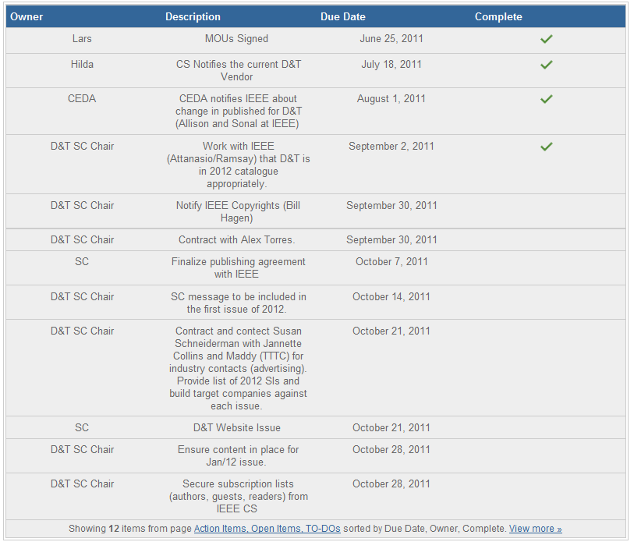
D&T SC Action Items

Slide 13
D&T Action Items
Current Arrangements
  Administrative assistance by S. Dailey: $5K/year
  IEEE Publishing Budget
    See Next Page
    Motion: Adopt budget with following elements
      IEEE Publishing Costs for Basic Design Services
      D&T Contracted Coverpage
      D&T Shared Administrative Assistant
      Co-publication Tax
      IEEE Surprise: 10% of Revenue

Slide 14
Services Being Contracted from IEEE
Common Design Service
  Editorial Service includes copy editing for style, basic grammar and QC only.
  Layout utilizes a common 3-column design throughout based on design of IEEE Transactions on Professional Communications.
  All author-supplied graphics, such as charts, diagrams and photographs are processed as supplied, there is no type replacement or redrawing of graphics and there is no color.

Slide 15
Please approve this publishing budget.

Slide 16
However, Keep in Mind
 | 2012 | 2013 | 2014
#Articles | 72 | 72 | 72
Pages | 600 | 600 | 600
Issues/Yr | 6 | 6 | 6
Revenue | $139,895 | $143,312 | $148,673
Expenses: Fixed | $86,821 | $85,981 | $85,981
Expenses: Variable | $31,304 | $31,304 | $31,304
Net Per IEEE | $21,770 | $26,027 | $31,388
Administrative Admin | ($5,000) | ($5,000) | ($5,000)
TAB Tax | ($20,000) | ($20,000) | ($20,000)
10% Margin | ($14,000) | ($14,000) | ($15,000)
Net to Societies | ($17,230) | ($12,973) | ($8,612)

Slide 17
Going Forward
We need to create products that
  Enhance the value of current offerings
  Create new value for our readers, contributors
We need to create processes that
  Ensure maximization of revenue generating opportunities for CEDA
  Prevent loss of revenue for CEDA
  Ensure cross-coupling of participant value across functional areas of CEDA
All of this is currently being worked on a proposal to be brought before excom EOY.

Slide 18
FYI: Assessing Impact of Our Publications
Publication success intimately tied to success of the technical community affiliated with it
  Impact of publication, its availability
Therefore, it is important to look at measures that our contributors will look at closely
  One such measure is citations
Let us take a closer look to under our current trajectory…

Slide 19
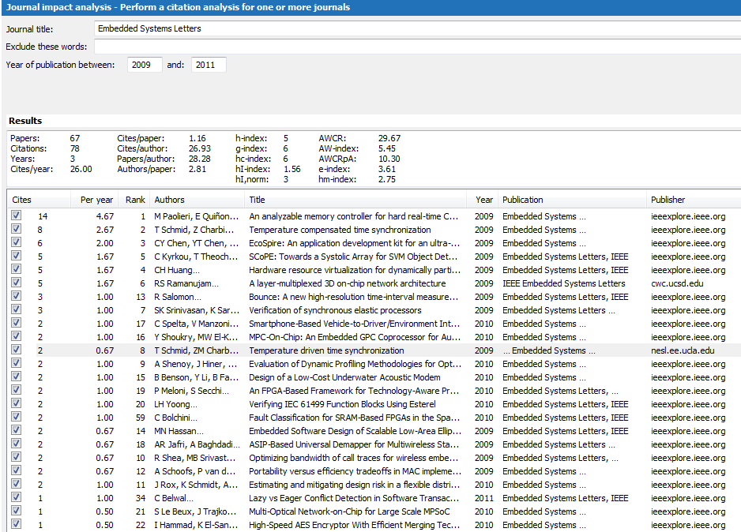
ESL Content: 66 papers published
Screen Shot from Publish or Perish
Since June 2009, Quarterly.
Revenue Loss

Slide 20
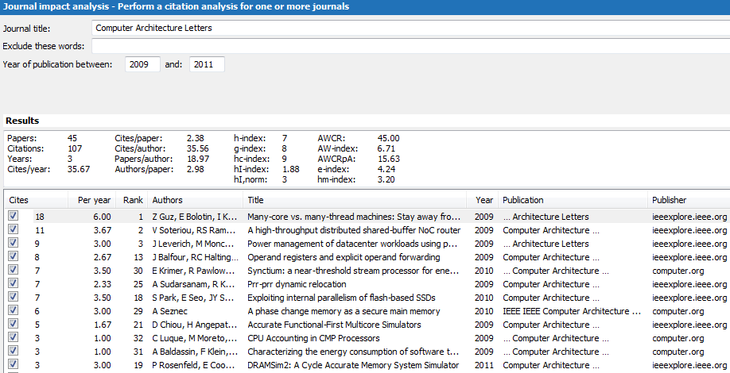
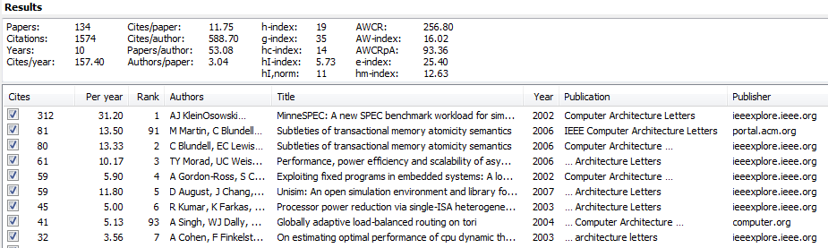
Some Calibration
Since 2002, Quarterly.

Slide 21
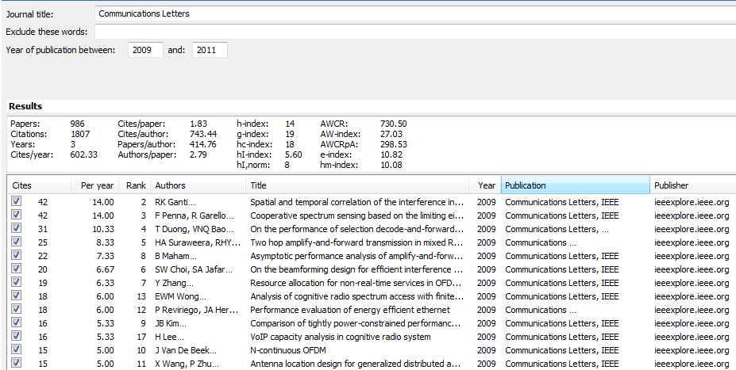
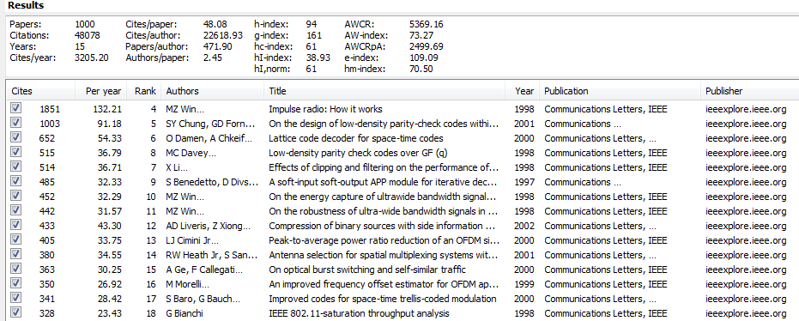
Since 1997, Monthly.

Slide 22
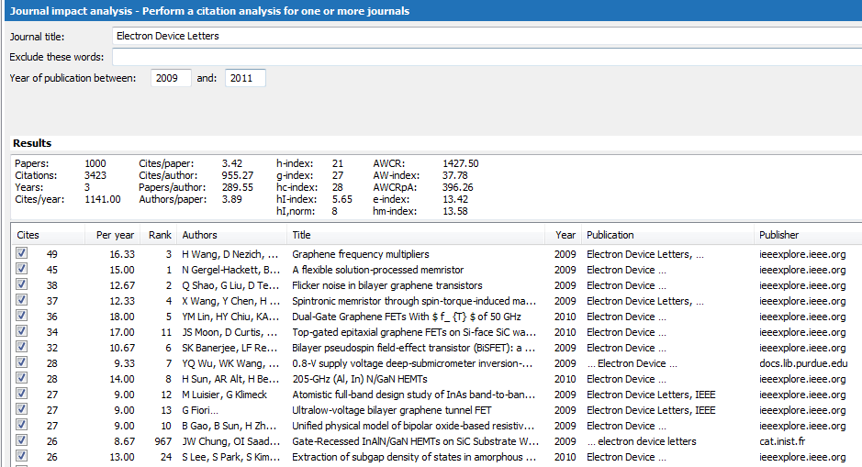
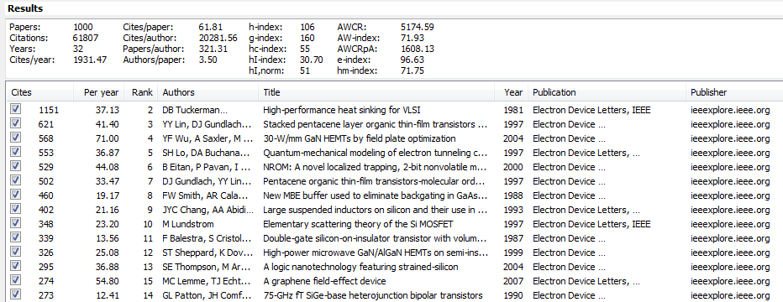
Since 1980, Monthly.

Slide 23
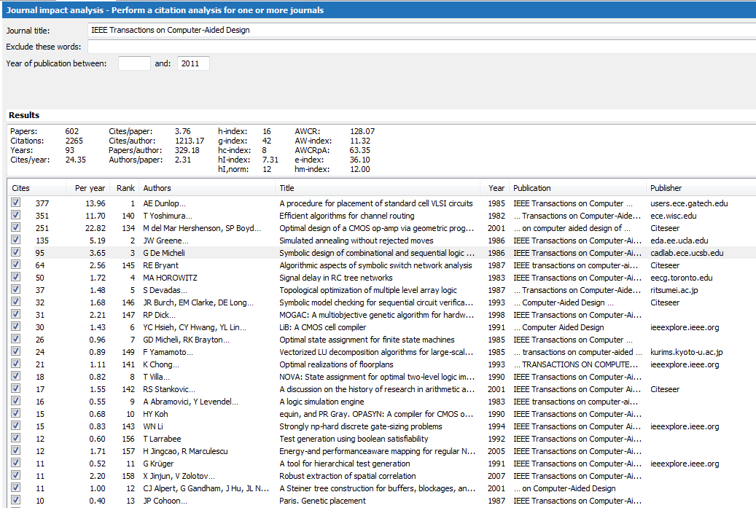
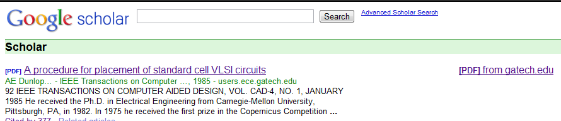
Caution

Slide 24
