Slide 1
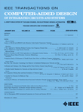
TCAD Report
Sachin S. Sapatnekar, EiC
Vijay Narayanan, DEiC
CEDA BoG Meeting
November 2011

Slide 2
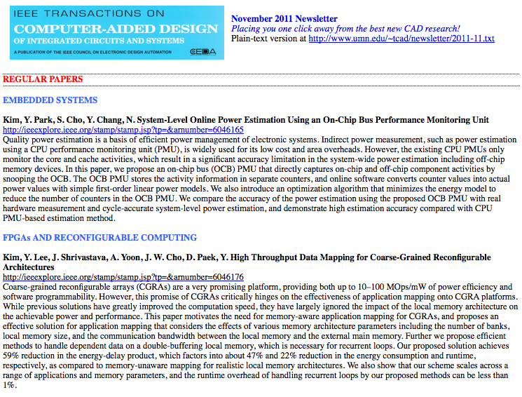
Key statistics
Number of pages
2010: 2128 used of 2145
2011: 2016 allocated: expect to
be within +/-5 pages of this
Backlog stable at ~5 months
New-look TCAD newsletter
Impact: 15 of 25 top accessed articles from 2011; 4 from 2010
Impact factor: 1.252
Submissions up 8%
Acceptance rate
In the last 12 mos: 39.0%
Average review cycle: time to
first decision
In the last 12 mos: 61 days
Average: 55 days

Slide 3
Special initiatives
Keynote papers/special sections
April
Cong et al.: High-Level Synthesis for FPGAs: From Prototyping to Deployment
July
Rivers et al.: Error Tolerance in Server Class Processors
October
Janapa Reddi/Brooks: Resilient Architectures via Collaborative Design: Maximizing Commodity Processor Performance in the Presence of Variations
Jan
Parallel CAD special section
Upcoming quarterly – several in the pipe
Data center power management (Pedram)
CNT technologies (Mitra)
Reliability (Cao)
Litho (Pan)
Special sections in process
Physical design
3D (coming soon)
Timing/software incl. repository (need CEDA support)

Slide 4
To-do items for 2012
Maintain turnaround time stats
Average time to first decision brought down from ~75 days to 61 days
Best Paper process 2012
Refine new process, include involvement of community
Institute best reviewer award
Need to sync with CEDA ExCom
New editorial board for 2012
Several new AEs on board in areas of need
Wang (UCSB), Ziv (IBM), Seshia (UCB)
Routine updates for next year
Please feel free to suggest good candidates

