Slide 1
Conferences
David Atienza, VP Conferences

Slide 2
Conferences Sponsored by CEDA
Conference | Characterization | CEDA %
Design Automation Conference | Core EDA conference, oldest/largest. | 33.3%
Network-On-Chip Symposium | Important area where EDA plays an enabling role. | 40%
VLSI-System-On-Chip | International conference with significant EDA component. | 25%
Embedded Systems Week | Collection of several conferences on embedded systems, an area of immense current and future importance. | 10%
International Conference on CAD | Core EDA conference, very influential, very research focused. | 66.7%
Design Automation and Test in Europe | Core EDA conference, largest in Europe. | 26%
Formal Methods for Co-Design | Targeted conference | 15%
Multi-Processor System-On-Chip | International conference with significant EDA component. | 33%
Computer-Aided Network Design | Targeted invitation-driven workshop | 100%

Slide 3
Finance “Health” of CEDA Conferences
Conferences projections look stable and healthy
IEEE has confirmed our initial projections for 2012 and contacts with organizers show similar trends in 2013
Main income is always DAC and now DATE is the second one
Year: 2013 | % Sponsor | 2013 Conference Budget |  |  | Society Share of Conference Budget
Conference Name |  | Revenue | Expense | Net | Revenue | Expense | Net
2013 Design, Automation & Test in Europe Conference & Exhibition (DATE 2013) | 26.5% | 990,000 | 920,000 | 70,000 | 261,855 | 243,340 | 18,515
2013 50th ACM/EDAC/IEEE Design Automation Conference (DAC) | 33.3% | 3,604,097 | 3,238,375 | 365,722 | 1,201,246 | 1,079,350 | 121,895
2013 Seventh IEEE/ACM International Symposium on Networks-on-Chip (NoCS) | 40.0% | 68,100 | 53,000 | 15,100 | 27,240 | 21,200 | 6,040
2013 12th International Forum on Embedded MPSoC and Multicore (MPSoC) | 33.0% | 85,000 | 85,000 | - | 28,050 | 28,050 | -
2013 10th IEEE/ACM International Conference on Formal Methods and Models for Codesign (MEMOCODE 2012) | 15.0% | 17,500 | 15,200 | 2,300 | 2,625 | 2,280 | 345
2013 IEEE/IFIP 20th International Conference on VLSI and System-on-Chip (VLSI-SoC) | 25.0% | 89,000 | 85,000 | 4,000 | 22,250 | 21,250 | 1,000
2013 8th Embedded Systems Week (ESWeek) | 10.0% | 221,800 | 210,000 | 11,800 | 22,180 | 21,000 | 1,180
2013 IEEE Computer-Aided Network Design Workshop (CANDE) | 100.0% | 0 | 0 | - | - | - | -
2013 IEEE/ACM International Conference on Computer-Aided Design (ICCAD) | 66.7% | 212,000 | 201,000 | 11,000 | 141,404 | 134,067 | 7,337

Slide 4
Technically Sponsored Conferences/Workshops
9 events, growth in different areas (formal methods, modeling, etc.)
Complicated to have consistent applications (different info from each organizers, unclear what to provide to CEDA, etc.)
A template form was created to help organizers (and CEDA to evaluate!)
Conference | Title
ASP-DAC | Asia and South Pacific Design Automation Conference
ESLSyn | Electronic System Level Synthesis Conference
FMCAD | Formal Methods in Computer-Aided Design
GLS-VLSI | Great Lakes Symposium on Very Large Scale Integration
Nano-Net | International Conference on Nano-Networks
PATMOS | Workshop on Power and Timing Modeling, Optimization and Simulation
SMACD | International Conference on Synthesis, Modeling, Analysis and Simulation Methods and Applications to Circuit
VARI | Workshop on CMOS Variability
VLSIDesign | International Conference on VLSI Design

Slide 5
Technical Sponsorship Request
Conference Name:
Sponsorship Year:
Conference website:
Contact Name:
Contact E-mail:
CEDA Technical Sponsorship Request Form (2012)

Slide 6
Description of Conference
Is the conference currently indexed in IEEE Xplore: Yes No
Does the conference maintain a public archive of its papers: Yes No
Approximate breakdown of academic/industrial attendance: 50% 50% Approximate breakdown of local/international attendance: 50% 50%
Provide a 1-paragraph overview of the conference (Please point out features that link this conference to the EDA community and CEDA, and show the strategic importance of the conference area of interest)
CEDA Technical Sponsorship Request Form (2012)

Slide 7
Sponsorship of Conference
Organization | Type of Sponsorship | % of total Conference
Provide a list of current financial and technical sponsors. Please include percentages for financial sponsors.
CEDA Technical Sponsorship Request Form (2012)

Slide 8
History of Conference
 | Place | Attendance | Submitted Papers | Accepted Papers | Budget Total | Final Surplus
Most recent (e.g. 2011)
Previous (e.g. 2010)
Previous (e.g. 2009)
Previous (e.g. 2008)
Fill as much of the this table as you can.
CEDA Technical Sponsorship Request Form (2012)

Slide 9
CEDA Conference Status Report First Conferences unclosed – status (May 2012)
Only five CEDA sponsored conferences still open at present
Thanks to Gi-Joon Nam
MEMOCODE 2011: concluded nine months ago.
General chair contact details unknown
VLSI-SoC 2011 and ESWeek 2011: concluded six months ago.
ICCAD 2011 and CANDE 2011: concluded five months ago.
No fees charged to CEDA if closed within 12 months from conclusion, no charge now

Slide 10
Help for Conference Organizers
Preparing a brief explanation of different steps required to get approval of sponsorship of CEDA
Prevent issues from joint sponsorship procedures (ACM/IEEE or even within IEEE due to multiple bodies)
Document to be posted on CEDA website
Organizers get bad impression about IEEE responsiveness
NOCS 2012: Organizers submitted MOU on June 8, 2011 and approved only in April 12, 2012.
Action points
Make sure CEDA is informed of MOU submission by all conferences its sponsored conferences
Discussions with IEEE and ACM headquarters to clarify this issue
More than 10 months! Extremely slow process when multiple IEEE/ACM bodies are involved

Slide 11
Availability of Proceedings On-Line in EDA Conf.
With the increasing availability of smart phones and tablets, there is interest in having “online” proceedings during a conference (request from DAC).
Similar request was proposed at the DATE Executive Committee on May 2012
Desirable that such online proceedings point to Xplore.
Bring new users, ensure Xplore is the repository of choice after the conference as well.
A number of issues to resolve…

Slide 12
DAC Report to CEDA-BOG
Al Dunlop, DAC Rep to CEDA,
and Patrick Groeneveld, CEDA Rep to DAC

Slide 13
DAC’11: Mission of the Tech Program Committee
Maintain reputation as #1 conference in EDA
Best conference to publish top-notch work
Maintain high quality through thorough review process
Expand into Emerging/Adjacent Areas
Embedded Systems & Software (ESS)
New and Emerging Technologies
Establish DAC as focal point for entire EDA and ESS Ecosystem
Keynotes, Special Sessions, Panels, Tutorials
New initiatives: WIP, UT,…
Co-located events

Slide 14
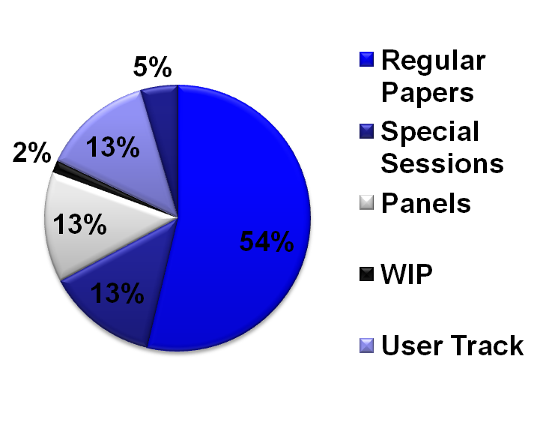
DAC 2012: Program components
‘Bottom-up’ Technical Program
Research manuscripts
Perspectives -- NEW
Work-in-Progress session
User Track
‘Top-down’ Technical program
Special sessions
Panels
Keynotes
Distribution by sessions

Slide 15
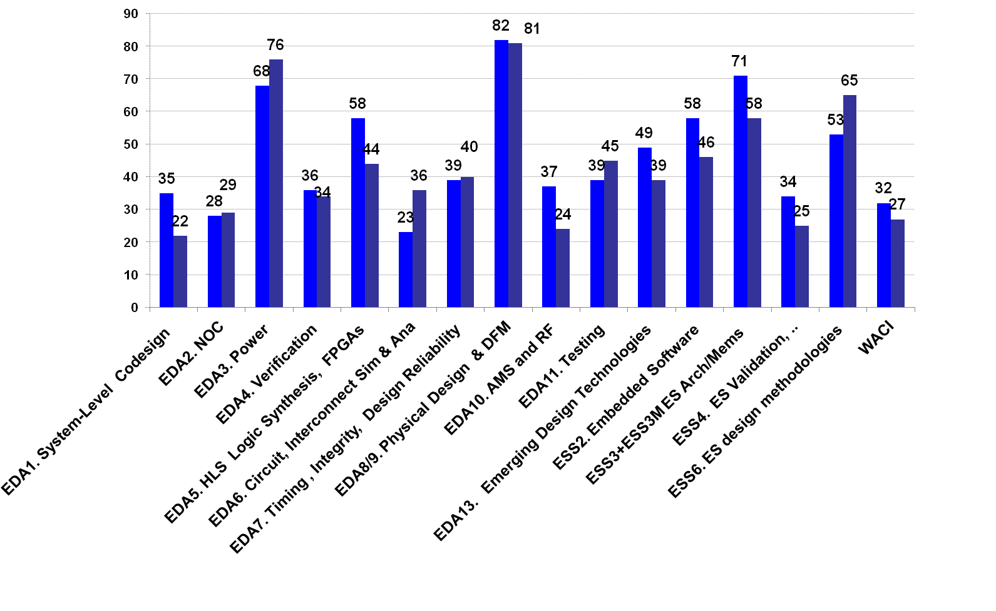
2012 vs. 2011 Submissions by area
Notes:
ESS 216 vs 194
EDA1 & 2 63 vs 51
ESS+ 279 vs 245
*

Slide 16
DATE 2012
(Thanks to Lothar Thiele and Donatella Sciuto)

Slide 17
DATE (Design Automation Test Europe)
CEDA is now the sole IEEE sponsor.
Flagship European event with exhibit component, on solid growth path.
Year | Location | Attendance | Papers | Surplus
2007 | Nice | 1641 | 25% | € 3K
2008 | Munich | 1420 | 25% | € 0.0
2009 | Nice | 1415 | 25% | € -6K
2010 | Dresden | 1300 | 25% | € 0.8K
2011 | Grenoble | 2300 | 27% | € 48K
2012 | Dresden | 1415 | 25% | € 27K
2013 | Grenoble | ~2300 | 25% | €24K (projected)

Slide 18
General Statistics
Total number of Web submissions: 974
Total number of papers sent out for review: 802
Number of TPC members: 322
Number of technical topics:
Design Methods and Tools: 15
Application Design: 7
Test Methods and Tools: 5
Embedded Systems Software: 5
Notes:
*

Slide 19
Breakdown by Regions
Region | submission % | accepted %
Europe | 49% | 52%
North America | 27% | 30%
Asia | 21% | 17%
Latin America | 1% | <1%
Africa | 1% | <1%
Australia | 1% | <1%

Slide 20
Most Popular Tracks
submissions
D – Design Methods and Tools 458
A – Application Design 125
+ 18%
T – Test Methods and Tools 92
E – Embedded Systems Sofware 108
+ 37%

Slide 21
Most Popular Topics
submissions
D3 – Simulation and Validation 52
D9 – Networks on Chip 49
A5 – Communication, Consumer and MM Systems 30
A2 – Secure, Dependable and Adaptive Systems 26
T5 – Test Access, DfT, Test Compression, System Test 27
T1 – On-Line Testing and Fault Tolerance 21
E1 – Real-Time, Networked and Dependable Systems 35
E2 – Compilers and Code Generation for ES 21

Slide 22
Acceptance Statistics
Track | # of Papers
D | 165
A | 49 (*)
T | 32
E | 33
 | 279 (**)
Acceptance ratio
16% regular presentations
9% short presentations
9% interactive presentations
(*) Including 10 Industrial Papers
(**) Including Interactive Presentations
57 Regular Sessions

Slide 23
DATE Future
Focused on locations where significant local support and/or sponsorship is available.
Continued strength in technical program.
Separate finances for exhibit and technical program.

