Slide 1
Finance Report (2012 Budget and 2013 Plan) CEDA BoG Meeting at DAC, June 2012 Shishpal Rawat, VP Finance
June 2012
Notes:
GTO2003EXT.ppt
*
*

Slide 2
Budget Comments
Surplus of $119K at end of 2011 despite special charges of $(104K) assessed at end of year.
DAC, DATE, ICCAD & TCAD ended with a nice surplus
Conservative forecasting
Assets exiting 2011 ~ $955K
Projected surplus in 2012 of $83K will carry us over the $1M assets by end of 2012 (Original target - 2015)
CEDA will continue to sponsor events at DAC, DATE (new), ICCAD and ASPDAC (new)

Slide 3
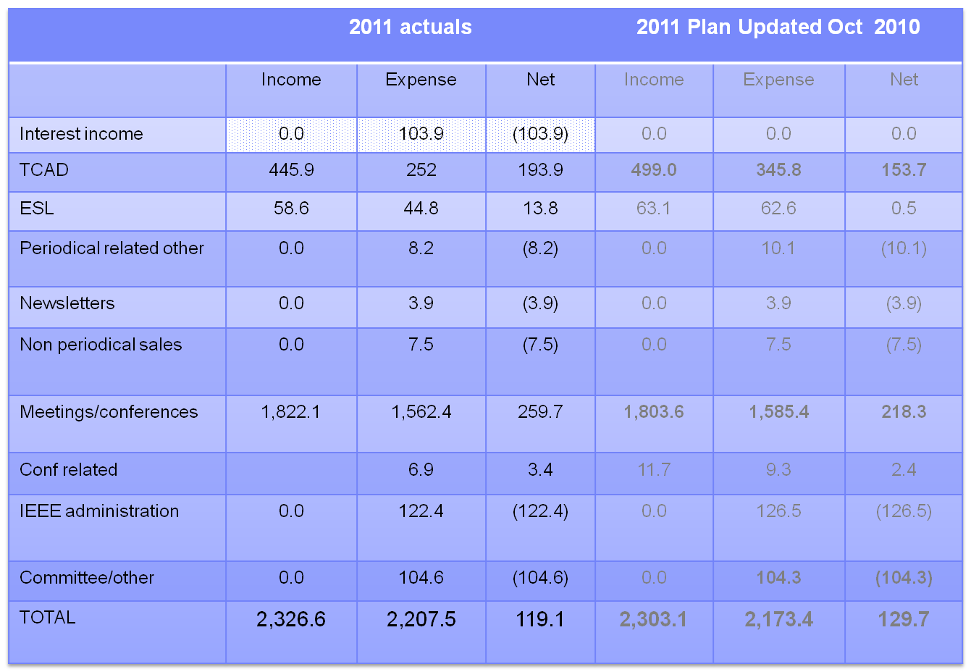
2011 Financials Updated (Unaudited)

Slide 4
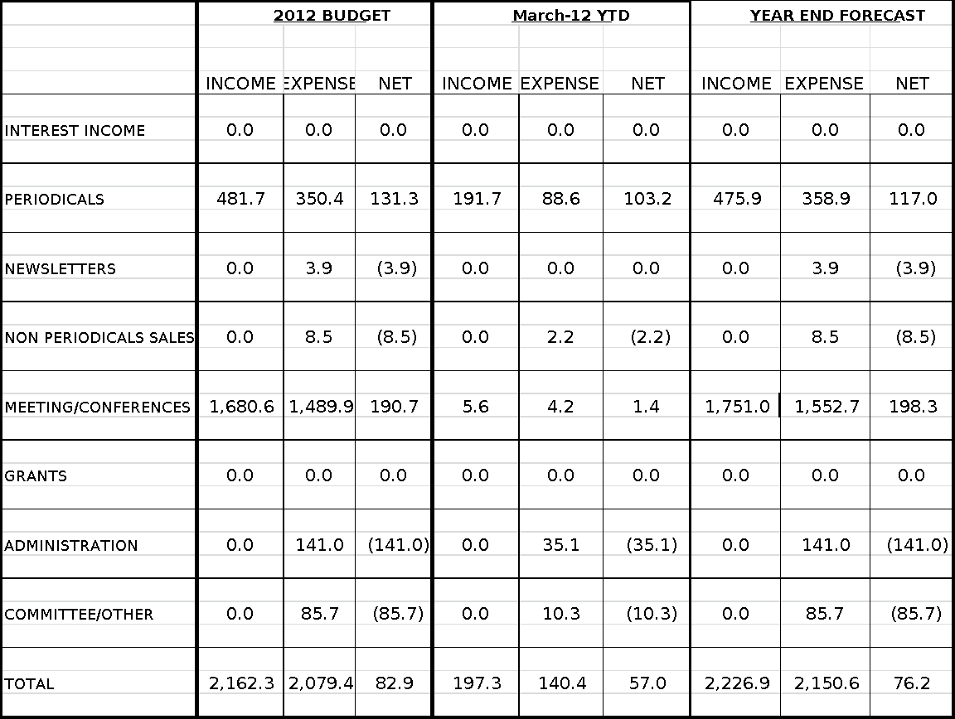
Budget 2012

Slide 5
Budget 2012

Slide 6
2012 Committee Allocations
Technical Committee | Budget 2011
Events | $7,000
Education (Young Faculty, EDA career) | $8,000
Distinguished lecturers | $13,000
Contests | $7,000
Misc. | $500
Local chapter init. | $1,500
Total | $37,000
Pubs Expenses | Budget 2011
Pub. Admin fixed costs | $5,000
Pub. Admin var. costs | $11,300
ESL editorial office | $5,000
Newsletter distribution DATE | $1,000
Newsletter distribution DAC | $1,400
Newsletter distribution ICCAD | $1,000
Pubs meeting | $1,000
Newsletter graphics | $500
TCAD editorial office and extra page charges | $30,000
Total | $56,200
Committee Expenses | Budget 2011
Administrator | $16,000
Adcom | $7,000
President | $6,000
Executive committee | $10,000
Other committee | $3,000
Awards | $14,000
Misc. | $5,000
Promotion & Publicity | $18,000
Total | $79,000

Slide 7
Budget 2013 Plan
Budget input cycle has begun
Guideline 4% revenue growth; 1% expense growth
Changes
Planning higher travel expenses (DAC in Austin 2013)
Publicity beyond press releases
Expenditure for Web/IT revamp
Reserve for sponsored conferences (besides DAC, ICCAD and DATE)
Increase TCAD page budget from 2020 to 2100
First pass looks similar to 2012
Finalize post-DAC

Slide 8
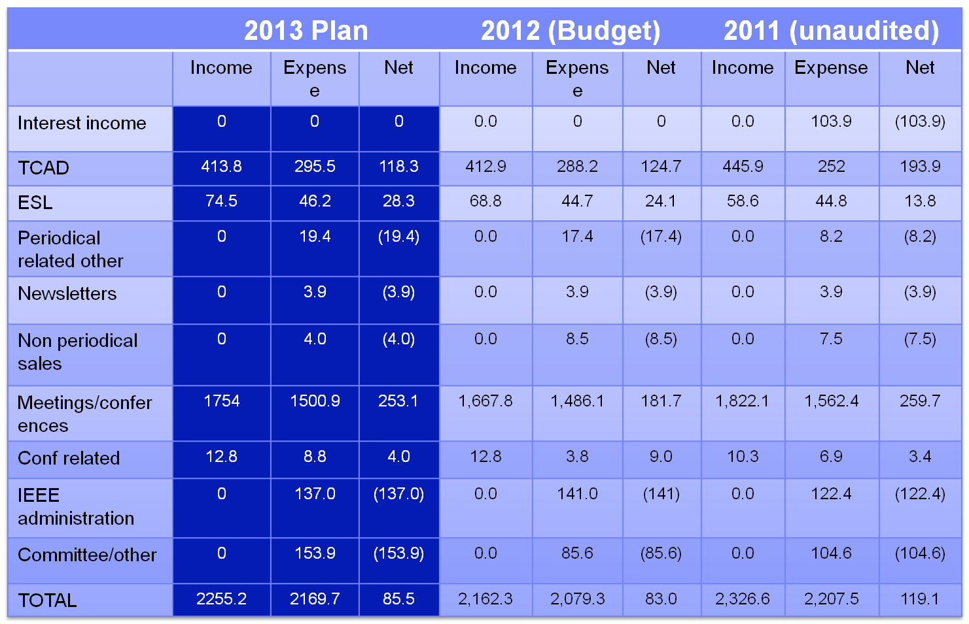
2013 Plan

Slide 9
Summary
Good financial results in 2011
Healthy reserves at $955.1K
Great progress to $1M reserve goal
No changes to Plan 2012; Adjustments will be made post DAC.
Preliminary Plan 2013 developed
Target 4% revenue increase; 1% expense increase
Details on some expenditures to be developed further

Slide 10
Backup

Slide 11
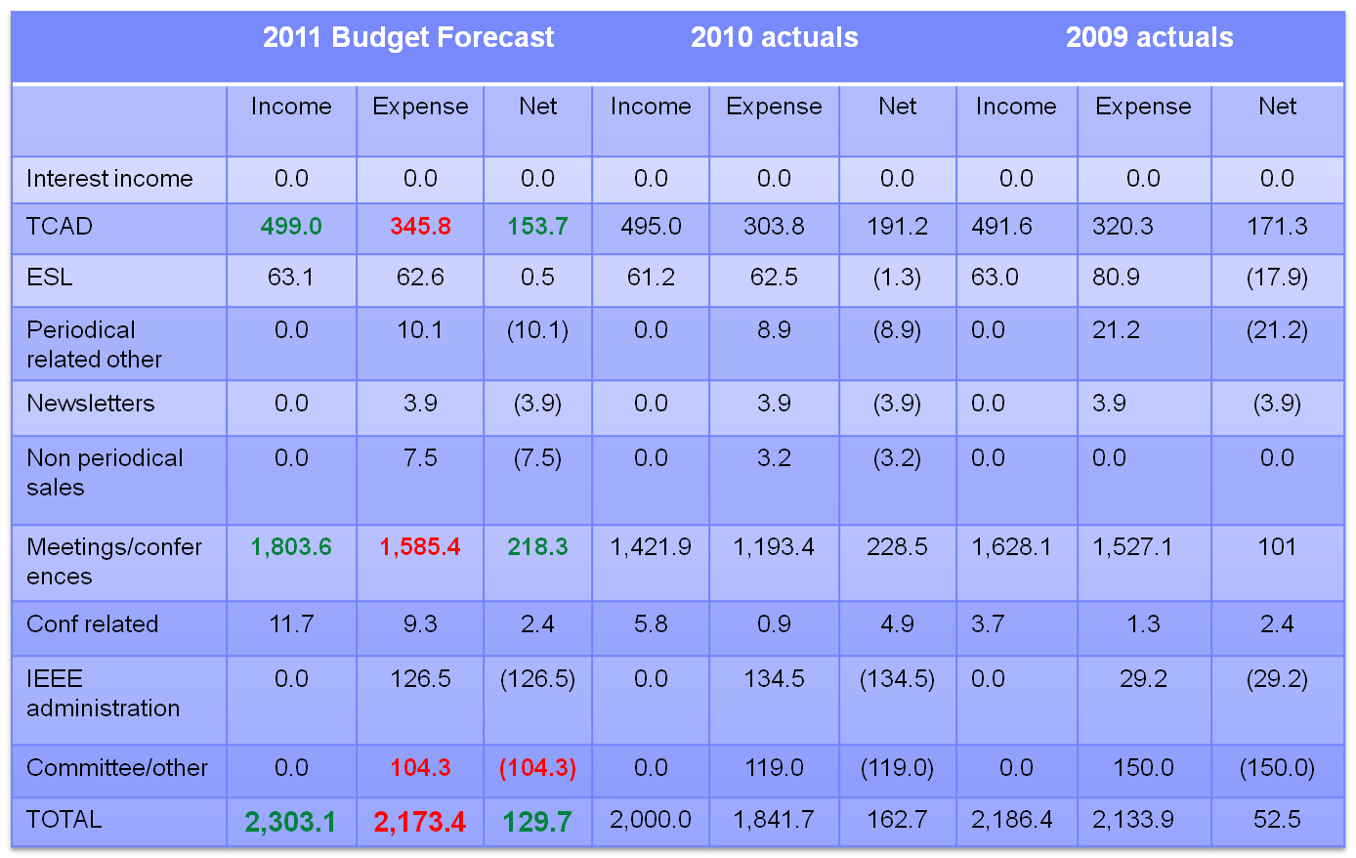
2011 Year End Forecast (presented Nov 2011)

Slide 12
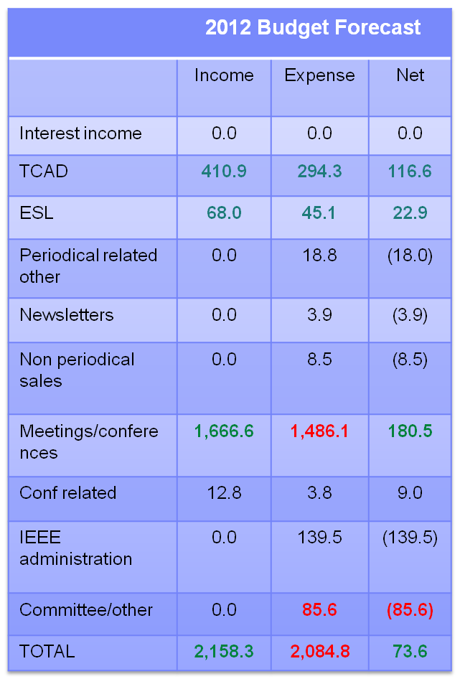
Budget 2012 – current plan vs forecast

