Slide 1
Publicity
Rajesh Gupta

Slide 2
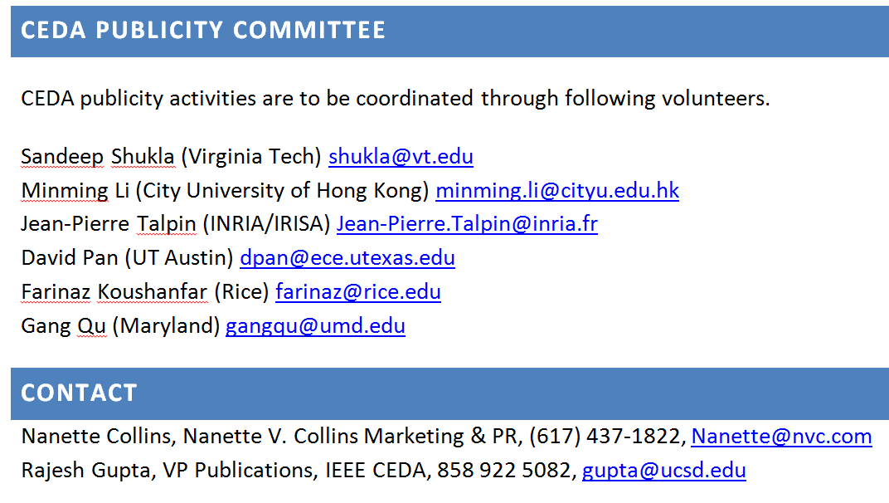
IEEE CEDA Publicity

Slide 3
Team Organized Across Goals
Goal A: Identity Creation and Imagement ($500)
(a) what is CEDA? (b) what does CEDA stand on hot topics of the day (e.g., Open Acess) (c) who are the public face of CEDA and what do they represent?
Nannette, Minming, Centrella
Goal B: Financing and Monetization ($1000)
ensure a sustainable financing model for CEDA publicity as well as maximization of revenue generating opportunities possible through publicity support.
Farinaz, Gupta, Shukla
Goal C: Solicit Community Participation ($1000)
maximize the extent (breadth and geographic diversity) of the communities associated with our products.
Talpin, Nannette, Minming
Goal D: Build CEDA Infrastructure ($500)
Content, Community (Mailing lists)
Talpin, Shukla, Qu

Slide 4
Issues
Press releases
Website
Soliciting advertising
Soliciting users

Slide 5
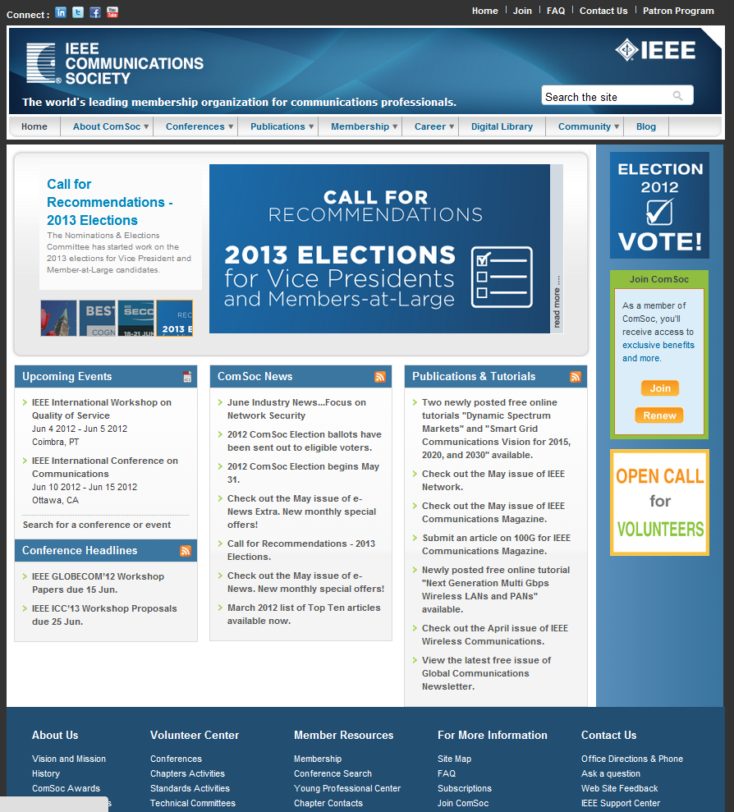
Social networks
Society calls
Monetization
Bottom panel ad, usually hidden

Slide 6
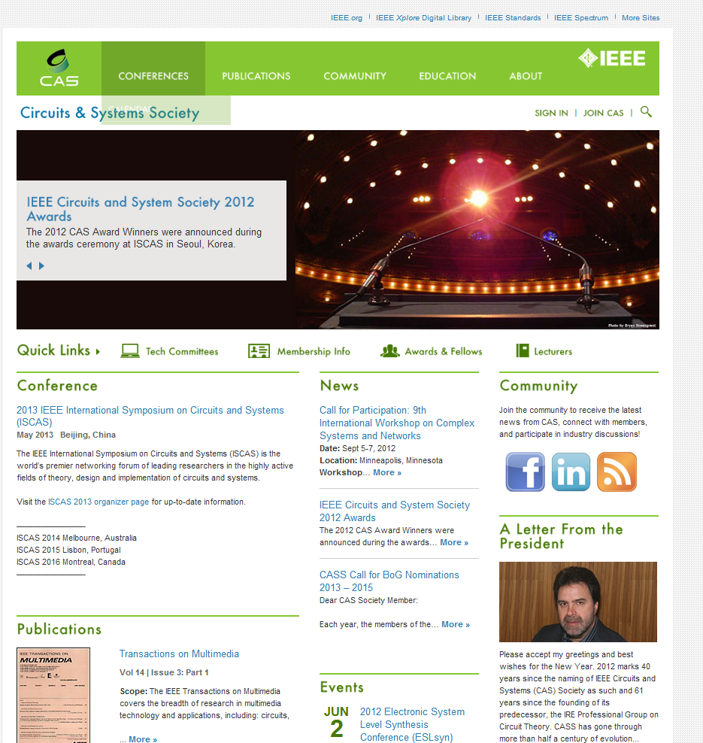
Scrolling Panel

Slide 7
Society Websites
What do visitors look for? Deal or Need
What can <society> do for me?
Awards and nominations, Standard document
Networking: for consulting, job, award nominations
People and BOF groups
What societies like to advertise? Narcissism
Who they are? Publications, conferences, councils, president’s letter, Awards…
Meet in the middle: Network, Discount, Taste

Slide 8
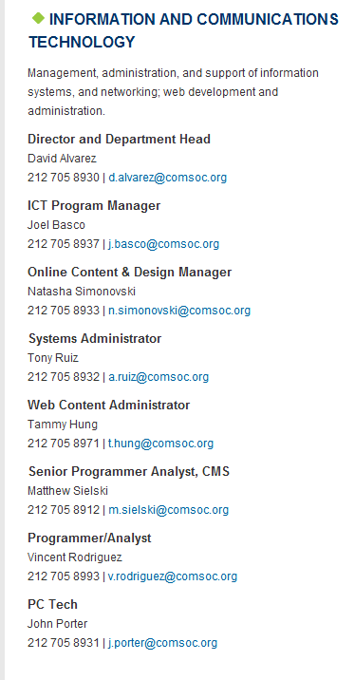
Costs Vary
What my guy thinks: $5K
Re: the C-EDA website: Yes, it's very old-fashioned. It does not have a massive amount of content, so it would not take very long to port everything to a new website. Looking at the other ones you like, I would say that the most contemporary design style is the one for IEEE-CAS. Designing a new site would probably take a week of our designer/webmaster's time (i.e. 40 hours at $67/hr for internal clients, if it goes through you, 40% more for external clients). I'm not sure if we'd need to write new content for the site, but probably not necessary at first. I suspect that we'll need to use a completely new content management system, but I'd recommend an open-source solution, and something that would be easy to learn for whoever will be responsible for uploading content. There are a number of bells and whistles that could provide new interactive capabilities to the site, e.g., something like our Research Intelligence portal, which we've adapted for use by the campus Global Health Initiative to showcase who is doing what across the world.

Slide 9
Obvious Question
What is the Goal (in redesigning the website)?
Network:
Lay the foundation for Council to Society transition by attracting people to form groups
Discount:
Promote CEDA products
Taste:
Internal communications: content management.

Slide 10
Going Forward
Solicit your inputs on Website
What are we missing?
Recommendation on how big we want go?
Solicit advertizers for D&T, work out a plan for reaching advertizers for special issues.

