Slide 1
Rajesh K. Gupta
IEEE CEDA Publicity Update

Slide 2
Issues
Press releases – situation normal
Website – update today
Soliciting advertising – LinkedIn DirectAD available now to Publications
Soliciting users – No action

Slide 3
Website Redesign Project Goals
Network:
Lay the foundation for Council to Society transition by attracting people to form groups
Discount:
Promote CEDA products
Taste:
Internal communications: content management

Slide 4
Actions and Progress
Put together a comprehensive RFP
Approved and released August 13, 2012, Due Oct 26, 2012
Closing date: November 15, 2012
Scope of Work
Design and implement CEDA Website
Implement a supporting Content Management System (CMS) on Linux, MySQL, PHP stack as supported by IEEE
IEEE Wordpress preference, Joomla, Drupal considered
Interface IEEE Single Sign On with non-IEEE augmentation
Interface IEEE Conference Database
Coordinate and respond to platform testing by CEDA volunteers with usability testing report
Manage transition with minimal downtime
Provide sufficient documentation

Slide 5
Setting the Expectations
The responders ranged from $50K-$600K
Our own expectation driven by CASS experience in 2010
Where responders ranged from $4K to $88K with selected team somewhere in the middle

Slide 6
Responses
6 potentials, interviews with the team
Two final proposals submitted
Electric Vine (Drupal on LAMP)
D2 (Joomla! On LAMP)
Despite limitations, initial costs outlined in $45K-55K range
Detailed comparison sheet put together by Kristin Steen

Slide 7
Proposal #1
Proposal
Drupal 7 on LAMP (Linux, MySQL, PHP)
Dynamic webpages with solicited inputs
Restricted areas
Custom code for 301 redirects
Testing on Firefox, Chrome, Safari, IE x MAC, PC
No mobile, iPAD support by elimination of Flash
Maintenance to be negotiated separately
Project start: 11/18 → complete design 12/28 → Beta 2/1 → Phase I launch 2/26 → Phase II launch 3/26
Examples: www.trycomputing.org , www.gasparinutrition.com, www.directworks.org, www.rethinkautism.com, opentravel.org

Slide 8
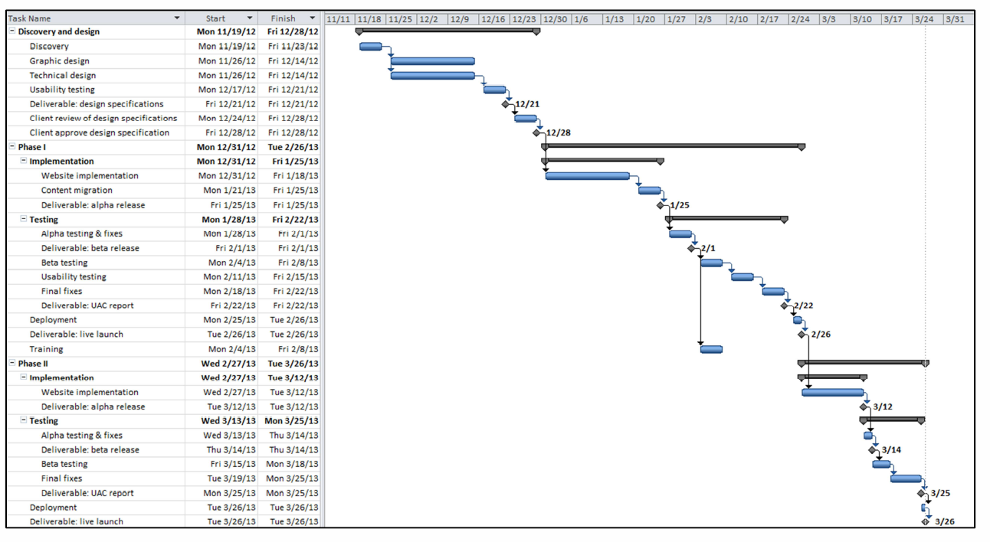
#1 Timeline

Slide 9
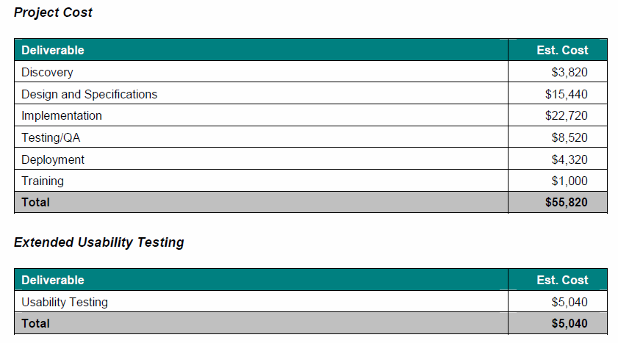
#1 Cost
Payment in four quarters.

Slide 10
Proposal #2
Joomla! On LAMP to host with IEEE EWH servers
Experience with IEEE SSO
Examples:
http://embs.org/
http://magazine.ieee-pes.org/
http://lifesciences.ieee.org/
http://www.medimediahealth.com/
http://www.synapseris.com
http://3dimaging.fujimed.com

Slide 11
#2 Costs
Basic Project Discovery, Design (2 rounds of revisions), 2 concepts, development and QA testing, deployment | $47,000
Usability testing | $10,000
Nominations tool | $16,000
Ongoing support | $5,000

Slide 12
Where does that leave us?
Option 1:
Do nothing, Status Quo
Option 2:
Serve as own general contractor
$100/hour developer available at Calit2
Estimated project: 12 weeks at 40% time, $20K
Option 3:
Bargain either of the two proposals down to within $40K

Slide 13
Going Forward -- Updated
Solicit your inputs on Website
What are we missing?
Recommendation on how big we want go?
Your recommendation/suggestion?
Solicit advertisers for D&T, work out a plan for reaching advertisers for special issues.
Where are we on D&T advertising?

