Slide 1
Dwight Hill Chung-Yang (Ric) Huang Rasit Topaloglu L. Miguel Silveira
Technical Activities
Ricardo Reis Marinos Vouvakis Jinjun Xiong Zhuo Li Joel Phillips (Chair)

Slide 2
Ongoing Activities
CEDA sponsored “Distinguished Lectures”
DAC 2012: Mark Horowitz on “Digital Analog Design”
ICCAD: Alberto Sangiovanni-Vincetelli special lecture for ICCAD 30th anniversary
DATE 2013: Would like to do lecture+lunch format, doesn’t work with program
DAC Young Faculty Workshop
Co-sponsored again with ACM/SigDA, NSF, …
Strong registration (48+ travel awards, up to 40 additional expressed interest)

Slide 3
Conference Related Activities
Contests
DAC 2012: small financial support
ICCAD 2012: technical co-sponsorship
Discussions with ACM on further coordination, reporting, results archive
“Conference cross-fertilization” initiative
Idea: organize series of special sessions between MTT/APS and EDA conferences
ICCAD special session: “The Next Wave: Top Challenges in Electromagnetic-Based Design Automation” organized by Marinos
Look at attendance, decide if valuable

Slide 4
Works in Progress
CAD “Grand Challenges” Website
Jinjun leading set-up with help of Prof. Yiyu Shi, Missouri University of Science & Technology
1st attempt done in spring of 2012
Registered domain name: http://www.edapedia.org
Created some sample content for illustration purpose
Some feedback from the TA committee
Not very much content, hard to get, low incentivation. Encouraging direct solicitation of domain experts

Slide 5
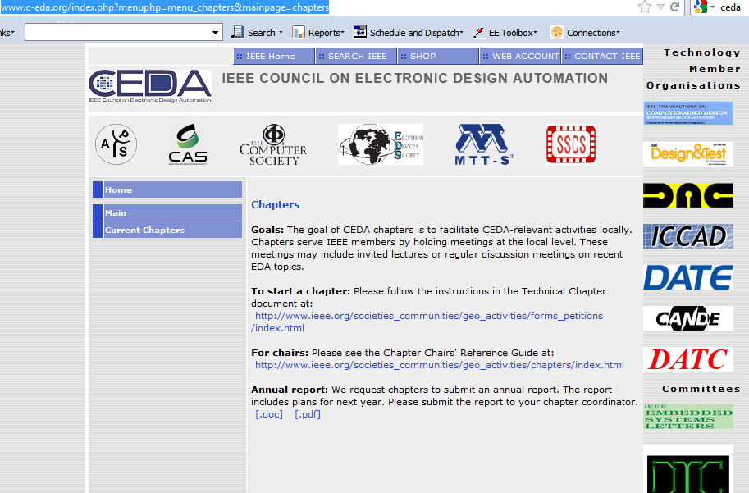
Chapter Activities
Benelux chapter, Ed Deprettere
Brazil chapter, Ricardo Reis,
Central Texas,(new) Zhuo Li
China chapter, (new) Lingli Wang
Taiwan chapter, Chung-Yang (Ric) Huang
Tunisia chapter, Mourad Fakhfakh (student chapter added this year)

Slide 6
Model Chapter: Central Texas (Zhuo Li)
Technical Meetings
Oct 24, IEEE CTS CTCN / CAS / SSC / CEDA / WIE / LM Joint Meeting, Gary Daniels, GIT Satellite Communications, “Legendary Engineering Success Stories”
Oct 9, 2012, Prof. Susmita Sur-Kolay, Indian Statistical Institute, Kolkata, India, “Challenges in Synthesizing Quantum Computers”
Oct 3, 2012, IEEE CTS CAS/SSC/CEDA Joint Meeting with UT ECE Department, Ruchir Puri, IBM, “Opportunities and Challenges for High Performance Microprocessor Designs and Design Automation”
Sep 24, 2012, Charles Lefurgy, IBM, “Active Management of Timing Guardband to Save Energy in POWER7”
Aug 30, 2012, Prof. Boris Murmann, Stanford University, IEEE SSCS Distinguished Lecture: “Energy Limits in Current A/D Converter Architectures”
Aug 20, 2012, Joshua Friedrich, IBM, “POWER Processor Design and Methodology Direction,”, Bill Read, Freescale, “Overview of Accellera Systems Initiative and IEEE Design Technology Committee”
DAC-related
2012 “review” (Sani, Zhuo) and 2013 publicity
Joint Distinguished Lecture Sponsorship
1st: Prof. Boris Murmann, Stanford University, IEEE SSCS Distinguished Lecture: “Energy Limits in Current A/D Converter

Slide 7
TAC in 2013
Distinguished Lectures program
Evaluate effectiveness of web videos (cost $6k/yr). Track closely post-ICCAD.
Should we expand to traveling lecturers?
Chapter interactions
Publicize Central Texas activities, ramp for DAC
Facilitate Distinguished Lectures from Societies
Subsidize/encourage local activities

Slide 8
Agenda, continued
Time | Item | Speaker
3:00 | Awards | David Yeh
3:15 | Publications | Sachin Sapatnekar
3:30 | Strategy | Bill Joyner
3:40 | Publicity | Rajesh Gupta
4:00 | DTC | Bill Read
4:15 | Technical Committees CANDE CS DATC MTT SSCS APS | Farinaz Koushanfar TBD Donatella Sciuto Michal Odyniec Bryan Ackland Marinos Vouvakis
 | Open Discussion | Donatella Sciuto
5:00 | Adjourn

