Slide 1
Activities Report BoG Meeting Yao-Wen Chang VP-Activities

Slide 2
TA Tasks
Chapter
Contest
Distinguished Lecture
Workshop

Slide 3
Chapters
Strategy | Conduct self organizing local outreach programs
Action | Create long-lasting chapters Hold annual review meeting at DAC Provide basic funding support
Goal | 10 active WW geo-diverse chapters by 2016 Group ownership with rotating chairs Chair networking for joint activities
Current status | 8 chapters: 3 are thriving (Central Texas, Japan, Taiwan) & 2 stable (Korea, Shanghai), 1 inactive (Brazil) & 2 lost (Benelux & Tunisia) CEDA EC approved chapters: HK, East PA In process: India, Mexico, Uruguay-Argentina, Abu Dhabi, Midwest (need more: Beijing, CA)?
Current issue | No effective means to handle inactive or lost chapters (e.g., the right to replace a chapter chair?)
Owner | Yao-Wen Chang

Slide 4
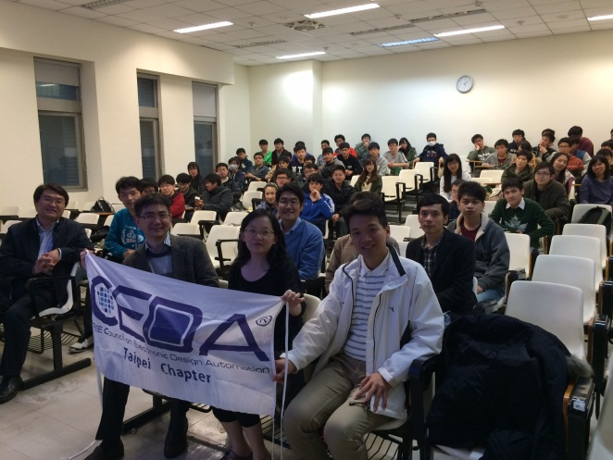
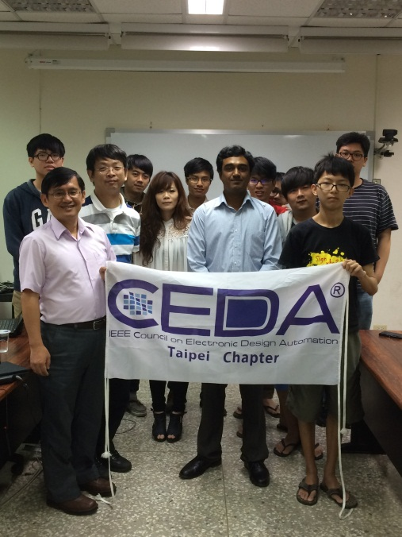
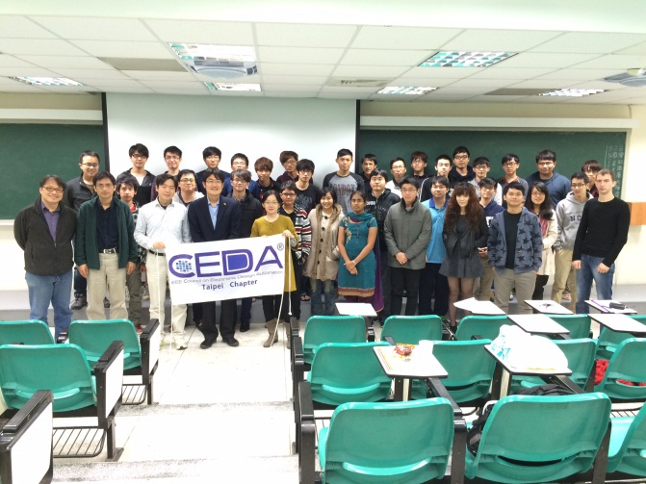
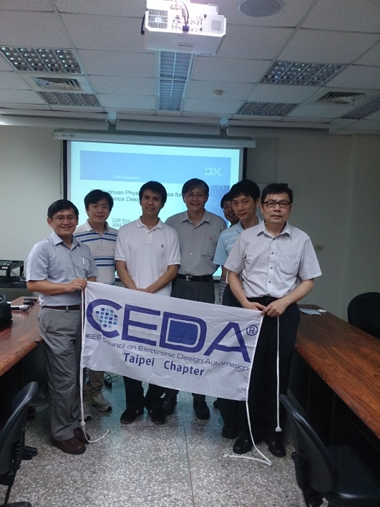
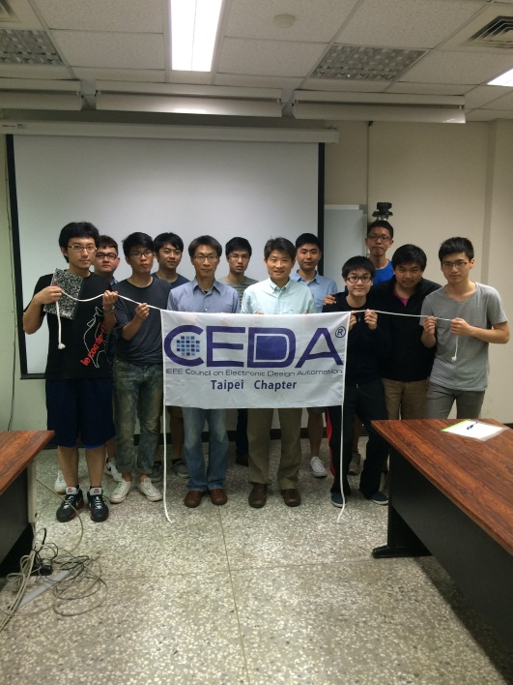
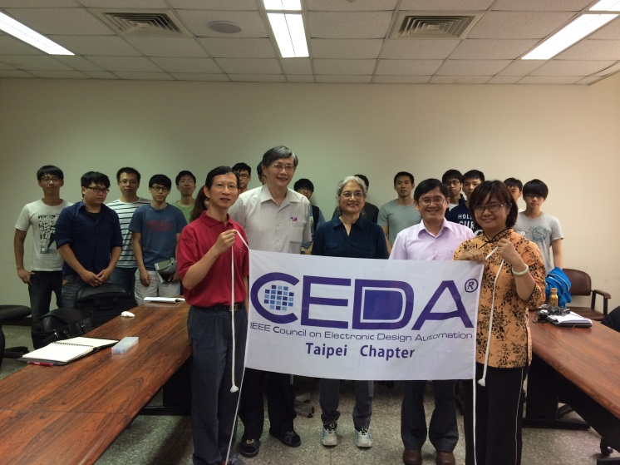
Taipei Chapter: Invited Talks/Meetings

Slide 5
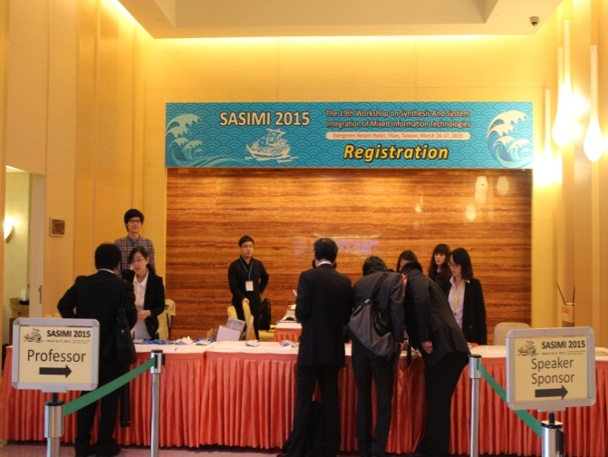
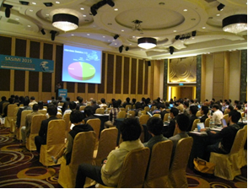
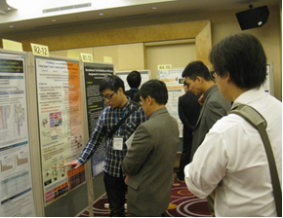
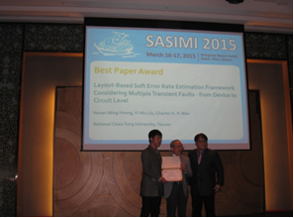
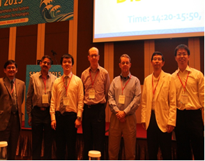
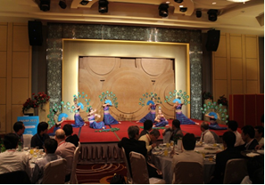
Taipei Chapter: Workshops

Slide 6
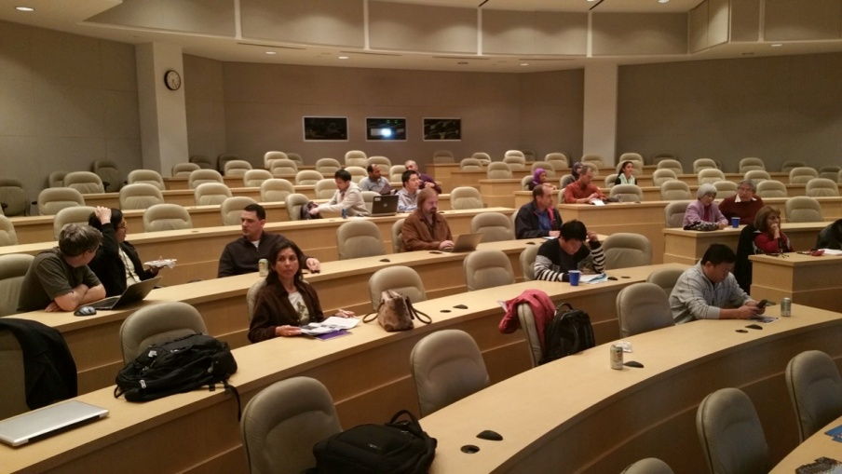
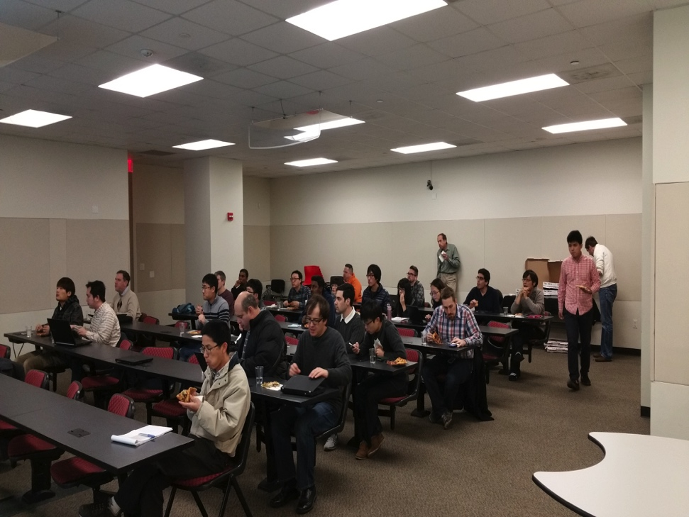
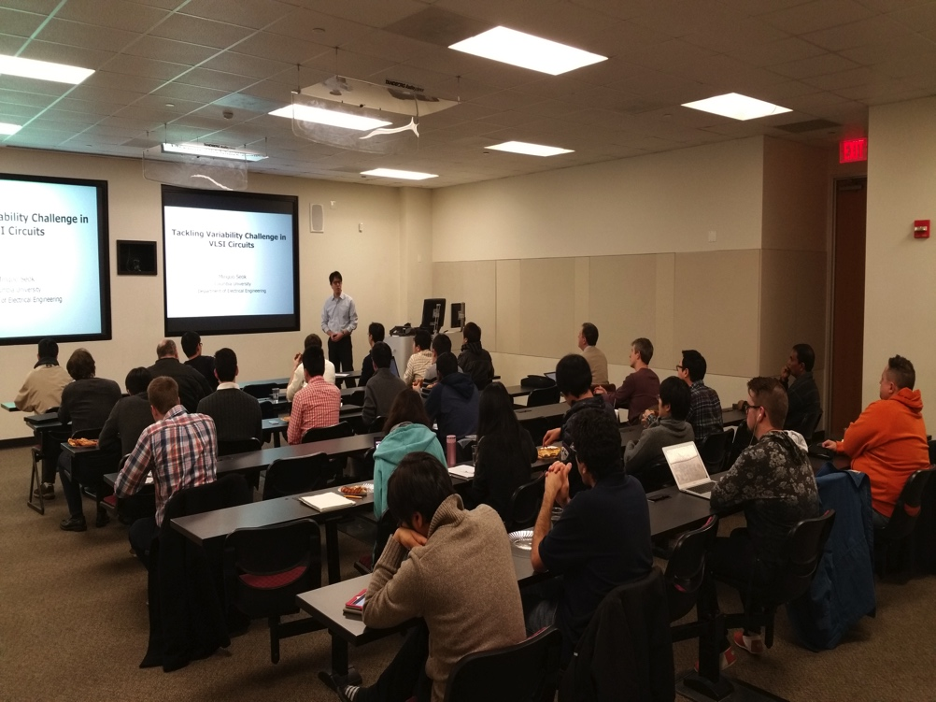
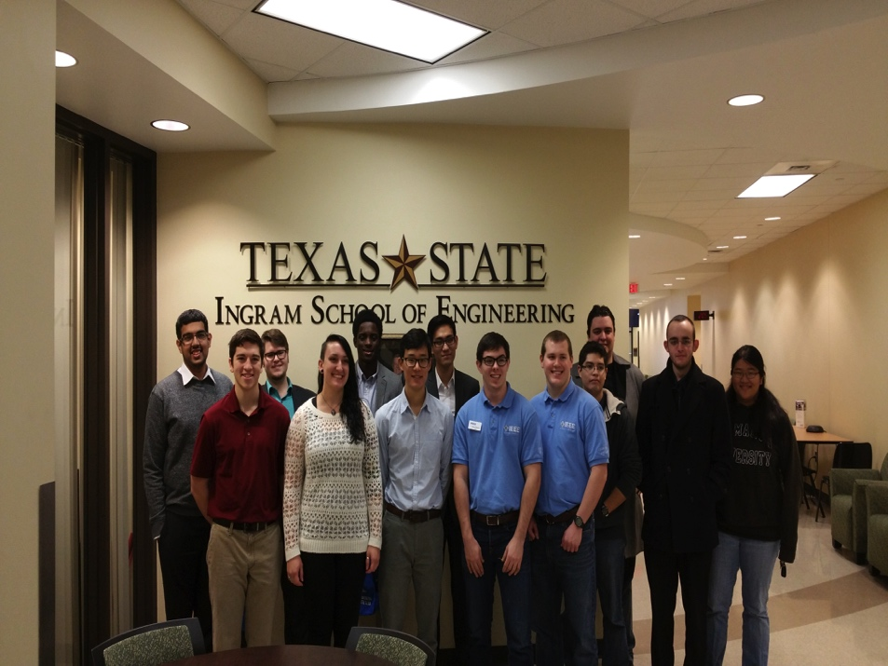
Central Texas Chapter Activities

Slide 7
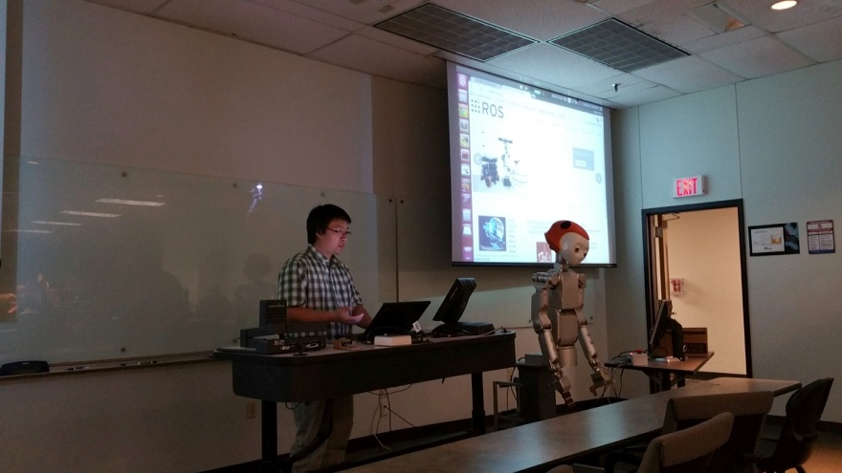
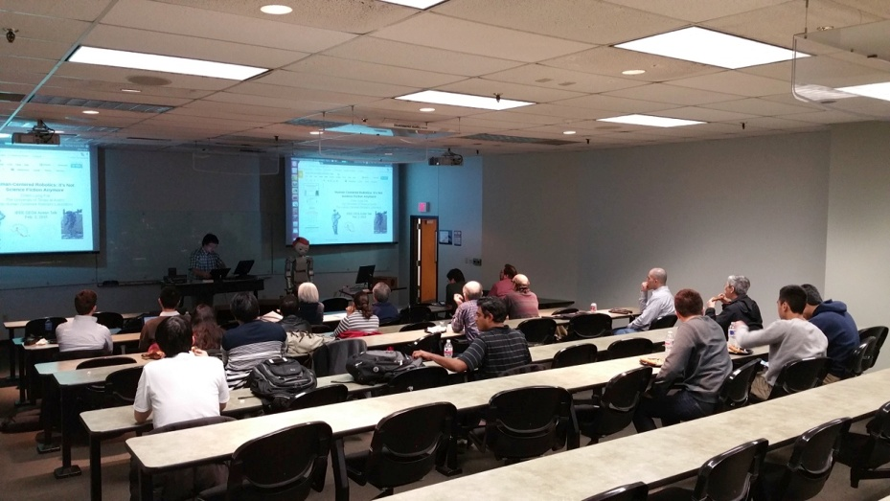
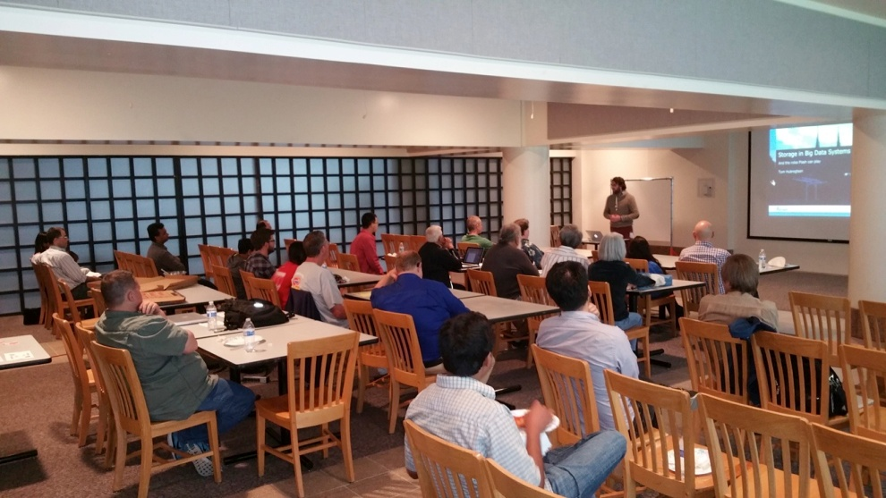
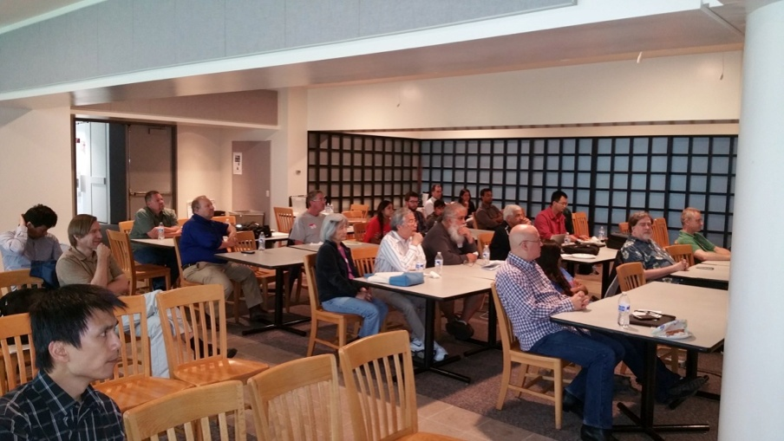
Central Texas Chapter Activities

Slide 8
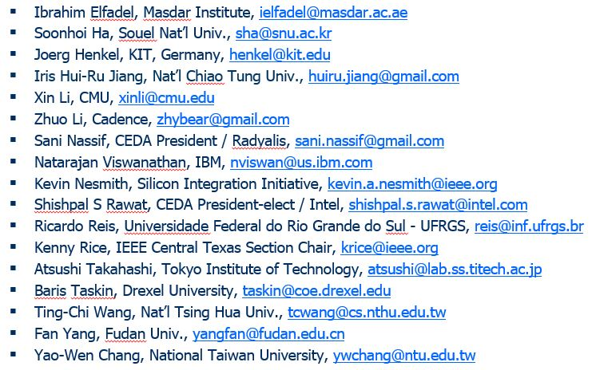
2015 Chapter/Contest/TAC Meeting
2nd Annual Chapter/Contest/TAC meeting at DAC’15
Time: 5:30--7:30pm, June 8th, 2015 (Monday)
Place: Room 230, Moscone Convention Center, SF

Slide 9
CAD Contest @ ICCAD
Strategy | Nurse EDA new blood & promote industry-academia research interactions
Action | Hold annual CAD Contest Release benchmarks
Goal | Increase geographical diversity (10+ regions) & participating teams (100+ teams) Work on broader topics (3+ areas) Consolidate EDA sister contests
Current status | Thriving with 112 teams in 2015 (56, 87, 93, 112) & highest ICCAD attendance & sufficient Taiwan MOE financial ($110K per year) Gained higher geographical diversity (12 regions, 60% from Taiwan now) Published 15+ DAC/ICCAD papers based on past contests
Current issue | Taiwan MOE might discontinue the financial support starting next year
Owner | Yao-Wen Chang
Notes:
The largest worldwide EDA research and development contest
Goal: Boost EDA research in advanced real-world problems; Foster industry-academia collaboration

Slide 10
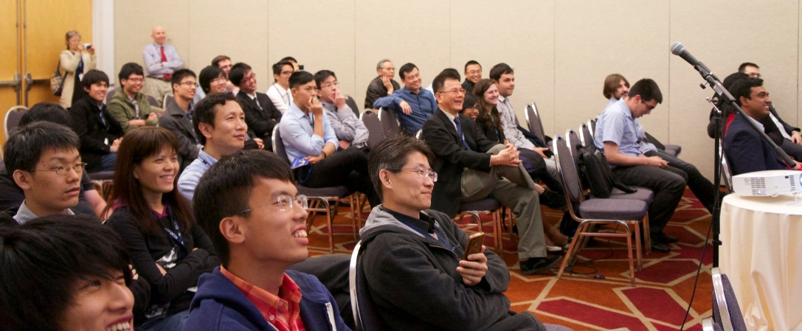
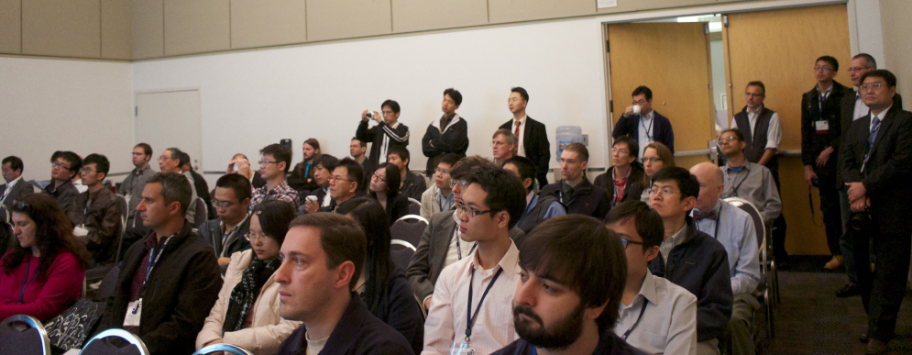
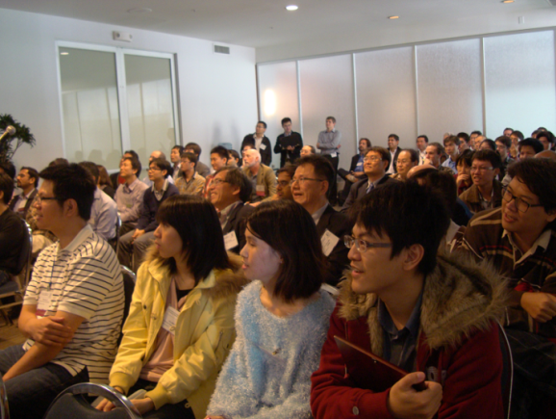
ICCAD Contest Sessions
Always attract a large audience!
Highest attendance; above all regular sessions at ICCAD 2012, 2013 and 2014
2014
2013
2012

Slide 11
CAD Contests Boost Research
2012 CAD Contest Citations
DAC: 7, ICCAD: 1, ISPD: 1, etc.
Total: 20+
2013 CAD Contest Citations
DAC: 2, ICCAD: 2, etc.
Total: 9+
2014 CAD Contest Citations
DAC: 1, ISPD: 2, etc.
Total: 4+

Slide 12
Registration Statistics
2012 CAD Contest
56 teams from 7 regions
USA, Japan, Mainland
China, Hong Kong,
Korea, Italy and Taiwan
2013 CAD Contest
87 teams from 9 regions
USA, Canada, Brazil,
India, Russia, Japan,
Mainland China, Hong
Kong and Taiwan
2014 CAD Contest
93 teams from 9 regions
USA, Canada, Brazil,
Russian Federation,
India, Singapore,
Mainland China, Hong
Kong and Taiwan
2015 CAD Contest at ICCAD
112 teams from 12 regions/countries
Asia: Taiwan, Mainland China, Hong Kong, Korea, India, Iran
North America: USA
South America: Brazil
Europe: Belgium, Sweden, Russian Federation
Africa: Egypt

Slide 13
Contest Problems
Contributor(s) | Topic (area)
Stanford University, IBM Research and ESL-EPFL Mohamed M. Sabry, Arvind Sridhar and David Atienza | 3D-ICON: 3D Interlayer Cooling Optimized Network (System Level Design)
Cadence Jacky Chih-Jen Hsu | Large-Scale Equivalence Checking and Function Correction (Logic Synthesis & Verification)
IBM Systems Myung-Chul Kim and Jin Hu | Incremental Timing-Driven Placement (Physical Design)

Slide 14
Distinguished Lecture
Strategy | Engage community across societies/councils
Action | Talks at major conferences Distinguished Lectures to chapters and other organizations
Goal | Increase CEDA impacts Explore emerging EDA areas
Current status | Arrange two luncheon talks per year, one at DAC, and one at ICCAD; typically attract high attendance Change to audio recording w. slides for lower cost, post audio & slides at CEDA web site, enrich web contents, but download/click count?
Current issue | Follow the CASS, etc. format/rules to select 2-4 distinguished lecturers with geographical diversity, each with a 2-year term?? Committee: Ulf Schlichtmann (chair), Naehyuck Chang, and David Pan
Owner | Ulf Schlichtmann & Yao-Wen Chang

Slide 15
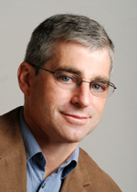
Distinguished Lecture at DAC
Title: Back to the Future Internet of Things
Speaker: Prof. David E. Culler, University of California, Berkeley
Time: 12:00--1:30pm, June 9th, 2015 (Tuesday)
Place: Room 220-226, Moscone Convention Center, SF
Two tables reserved for EC & BOG; first 100 attendees get plated luncheon

Slide 16
Workshops
Strategy | Nurse new events across societies/councils
Action | Provide necessary financial support
Goal | Nurse continuously running workshops/events for human resource cultivation
Current status | Scattered requests for support, discontinued events 2014: TCAD Workshop at ICCAD (excellent slate of speakers & attendance), ISPD contest financial support (EE Times citation, etc.), DATE support for new initiatives 2015: Summer program DUCA for high school students at Drexel Univ., DATE
Current Issue | Provide not only financial support, but also direct involvement
Owner | Yao-Wen Chang

