Slide 1
Conferences and Outreach Activities June 2015 BoG Meeting David Atienza Alonso VP-Conferences

Slide 2
Goals Last Year (for Conferences)
GOAL: To be the preferred organizer and sponsor for high value conferences, in EDA and embedded systems (ES)
Identify growing areas where EDA/ES can help
Add new conferences, while reinforcing current ones
Make CEDA visible world-wide
Outreach programme and links with activities in conferences of related societies
Streamline flow with IEEE and helping organizers
New fees discussions, clarify sponsoring process and provide support with IEEE

Slide 3
Complete List of CEDA Conferences
23 conferences so far, well established and healthy growth
Regularly receive 15-20 new conferences that request CEDA sponsorship
Conference | Conference
DAC | ESLsyn
NoCs | FDL
ISVLSI | GLS-VLSI
ESWEEK | IDT
ICCAD | LATW
DATE | SBCCI
ASP-DAC | SMACD
ETS | VLSI Design
FMCAD | MPSoC
IOLTS | NoCs
MEMOCODE | PATMOS
VLSI-SoC

Slide 4
Stable Trends in “Classic” Conferences
Consolidation with IEEE OUs (CASS and CS): TTTC and link to EDA/ES
Growing cooperation with ACM SIGDA and EDAA: co-sponsoring DATE PhD Forum, DAC UBooth and ISPD 2016 Competition under discussion
Conference | Characterization | CEDA %
DAC | Core EDA conference, oldest/largest. | 33.3%
Network-On-Chip Symposium | Important area where EDA is enabling actor. | 40%
VLSI-System-On-Chip | International conf. with significant EDA part | 25%
Embedded Systems Week | Several conferences on embedded systems | 25% (10%)
ICCAD | Core EDA conference, influential, very research focused. | 46.7% (66.7%)
DATE | Core EDA conference, largest in Europe. | 26%
ASP-DAC (2014 onwards) | Sister conference to DAC and DATE | 12%/25%
ETS (2014 onwards) | Eur. Testing conference with EDA component | 25%
ISPD (2016 onwards) | Physical design of VLSI systems | 20-30%

Slide 5
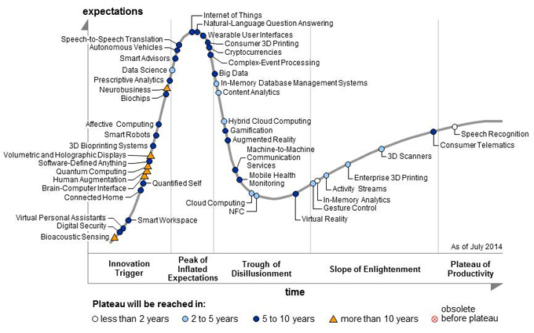
Effort to Grow in New Areas: Trends
Strong push in IEEE
Internet of Things (IoT)
Asia and US
Big Data and Cloud
US and Europe (security)
eHealth and ULP
EU, Africa and US
Cyberphysical
US and Asia
CEDA Engaged in two:
IEEE World Forum on IoT: 8.5% sponsorship (+7 other OUs)
Rebooting Computing: attended 2 summits, and organize 1st Low Power Image Recognition Challenge (LPIRC) at DAC’15
[Source: Gartner]
Notes:
List of WF-IoT:
Consumer Electronics Society 8.5 %
Communications Society 25 %
Computer Society 15.5 %
Council on Electronic Design Automation (CEDA) 8.5 %
Reliability Society 8.5 %
Sensor Council 8.5 %
Social Implications of Technology Society 8.5 %
Signal Processing Society 8.5 %
Vehicular Technology Society 8.5 %

Slide 6
New Conferences in Classic and Growing Areas in 2015
7 events, growing in different areas (IoT, test, Nano, etc.)
Very limited growth possible in classic areas (mostly TTTC and CASS)
Conference | Title
WF-IoT | World Forum on Internet of Things (8.5% -> 15.5%)
LASCAS | Latin American Symposium on Circuits and Systems (30%)
LATS | Latin American Test Symposium (30%)
ISED | International Symposium on Electronic System Design
SBCCI | Symposium on Integrated Circuits and Systems Design
EDPS | Electronic Design Process Symposium
iNIS | International Symposium on Nanoelectronic and Information Systems
Conclusion: Key to position CEDA in conferences of new areas
- Strengthen visibility on IoT, Nanotech and eHealth
- Big Data, others?

Slide 7
Make CEDA Visible World-Wide: Outreach Activities
Latin America focus (2014 and 2015): new conf. sponsorship and creating local chapters (Mexico and Uruguay-Argentina)
Colombia: in 2014 two events covered in one trip
CWCAS (Bogota) – focus on MPSoC (~120 attendees)
IBERSENSOR (Cali) – focus on wearable and IoT (~200)
Uruguay and Mexico in 2015:
LASCAS 2015 – focus on design of embedded systems (~180)
LATS 2015– focus on design and test (~150), tech sponsor now
Conclusions: Clear need for CEDA to promote itself
Creation of CEDA Distinguished Lecturer Programme (DLP)
CEDA Outreach Activities: Africa, Middle East and Asia (local chapter creation options to be discussed as well)
More activities in conferences of founding societies, carefully planned…
(Lunch Keynote at ISCAS’15, CEDA IoT competition at DATE 2015)

Slide 8
Policy Changes for Technically Sponsored Events (Jan 1st, 2016)
IEEE technically co-sponsored events
Fee of $1000 + $15 per paper sent to IEEE Xplore.
Before two options:
$50 fee charged to IEEE Ous (no charge for papers sent to Xplore)
$500 charged to IEEE OUs when no content submitted to Xplore
Three options given to handle new fee:
All fees will be covered by the society/council
All fees will be paid by the conference (check of addition done in budget when submitted to IEEE Conf. Application Website)
The society/council will be able to decide on a conference-by-conference basis how the fee will be charged.
Limited impact to CEDA ($3000-$5000) : option 3

Slide 9
Strategy Discussion and Requests
Grow and Expand visibility of CEDA
CEDA conf. growth in emerging topics (which continents?)
CEDA Asia and Africa Outreach programme (cost: $15K)
CEDA DLP submission/request on website (cost: $15-20k)
Extend support of CEDA to organizers
Full tracking of sponsoring process development within CEDA website (Final version by end of mid 2016, budget: $10K).
Explanation (video) for conference sponsoring process (to developed in 2015-2016, budget: $5K, metric: nr. of visits).
Setup admin support for joint sponsored events from end of 2015 (Budget estimate to be defined, discussing with events)
Notes:
What are the goals that you are driving to (or an ideal state)
What is the current state of affairs
How do you measure progress
What help do you need (no restrictions on what you can ask for)

Slide 10
CEDA/Parent Society Activities
International Symposium of Circuits and Systems (ISCAS)
Flagship conference of CASS
CEDA co-sponsored student registration and meals
CEDA contributed special keynote:
“Disruptive Engineering and Societal Impact” by Steve Eglash, Stanford University, using five examples:
Securing the Internet of Things
Enabling an agile electric grid
Exposing human trafficking on the web
Helping judges make smarter bail decisions
Eliminating kerosene lanterns in the developing world

