Slide 1
CANDE June 2015 BoG Meeting Farinaz Koushanfar Member Technology Organization Representative

Slide 2
DA Perspective’15 (CANDE)
Farinaz Koushanfar, Rice U
Presentation to CEDA BoG

Slide 3
Background
Our team is committed to establish a new/
clear/impactful focus for CANDE
Possible new strategies
Developed over a series of meetings and discussions from 2013-present
Looked into the visionary activities from other communities
As we move from EDA to DA, the objective is to unite the directions and visions of our community members

Slide 4
Our Team
Chairs: Andrew Kahng(UCSD) and Farinaz Koushanfar (Rice U)
Members: Deming Chen (UIUC), Priyank
Kalla (Utah), Steve Levitan (U Pitt), Subhasih Mitra (Stanford), Gi-Joon Nam (IBM), Gang Qu (UMD), David Pan (UT Austin), Miodrag Potkonjak (UCLA), Zhiru Zhang (Cornell)

Slide 5
Summary of Recent Activities
Study subgroups
Relationship with CASS
DA Perspective Challenge’15

Slide 6
Internal Study Subgroups
We have formed three study groups, each addressing one of the following questions:
What has been projected for design, so far? (Gang, Zhiru, Farinaz)
How well have these projections been made? (Andrew, David, Gi-Joon)
What would the future look like? (Deming, Priyank, Subhasish, Steve, Miodrag)
Suggestions on where/how to present?

Slide 7
CASS Relationship
Historically we have been asked to help with ISCAS
Gi-Joon has helped for ISCAS’15
Informed D. Skellern in Feb about closing CANDE TC
Need a summary of the internal review process which has resulted in the TC deciding on closure
The reasons for the closure
Details of the closure resolution and voting conducted in a manner allowed for in the CANDE TC Bylaws
The formal date of closure

Slide 8
DA Perspective Challenge 2015 @DAC
Solicited visionary proposals describing key long-term research problems in DA of emerging domains
Those that can benefit/evolve the EDA practices and methodologies developed over a half century
Received 30 proposals, selected about 1/3 for presentation at the competition
The competition will be held in #300 Moscone Center, on Mon June 8th, 2015

Slide 9
Selected Proposals
Bourbaki design automation
Thinking outside the silicon box
Finding structure in chaos: automation of clinical genomic pipeline
Design automation without borders: from EDA tools to DA toolboxes
Design automation for networks of autonomous vehicles
Design automation of things – future of EDA: electronic vehicle power and energy optimization

Slide 10
Selected Proposals (Cont’d)
Embrace the brain century: EDA challenges in neuromorphic computing
Design automation in energy systems
A call for trustworthy trusted hardware
Design automation and test challenges for flexible electronics
Simulation and design challenges for integrated silicon photonics for high speed optical data communication
Integrated system-package-chip co-design environment

Slide 11
More About the Event…
3 mins presentation + 1 min Q/A
3 Awards + 1 best student proposal award
Judges: Ray Juan, CK Cheng, Sani, Shishpal
Will get the input from the audience as well
Need your ideas to get as many people attend the event as possible!

Slide 12
DATC Status: OpenDesign Flow Database June 2015 BoG Meeting Gi-Joon Nam Member Technology Organization Representative

Slide 13
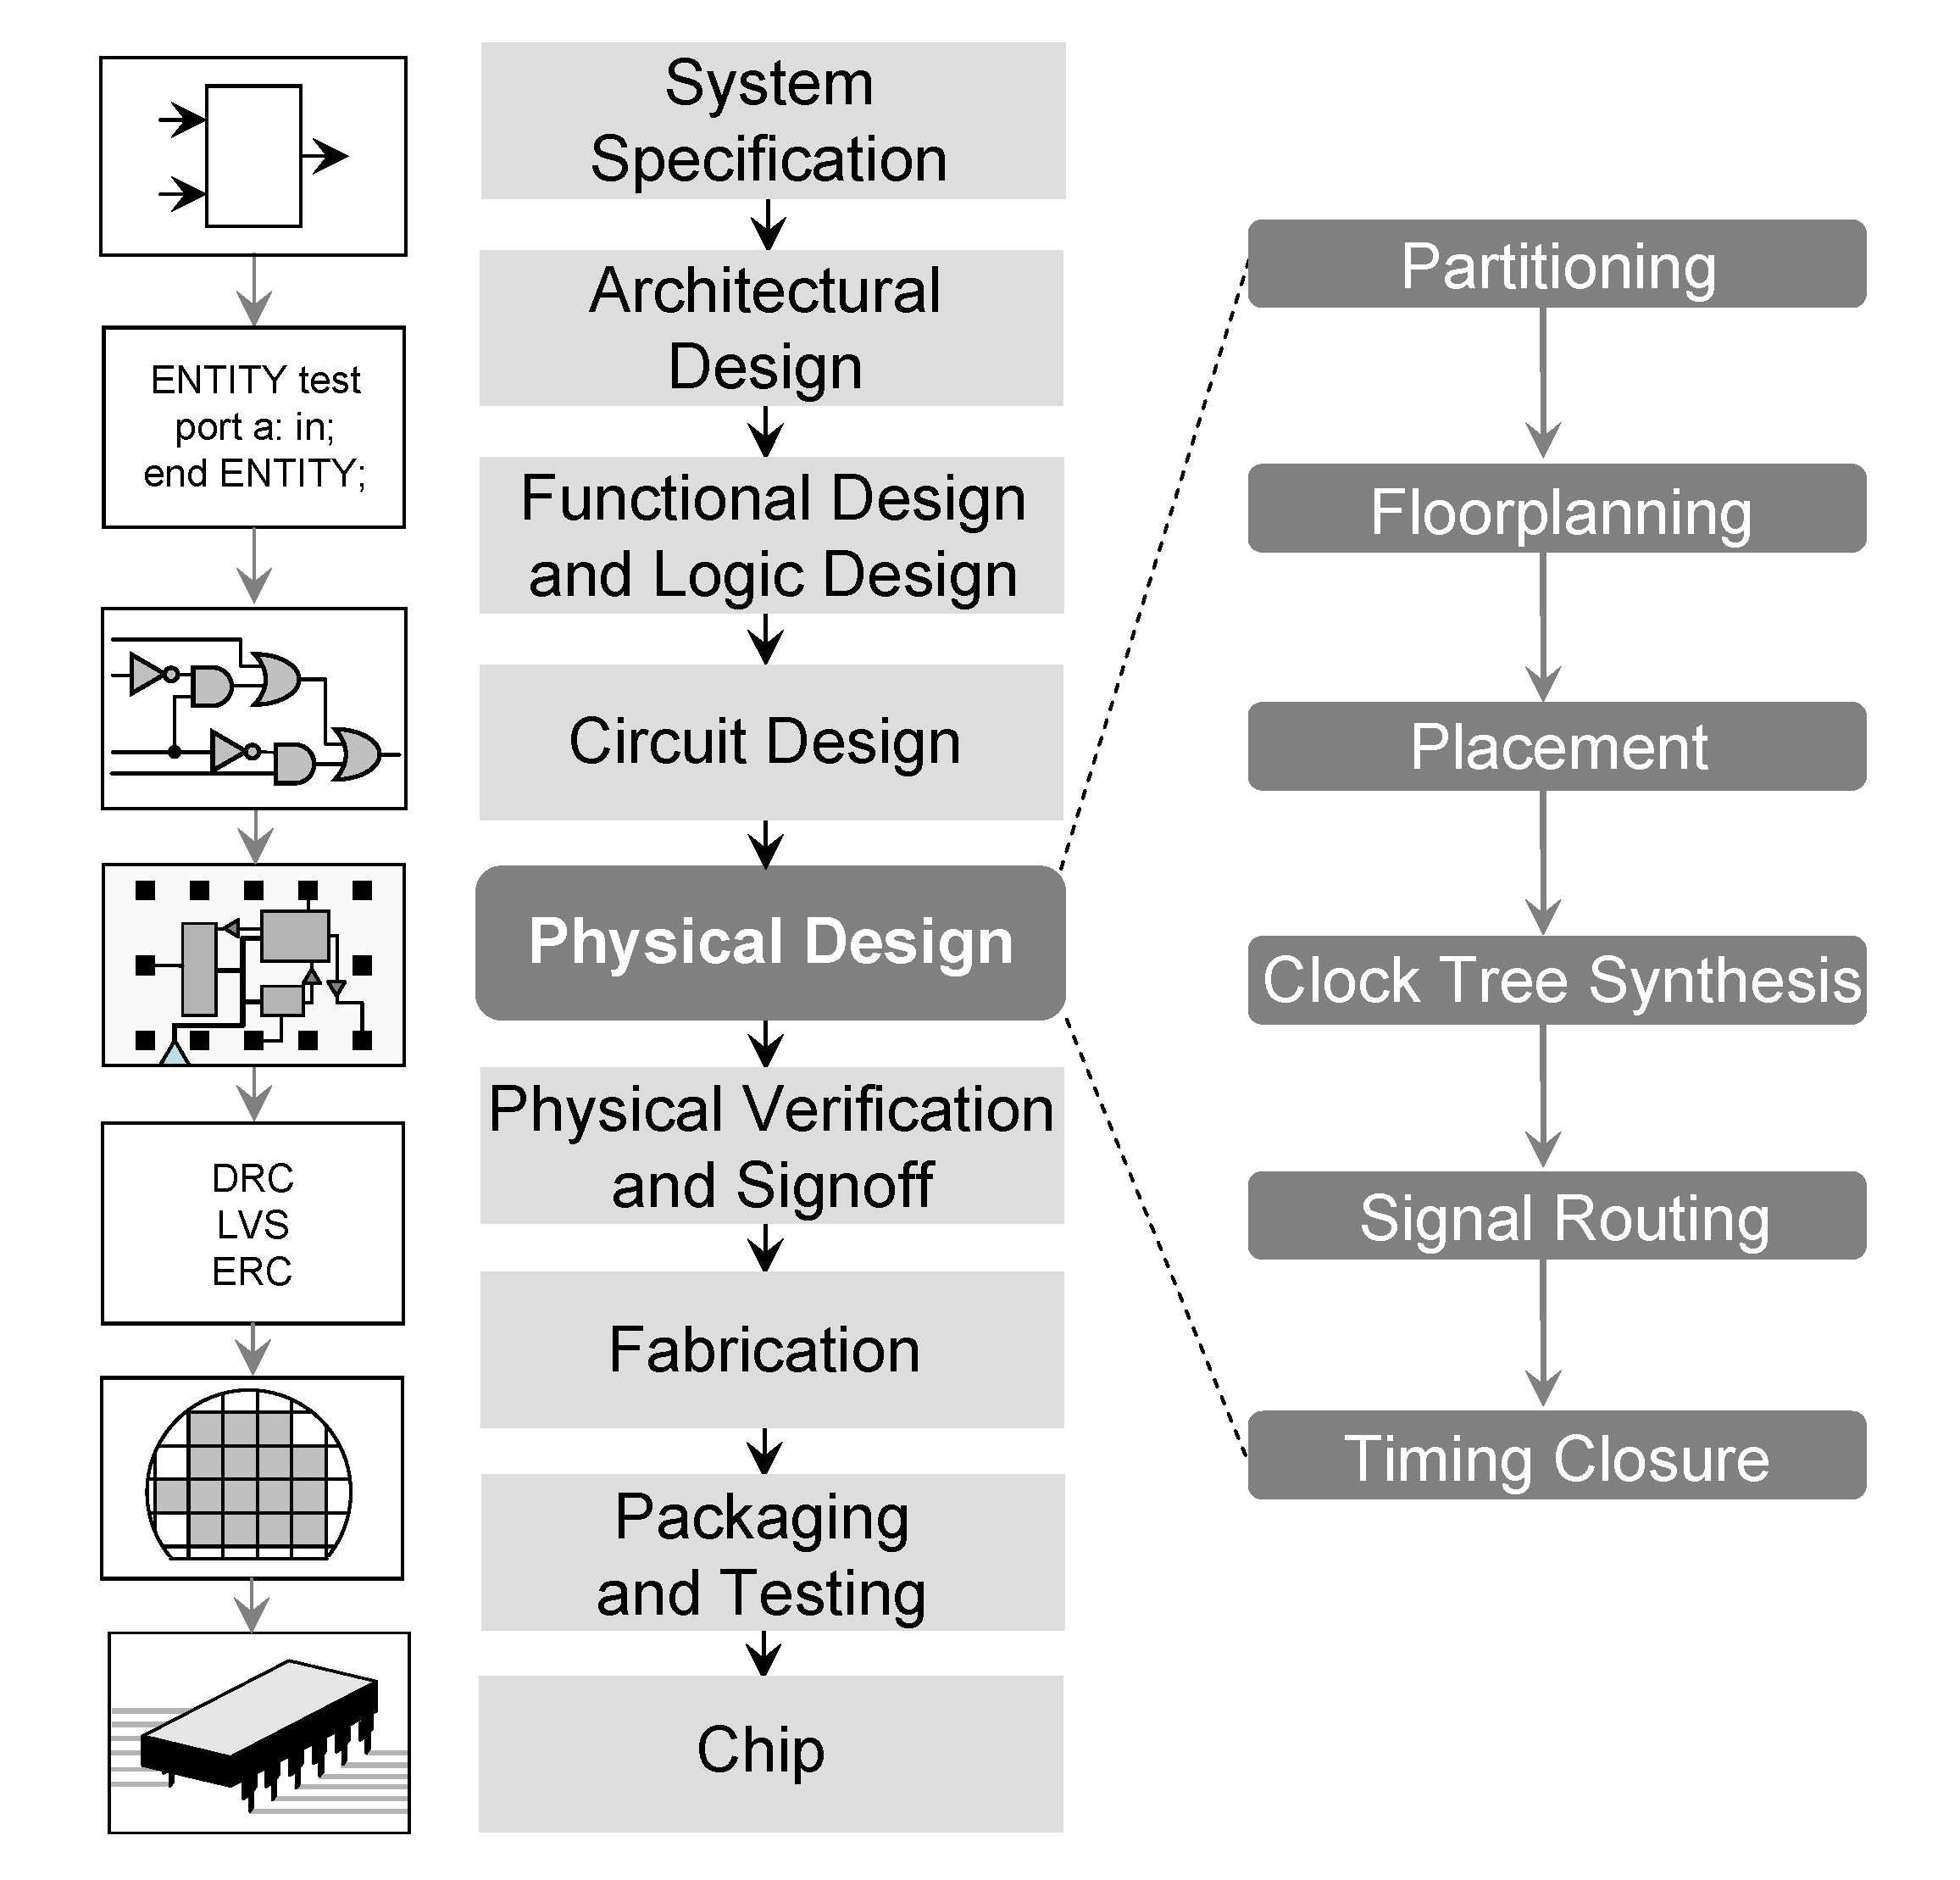
What We Have Been Building: OpenDesign Flow DB
Input Netlist
A
Partit ioner
B
Partit ioner
C
Partit ioner
D
Partit ioner
A
Floor plan
B
Floor plan
C
Floor plan
D
Floor plan
A
Place
B
Place
C
Place
D
Place
A
Clock
B
Clock
C
Clock
D
Clock
A
Route
B
Route
C
Route
D
Route
A
Time Opt
B
Time Opt
C
Time Opt
D
Time Opt
Place&Routed Output Netlist
Source: A. Kahng, J. Lienig, I. Markov, J. Hu, VLSI Physical Design: From Graph Partitioning To Timing Closure, Springer, 2011

Slide 14
Committee for OpenDesign Flow DB
First | Last | Institution | Role
Gi-Joon | Nam | IBM | Chair
Andrew | Kahng | UCSD | Co-Chair
Iris Hui-Ru | Jiang | NCTU | Physical Synthesis; ICCAD CAD Contest Chair
Ismail | Bustany | Mentor Graphics | Placement & Routing; ISPD Contest Chair
Victor | Kravets | IBM | Logic Synthesis
Cheng | Zhuo | Intel | Timing; ISPD’12/13 GateSizing organizer
• Small yet active participating group
• All confirmed

Slide 15
Design Steps | Sub-problem | Contest | Remarks | Coverage
Logic Synthesis | SAT solver | ICCAD’14 | Minimize (TAT)
 | Tech. Mapping | ICCAD’13 | Minimize (#gate)
Placement | Floorplanning | N/A | Mixed-size Placement available
 | Global Placement | ISPD’05/’06, ISPD’11/ DAC’12/ICCAD’12 | HPWL & Routability
 | Timing-driven Placement | ICCAD’14 | Timing Engine Integration
 | Detailed Placement | ICCAD’13
Clock Synthesis | Clock Network Synthesis | ISPD’09/’10 | Minimize Skew under PVT/Slew limit
PD Optimizations | Gate-Sizing | ISPD’12/’13 | Minimize (Power, TAT)
Routing | Global Routing | ISPD’07/ISPD’08 | Routability
 | Detailed Routing | N/A | ISPD’14 contest uses industry detailed routing
Timing | SSTA | TAU’13/’14 | Accuracy, TAT, Memory
Functional ECO | Min Logic Difference | ICCAD’12 | Logic equivalence
Physical Verification / DFM | Pattern matching for physical verification | ICCAD’12 | Maximize (accuracy, TAT)
 | Mask Optimiztion | ICCAD’13 | Minimize (var, TAT)
 | DFM flow | ICCAD’14 | Minimize (Perf deg, VAR, TAT, Size)
☒
☑
☑
☒
☒
☒
☒
☒

Slide 16
Execution Plan
Phase 1 (2015)
Build a PD reference flow for physical synthesis
• Reference flow release near ICCAD 2015
• Workshop at DAC 2016
Phase 2 (2016)
Build/Support contests in missing areas of PD design flow
• Timing model and analysis (STA, SSTA)
• Timing closure optimizations (buffering, cloning, logic optimization etc)
• Detailed Routing
Extend the concept to other areas
• Logic synthesis
• Architectural synthesis
• Physical Verification/DFM areas
Phase 3 (2017)
Cloudify the reference flow

Slide 17
DTC June 2015 BoG Meeting Arjun Rajagopal Member Technology Organization Representative

Slide 18
Outline
Distributed Design Flow : EDA 3.0
AMS Simulation and Verification Gaps
Long Term Roadmaps for Design Challenges

Slide 19
Distributed Design Flow: EDA 3.0
As recently defined by Leon Stok (IBM) ( Keynote:Tau 2015)
EDA1.0
Point tools on individual workstations
EDA 2.0
Integration of design tools on server farms
EDA 3.0
Integration of design flow on Distributed Clouds
EDA as a service with improved Data Analytics and Cost – Learn from Big Data: other data and graph parallel systems – Capitalize on the Changing nature of IT so we will be able to run this effectively.
Needs to work out infrastructure, database model , licensing and security
DTC strategy meeting at DAC to:
Define need and value proposition for companies for proposed EDA 3.0
Can we enroll academia to build a demo/infrastructure and following for this effort
Can we use SRC/Si2/Accellara to define work for this effort.?
Needs to be an open source model ?
Example of similar efforts are the cadence OA standard for inter-operabilty between tools/flows
Would be a multi-year project

Slide 20
AMS Verification and Simulation Gaps
DTC member companies sharing gaps on AMS verification:
Analog behavioral languages (e.g. Verilog-A) make top-level simulation seriously slow and often instable
(w)real modeling gives a too simplistic model abstraction which ignores continuous-time and conservative properties
Verilog-AMS offers insufficient features for system-level verification aspects (no interfaces, no user data types, etc.)
LRM is loosely defined and vendors implement constructs differently causing compatibility issues with IP’s across vendor tools
At the A/D-boundary we face multi-language issues due to language limitations and incompatibilities

Slide 21
Identifying Long Term Roadmaps for Design Challenges
ITRS-2.0 : Defines new direction for semiconductor roadmap with updated design drivers.
Lacks definition and ways to solve design productivity gaps( Tools/Flows)
How can DTC contribute ?
Drive ITRS activity using working groups drawn from within DTC member companies to:
Define different design drivers and unique challenges
Define workflows for reference designs
Engage with EDA Vendors with forward looking Roadmap from ITRS work
DTC members provide a prioritized list of focus area/challenges
Define design technology improvements and workflow requirements to drive designer productivity

Slide 22
Solid-State Circuits Society June 2015 BoG Meeting Bryan Ackland Member Society Representative

Slide 23
SSCS Highlights
Publications
Journal of Solid State Circuits:
Mean time to electronic publication: 148 days
Compare to conference ISSCC = 168 days
New Jnl. of Exploratory Solid State Computational Devices & Circuits
Open access fee $1350
Early Access papers of 1st issue available now on Xplore
ISSCC
3179 attendees in Feb. 2015, $290K surplus
Prior to conference – ISSCC online course:
11 10-18 min lectures by leaders in field
Over 7050 “students” registered
Students who complete get continuing education credits from IEEE
Strategy Discussion at Feb, 2014 AdCom
Where will our new members come in 10 years time?
CMOS circuit design mature technology
Most digital innovation at systems level (now accept digital systems papers)
Analog topics are increasingly specialized - require deep expert knowledge
Students today excited by higher level apps based on systems level black boxes
e.g. Raspberry Pi, Arduino

