Slide 1
Website/Outreach BoG Meeting José Ayala CEDA Webmaster

Slide 2
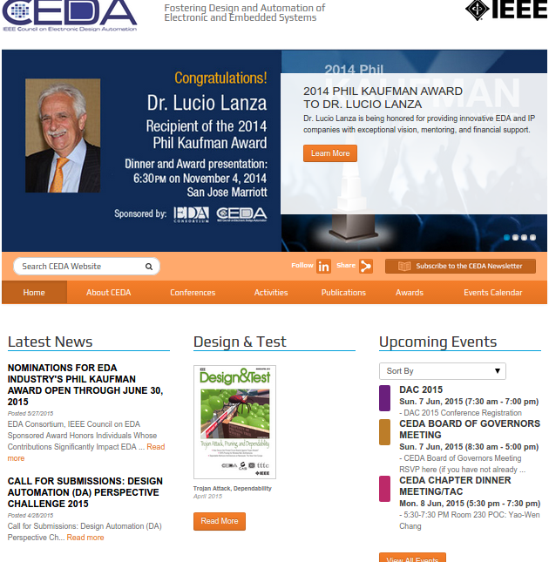
A quick view of the CEDA website

Slide 3
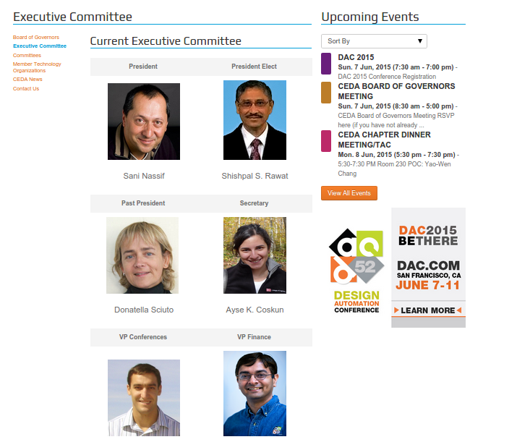
What can you find there?
Who we are
BoG
EC
Committees
Know the faces behind CEDA
Easy mechanism to make contact

Slide 4
What can you find there?
Updated news related to EDA
Calls for nominations
CFPs
Webinars
Keynotes
Events
Make the community aware of these events
Motivate the reader to get to know CEDA

Slide 5
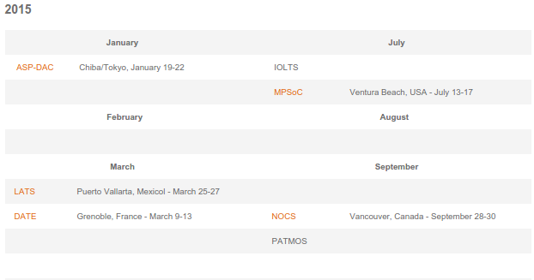
What can you find there?
Sponsored conferences
Calendar; Getting Started Manual; Keynotes, awards and sponsored talks
Provide help to the organizers of EDA conferences
Make visible the conferences where CEDA is involved
Reference site for authors on EDA

Slide 6
What can you find there?
Publications
TCAD
D&T
ESL
Newsletter
Information about the scope, call for papers, and archive of our journals
Easy access to Newsletter issues since 2006

Slide 7
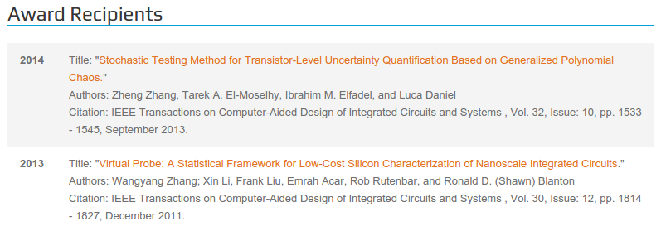
What can you find there?
Awards
Latest recipients; Call for nominations
Make visible the top achievements in the field and the most recognized professionals

Slide 8
CEDA Newsletter
Bi-monthly publication
It includes CFPs,
announcements, invited
columns, etc.
Open for contributions
(send me an email!)
Distributed by email to
CEDA list subscribers,
available on the website archive

Slide 9
Our communication goals
Keep the CEDA friends informed on the related events, updated with the latest information
Present CEDA activities and opportunities
Reach a broader scope of audience and awaken an interest in CEDA to young professionals

