Slide 1
Conferences Report
BoG Meeting
David Atienza Alonso
VP-Conferences

Slide 2

Stable Projections for CEDA in Conferences
Conferences projections look stable, but not easy growth coming
  IEEE projections match ours, but large conferences shrank in 2015
  Main income still DAC and many “small ones” can be second one
Year: 2015 | % Sponsor | Society Share of Conference Budget
Conference Name |  | Revenue | Expense | Net | Vs. Projected
2015 52nd ACM/EDAC/IEEE Design Automation Conference (DAC) | 33.3% | 1,085,487 | 1,037,031 | 48,456 | (50,533)
2015 Design, Automation & Test in Europe Conference & Exhibition (DATE 2015) | 27% | 164,101 | 162,015 | 2,086 | (5,055)
2015 Eight IEEE/ACM International Symposium on Networks-on-Chip (NoCS) | 40.0% | 28,400 | 22,000 | 6,400 | 1,050
2015 13th International Forum on Embedded MPSoC and Multicore (MPSoC) | 33.0% | 26,730 | 26,235 | 495 | --
2015 11th IEEE/ACM International Conference on Formal Methods and Models for Codesign (MEMOCODE) | 15.0% | 2,715 | 2,310 | 405 | --
2015 IEEE/IFIP 21st International Conference on VLSI and System-on-Chip (VLSI-SoC) | 25.0% | 22,600 | 21,375 | 1,225 | --
2015 9th Embedded Systems Week (ESWeek) | 10.0% | 21,800 | 20,300 | 1,500 | --
2015 IEEE Computer-Aided Network Design Workshop (CANDE) | 100.0% | 35,000 | 34,500 | 500 | --
2015 IEEE/ACM International Conference on Computer-Aided Design (ICCAD) | 66.7% | 95,735 | 93,867 | 1,868 | --
2015 IEEE/ACM Asia and South Pacific Design Automation Conference (ASP-DAC) | 25%/12.5% | 195,000 | 190,000 | 5,000 | --

Slide 3
Growth in Cooperation with IEEE Bodies and ACM
5 new conferences in 2015: Only accept very few conferences that can show added value, and new links with EDA/ES
  Sponsoring IEEE/ACM/EDAA PhD Forum at DATE since DATE 2016
  Growing in sponsorship to other conferences, main focus on TTTC
  Trying to reach other regions (Outreach activities in South America)
Conference | Characterization | CEDA %
IEEE Latin America Test Symposium (LATS 2015) | Main testing conference in South America with EDA component | 30%
IEEE European Test Symposium (ETS 2015) | Main European test conference with EDA component | 25%
IEEE Latin America Symposium on Circuits and Systems (LASCAS 2015) | Flagship conference of IEEE CASS in South America, Technical Sponsorship of CEDA for EDA and embedded systems components | Technical, 20-25% since 2016
21st International Mixed-Signal Testing Workshop (IMSTW 2015) | Targeted workshop on new technology on mixed-signal design and test in South and Eastern Europe | 100%
2015 IEEE Int. On-Line Testing Symp (IOLTS 2015) | Test Conference focused on on-line testing in Europe | 100%

Slide 4
CEDA Conf. Monitoring – status (Nov 2015)
No CEDA sponsored conferences pending to be closed older than nine month = NO DELAY FEES charged to CEDA (for 3 consecutive years already)
  Average closing time CEDA: 6.3 months (#3 / 52 in IEEE ranking)
  One conference (ESWeek 2015) pending proof of bank closure, NOCS 2015 pending final budget
  New additions from TTTC have been effective (ETS and IOLTS)
Good discussions with IEEE MCE to monitor conferences
  Monthly conference activity report (status of each conference)
  Accurate quarterly report of conferences charges by IEEE HQ.
  Still not accurate estimate of annual conference publication distribution (#docs added #downloads per year and conference)

Slide 5
Status on CEDA OutReach Activities
Latin America focus in 2014-15
  2015: Paraguay-Argentina2015: Paraguay-Argentina and Mexico
    LATS 2015– focus on design and test (~150), 30% financial sponsor since 2016
    LASCAS 2016 – focus on design of embedded systems (~180), tech. sponsor since 2016 (pending IEEE CASS approval)
Starting contacts in Africa – First visit in Nov. 2014
  Invited talk at Technical University of Marrakech
    Interest to create local chapter, but not enough IEEE Members
  Further discussions 2015: Link CASS chapter Morocco-Tunisia
    Invitation to CEDA to give keynote at 3rd IEEE Int. Renewable and Sustainable Energy Conference (IRSEC'15), Marrakech & Ouarzazate, Dec. 10-13, 2015
    Large potential to setup stable growth in 2016 (Outreach Programme)

Slide 6
Develop Strategic Vision for Conferences
GOAL: Continue to be the preferred organizer and sponsor for high value conferences, in EDA and ES
  Participating already in all main conferences in EDA/ES and make CEDA visible at growing areas related to both domains
        Financially sound, but need to keep growing
  Good relationships with conference organizers, dealing well with IEEE relations and adding value to the communit
        Develop further on-line sponsorship application support
  Make CEDA a key reference for young researchers, and professionals for promotion and development
        Grow in key topics: WF-IoT (10% until 2017, 20% after), RC
        Grow in other geographical areas: Africa, Asia, etc. (Outreach programme and CEDA Distinguished Lecturers)

Slide 7
Conferences summary
CEDA conferences have developed well in period 2011-2015.
  Good percentages in all major EDA/ES conferences.
  Recognized as highly selective for small-medium size events.
Proposed CEDA vision related to conferences.
  Need to increase IT support and services for organizers to keep reputation.
  Growth needed in other areas (IoT, etc.)
  Expand visibility to other regions (Outreach Prog. in Africa and Asia)
  Especially among Young Researchers to “join” IEEE CEDA
    IEEE Rebooting Computing competition at DAC.
    IEEE CEDA IoT competition at DATE.

Slide 8

Organizing Committee (Local)
General Chair Rui Paulo da Silva Martins (University of Macau)
Financial Chair Seng-Pan U (University of Macau)
TPC Vice Chair Pui In Mak (University of Macau)
Tutorial Chair Jun Yin (University of Macau)
Publication Chair Sai Weng Sin (University of Macau)
Local Arrangement Co-Chairs Chi-Seng Lam (University of Macau)
Fan Ng (University of Macau)
Design Contest Co-Chairs Man-Kay Law (University of Macau)
Yan Lu (University of Macau)
Publicity Chair Sio Hang Pun (University of Macau)
Industry Liaison and Web Publicity Co-Chairs
Man Chung Wong (University of Macau)
Yan Zhu (University of Macau)
Promotion Co-Chairs Mang I Vai (University of Macau)
Chio-In Ieong (University of Macau)
PCO (Professional Conference Organizer) Karen Neng (Moxlinx)
IT Supporting Un Pang Lei (University of Macau)
Chi Wai Tang (University of Macau)
Secretariat Yuen Ki Chan (University of Macau)
Pui Wan Sou (University of Macau)
Ronnie Lou (Moxlink)

Slide 9
Technical Program Committee (TPC)
Technical Program Chair:
TingTing Hwang (National Tsing Hua University, Taiwan)
Technical Program Vice Chairs:
David Z. Pan (University of Texas at Austin, USA)
Pui-In Mak (University of Macau, Macao, China)
Secretaries:
Chih-Tsun Huang (National Tsing Hua University)
Kai-Chiang Wu (National Chiao Tung University)
Yung-Chih Chen (Yuan Ze University)
Yi-Yu Liu (Yuan Ze University)
Secretariat:
Patty Huang (National Tsing Hua University)
Subcommittees:
* : subcommittee chairs
[1] System-Level Modeling and Design Methodology
* Soonhoi Ha (Seoul National University)
[2] Embedded System Architecture and Design
* Wei Zhang (Hong Kong University of Science and Technology)
[3] On-chip Communication and Networks-on-Chip
* Mehdi Tahoori (Karlsruhe Institute of Technology)

Slide 10
Technical Program Committee (TPC)‏
Subcommittees (Cont’):
* : subcommittee chairs
[4] Embedded Software
* Chung-Ta King (National Tsing Hua University)
[5] Device/Circuit-Level Modeling, Simulation and Verification
* Jaijeet Roychowdhury (University of California, Berkeley)
[6] Analog, RF and Mixed Signal
* Luca Daniel (Massachusetts Institute of Technology)
[7] System-Level Power and Thermal Management
* Chia-Lin Yang (National Taiwan University)
[8] Device/Circuit/Gate-Level Low Power Design
* Yiyu Shi (University of Notre Dame)
[9] Logic/Behavioral/High-Level Synthesis and Optimization
* Juinn-Dar Huang (National Chiao Tung University)
[10] Physical Design
* Atsushi Takahashi (Tokyo Institute of Technology)
[11] Design for Manufacturability and Reliability
* Martin D. F. Wong (University of Illinois at Urbana-Champaign)

Slide 11
Technical Program Committee (TPC)
Subcommittees (Cont’):
* : subcommittee chairs
[12] Timing and Signal/Power Integrity
* Hao Yu (Nanyang Technological University)
[13] Test and Design for Testability
* Tomokazu Yoneda (Nara Institute of Science and Technology)
[14] Security and Fault-Tolerant System
* Swarup Bhunia (Case Western Reserve University)
[15] Emerging Technology
* Yiran Chen (University of Pittsburgh)
[16] Emerging Application
* Tohru Ishihara (Kyoto University)

Slide 12
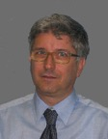
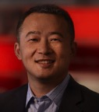
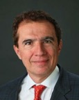
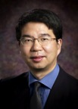

Keynote
Keynote 1: The Next Decade
Alessandro Cremonesi, Group Vice President, General Manager of ST Central
Labs at STMicroelectronics
Keynote 2: Systems of Systems - The Next Frontier of Semiconductor
Qi Wang, VP and Chief of Staff to the CEO at Cadence Design Systems, Inc.
Joint-Keynote 3: (90min)
3-1: New Logic Synthesis and Methods for Emerging Digital Nano-
technologies
Giovanni De Micheli, Professor, École Polytechnique Fédérale de Lausanne, Lausanne,
Switzerland
3-2: Scalable Compilation for Programmable and Composable Accelerators
Jason Cong, Chancellor’s Professor, University of California, Los Angeles, USA
3-3: Software and System Co-optimization in the era of Heterogeneous
Computing
Ruchir Puri, IBM Fellow, IBM Thomas J Watson Research Center, USA
Notes:
Alessandro Cremonesi
Group Vice President, General Manager of ST Central Labs at STMicroelectronics
Abstract
In his speech Alessandro Cremonesi will give his perspective of major trends in electronics for the next decade. New services and applications will be fueled by the evolution of the electronic systems and by the evolution of the cloud technologies. Both together will bring us to a new way to handle our life, our work, our social interactions and our interaction with the environment. We will have lot of challenges in front of us but also new tools and methods to handle them.
Biography
Alessandro Cremonesi is Group Vice President, General Manager of ST Central Labs at STMicroelectronics. In this role, he manages the Company’s Labs dedicated to System Application and Innovation worldwide with responsibilities that span from corporate advanced R&D to system-solutions support for ST customers. Cremonesi performs institutional and advisory roles with several industrial and academic bodies. He has authored several technical papers and patents in analog and digital signal processing and is a member of the Scientific Advisory Board at IMEC.
Qi Wang
VP and Chief of Staff to the CEO at Cadence Design Systems, Inc.
Abstract
Most of today’s most exciting new electronic products are not single-function, standalone devices, but rather are multi-function system devices, composed of subsystems, and connected into even larger systems. Being at the core of any electronic system, the semiconductor technology is going through a sea change where tackling the traditional semiconductor issues such as timing, power, and performance becomes insufficient. Additional challenges include time-to-market, functional partitioning, communications protocols, IP selection, hardware-software verification, reliability, safety, and many others. In this presentation, the presenter will summarize the design challenges and highlight some solutions for system design enablement in this increasingly complex environment.
Biography
Dr. Qi Wang is the VP and Chief of Staff to the CEO at Cadence Design Systems, Inc. He has over 16 years experience in EDA and held various R&D and marketing positions at Cadence. Prior to his current role, he is the Product Marketing Group Director of the Solutions Marketing group, with a focus on Cadence low power and mixed signal solutions. He is the chief architect of Common Power Format, which was contributed to Si2 and became the industry first open power format in early 2007. He held various positions in international standard organization like Si2 and IEEE. He had more than 20 papers published in various international conferences and journals. He also holds 7 US patents and a recipient of Cadence Outstanding Patent Award in 2010. In 2011, he received the Distinguished Service Award from Si2. Dr. Wang received his Ph.D. degree in Computer Engineering from University of Arizona and his B.S. degree from Shanghai Jiao Tong University.
Abstract
Logic synthesis/optimization algorithms and tools have been used for over three decades. Still they suffer from various weaknesses, because they were conceived with CMOS AOI static gates in mind, to run on less powerful computers and storage systems, and without a strong formal basis. The design of large-scale, computation oriented, digital circuits is still a main challenge even with state of the art commercial tools. Because of the convergence of fabrication technologies, the competitive edge in CMOS design resides in its logic-level structuring achieved within synthesis. Moreover, novel nano technologies open new horizons by means of logic gates with enhanced functionality. Thus, more than ever, synthesis technology is a key to exploit technology in the search for the best design.
Abstract
In order to drastically improve energy efficiency, we believe that future processor architectures should be customized with extensive use of accelerators from single-chip implementation to datacenter-level integration, as custom-designed accelerators often provide 10-1000X performance/energy efficiency over the general-purpose processors. Such an accelerator-rich architecture presents a fundamental departure from the classical von Neumann architecture, which emphasizes efficient sharing of the executions of different instructions on a common pipeline, providing an elegant solution when the computing resource is scarce. In constrast, the accelerator-rich architecture features heterogeneity and customizaiton for energy efficiency, which is better suited for energy-constrained designs where the silicon resource is abundant.
In this talk, I shall present an overview of our research on customized computing, from single-chip, to server node, and to data centers, with extensive use of composable accelerators and field-programmable gate-arrays (FPGAs). Then, I shall focus on the needs and challenges for efficient compilation support for customized computing at different levels of computing system hierarchy, and present our compilation and runtime solutions at each level.
Abstract
Escalating costs of semiconductor technology and its lagging performance relative to historic trends is motivating acceleration and specialization as more impactful means to increase system value. Targeted specialization is being increasingly pursued as an important way to achieve dramatic improvements in workload acceleration. This requires a broad understanding of workloads, system structures, and algorithms to determine what to accelerate / specialize, and how, i.e., via SW?; via HW?; or via SW+HW? which presents many choices, necessitating co-optimization of SW and HW. In this talk, we will focus on an application driven approach to software and system co-optimization, based on inventing new software algorithms, that have strong affinity to hardware acceleration. A High Level design methodology that is needed to enable targeted specialization in hardware will also be described.

Slide 13
Tutorials
Tutorial-1: Directed Self-Assembly Lithography (DSAL): Mask Synthesis and Circuit Design
Speaker: Prof. Youngsoo Shin (KAIST)
Mr. Seongbo Shim (Samsung)
Tutorial-2: Uncertainty Quantification for Electronic Systems: State of the Art and Recent Progress
Speaker: Prof. Luca Daniel (MIT)
Dr. Zheng Zhang (MIT, and Argonne National Labs)
Notes:
Tutorial Outline:
With continuous down scaling of semiconductor technology, optical lithography has already become the bottleneck for integrated circuit (IC) fabrication. Directed self-assembly lithography (DSAL) is considered as a most promising patterning solution for contact holes and vias in technology node of 7nm and below.
DSAL consists of two steps: optical lithography to form guide patterns (GPs) on a wafer, and DSA to form contacts (or vias) within each GP. A GP, which is a key component of DSAL, poses a few challenges. In mask synthesis, a set of GPs for a given contact layout can only be extracted through lengthy simulations; once GPs are obtained, they should be verified to see whether target contacts are formed, which is also a difficult problem. Contact topologies are limited due to the limitation of GP, which calls for careful consideration in design stages, e.g. during custom layout, placement, and routing.
The goal of this tutorial is to present the basics of DSAL technology and a few state-of-the-art in mask synthesis and design optimization, and to address a number of open research questions and topics. The tutorial will consists of:
Tutorial Outline:
The increasing process variations (e.g., material-property variations and geometric imperfection) in nano fabrications have caused lots of performance degradations and functional failures in nano-scale electronic, circuit and system design. In order to support variation-aware and robust chip design, it is highly desirable to develop efficient stochastic modeling and simulation algorithms to characterize such uncertainties. This session first reviews popular uncertainty quantification techniques (e.g., classical sampling-based and intrusive methods, sparse approximation techniques such as compressed sensing) for stochastic electromagnetic field solvers and circuit/MEMS simulation. Then, some advanced computational techniques (such as stochastic model-order reduction, dominant singular-vector methods and tensor-based algorithms) will be introduced to solve the challenging high-dimensional problems in VLSI parasitic extraction, analog/RF circuit and MEMS simulation.

Slide 14
Tutorials (Con’t)
Tutorial-3: Energy-efficient Data Analytics: Thousand-core Accelerator In-Memory with Reconfigurable I/Os
Speaker: Prof. Hao YU (Nanyang Technological University)
Tutorial-4: Machine Learning and Neuromorphic Computing Acceleration
Speaker: Prof. Yu Wang (Tsinghua University)
Prof. Yiran Chen (University of Pittsburgh)
Notes:
Hao Yu obtained Ph. D degree from electrical engineering department at UCLA in 2007. Since 2010, he has been a faculty at school of electrical and electronic engineering and area directors at VIRTUS (IC design) and Valens (biomedical) centre of excellence, Nanyang Technological University (NTU), Singapore. His primary research interest is in CMOS emerging technology for energy-efficient links and sensors with more than 4M-USD research funding from agency and industry (Intel, Oracle, Huawei, TSMC). He has ~160 peer-reviewed IEEE/ACM/Nature publications, 4 books, 1 best paper award of ACM Transaction, 1 keynote talk, 3 best paper award nominations, 3 student paper competition (advisor) finalists, 1 inventor award from semiconductor research cooperation (SRC), and 10 pending patents. He is associate editor and technical program committee member of many IEEE/ACM international journals and conferences. He is a senior member of IEEE and member of ACM.
Tutorial Outline:
Big-data analytics has scaled up to Exa-scale that is already beyond the scalability of the present technology and architecture. It has thereby raised many new research opportunities to deploy emerging technology and architecture towards building a data server on chip with integrated 1000-acclerator-core and main memory. One fundamental challenge is how to overcome dark silicon dilemma with improved I/O utilization for both power management and data communication. Firstly, we discuss a 2.5D through-silicon-interposer reconfigurable I/O (connection and voltage swing) architecture developed for both scalable power management and data communication in data-server with results reported in DAC’13, ICCAD’14, and CICC’15, where on-chip data analytics is deployed to learn data pattern such that I/Os can be configured for energy-efficient data migration at 1000-core scale. Secondly, we discuss a non-volatile in-memory accelerator (machine-learning) architecture without I/Os. According energy-efficient compressive machine-learning accelerators are developed in both CMOS and memristor with results reported in DATE’15, ISLPED’15 and VLSI-SYMP’15.
Tutorial Outline:
Machine learning (ML) is the enabler of many modern applications like big data analytics, speech and video recognition, natural language processing, robotics etc. The algorithms of ML, especially the recently emerged deep learning ones, often consume a large volume of computation resources and memory. Considering the rapid upscaling pace of the problem size that ML applications face, e.g., increasing one order-of-magnitude per year, the cost of the computer systems that run the ML applications will quickly become unaffordable. Designing a special circuit or hardware system that can accelerate ML applications leads to a promising alternative way to continue scaling up the capacity of the computing platform for ML. The great potential demonstrated by such special circuit and hardware system has gained tremendous attentions from both company and academia, and inspires the corresponding fast-growth industry sector.
In this tutorial, two speakers will cover the a few important topics in machine learning acceleration. At first, Prof. Yu Wang from Tsinghua University will first introduce the basics of the most widely utilized convolutional neural networks (CNN), and then provide an overview of state-of-the-art designs for embedded CNN. Furthermore, their solutions with FPGA and embedded GPU (winner of the LPIRC 2015) will be presented as a case study. After that, Prof. Yiran Chen from University of Pittsburgh will present a systematic approach to design reconfigurable on-chip machine learning acceleration hardware, including the realization on both FPGA platform or as the accelerator augmented to conventional pipeline. The topology and computation flow of the designed circuit can be easily reconfigured to adapt to the requirements of different machine learning applications on resources and their management, achieving 2~3 orders of magnitude performance speedup.

Slide 15
Technical Sessions & University LSI Design Contest‏
Technical Sessions
24 technical sessions will be organized.
Face-to-face TPC meeting was held on Aug. 31 in Taiwan.
94 high quality papers were selected from 274 submissions from 27 countries.
University LSI Design Contest
12 papers were selected from 15 submissions.

Slide 16
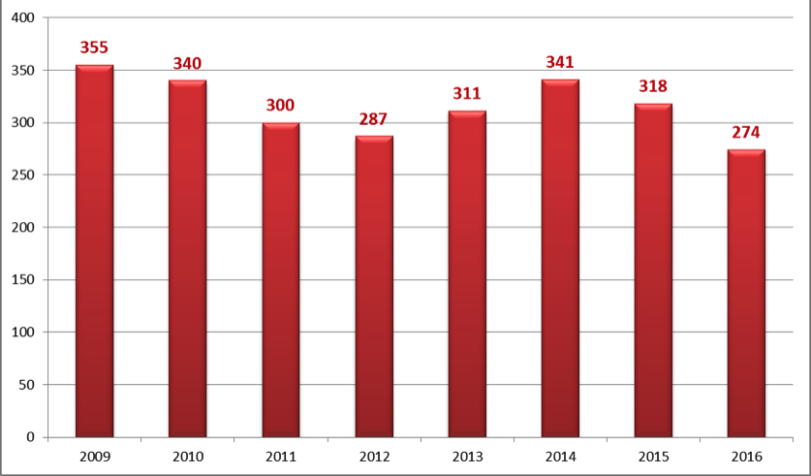
Paper Submission

Slide 17
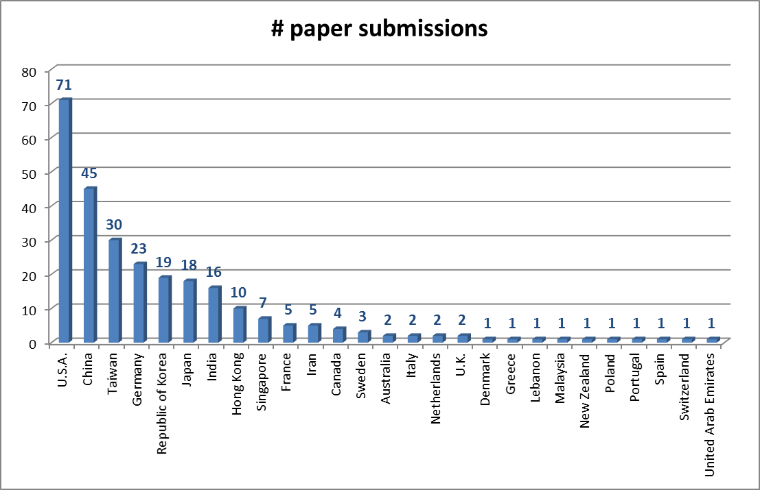
# of Submitted Papers by Country

Slide 18
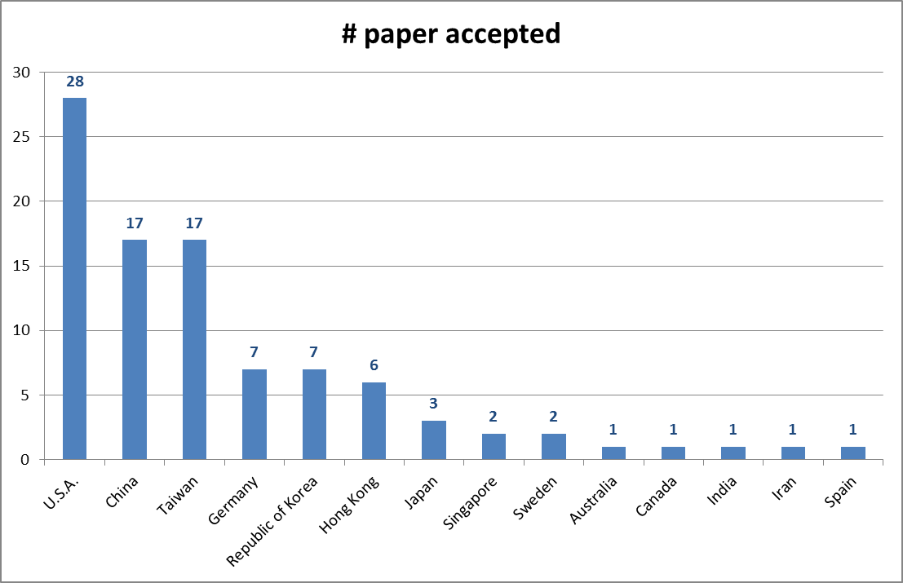
# of Accepted Papers by Country

Slide 19
Student Research Forum
Student Research Forum
The Student Research Forum offers both Ph.D. and M.S. students great opportunity to present and discuss their research with experts in system design and design automation community. The forum is open to all students of the relevant research community and is free-of-charge.
Submission Deadline: October 31, 2015
Notification Date: November 21, 2015
Poster Session: January 26, 2016

Slide 20


53rd DAC Report
(Presenter: Shishpal Rawat)

Slide 21
2013-2015
 | Austin | San Francisco | San Francisco
 | 2013 | 2014 | 2015
Total Income | $3,361,605.98 | $3,455,746.89 | $3,256,460.54
Exhibit Income | $2,097,658.00 | $2,255,835.00 | $2,065,239.00
Reg. Income | $811,666.00 | $859,328.00 | $759,798.50
Net Surplus | $393,664.01 | $301,592.67 | $145,368.90
Total Attend. | 6061 | 6760 | 6997
Total Exhibiting Companies | 173 | 167 | 158

Slide 22
Attendance (2007-2015)
Year | City | Attendance
2007 | San Diego | 8340
2008 | Anaheim | 7766
2009 | San Francisco | 7996
2010 | Anaheim | 5660
2011 | San Diego | 6052
2012 | San Francisco | 7416
2013 | Austin | 6061
2014 | San Francisco | 6760
2015 | San Francisco | 6997

Slide 23
Exhibiting Companies (2013-2015)
Year | City | Companies
2013 | Austin | 173
2014 | San Francisco | 167
2015 | San Francisco | 158

Slide 24
2013-2015 Comparison

Slide 25
Program Themes
Austin – 2013- 50TH DAC | San Francisco- 2014- 51ST DAC | San Francisco- 2015- 52ND DAC
Total Paper Submission: 743 | Total Paper Submission: 787 | Total Paper Submission: 785
Global Forum | Tutorials: Physical design, low power, automotive, hardware security, embedded systems | Designer Track / IP Track
Designer Track | Designer Track / IP Track | Embedded Systems & Software & Automotive Track
Embedded Systems & Software | Embedded Systems & Software & Automotive Track | Keynotes: Google, Moore’s law, automotive, cyber threats panel, electronics for the human body
Keynotes: Design, ESS, Automotive, Future of Technology | Keynotes: IP, Sum-10nm era, Automotive keynote, mobile computing | ARM CC (exhibit floor)
Designed in Texas | ARM CC (exhibit floor) | Automotive Pavilion (exhibit floor)
Visionary Talks | Automotive Pavilion (exhibit floor) | Training Day (Doulos)
Training Day (Doulos) | Training Day (Doulos) | Visionary Talks
ARM CC (exhibit floor) | Visionary Talks | SKY Talks (short keynotes moved to DAC Pavilion)
SKY Talks (short keynotes after panels) | SKY Talks (short keynotes)

Slide 26
DAC 2015: New and Expanded Technical Contents
Internet of Things
  Focused contents with invited talks, panel, and special sessions
Security and AUTO
  Single track spanning all three days
Growing interests in Embedded Systems contents
  Close to 10% increase in submissions

Slide 27
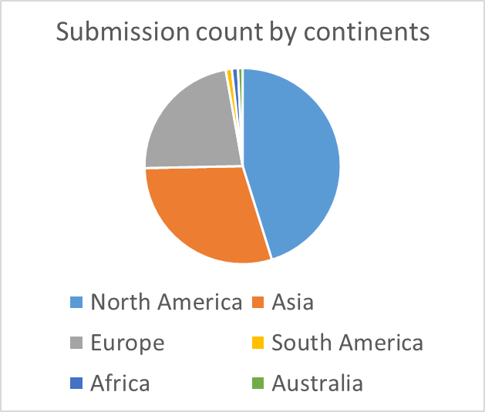
Research Paper Submission Summary
Approved submissions for review: 790
  Academia: 89%
  Industry: 11%
  Countries with most submissions:
    U.S.
    Germany
    China
    Taiwan
    Korea
Notes:
Only have 3 more approved submissions than last year.
A slight decrease (11% vs. 14% in industry submissions)

Slide 28
Research Paper Submission Trends
Notes:
Note that AUTO and part of SEC papers could be categorized into ESS. So the ESS submissions are not really reduced per se.

Slide 29
TPC Information
2013: 96, 2014: 170, 2015: 168
Increased TPC to
  Cover newly introduced tracks
  Reduce the paper review workload
Notes:
Each tpc member handles about ~24 papers now instead of ~38

Slide 30
Contact‏
Conference Secretariat
E-mail: asp-dac2016@moxlink.com
Tel: +853 2871 2020
Fax: +853 2872 1046
Add: Av. Marciano Baptista No26-54B Centro Comercial Chong Fok,3/B Macau
Office Hours: Monday- Friday: 9:30am - 6:00pm GMT +8

Slide 31

For more detail information, the Advanced Programme will be announced on ASP-DAC website around November, 2015.
http://www.aspdac.com
Thank You,
Looking forward to seeing you in Macao!!!
http://www.amsv.umac.mo/aspdac2016/index.html

Slide 32
Conference Geographical Accessibility
- Attract More Chinese Delegates
Macao
With our experience in IEEE APCCAS 2008 (492 participants),
37% of participants come from China (including Macau SAR , & Hong Kong SAR)‏
55% of participants are Chinese

Slide 33


About us
Conference Organization and Host
University of Macau (since 1981)‏
State Key Laboratory of Analog and Mixed Signal VLSI -
www.amsv.umac.mo]
(Unique in Guangdong Province !@ par with other leading
VLSI Labs in the Greater China Region !)
Co-organizers
IEEE Macau Section (created in the end of 2003)‏
IEEE Macau Joint-Chapter CAS/COMM (since 2005)‏
IEEE Macau Chapter on Solid-State Circuits (since 2009)

Slide 34


DATE 2016
(Thanks to Jürgen Teich)

Slide 35




Topic Team Sizes
DATE Structure Stable
Based on 4 reviews/paper
Maximum of 10..12 reviews/reviewer
Still structured in the classical 4 tracks of DATE
Jürgen Teich
D Track Chair
Ayse K. Coskun
A Track Chair
Cecilia Metra
T Track Chair
Franco Fummi
E Track Chair
Topics D1-DT5, D6-D13
12 Topic Chairs
11 Topic Co-Chairs*
164 Topic Members
Topics A1-A7
7 Topic Chairs
7 Topic Co-Chairs
41 Topic Members
Topics T1-DT5
4 Topic Chairs*
5 Topic Co-Chairs
35 Topic Members
Topics E1-E5
5 Topic Chairs
5 Topic Co-Chairs
30 Topic Members
Total Members: 187
Total Members: 55
Total Members: 44
Total Members: 40
309 initial/ 327 final members in total,
-1 w.r.t. DATE’15 (initial), -11 wr.t. DATE´15 (final)
Notes:
To be done: rot
Note: 2015 waren es eigentlich 338 (29 spät Eingeladene);
Anzahl Prozent
Alle 327 100,00
Men 288 86,54
Women 37 11,30
unclear 2 0,61

Slide 36
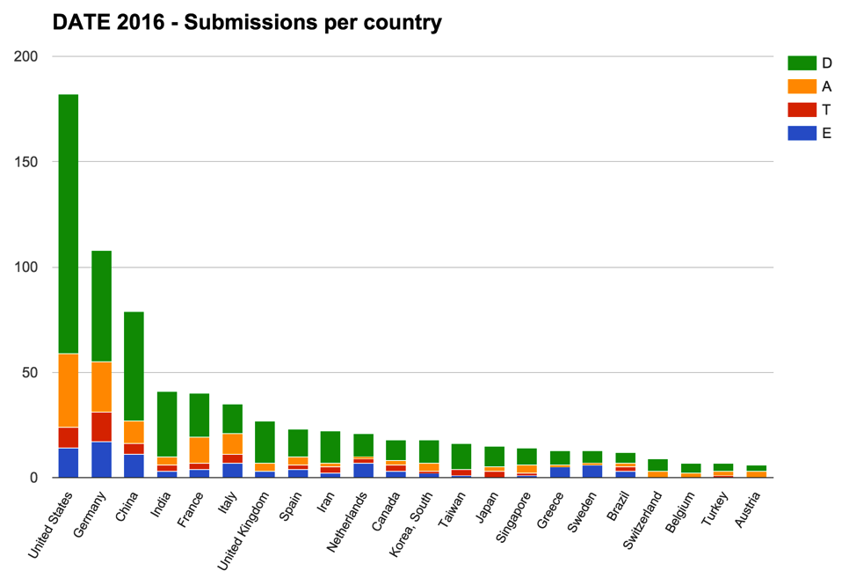

DATE Submissions: 793 (13% less)
Submission statistics – countries

Slide 37
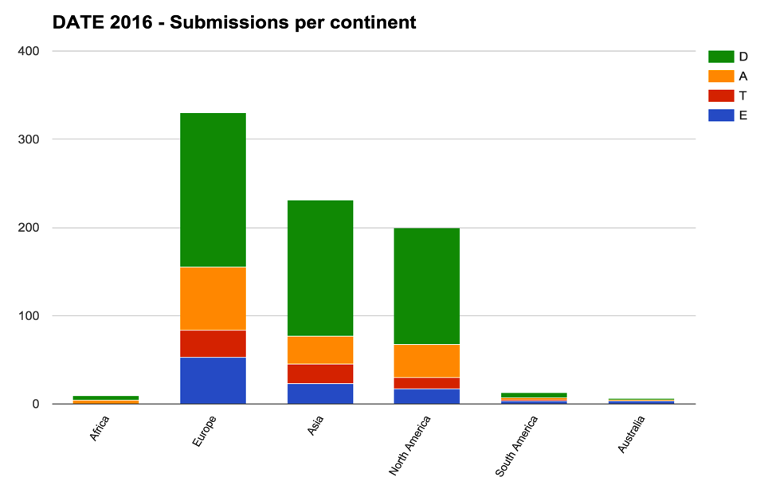
Asia Passed US in No. Submissions
Submission statistics – continents
42%
29%
25%
Notes:
Industry: 33%
Academia: 66%

Slide 38
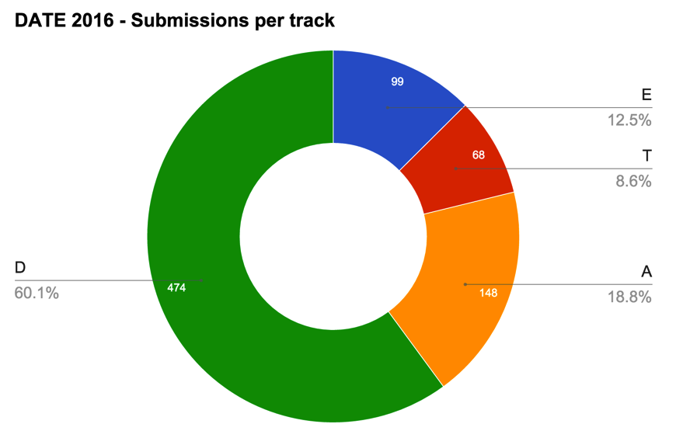
Design (D) Dominates,
Test (T) and Embedded Sw (E) Shrink
Submission statistics – per track
Notes:
D 2015: 58.1 % -> 60.1 % 2016
A 2015: 18.1% -> 18,8 % 2016
T 2015: 11.9% -> 8.6 % 2016
E 2015: 12.0 % -> 12.5 % 2016

Slide 39
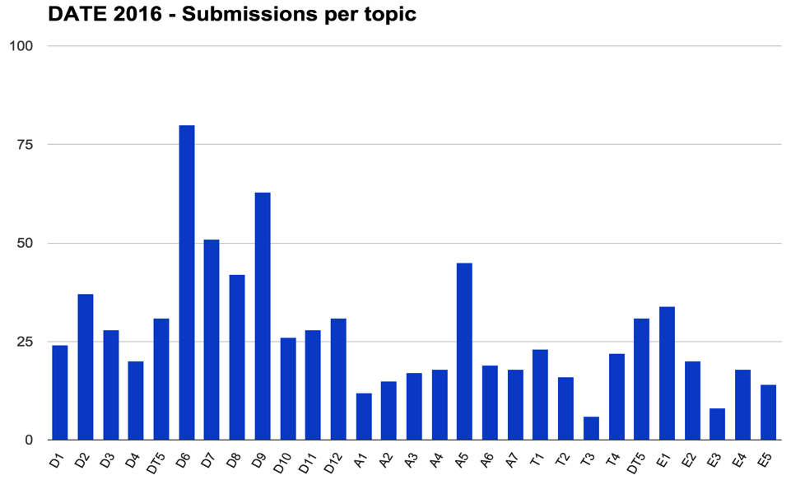
Key Topics This Year – D Track
Submission statistics – per topic
Emerging Technologies and Systems
80 papers

Slide 40
Key Topics This Year – D Track
Submission statistics – per topic
Architectural &
Microarchitectural Design
63 papers

Slide 41
Key Topics This Year – A Track
Submission statistics – per topic
Secure Systems
45 papers

Slide 42
But Issues in the T and E Tracks
Submission statistics – per topic
Model-Based Design & Verification of ES
Design-for-Test, Test Compression and Access
6
8

Slide 43
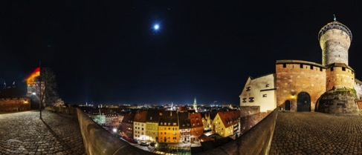
Review Process & meeting (Nuremberg, DE)
Performed
Reviews 3062
Reviews / Paper 3.9
Reviews / Reviewer ≤12
Missing: < 1%, good attendance (~63% TPC members)
Accepted papers: 187, rates:
  Long: 152
  Short: 35
Accpt. Rate: 24%
  IP: 81
Accpt. Rate: 10%

Slide 44
DATE Budgets and Forecast (kEuro)
 | 2014 | 2015 | 2016 forecast
Income | 580.3 | 507.8 | 578
Costs | -604.6 | -550.64 | -577
Local support | 27.0 | 100 | 10
Surplus | 2.6 | 7.1 | 11

Slide 45
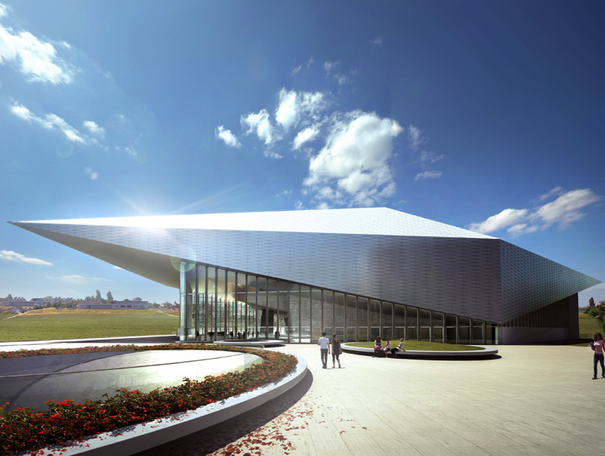
DATE ‘17 in Lausanne (March 27-31, 2017):
General Chair: David Atienza, EPFL (CH)
TPC Chair: Giorgio Di Natale, LIMRR (FR)

