Slide 1
Website and CEDA Newsletter
BoG Meeting
José Ayala
CEDA Webmaster

Slide 2
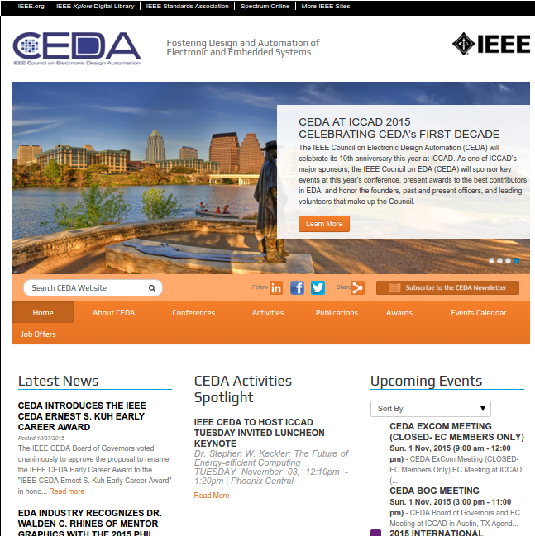
A quick view of the CEDA website

Slide 3
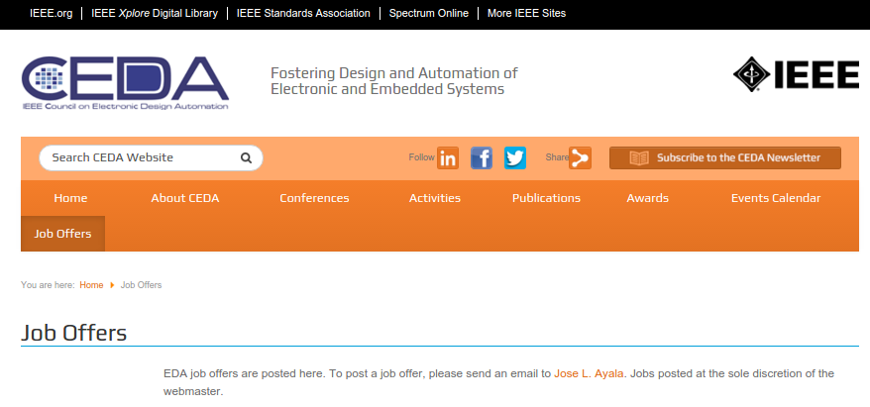
New section: Job Offers
EDA Job offers to be posted on the website for easy and broad advertisement
Send us your job offers, email link on the website

Slide 4
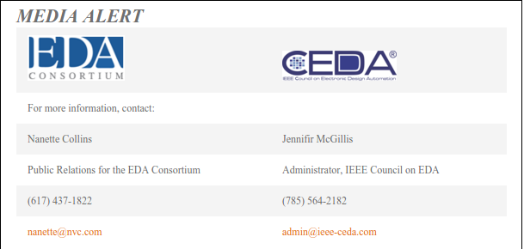
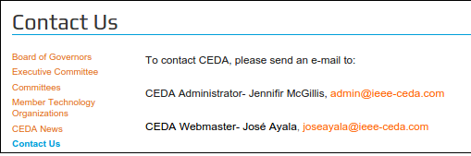
CEDA News
Can also be used to practical and efficient media alert

Slide 5
Open Call for Travel Grants
CEDA is offering conference travel awards for supporting three participants to attend the 2nd IEEE Women in Engineering International Leadership Conference (WIE-ILC).
Applications are due Feb 19th, 2016
More information on the website, Awards section

Slide 6

New Format in Our Email Blasts

Slide 7

CEDA Newsletter
Bi-monthly publication
It includes CFPs,
announcements, invited
columns, etc.
Open for contributions
(send me an email!)
Distributed by email to
CEDA list subscribers,
available on the website archive

Slide 8
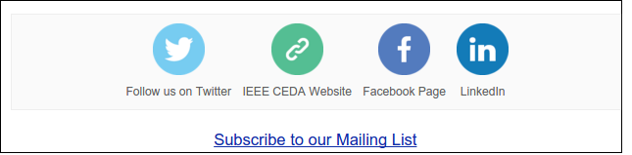
Follow Us on...

