Slide 1
Activities Report Peng Li VP-Activities

Slide 2
Chapters (1)
Current (11):
Beijing, Brazil, Central Texas, Hong Kong, India, Japan, Korean, PA, Shanghai, Taiwan, Montreal
New chapters in progress
Illinois (Champion & Chicago) – Deming Chen
Spain – Jose L. Ayala
New PA chapter chair
Baris Taskin (Drexel)

Slide 3
Chapters (2)
Possible new chapters for new future
UAE (1-2 years)
Turkey and Africa (2-3 years)
Southern California

Slide 4
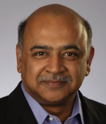
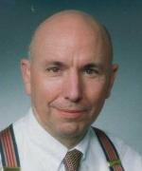
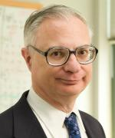
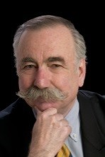
Distinguished Lecture @ DAC
CEDA Luncheon and Distinguished Lecture in Honor of Prof. Edward J. McCluskey
Distinguished Lecture Speaker: Dr. Arvind Krishna, Senior Vice President and Director, IBM Research
Tribute Speakers:
Dr. Bill Joyner, Senior Science Director, SRC
Prof. Daniel P. Siewiorek, Buhl University Professor, CMU
Dr. Tom Williams, Synopsys Fellow (Retired)

Slide 5
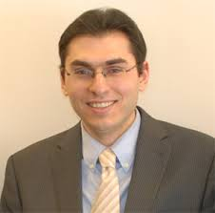
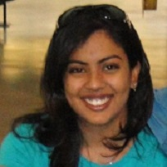
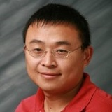
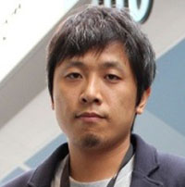
CEDA Career Perspectives Panel @ DAC
Support 110 attendees; funded by CEDA and DAC
Panelists:
Zaher Andraus, Ph.D. 2009 – Michigan; CEO of Reveal Design Automation
Pranavi Chandupatla, M.S. 2014 – UT Dallas; Physical Design Engineer, ARM
Zhuo Li, Ph.D. 2005 – TAMU; Physical Design Manager at Cadence
Bei Yu, Ph. D. 2014 – UT Austin; Assistant Professor, Chinese University of Hong Kong
Moderator: Dr. Bill Joyner, SRC

Slide 6
Young Faculty Workshop @ DAC’16
Organizers
Jinjun Xiong - IBM T.J. Watson Research Center, Yorktown Heights, NY
Eli Bozorgzadeh - Univ. of California, Irvine, CA
Soha Hassoun - Tufts Univ., Medford, MA
(In Memory) Steve Levitan - Univ. of Pittsburgh, PA
Patrick Haspel - Cadence Design Systems, Inc.
Michael Huebner - Ruhr Univ. Bochum
Activities
Getting an Academic Job, Research ‐ papers, conferences and grants, The NSF proposal process for CAREER and other programs, Teaching ‐ Best practices, Special Issues, University programs in EDA industries, and a “Speed Networking” lunch event.

Slide 7
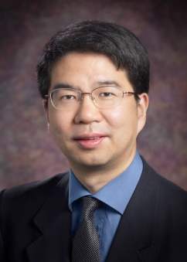
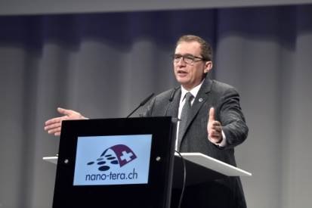
Inaugural Distinguished Lecturers and Proposed Topics
Jason Cong, UCLA
Customizable Computing at Datacenter Scale
High-Level Synthesis and Beyond
Giovanni De Micheli, EPFL
Majority-based Logic Synthesis
Technologies and Platforms for Cyberphysical Systems
3-Dimensional Nano-Devices: Models and Design Tools
Committee
Ulf Schlichtmann (chair), Naehyuck Chang, and David Pan
Need to follow up with Ulf

Slide 8
2016 ICCAD CAD Contest
Problems
Problem A: Identical Fault Search
Problem B: NP3: Non-exact Projective NPNP Boolean Matching
Problem C: Pattern Classification for Integrated Circuit Design Space Analysis
Contest chair: Shih-Hsu Huang (Chung Yuan Christian University, Taiwan)
Contest co-chairs:
Rung-Bin Lin (Yuan Ze University, Taiwan) Myung-Chul Kim (IBM Corporation, USA) Shigetoshi Nakatake (The University of Kitakyushu, Japan)
Topic chairs:
Tangent Wei and Luke Lin (Synopsys Taiwan Co., Ltd.); Chi-An (Rocky) Wu and Chih-Jen (Jacky) Hsu (Cadence Design Systems Inc., Taiwan); Rasit O. Topaloglu (IBM Corp., USA)

Slide 9
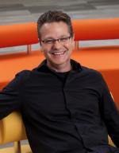
2016 CEDA Distinguished Lecture @ ICCAD
“Socially Acceptable AI-based City Driving”
Speaker: Maarten Sierhuis
Director Nissan Research Center, Silicon Valley

Slide 10
HALO Workshop @ ICCAD’16
Hardware and Algorithms for Learning On-a-chip (HALO)
2015: 11 invited talks, 31 posters, > 75 attendees, a special JETC issue
Organizers
Yu Cao - Arizona State Univ.
Xin Li - Carnegie Mellon Univ.
Jae-sun Seo - Arizona State Univ.
$3K from CEDA to provide travel grants for 10 students

Slide 11
EDA Research Outreach Workshop
December 12 – December 13 at Tsinghua University
Organizers
Tsinghua, ACM SIGDA, CEDA, DAC
Attendees
ACM SIGDA/CEDA representatives
DAC/ICCAD chairs
EiCs: TCAD, TODAES, JETC, TVLSI, D&T EIC, ESL, ACM/CPS
Others (e.g. industry, government, chip design companies, investors, students/faculty)
Funding request to support PhD students/junior faculty to travel to Beijing ($5K??)

Slide 12
New TA Initiatives – Discussions
Help from Ayse and others
Cyber-physical systems:
IEEE SMC/Technical Committee on Cybernetics for Cyber-Physical Systems (CCPS)
ACM CPS
IET CPS
IoT activities
DATE IoT Challenge
DA for Deep Learning
ICCAD Halo Workshop
IEEE CAS Neural Systems & Applications TC (?)
INNS (?)

Slide 13
SRC Recommendations – Discussions
“Interactions with non-IEEE professionals”
ACM Sigda, INNS and others (?)
“Develop and execute a plan to include more young professionals in CEDA (AdCom, Conferences, Chapters etc)”
DAC EDA Career Panel
Young faculty workshop
“Pursue active strategies to recruit for diversity on the AdCom with regard to gender diversity, and young professionals”
?
Consider practices employed by other Councils and Societies to engage women and Young Professionals
?

