Slide 1
IEEE CEDA Executive Committee Meeting at ICCAD 2018
Hilton San Diego Resort & Spa, San Diego, CA November 4th, 2018

Slide 2
Agenda
CEDA as a standards “Sponsor”
Many IEEE Societies are Standards Sponsors
Few Non-Society Standards Sponsors
IEEE-SA Corporate Advisory Group (CAG)
Sensors Council

Slide 3
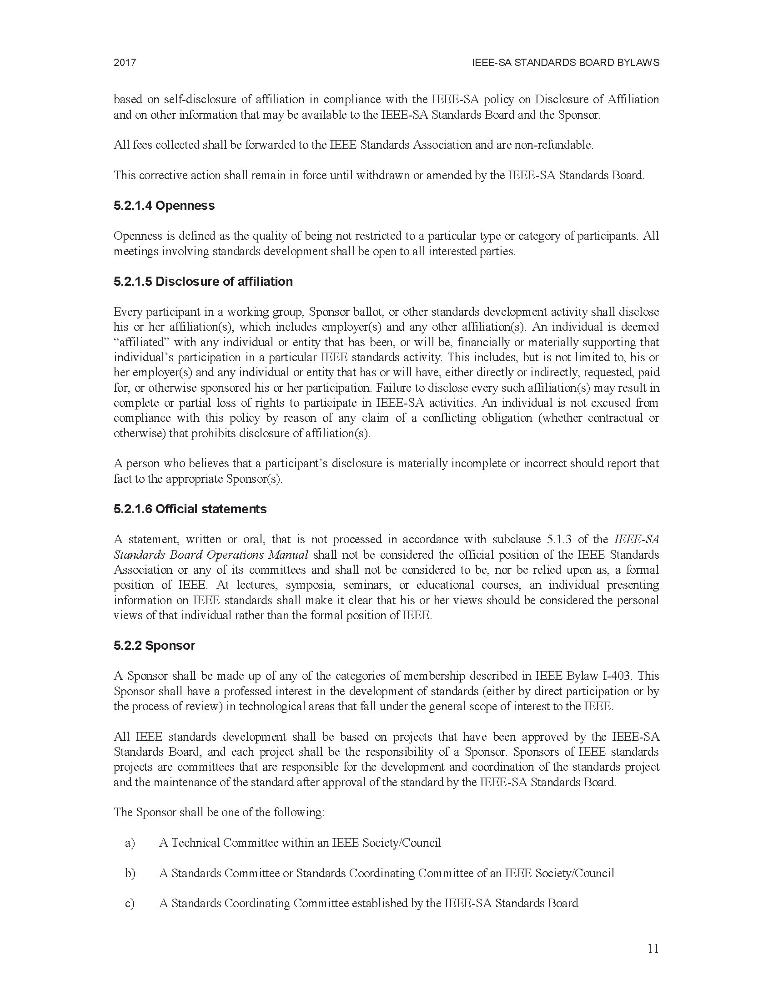
Standards Sponsorship
45 Technical Societies
IEEE Standards Sponsors Include:
A Standards Committee or Standards Coordinating Committee of an IEEE Society/Council
Councils added to list of accepted Sponsors
Sensor Council only Council to sponsor standards at the moment
Source: https://standards.ieee.org/about/policies/bylaws/sect5.html

Slide 4
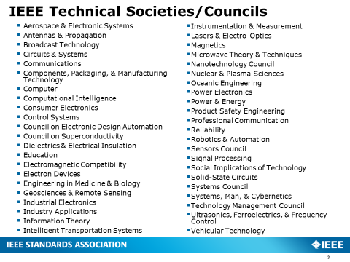
Request to Sponsor Standards
Connect requestors to CEDA member societies
IEEE Antennas and Propagation Society
IEEE Circuits and Systems Society
IEEE Computer Society
IEEE Electron Devices Society
Electronics Packaging
IEEE Microware Theory and Techniques Society
IEEE Solid-State Circuits Society
Sponsor Directly

Slide 5
PARs Under Review
Slide from IEEE-SA Corporate Advisory Group meeting – Atlanta, GA USA – September 2018
Project Number | Title | Submitter/ Chair | Identified Potential Sponsor | Status
PXXXX | Guide for frequency-phase controlled AC voltage withstand tests of gas-insulated metal-enclosed switchgear | SGCC | PE/SUB | Under review: Conference call b/t SUB and SGCC end of Sept.
P2747 | Standard of requirements for energy consumption test and energy saving technology evaluation of electric power fittings | SGCC | PE/T&D | T&D Admin SC is currently voting
P2772 | Standard of test method for energy loss of overhead conductors | Far East Smarter Energy | PE/T&D | T&D Admin SC is currently voting
P2749 | Recommended Practice for Risk Identification and Evaluation of Smart Power Distribution System | CEDA SGCC | PE/T&D | Received in September, T&D is reviewing
PXXXX | Guide for Forecast and Early Warning of Icing on Overhead Transmission Lines in Micro-topographic Areas | SGCC | PE/T&D | T&D Admin SC is currently voting
PXXXX | Testing Guide for Automatic Voltage Control Systems in Regional Power Grids | SGCC | PE/PSRCC | Task Force created, SGCC to present Sept 11th at PSRCC face to face meeting
PXXXX | Specification of polymer-housed metal oxide surge arrestors with series gap for 1000 kV AC power transmission lines | CSEE | PE/SPDHV | Overlap identified. CSEE will send attendees to participate in SPDHV doc. No further action needed.
PXXXX | Guide for the Frequency Response Testers of Power Transformers | SGCC | PE/TR | Overlap identified with two TR documents. SGCC invited to participate in revision. No further action needed. No intent to submit to CAG.

Slide 6
Should we seek Standards Sponsorship Rights?
Act as funnel for sponsorship requests to member Societies
Guide future standards needs from cross-Societal viewpoint
Secure option for greater future use
Don’t compete with member Societies

