Slide 1
DAC 2021 Updates
Gi-Joon Nam
12/05/2021

Slide 2
2021 Live Conference Content
FULL CONFERENCE
Research Focused
Research Papers
Research Panels
Research WIP Posters
Late Breaking Results
Workshops
Tutorials
Research Invited Talks
Research Best Paper
Training Day Sessions
Keynotes
SKYtalks (Short Keynotes)
Pavilion TechTalks
Industry Analyst Reviews
Industry Focused Best Paper
Industry Presentations
Industry Posters
Industry Panels
Industry Invited Talks
Networking
DESIGNER, IP, and EMBEDDED SYSTEMS TRACKS
Industry Focused

Slide 3
2021 Hybrid Conference Content
FULL CONFERENCE
Research Focused
HYBRID Live & Virtual Component
Research Papers
Research Panels
Research WIP Posters
Late Breaking Results
Workshops
Tutorials
Research Invited Talks
Research Best Paper
Training Day Sessions
Keynotes
SKYtalks (Short Keynotes)
Pavilion TechTalks
Industry Analyst Reviews
Industry Focused Best Paper
Industry Presentations
Industry Posters
Industry Panels
Industry Invited Talks
Networking
DESIGNER, IP, and EMBEDDED SYSTEMS TRACKS
Industry Focused

Slide 4
Last minute Update on Virtual DAC 2021
FULL CONFERENCE
Research Focused
HYBRID (Virtual Registration, included in Full Conference Registration) Live & Virtual Component
Research Papers*
Research Panels
Research WIP Posters
Late Breaking Results*
Workshops
Tutorials
Research Invited Talks
Research Best Paper
Training Day Sessions
Keynotes
SKYtalks (Short Keynotes)
Pavilion TechTalks
Industry Analyst Reviews
Industry Focused Best Paper
Industry Presentations*
Industry Posters
Industry Panels
Industry Invited Talks*
Networking
* Virtual Research Papers
* Virtual DIET Presentations
DESIGNER, IP, and EMBEDDED SYSTEMS TRACKS
Industry Focused

Slide 5
Over 38 hours of on-demand high-quality technical content
2021 Hybrid Conference Content
4 – Keynote Speakers
3 – SkyTalks
3 – Pavilion TechTalks
2 – Industry Analysis Reviews
32 – Research Invited Talks
4 – Research Best Paper Talks
4 – Designer, IP, Embedded Systems Track Best Paper Talks
4 – Training Day Sessions

Slide 6
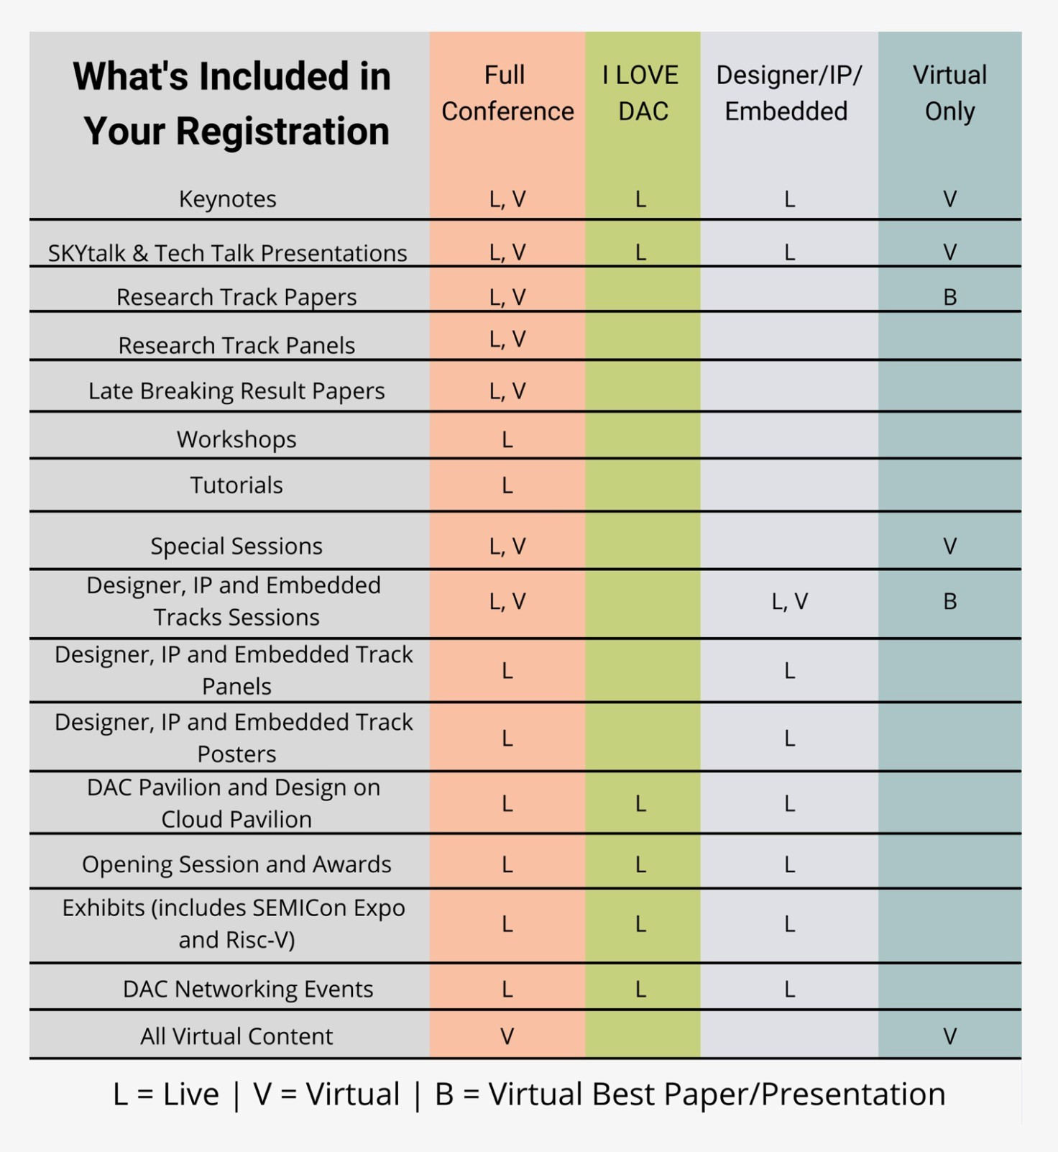
Updated Registration Page
Updated Registration Page

Slide 7
Updated Budget: Pre-Event Forecast
 | Annual | Pre-Event
Description | Budget | Forecast*
Revenue:
130 Exhibits - Revenue | 1,916,711 | 2,023,669
140 Annual Conference - Revenue | 671,912 | 440,060
Total Revenue | 2,588,623 | 2,463,729
Expenses:
110 Operations - Expenses | 480,296 | 551,651
120 Executive Committee - Expenses | 61,286 | 54,401
130 Exhibits - Expenses | 851,463 | 753,339
140 Annual Conference - Expenses | 1,360,772 | 1,274,082
145 TPC - Expenses | 18,300 | 17,096
170 Professional Development - Expenses | 10,000 | 10,000
Total Expenses | 2,782,117 | 2,660,569
Net Income(Loss) | (193,494) | (196,840)
*as of November 17, 2021

