Slide 1
Publications
L. Miguel Silveira
November 1st 2020

Slide 2
Publications
VP: L. Miguel Silveira, INESC-ID / IST - U Lisboa, Portugal
Ass VP: Sri Parameswaran, CS&E, UNSW, Sydney, Australia
Sachin Sapatnekar, Dept. ECE, U Minnesota, USA
Naehyuck Chang, School of Electrical Eng., KAIST, South Korea
Rajesh Gupta, Dept. CSE, UC San Diego, USA, (EiC TCAD)
Joerg Henkel, Embedded Systems, KIT, Germany, (EiC D&T)
Preeti Ranjan Panda, CSE, IIE Delhi, India, (EiC ESL)
Sri Parameswaran, CS&E, UNSW, Sydney, Australia (CEDA Ass. VP Pubs)
L. Miguel Silveira, INESC-ID/IST - U Lisboa, Portugal (CEDA VP Pubs)
Publications Committee

Slide 3
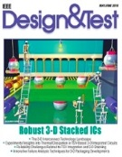
CEDA Periodicals
Sole financial sponsor:
Embedded Systems Letters (ESL)
Trans. Computer-Aided Design (TCAD)
Financial co-sponsor:
Design & Test magazine
JxCDC
Technical co-sponsor:
TSUSC
E
P
e
ε
Y
μ_{B}
M
σ
H

Slide 4
Overview & Current Status (1/2)
TCAD and ESL moved to online only in 2020
Push from IEEE
Partial (small) cost reduction
New ESL EiC, Preeti Ranjan Panda, IIT Delhi
Renewed editorial board, new ideas (e.g. video previews)
Pushing for increased submissions
JxCDC showing encouraging signs
Journal targeted by IEEE Pubs as “being in trouble”
too few submissions, not yet indexed: target for the next few years
EDS also became financial co-sponsor at the end of 2019
New EiC and increased involvement with sponsoring S/C
Increase involvement & activity in Steering Committee (mostly inactive)
A noted concern from TAB
E
P
e
ε
Y
μ_{B}
M
σ
H

Slide 5
Overview & Current Status (2/2)
D&T maintains broad coverage of topics
Mostly through special issues, surveys & tutorials
Well filled pipeline even beyond 2021
Financial situation always a small problem
TCAD EiC & deputy EiC reappointed
Strengthened Editorial Board upon EC recommendation
Editors-at-Large: “heavyweights”, strategic planning, advisors
Publishing of ESWeek 2020 Proceedings
Continued effort to strengthen CPS/IOT/Embedded areas
Donald O. Pederson Best Paper Award: to be announced at ICCAD 2020
Increased submissions but acceptance ratio too high
Review process under internal discussion
Financial effort to reduce backlog

Slide 6
Challenges / Actions (1/2)
ESL
D&T
JxCDC
Shorten processing times
Targetting improved visibility (impact factor )
Attract new readers and drive curiosity (video preview)
Improving geographical spread of AE and authors
Magazine continues to be driven by Sis
Well-filled pipeline throughout 2021 and beyond
D&T covers all hot topics in design and test (e.g. good coverage in ML trends)
Monitor financial situation, seek improvement
Paper solicitation is highest priority
Seeking Impact Factor (meeting required 25 papers)
Increase SC relevance and participation
Increase visibility within CEDA (and EDS, etc)

Slide 7
Challenges / Actions (2/2)
TCAD
Large backlog (close to 250 papers, over 2500 pages)
More than 1 year until assigned to an issue
Page counts for 2021 already increased but not sufficient
Decision was made to produce 2o large issues (Oct. & Dec.)
October out, 1200 pages, 95 articles
December prepared
Solves problem but larger difficulty looms
Acceptance ratio too large
Ongoing discussion re: review process and feedback - draft proposal prepared
Continued discussion on publication model vs conferences
ESWeek example: proceedings published again in 2020 (Nov. issue)
Open Access (accelerated process)
currently in a waiting state (wait and see)
decision was expected in 2020, delayed due to COVID-19 events

Slide 8
Action Items for 2021
Update D&T MoU
D&T, ESL and TCAD EiC searches
TCAD development, embedded and cyberphysical systems topics
Continuing relation with ESWeek, further analysis of model
Ongoing work towards rethinking TCAD review process
Targetting a reduction in the acceptance ratio, Requires policy changes
Monitor effects of all changes taken place in 2020
[Restart] Open Access monitoring and discussion

Slide 9
Detailed Publication Slides

Slide 10
IEEE TCAD Update
Current Status
Editorial Board: 67, Editors-At-Large: 5
Areas streamlined: ML/AI Automation; Approximate Computing; Arch. Design & Opt.; DA for CPS/IOT, Embedded Intelligence; Safety, resilience, security.
At a glance: Accept Ratio: 248/471 (52.7%)
Manuscripts Received: 881 (Original: 490, Revised: 391)
2020: 799 (446); 2019: 779 (432); 2018: 853 (478); 2017: 899 (515); 2016: 818 (527).
Pending Manuscripts: 195
Oldest manuscript without decision: 170 days.
Publishing backlog remains
Need to understand why IEEE online costs are so much higher than ACM. ($48/page versus zero)
Averages
Days from submission to 1st decision: 68.1
Reviewer assignment: 11.4 (original) 5.3 (revision)
Reviewer turnaround (original): 30
Reviewer turnaround (revision): 24.6
Submission to final decision: 101.3
AE turn-around: avg. 59 (4-133 days)

Slide 11
TCAD Donald O. Pederson Best Paper Award: To be announced at ICCAD
Process repeated from last year
Phase 1: papers nominated by AEs (6 papers) + Autonominated papers based on citations and downloads (10 papers, 2 of which overlap with nominated set) = 14
Phase 2: 3 papers selected from voted papers (2 nominated, 1 autonominated)
EAL board reviewed and selected the final candidate:
An Efficient Methodology for Mapping Quantum Circuits to the IBM QX Architectures
Alwin Zulehner ; Alexandru Paler ; Robert Wille
Data of publication: 6/12/2018
Appeared in TCAD Issue: July 2019

Slide 12
IEEE TCAD REVIEW PROCESS CHANGES
Extensive discussion within the Editorial Board and Editors-At-Large about structuring the review process. Suggestions have finally converged into a proposal for review and implementation here: http://bit.ly/TCAD-REVIEW
The goal of this process is to shift the review burden slightly towards the authors in explicitly stating contributions, novelty etc, introduce reproducibility awareness and to make the review itself directed that speeds up the evaluation process.

Slide 13
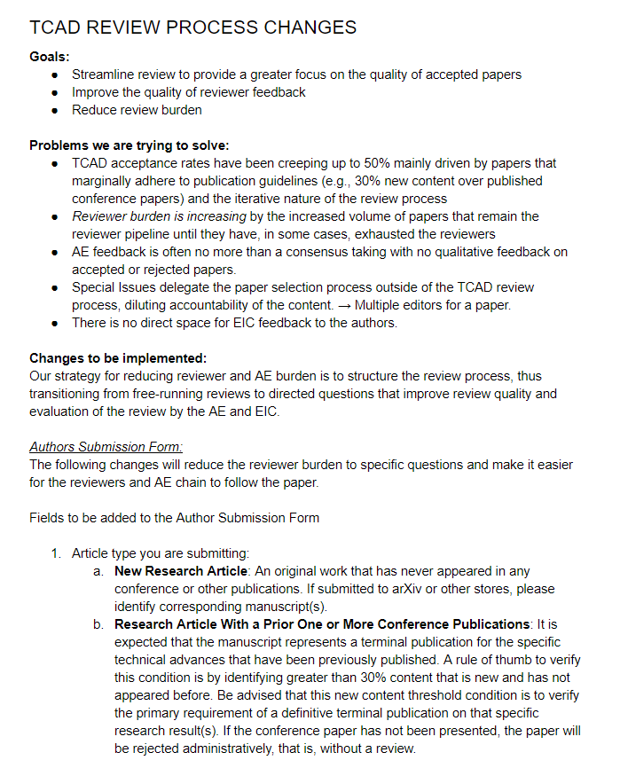
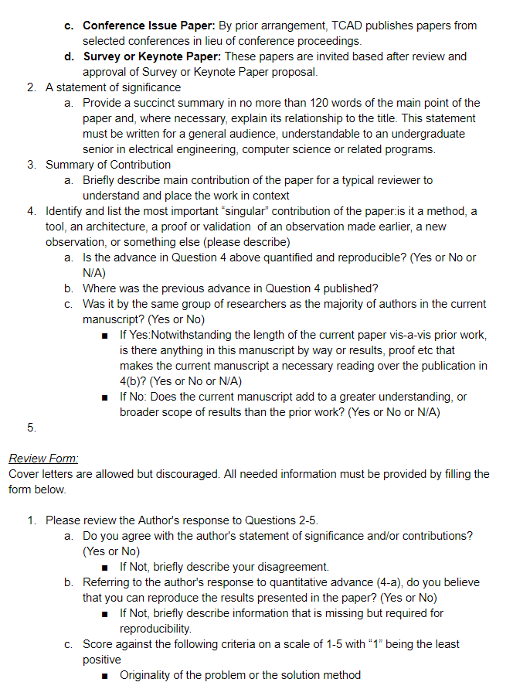
http://bit.ly/TCAD-REVIEW

Slide 14
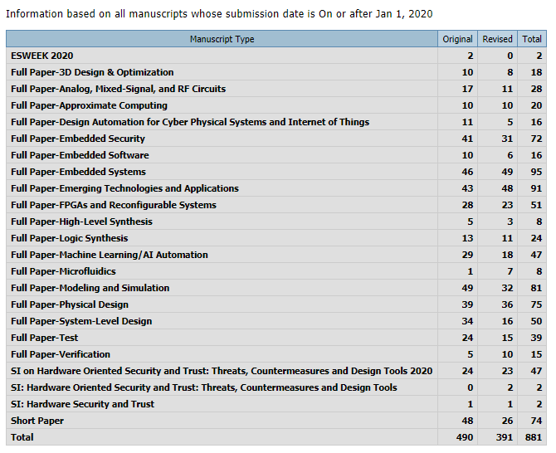
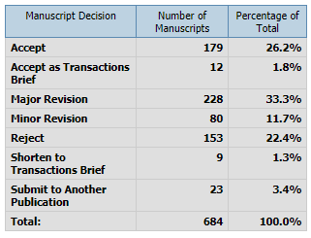
TCAD: Manuscripts Received in 2020
Manuscript Decisions Since 1/1/2020

Slide 15
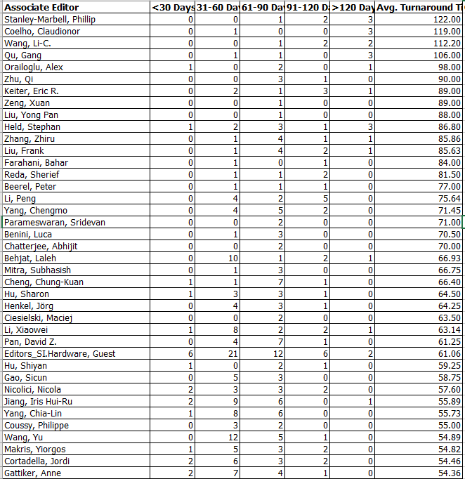
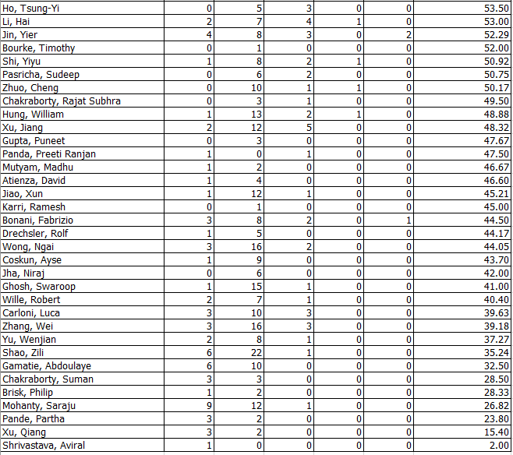
Turnaround by Editor, Average 59 days.

Slide 16
November 2020
EiC Jörg Henkel
A-EiC: Partha Pande

Slide 17
D&T
Status:
Well-filled pipeline of SIs throughout 2021 and beyond (see next three pages)
D&T covers all hot topics in design and test (e.g. good coverage in ML trends)
The magazine continues to be driven by SIs
Some SIs in past two years sometimes attracted < 5 papers since competition with other magazines/journals is high. But no problem since with well-filled pipeline, two SIs can be published in one issue if necessary.
We continue to have excellent content from industrial and academic leaders like keynotes, roundtables etc. -> distinction to journals

Slide 18
Special Issue Pipeline (1/3)
STATUS: Scheduled for / or published in 2020
Design and Management of Mobile Platforms (Scheduled for Sept/Oct)
VTS (Jul/Aug)
SBCCI (MayJun)
Robust Resource-Constrained Systems for Machine Learning (MarApr)
Embedded Intelligence in the Internet of Things (JanFeb)

Slide 19
Special Issue Pipeline (2/3)
STATUS: Submissions deadlines passed, not yet scheduled for publication:
Cross-Layer Design of Cyber-Physical Systems (Devendra, Chakraborty, Chen, Annaswamy). 16 submitted.
Embedded Intelligence in the Internet-Of-Things (Dick, Shang, Wolf, Yang).8 submitted.
Machine Intelligence at the Edge (Benini, Chen, Xiong, Zhang). 8 submissions.
Autonomous Systems Design (Saidi, Ernst, Ziegenbein, Deshmukh) 10 submissions
Hack@DAC (Holcomb, Garg, Rajendran) 5 submissions
Education for Cyber-Physical Systems (). 10 submissions.
OpenSource EDA, . 12 submissions.
HW-Security Top Picks (). 11 submissions.
Design and Test Solutions for Embedded Systems with Non-volatile Memories. (). No Submissions
SBCCI. 7 submissions.

Slide 20
Special Issue Pipeline (3/3)
STATUS: Calls Still Open:
ITC50
Stochastic Computing for Neuromorphic Architectures.
Near-Memory and In-Memory Processing.
Benchmarking Machine Learning Systems and Applications. submissions.
Plus:
3 more Special Issue proposals currently in approval phase by the D&T board

Slide 21
Preeti Ranjan Panda (Editor-in-Chief)
Aviral Shrivastava (Deputy Editor-in-Chief)

Slide 22
ESL - New Editorial Board from Jan 2020
Editor-in-Chief
Preeti Ranjan Panda, IIT Delhi
Deputy Editor-in-Chief
Aviral Shrivastava, Arizona State Univ.
Associate Editors (6 continuing, 17 new)
Hiroyuki Tomiyama
Ritsumeikan University
Ramesh Karri
New York University
Catherine Gebotys
University of Waterloo
Partha S. Roop
University of Auckland
Yiran Chen
Duke University
Donatella Sciuto
Politecnico Di Milano
ESL Editorial Board
Geographical Distribution
Jingtong Hu
University of Pittsburgh
Yun (Eric) Liang
Peking University
Rasit Topaloglu
IBM
Swagath Venkatramani
IBM
Gabriela Nicolescu
Ecole Poly. de Montreal
Yu Wang
Tsinghua University
Akash Kumar
TU Dresden
Ozgur Sinanoglu
NYU Abu Dhabi
Luigi Carro
UFRGS
Partha Pratim Pande
Washington State University
Francesca Palumbo
University of Sassari
Reiley Jeyapaul
ARM
Srinivas Katkoori
University of South Florida
Dip Goswami
Eindhoven Univ. of Tech.
Aritra Hazra
IIT Kharagpur
Soontae Kim
KAIST
Anupam Chattopadhyay
Nanyang Tech. Univ.

Slide 23
ESL: Statistics and Processing Times
Number of manuscripts: 159
Handled by new EB (Dec 2019 to Oct 2020)
Acceptance Rate: 26% (29% excluding minor revisions)
Processing times (Submission to Decision)
48 days
Improvement over 69 days (IEEE Q4 2019 report)

Slide 24
New ESL Feature: Video Preview
3-4 minute video advertisement for accepted papers
Prepared by author after paper acceptance
Hosted by IEEE
Attract new readers and drive curiosity/interest
Short preview ensures that video doesn’t substitute for paper download
Reviewed by AE (guidelines for author/AE to be developed)
IEEE working on operationalizing the feature

Slide 25
IEEE Journal on Exploratory Solid-State Computational Devices and Circuits (JXCDC)
E
September 2020
Azad Naeemi (EiC)
P
e
Y
μ_{B}
ε
M
σ
H

Slide 26
JXCDC – Status (June 2020)
 | Published
2015 | 12
2016 | 7
2017 | 12
2018 | 10
2019 Vol. 5 (Issues June & Dec) | 25
JXCDC Volume 5:
Regular Papers: (6 papers published)
Special Topic #1 - Pub. with June Issue (6 papers published)
Special Topic #2 - Pub. with Dec. Issue (6 papers published)
Special Topic #3 - Pub. With Dec. Issue (7 papers published)
2020 Vol. 6 (Issue 1 - June) | 12
CiteScore Three-Year Impact Factor for 2019: 3.4
https://www.scopus.com/sources.uri

Slide 27
JXCDC – 2020 Status (Sept. 2020)
Number of articles published in 2019 and 2020 as of Sept. 19th
2019 – 25 papers,
2020 – June Issue, 12 papers (18 submissions)
10 Special Topics papers
2 Regular papers
2020 – December Issue
3 regular papers accepted.
2 special topic paper accepted and 2 going through minor revisions.
Another special topic is due in mid-October (3 submissions so far)
Statistics on turnaround times (2020):
Average time between original submission and original decision (30 days)
Average time between original submission and final decision (55 days)

Slide 28
JXCDC – Special Topics for 2020
JXCDC 2020 Special Topic #1 (closed on Feb 1st 2020), Part 2, Issue 1 “Exploratory Devices and Circuits for Compute-In-Memory” (Guest Editor Prof. Shimeng Yu, Georgia Institute of Technology) (14 papers submitted, 10 accepted and published)
JXCDC 2020 Special Topic #2 (closing on July 30th 2020), Part 2, Issue 2 “Tunneling FETs for Energy-Efficient Computing & Information Processing” (Guest Editor: Dr. Uygar Avci, Principal Engineer, Intel Corp.) (5 papers submitted, 2 accepted, 2 still being reviewed)
JXCDC 2020 Special Topic #3 (closing on Sept 30th 2020), Part 3, Issue 2 Coupled Oscillators for Non- von Neumann Computation (Guest Editor: Prof. Chris Kim, University of Minnesota) (Submission Deadline: Oct. 15)

Slide 29
JXCDC – Plans for 2020 and 2021
Paper solicitation is JXCDC’s highest priority with focus on:
Special Topics – New “Call for Papers” sent 3 or 4 times per year (with sponsor support of distribution)
Next call (open in Oct. 2020): Monolithic 3D integration for future computing
Awaiting an Impact Factor now have published 25 papers in 2019.
Request support from IEEE to monitor the status and avoid misunderstanding in the past about the requirements
Rotate and increase number of AEs.
Have EDS become a financial sponsor
Increase Steering Committee involvement/support
Considered having a Poster Session at IEDM 2020 (COVID-19 ?). Will reconsider for 2021.

Slide 30
JXCDC – Editorial Board
Editor-In-Chief:
Prof. Azad Naeemi Georgia Institute of Technology
ASSOCIATE EDITORS :
Materials and Magnetics: Prof. J. P. Wang, University of Minnesota
Materials and Electronics: Prof. Suman Datta, University of Notre Dame
Electronics and Magnetics: Dr. Zoran Krivokapic
Materials and Devices: Prof. Sayeef Salahuddin, Univ. of California at Berkeley
Circuits and Architecture: Prof. Naresh Shanbhag, Univ. of Illinois at Urbana- Champaign
Circuits and Architecture: Prof. Vijaykrishnan Narayanan, Penn State University
Devices, Circuits, and Architecture Prof. Shimeng Yu, Georgia Institute of Tech.

Slide 31
JXCDC Steering Committee Members
Professor H. S. Philip Wong, Electron Devices Society, Chair
Dr. Ian A. Young, Solid-State Circuits Society
Professor John R. Long, Solid-State Circuits Society
Professor Randall H. Victora, Magnetics Society
Professor Vladimir Stojanovic, Circuits and Systems Society
Professor. Sayeef Salahuddin, Electron Devices Society
Professor Yiran Chen, Council on Electronic Design Automation
Dr. Elie K. Track, Superconductivity Council

