Slide 1
DAC 2023 Updates
L. Miguel Silveira
April 16th 2023

Slide 2
Report Overview
DAC 2023 Program
Financial Situation
Future Outlook

Slide 3
DAC 2023 Program – 60th DAC!!
Program publicly available
Lots of hard work from EC volunteers
3 Keynote presentations, 4 visionary talks, 3 Sky Talks and 3 Techtalks
Strong Research and Engineering programs
DAC Pavvilion, Exhibition

Slide 4
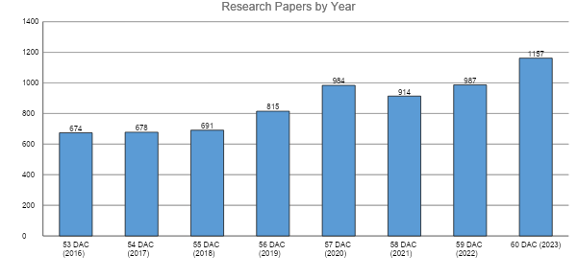
DAC 2023 Program – 60th DAC!!
266 TPC members in 29 tracks, 33 subcommittees
1157 submissions, 263 accepted (22.7%)
17% increase in submissions, lots of momentum!!
Continued increase from Asia
Hoping for no attendance issues

Slide 5
DAC 2023 Program – 60th DAC!!
Additionally 9 Research Panels, 9 Special sessions
Including 60th DAC Celebratory Panel
Also 6 Sunday Workshops (from 10 submissions), 12 Monday Tutorials (from 20 submissions)
Engineering Track also going strong
108 submissions, 24 accepted, plus 30 posters,
3 invited sessions, 4 submitted sessions
DAC Pavillion presentations (18 sessions, 3 per day)
Considerable Focus on AI: AI Day (Wednesday), AI HW Alley, etc

Slide 6
DAC 2023 Program – 60th DAC!!
Usual strong Student/Early Career Program
Co-sponsored between CEDA and ACM SIGDA
DAC PhD Forum
University Demos
DAC Early Career Workshop
DAC System Design Contest
Hack@DAC
Young Fellows Program (104 applications in 2022, vibrant, handled by DAC)

Slide 7
DAC 2023 Finance and Planning
CEDA chairs the Sponsor’s Committee
Financial situation is difficult (dire really!)
DAC was one of CEDA’s best sources of income
DAC has not provided any surplus since 2019!
Covid, of course, partially explains this
Huge loss in 2020, marginal gain in 2021, 2022
60th DAC was planned to be celebratory
Original plans included several possible celebration events
San Francisco is an expensive city, unionized, hard to avoid costly expenses
Original budget was “expense-balanced” (no surplus, no overhead)
Several “questionable” expenses (traditional way of doing things)

Slide 8
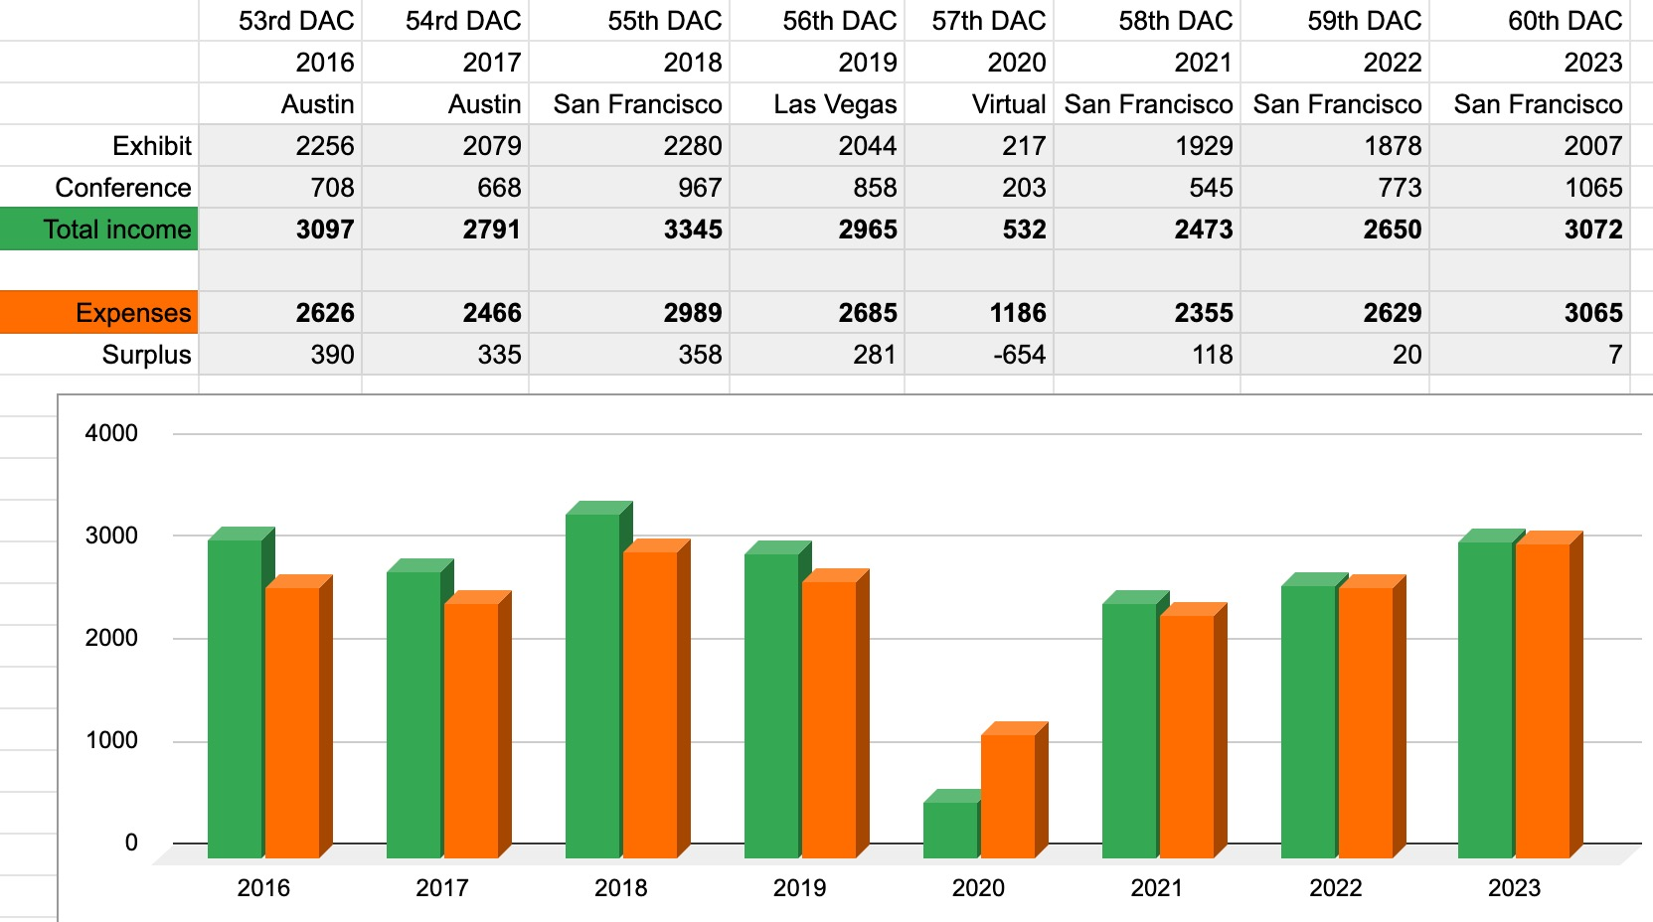
DAC Income and Expenses over the Years ($K)
Pre-covid
Reference
year
2023 Budget
Raised Conference fee by 15%
Authors pay same rate as members
60th Celebration
Various cuts

Slide 9
DAC 2023 Finance and Planning
Original budget was “break-even”
Income (barely) covered expenses
No surplus but ACM required overhead (similar situation to ICCAD)
Technical “Conference” is doing well, perhaps not great
Exhibition lacking significantly
Consolidation in industry a problem, lack of new players appearing
Difficulty in attracting neighbor markets
Synopsys always a ”tough cookie”
In February Synopsys decided not to participate
Huge income loss (> $100k)
Cadence also reduced support subsequently but did not drop out!

Slide 10
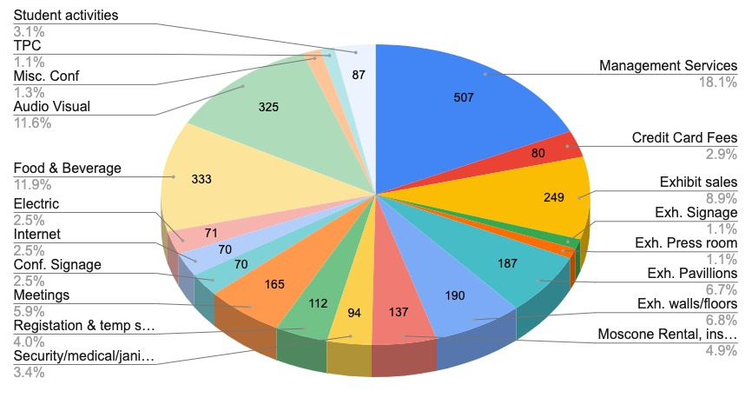
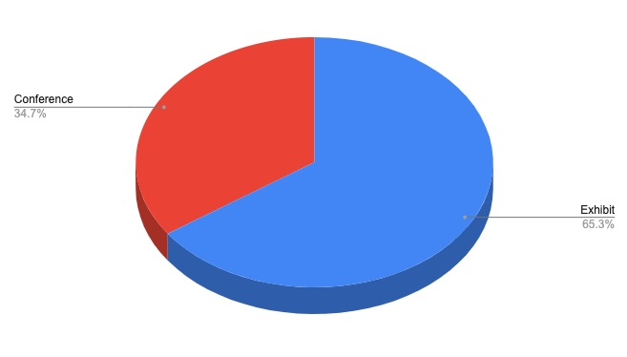
2023 DAC Expenses Detail (Approved Budged)
Income:
Expenses:
Conference
1065K
$3,072K
$3,065K
Exhibit
2008K
-$105K Synopsys

Slide 11
2023 DAC: Updated (targeting break-even)
Synopsys dropped out, Cadence reduced support, struggling to break even
-$9K
-$6K
-$45K
-$17K
-$10K
-$10K
-$12K
-$3K
11

Slide 12
DAC 2023 ► 2024 Finance and Planning
Major expense items are:
Conference management, overly expensive ($500K)
Currently negotiating necessary reduction! If not successful need to go for bids!
Moscone ($190K), Food and Beverage ($350K), Internet
Not changing, committed for 2024, looking at options for 2025, possibly Austin
A/V ($500K), Exhibition (Sales, room, etc, $440K), Registration ($112K)
Will go for RFPs for 2024 hoping to find cost reduction
Direct, EC costs ($165K)
Will impose restrictions on costs, support
Ending collocation with SEMI in 2023
Must handle direct contracting for 2024: IEEE & ACM helping

Slide 13
DAC 2024 Challenges / Outlook
Tough road ahead
Clear clash of perceptions, hard to change “old” ways
Many things are still being done/seen as in past times (same people!)
Advisory Committee was setup and started working: experienced people, will help
Location issues
San Francisco too expensive, need to relocate, considering Austin every other year
But need to ensure exhibitors accept move
2024 Conference/Budget preparations starting
2023 Budget was approved with several strong warnings for 2024 (before SYN drop out)
ACM has stated it will not approve a budget without surplus (overhead & contingency)

