Slide 1
IEEE CASS News
CASS representative: Ricardo Reis
July 2023

Slide 2
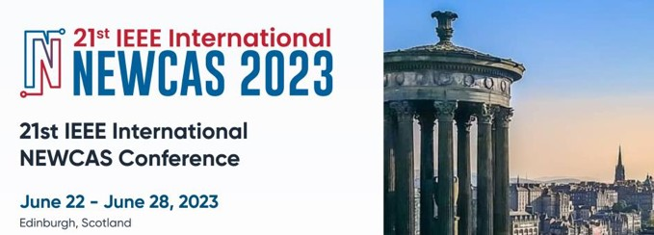
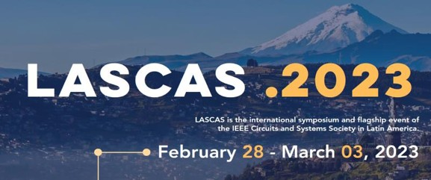
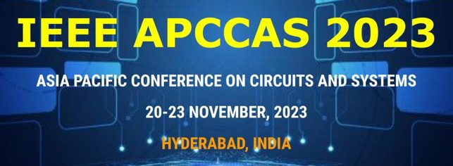
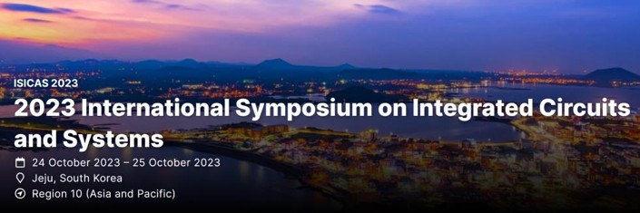
CASS Conferences 2023
Global Flagship Conference
Int. Symp. on Circuits and Systems (ISCAS)
Regional Flagship Conferences
Monterey (CA), USA, 21-25 May 2023
Phoenix (AZ), USA 6-9 Aug 2023
Edinburgh, Scotland 26-28 June 2023
Istanbul, Turkey 4-7 Dec 2023
Quito, Ecuador 28 Feb - 3 Mar 2023
Hyderabad, India 20-23 Nov 2023
Premier Conferences
Hangzhou, China 11-13 June 2023
Jeju, South Korea 24 - 25 Oct 2023
Toronto, Canada 19-21 Oct 2023
46

Slide 3
Conferences
New! 2024 Conference Features
CASS Flagship Registration Discount for Low-Income Countries and low-middle- income economies in 2024 at 50% of regular rate
As defined by the World Bank Country and Lending Groups list, who are residing and working in their countries.
Norm extended to 82 countries (28 low-income and 54 low-middle-income economies)
Registration fees are not aligned to the reality of affordability in countries where the per capita Gross National Income (GNI) is US $4,300 or less
Lowering financial barriers to participate at conferences
4

Slide 4
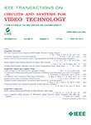
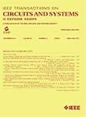
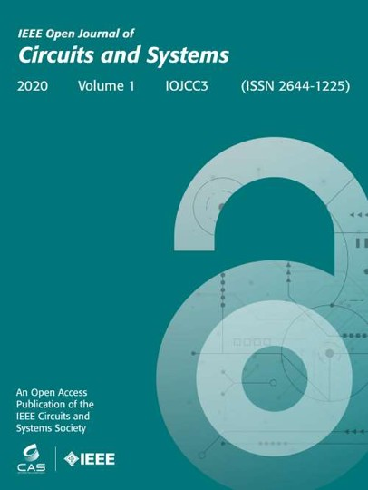
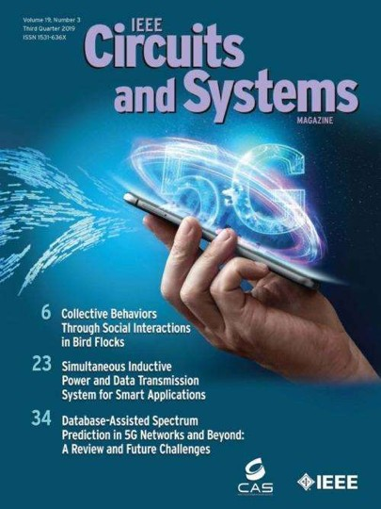
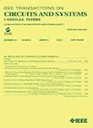
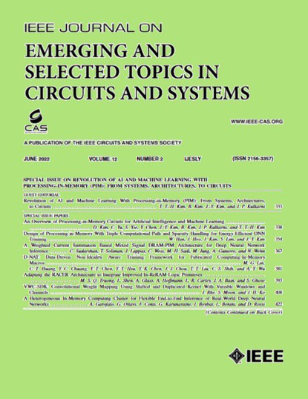
Publications
Fully-Sponsored Periodicals
IEEE Trans. on Circuits & Systems – I Regular Papers (TCAS-I)
IEEE Trans. on Circuits & Systems – II Express Brief (TCAS-II)
IEEE Trans. on Circuits & Systems for Video Technologies (T-CSVT)
IEEE J. on Emerging Topics in Circuits & Systems (JETCAS)
IEEE Open Journal on Circuits and Systems (OJCAS). Full OA journal
IEEE Circuits and Systems Magazine (CASM)
5

Slide 5
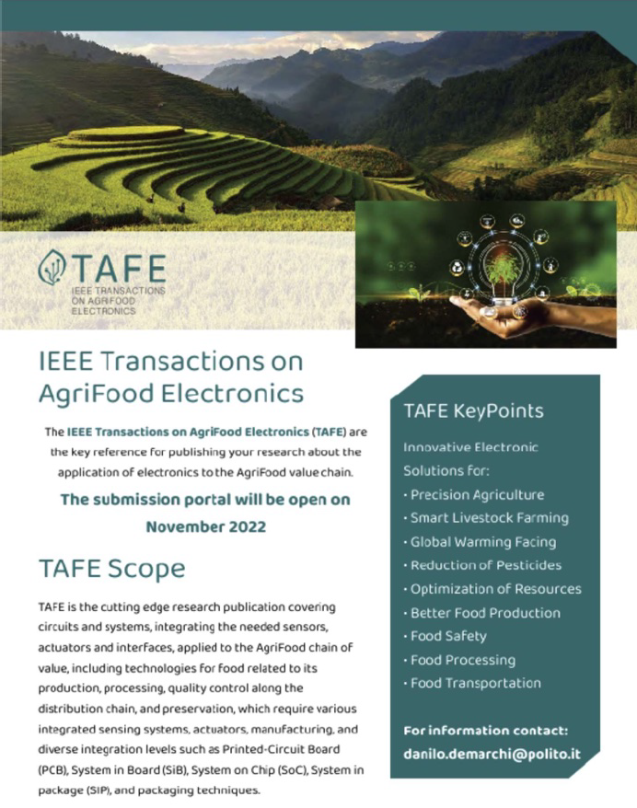
Publications
Periodicals co-sponsored with other IEEE Societies
IEEE Trans. on Biomedical Circuits & Systems (TBioCAS). 80%
IEEE Trans. on Agrifood Electronics (TAFE). 57%
IEEE Trans. on Network Science and Engineering (TNSE). 50%
IEEE Trans. on Very Large Integrated Circuits (TVLSI). 40%
IEEE Design and Test Magazine (DTM). 33.3%
IEEE Trans. on Multimedia (TM). 25%
IEEE Trans. on Mobile Computing (TMC). 25%
IEEE J. on Exploratory Solid-State Computational Devices and Circuits (JXCDC). 11%
IEEE J. on Flexible Electronics (J-FLEX). 10%
6

Slide 6
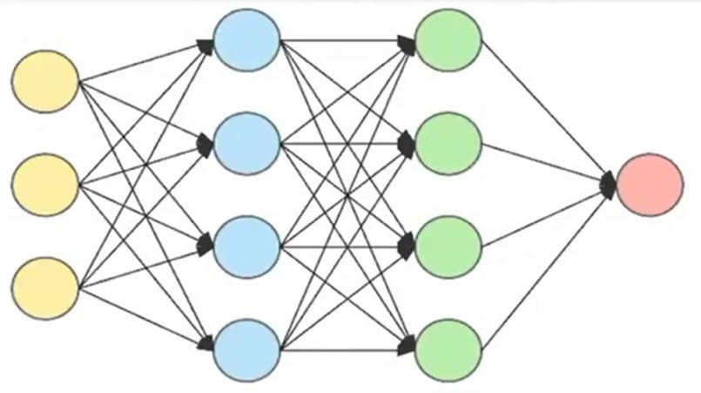
Publications
NEW! IEEE Magazine on Radio Frequency Integrated Circuits. 33.3%
NEW! IEEE Trans. on Circuts and Systems for Artificial Intelligence (TCASAI)
Phase I proposal approved by IEEE TAB (June 2023)
Scope: TCASAI publishes contributions related to circuits and systems for artificial intelligence, including circuit design, hardware-software co-design, and electronic system design, implementation and demonstration
Additional Societies to join in Phase II
Target launch: mid 2024
7

Slide 7
Publications

Slide 8
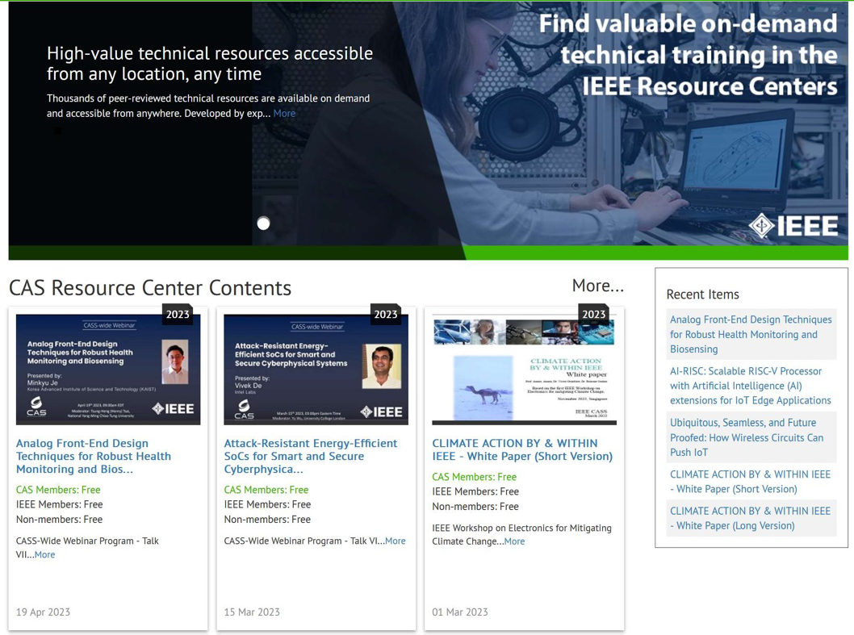
Education
New CASS-wide webinar program to deliver high-quality talks on the FoI of the circuit and systems community
Enhanced CASS Resource Center
Selected keynotes from flagship conferences
Seasonal Schools
White papers…
New educational paradigm: CASS MiLe
8

Slide 9
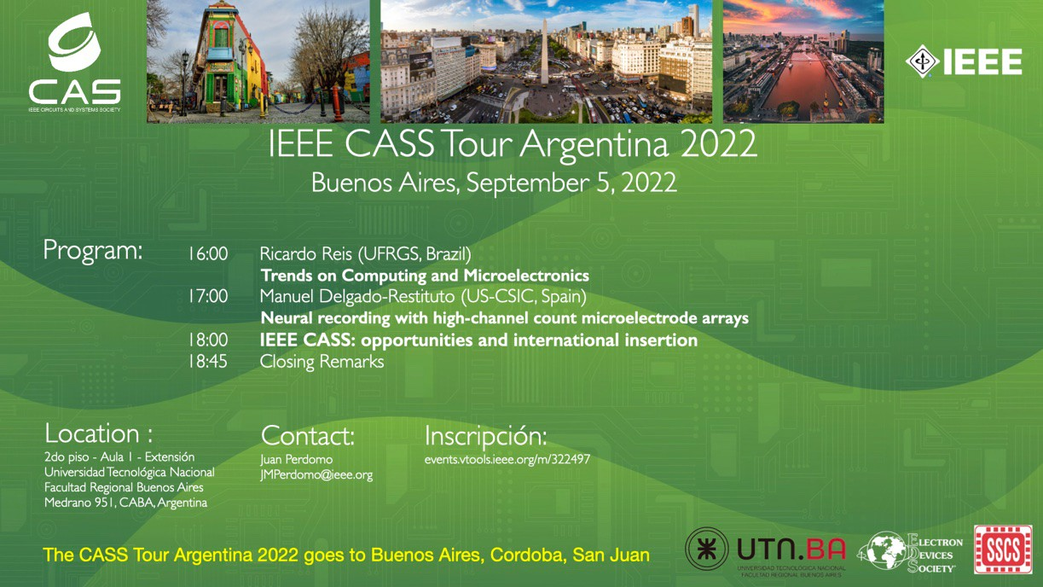
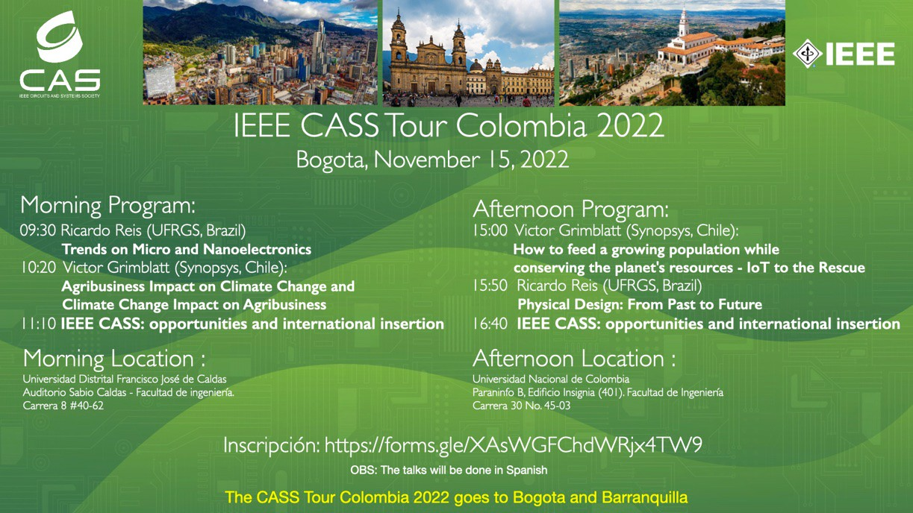
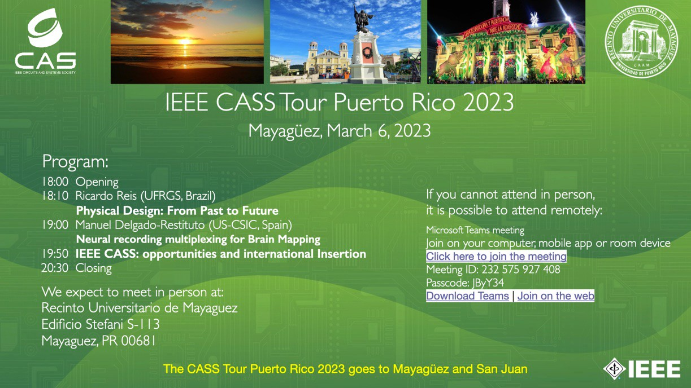
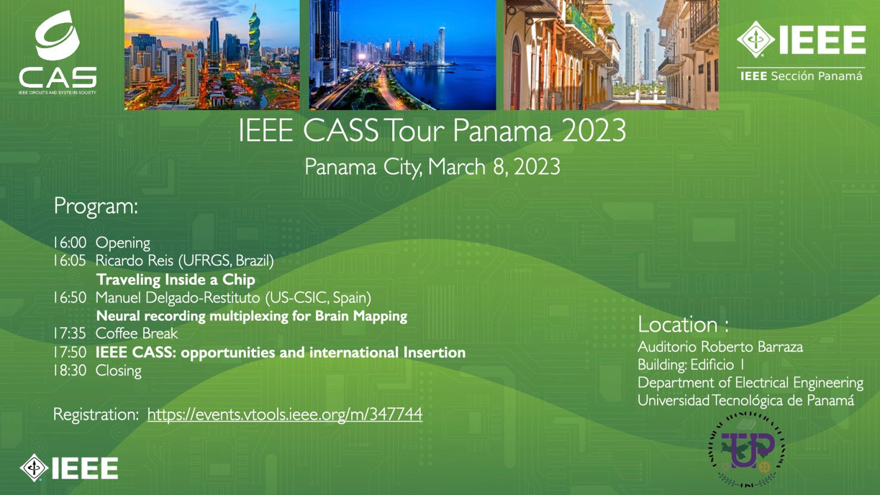
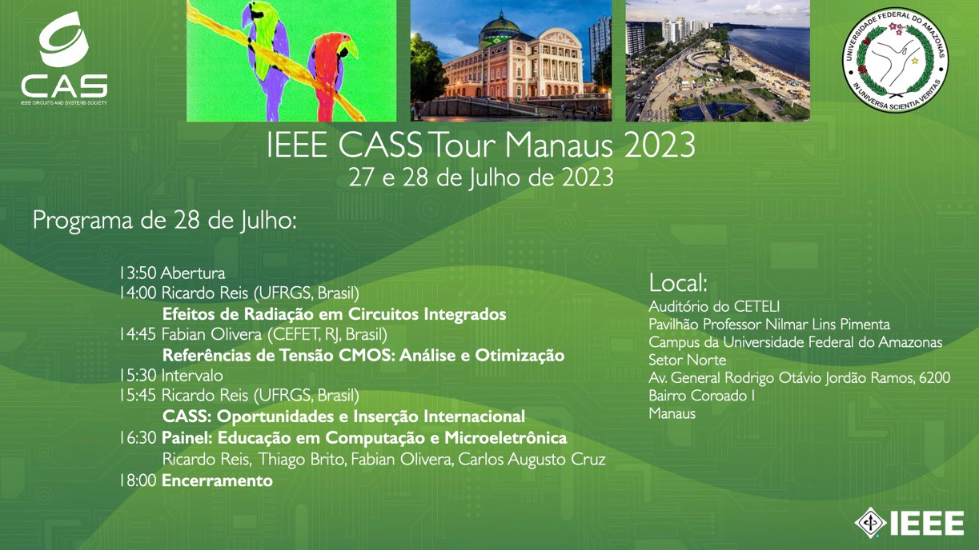
IEEE CASS Tours in Latin America
The CASS Tours already went to Buenos Aires, Cordoba, San Juan (Argentina), Bogota, Barranquilla, Mexico City, Puebla, Guadalajara, Veracruz, Rio de Janeiro, Mayaguez, San Juan de Puerto Rico, Panama, Morelia, Monterey, Santa Maria, Cuenca, Guayaquil.
Some of NEXT CASS Tours: Manaus, Trujillo, Arequipa, Lima, Santiago de Chile, Valparaiso, Cartagena, Barranquilla, Brasilia,…

Slide 10
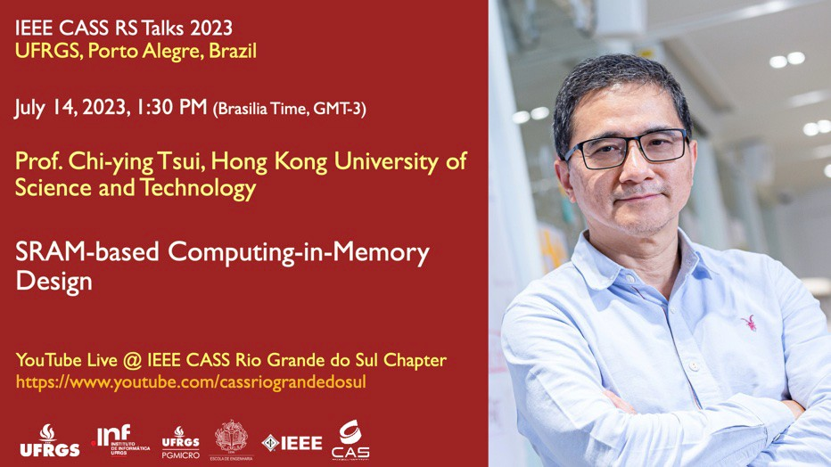
IEEE CASS Talks by CASS Rio Grande do Sul Chapter
Some of the 2023 CASS TALKS
More than a 150 talks in the CASS Rio Grande do Sul YouTube Channel including Industrial Talks

Slide 11
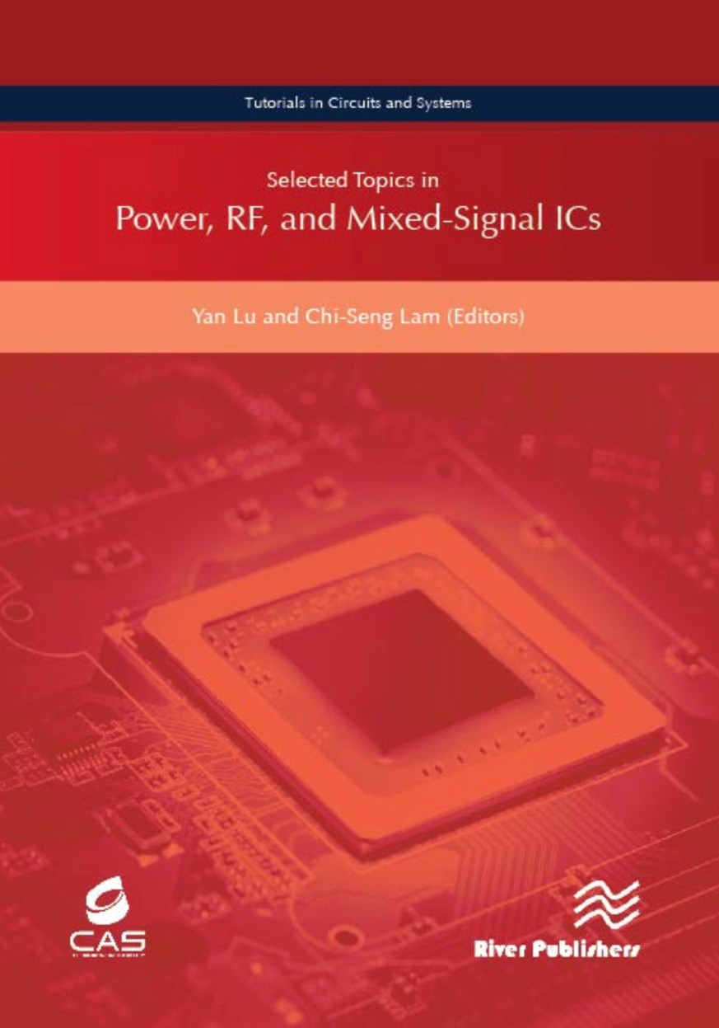
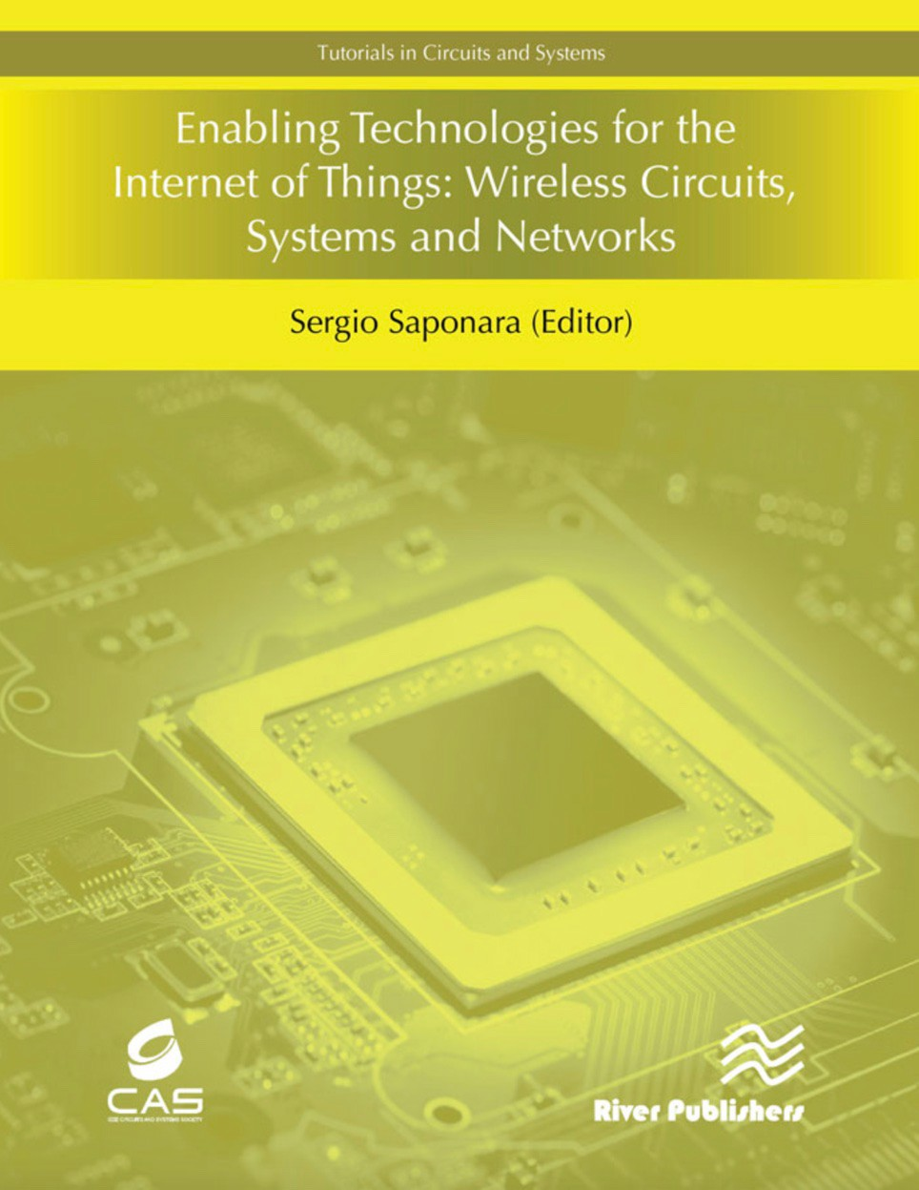
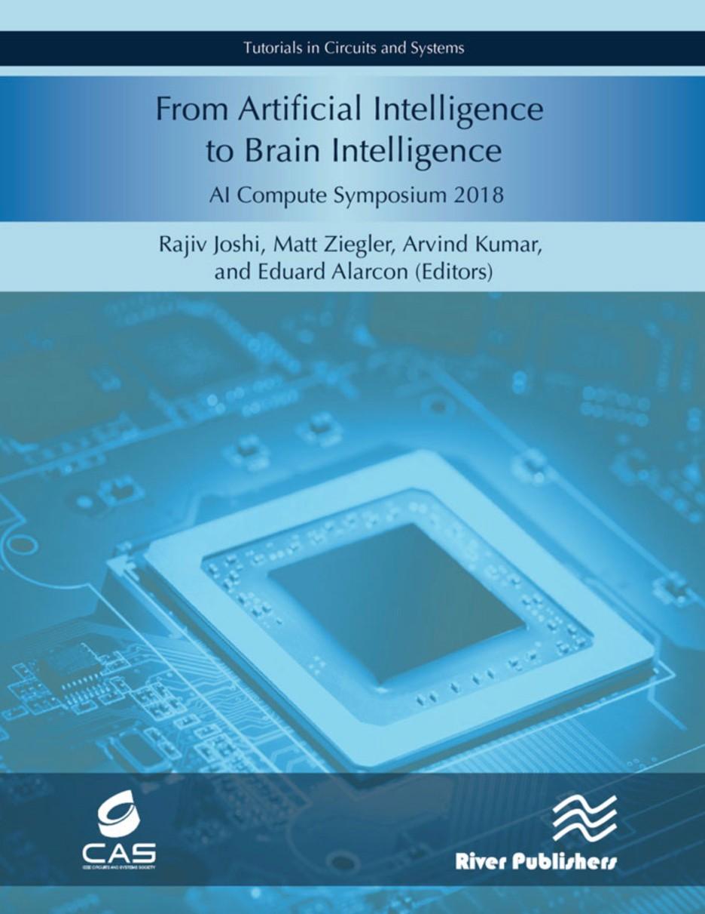
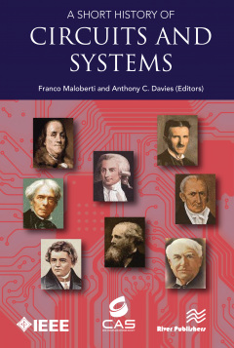
CASS eBooks
The pdf version is free for CASS members About US$10 for other IEEE members
11

Slide 12
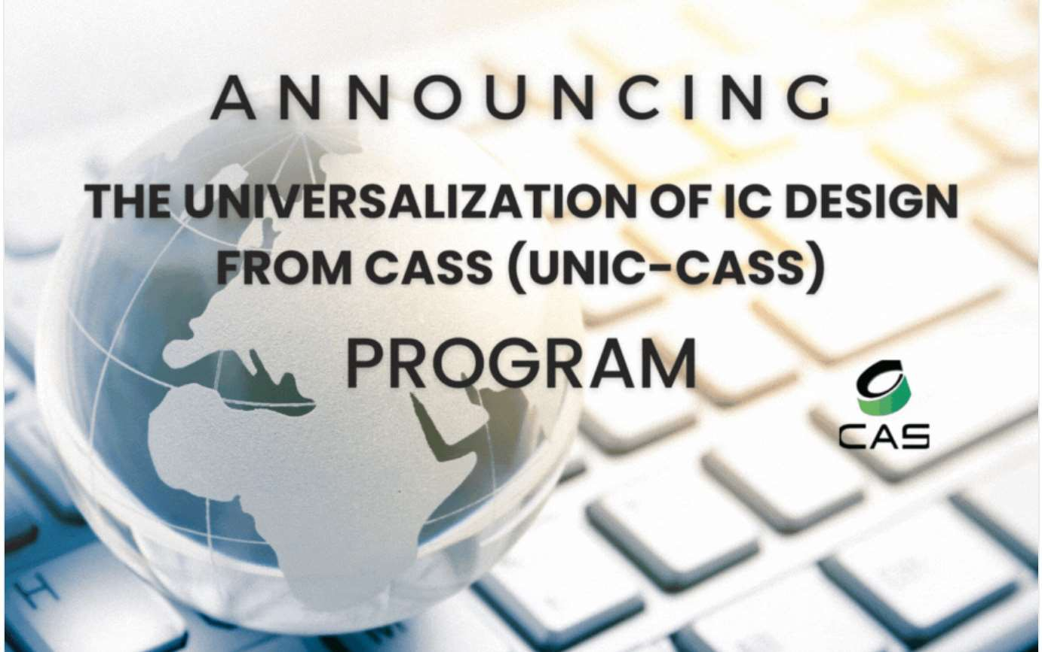
Education
New! UNIC-CASS
The Program aims to improve the know-how and accessibility to IC Design technologies for design communities worldwide in low- to-middle-income and/or low-opportunity countries
Open source ecosystem through Google efabless
9

Slide 13
Membership Programs
CASS student membership fee for 2024
CASS electronic membership fee discount program in 2023 for student members residing in Developing Nations (50% off) and Low-Income Countries (80% off)
No promotional codes needed
US $6 - IEEE CASS Membership for student members in Developing Nations
US $2 - IEEE CASS Membership for student members in Low-Income Countries
10

Slide 14
Membership Programs
SPECIAL MEMBERSHIP OFFER FOR 2024
Try
IEEE members, who have never been CASS members, can join CASS for free for a year!!!
Promotion codes for students and professionals available during the 2nd semester of 2023
11

Slide 15
CASS SET of CALLS
Outreach Initiative: 2 runs per year
Student Travel Grants: 4 runs per year for CASS Flagship Conferences
1 run per year for CASS non flagship conferences
CASIF (CASS Industry Forums): events with industry
Seasonal Schools: 2 runs per year
Student Design Competition: finals at ISCAS
Predoctoral Grants Distinguished Lecture Program CAS Micro Learning (MiLe)
Women in CAS Program (WiCAS) UNIC-CASS

Slide 17
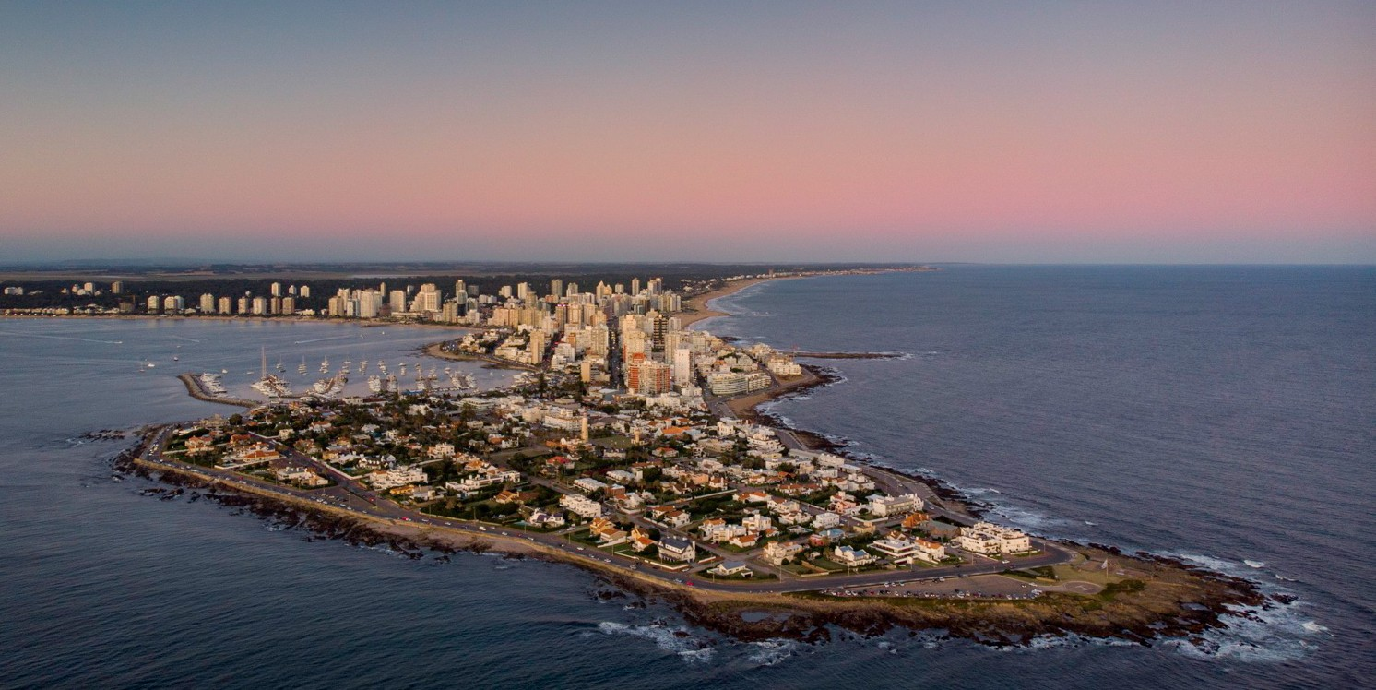
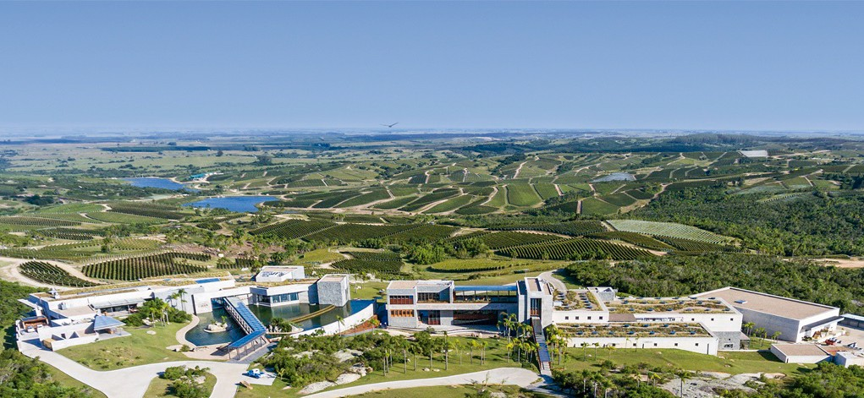
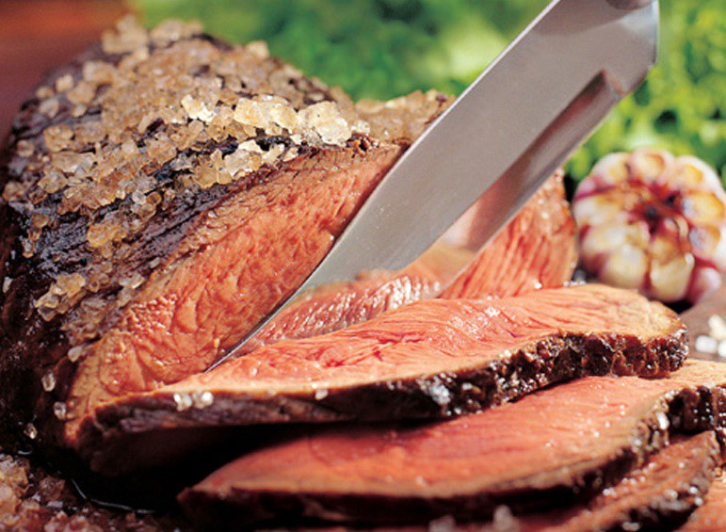
LASCAS2024
Punta del Este, Uruguay
February 27 - March 1, 2024

Slide 18
CASS 75th Anniversary
12

Slide 19
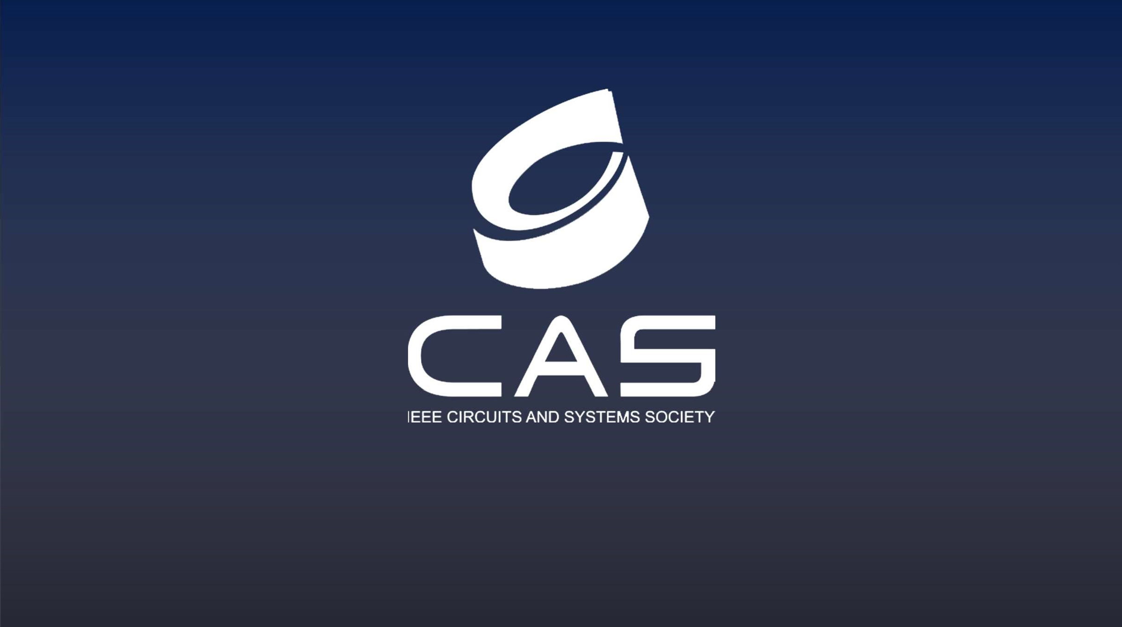
For more information and to join CASS, visit: IEEE-CAS.ORG

