Slide 1
Computer Society Report
Ramesh Nair
07/09/2023

Slide 2
About Computer Society:
Largest Global Community of Computer Scientists & Engineers.
375K+ community members, 168 countries, 654 chapters.
Leading developments & advancements in CS with 189+ International conferences and 3113+ technical and networking events.
12K+ volunteers and 619 committees/boards.
https://www.computer.org/

Slide 3
Major Conferences with CEDA interest:
2023 IEEE COMPSAC → CS Flagship Conference
27-29 June 2023, Torino, Italy
2023 Asian Test Symposium (ATS 2023) → CEDA and CS are financial sponsors.
14-17 Oct 2023, Beijing, China
2023 IEEE Test Conference in Asia (ITC-ASIA 2023) → CEDA and CS are technical co-sponsors.
12-14 Sept 2023, Matsue, Japan
2023 IEEE COINS → CEDA and CS are financial sponsors.
23-25 July 2023, Berlin, Germany

Slide 4
Standards:
IEEE Computer Society has 2 standards committees that are of interest to CEDA
IEEE CS Design Automation Standards Committee (DASC) - https://sagroups.ieee.org/dasc/
IEEE CS Test Technology Standards Committee (TTTC) - https://sagroups.ieee.org/ttsc/

Slide 5
Education & Career:
Online resources with interest to CEDA including newly added courses on AI and Cyber Security. Visit https://www.computer.org/education

Slide 6
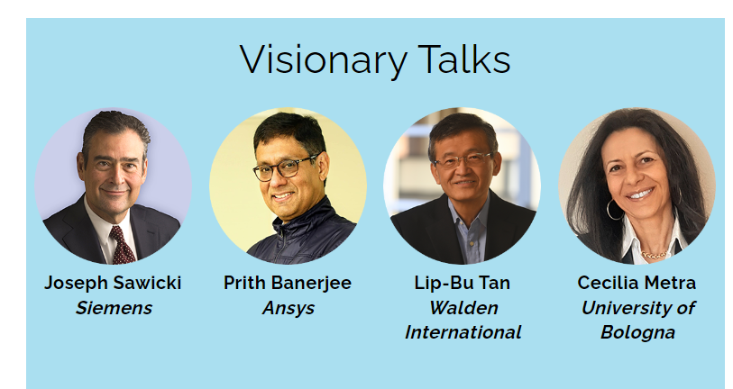
Leadership with CEDA background:
Dr. Cecilia Metra is the Past CS President & current Division Director of IEEE.

Slide 7
Collaboration with CEDA:
Would love to collaborate with CEDA to host workshops/panels/meet-ups for early/mid career professionals at our conferences.
Ideas and suggestions welcome!

Slide 8
Thank You!
Ramesh Nair
rameshnair@ieee.org

