Slide 1
Design Automation Technical Committee
Jinwook Jung
IBM Research
IEEE CEDA BoG Meeting @ DAC 2023
July 9th, 2023
Notes:
Hi I am Jinwook Jung from IBM Research, and I am the chair of the Design Automation Technical Committee.

Slide 2
Design Automation Technical Committee (DATC)
A technical committee of IEEE Council on EDA (CEDA)
Established to provide a forum for discussing strategies and issues in design automation
Web page: https://ieee-ceda.org/technical-committee/datc
Current roster (as of July 1st, 2023):
Jinwook Jung (IBM Research)
Andrew B. Kahng (UCSD)
Rhett Davis (NCSU)
Notes:
The mission of DATC is stated in this slide.
Our mission is to provide a forum for discussing issues and strategies in design automation technology.
Having this mission, our current committee members are shown here.
I myself serve as the chair of the committee starting last year, together with Prof. Andrew Kahng of UCSD, who serves as the co-chair of DATC.
And starting this year, we are trying to bring new blood in DATC, and so we are actively recruiting new committee members.
Prof. Rhett Davis of NC State University has recently joined our committee.
He is an expert of 3D IC and low power circuit designs, and probably most renowned for the FreePDK development.
We are also looking for one or two more committee members hopefully from industry, and we hope to have a complete roster soon.

Slide 3
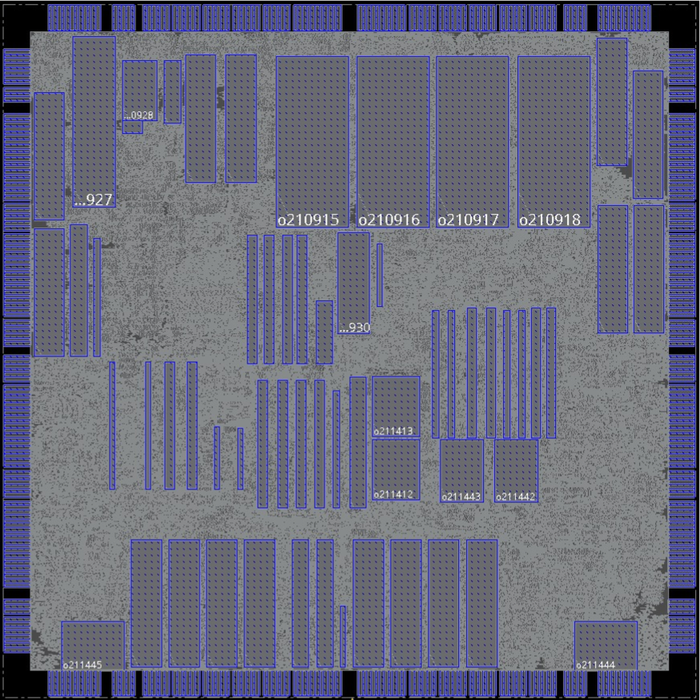
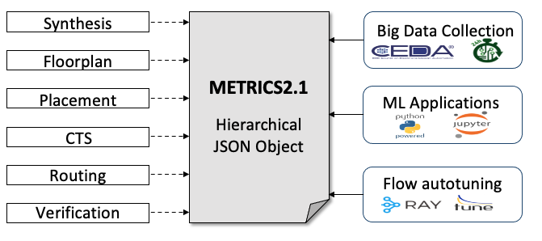
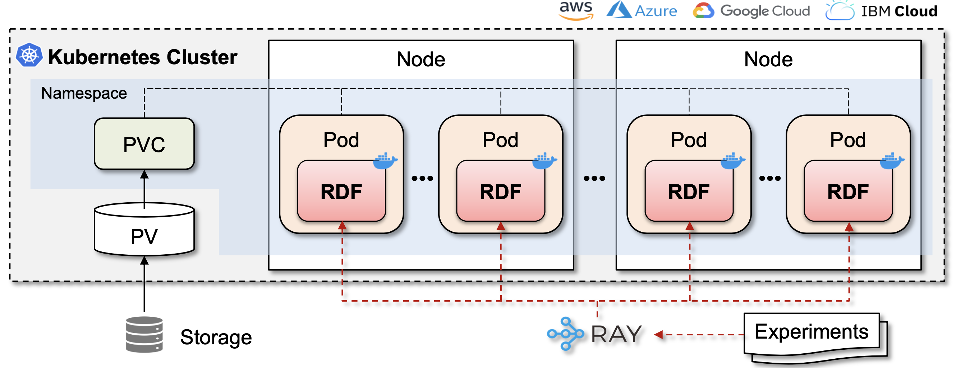
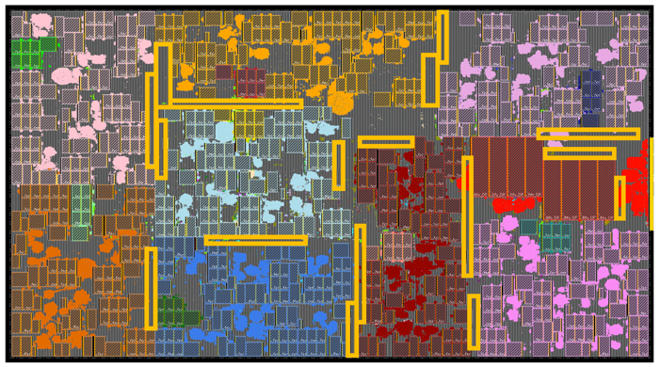
DATC Goals: 2022-2023
Goal: expand research foundations for Physical Design and ML-CAD
RosettaStone benchmark converter with more benchmarks and timing-sensible version
Native JSON implementation of METRICS2.1 and its deployment
Augmented calibrations dataset for electrical analysis and verification tasks
Macro placement benchmarks and macro placer for large-scale designs
Cloud-native enablement of large-scale design of experiments for ML-enabled EDA
adaptec
NanGate45
Calibration
Dataset
Macro placement
Notes:
So this slide describes what we’d like to go after from this year and beyond.
The goal is to establish and expand research foundations for IC Physical Design and ML-Enabled EDA.
With that goal, here are four tasks that we would like to carry out.
First, we would like to build modern complete benchmarks for physical design.
There has been many classical benchmarks, but the issue we see is that they are either too old or incomplete.
For example, the placement benchmarks from ISPD’05/06; the benchmarks are in bookshelf format, so it is virtually impossible to use such benchmarks for the flow-scale evaluation.
To cope with such issue, we DATC will try to enable modern and complete benchmark suites.
Secondly, we’d like to build a golden calibration dataset for analysis and verification tasks.
The golden dataset will be generated from industrial golden tool chains, and it will include timing analysis data, RC extraction data, IR analysis data, and more.
We hope the dataset to be used for diagnosing and improving analysis and verification accuracy, especially in open-source tools.
Next, we would like to propose standardized metrics system.
The purpose of this activity is to measure all design activity during the flow, mine abundant data and metrics, and share them in a common and tool-agnostic manner.
With such metrics format, we would like to establish a standard platforms for measuring and sharing design activities, in an interoperable and unambiguous manner.
Finally, we’d like to establish a generic cloud enablement for large-scale design of experiments.
The interests in ML-enabled CAD have been increasing, but generating large amount of data for ML-CAD needs huge amount of compute resources.
We would like to bring attention to cloud computing, which is now prevalent to us, and we will try to answer how we should best-utilize public cloud to generate large data for ML-CAD research.

Slide 4
DATC Activities 2022-2023
[Nov 2022] Invited paper presentation at ICCAD 2022
[Nov 2022] Presentation at IEEE CASS Seasonal School: AI/ML for IC Design and EDA
https://youtu.be/-aDYrBc7NzY
[Nov 2023] Invited paper presentation at ICCAD 2023
Notes:
Now, here are our plans for this year.
The first item, ASP-DAC tutorial, has completed already.
We had tutorial at ASP-DAC 2022 in Jan, and advertised our activities toward standard platform for IC physical design and ML-enabled EDA.
We also plan to have invited paper and presentation at this year’s ICCAD, trying to formalize our efforts about the Expanding Research Foundations for IC Physical Design and ML-Enabled EDA.
We will also bring in a few more committee members, hopefully from industry.
And finally, we will try to populate public code and data repositories for the four tasks stated in the previous slide.

