Slide 1
IEEE-EPS Report
Jose Schutt-Aine
July 9, 2023

Slide 2
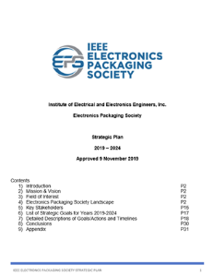
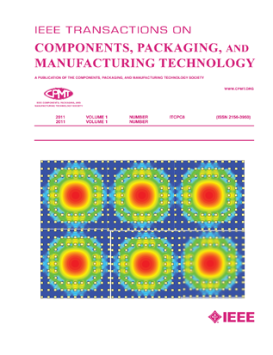

IEEE EPS – Significant Worldwide Footprint
EPS is a small part of the IEEE organization, with just ~2300 members compared to the 400,000+ IEEE members worldwide
EPS has 40 Chapters, 27 Student/Branch Chapters
12 Technical Committees
Peer Reviewed Transactions
Supports Financially and/or Technically Sponsors /Cosponsors more than 25 Conferences in 2021
Conferences hosted about 4500 attendees in total
Solid Education Program
Strong Awards Program
Heterogeneous Integration Roadmap (3rd Edition)
All the Above Supported by our Strategic Plan (2019 – 2024)
2

Slide 3
IEEE EPS Partnering Ongoing
Africa EPS Conference in Addis Ababa, Ethiopia (2022 & 2023)
India IESA Workshop in Bangalore (2022 and planning in place for 2023)
IEEE TAB Initiatives Participation
  Quantum, Nanotechnology, FNI and Digital Reality
New student and regular chapters around the world being formed
EPS BOG membership participating in IEEE sponsored meetings, workshops, and adhocs
Member of New Fellow Process Adhoc Committee
IEEE TAB Initiatives Participation
  Quantum, Nanotechnology, FNI and Digital Reality
Working within IEEE and potential outside universities for education, development of Advanced Packaging Curricula/Webinars and more.
Many Other….

Slide 4


Slide 5
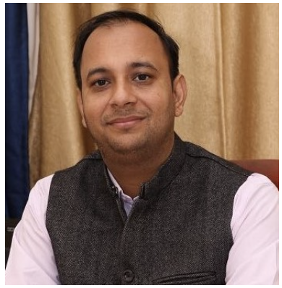
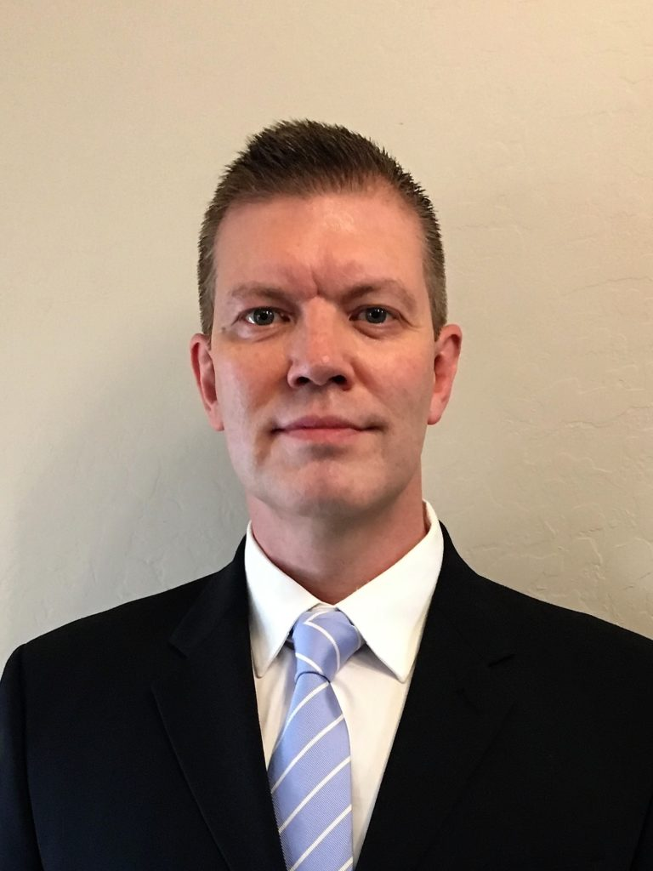
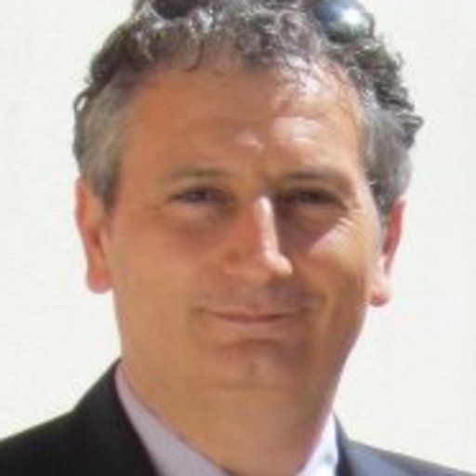
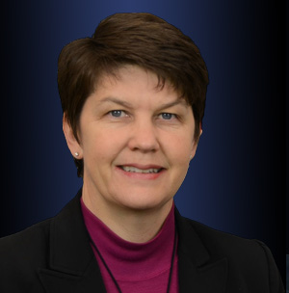
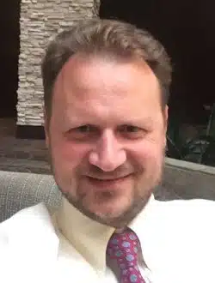
EDMS Technical Committee
Leadership:
  Prof. Rohit Sharma, Indian Institute of Technology Ropar, India (chair)
  Dr. Kemal Aygun, Intel Corporation, Chandler, Az, USA (co-chair)
  Prof. Antonio Maffucci, Univ. Cassino and South. Lazio, Italy (co-chair)
Subcommittee: Packaging Benchmarks
  Dr. Heidi Barnes, Keysight (Chair)
  Prof. Vladimir Okhmatovski, Univ. Manitoba, (co-Chair)
  Three Benchmark subcommittees
Members – 78 on mailing list
Website: https://cmte.ieee.org/eps-edms/

Slide 6

Mission
The EDMS TC addresses the electrical aspects of package and system design.
The committee strives to balance industry and academic participation to guide the members of the EPS society in this area.
Activities
EDMS is involved in several chapters of the Heterogeneous Integration Roadmap,
chairing two of them.
A benchmark subcommittee is providing designs for researchers to develop their electrical design methodologies.
The EPEPS, SPI, EDAPS and DTMES conferences are industry-leading conferences supported by EDMS.
We actively support publication, distinguished lectures, seminars and technical development activities in the area of electrical design, modeling and simulation.

Slide 7
EDMS Outreach Areas
IEEE Heterogenous Integration Roadmap (HIR):
  HPC and Co-Design Chapters Leadership and Participation in others such as 2D/3D and simulation
  Workshop and Seminar Presentations by members of TC-EDMS
  https://eps.ieee.org/technology/heterogeneous-integration-roadmap/2023-edition.html
TCPMT Special Sections
  “Advances in Electrical Modeling and Validation of Electronic Packaging and Systems” (Sept 2021, Guest Ed: Kemal Aygün, Intel and Xu Chen, UIUC): https://ieeexplore.ieee.org/xpl/tocresult.jsp?isnumber=9534856
EPS Newsletter articles
  Available at: https://eps.ieee.org/publications/eps-newsletter.html
Packaging Benchmarks
  Website launched with 4 peer reviewed benchmarks: https://packaging-benchmarks.org/
Distinguished Lecturers (DLs)
  Wendem Beyene, Kemal Aygun, Ram Achar, José Schutt-Ainé, Rohit Sharma, Rajen Murugan
  Complete list of EPS DLs at: https://eps.ieee.org/education/distinguished-lecturer-program.html
Conferences sponsored by IEEE EPS Society and TC-EDMS: SPI, EPEPS, EDAPS and DTMES

Slide 8

IEEE EPEPS (AMERICA)
IEEE EDAPS (ASIA)
IEEE SPI (EUROPE)
IEEE DTMES (AFRICA)

Slide 9
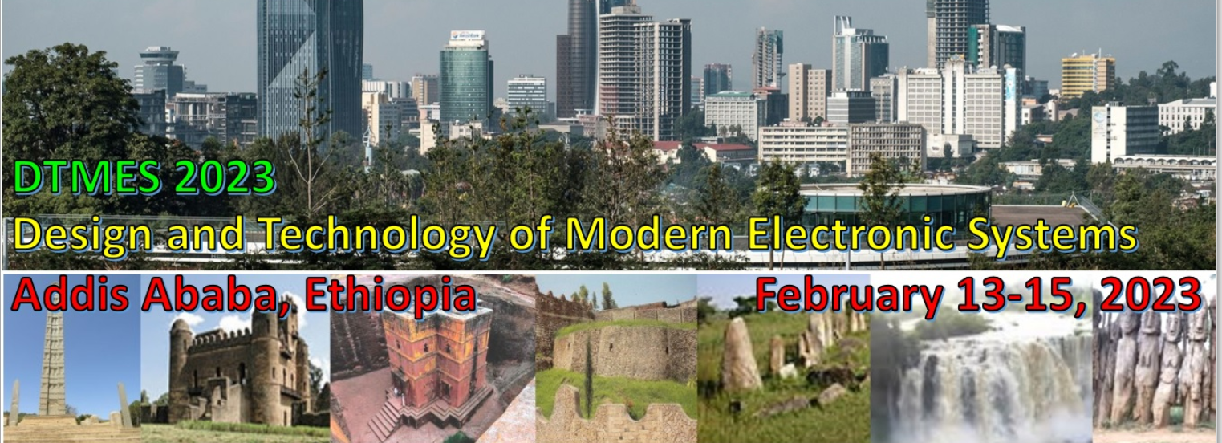






Co-Chairs
- Wendem Beyene, Meta
- Fetene Mulugeta, AAiT

Slide 10
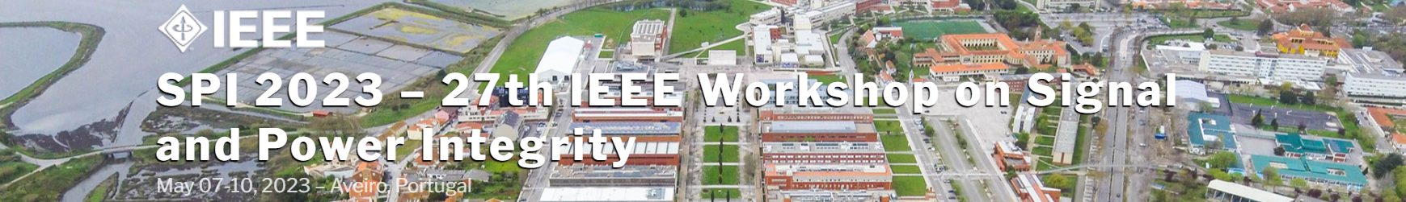

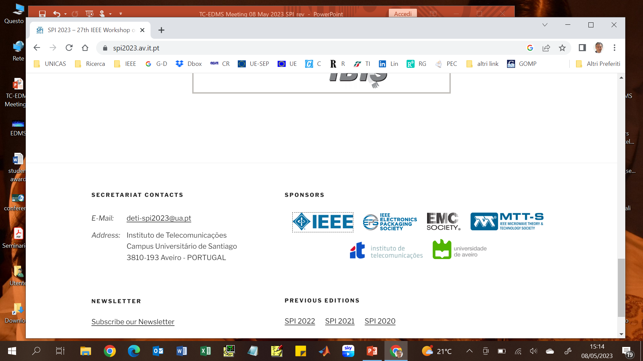
1 tutorial
2 keynote speeches
29 papers
7 technical sessions
1 short communication session
1 industry forum
2 best student paper awards

Slide 11




EPEPS 2023
IEEE 32nd Conference on Electrical Performance of Electronic Packaging and Systems
EPEPS 2023 Co-chairs:
Swagato Chakraborty Siemens EDA
Prof. Piero Triverio University of Toronto

Slide 12



EDAPS 2023 Conference Update
Date: Dec. 12-14th, 2023
Location: Sugar Beach Sun Resort, Republic of Mauritius, Indian Ocean
Theme: Semiconductor Packaging: The Next Frontier
Benefits: Awards, Travel Grants, and Special Issue in TCPMT
Programme: WIP

Slide 13

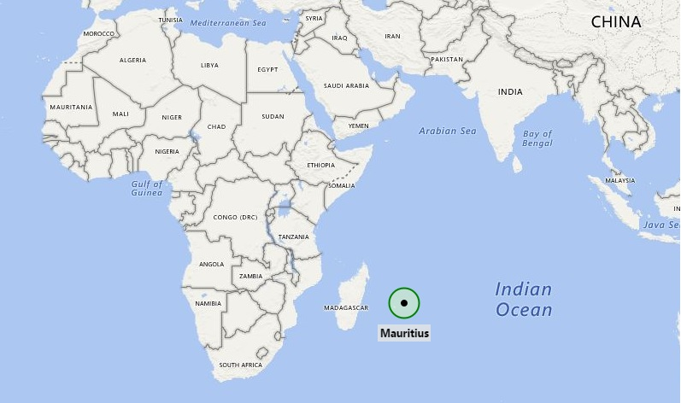
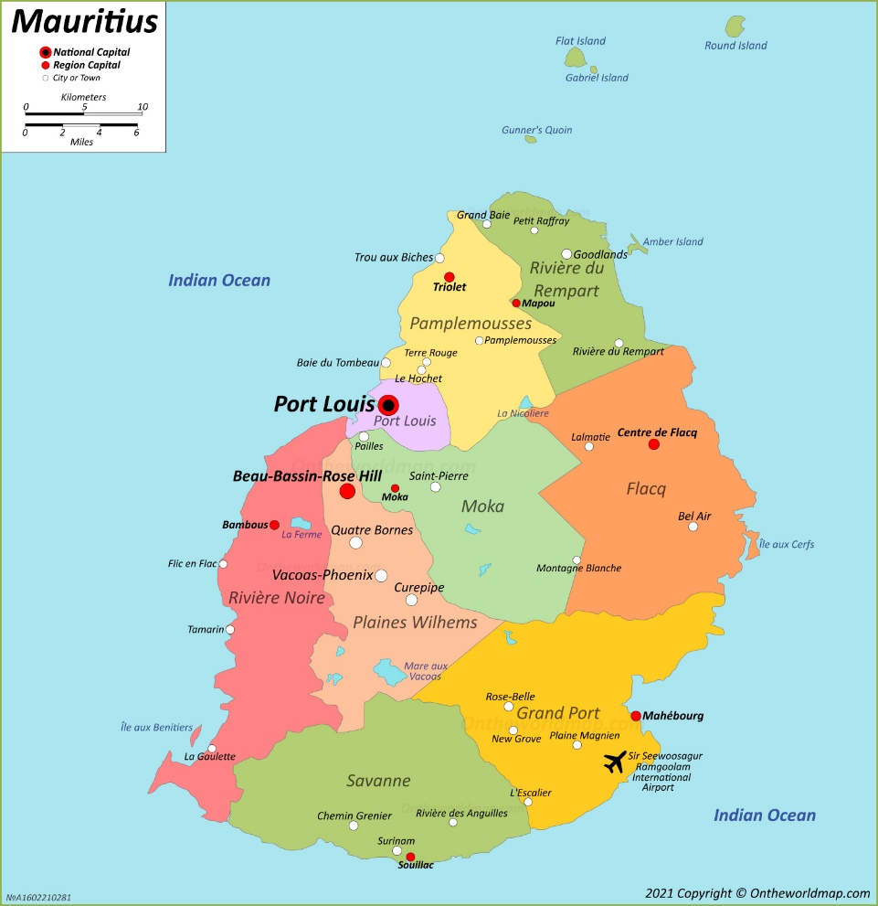
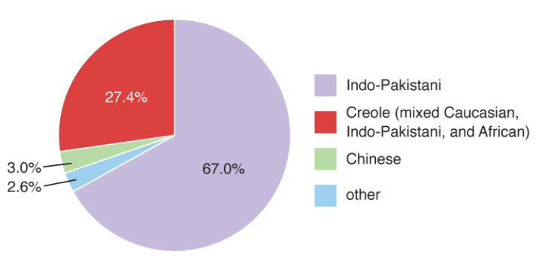
About Mauritius
“Mauritius was made first, and then heaven; and heaven was copied after Mauritius.”, Mark Twain 1896.
Some facts about Mauritius:
  Mauritius, island in Indian Ocean, located off the South-Eastern coast of Africa.
  Mauritius became independent on March 12, 1968
  788 mi² in area; Population: 1.266 million (2020)
  Economy based on manufactured exports, agriculture, tourism, and financial services.

Slide 14
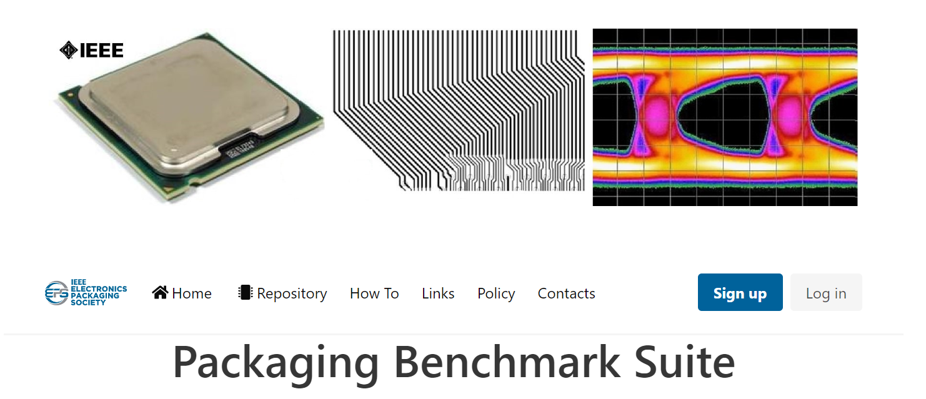
A joint industrial-academic effort to establish a modern, publicly available Packaging Benchmark Suite for verification, validation, and performance benchmarking.
Researchers and practitioners can find here electromagnetic and circuit modeling/simulation problems and state-of-the-art solution methods used when designing, analyzing, and developing electronic packages
http://www.packaging-benchmarks.org/

Slide 15
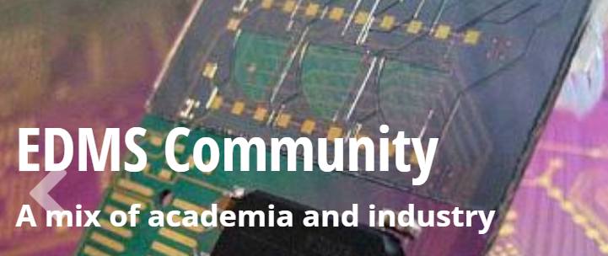
Are you interested? Sign up today!
https://cmte.ieee.org/eps-edms/

