Slide 1
MTT-S Report
José Rayas-Sánchez
San Francisco, CA
July 9, 2023

Slide 2

MTT-S Report
MTT-S Inter-Society Committee
MTT-S Technical Committee on Design Automation (TC-2)
TC-2 invited papers for the IEEE Journal of Microwaves
IMS-2023 events on AI & ML
CEDA related MTT-S Conferences

Slide 3
MTT-S Inter-Society Committee
MTT-S Inter-Society Committee is in charge of cultivating relationships with IEEE Councils and other technical societies
Inter-Society Committee is aiming at encouraging a stronger participation of MTT-S in IEEE Councils
MTT-S currently has official representation in 7 councils

Slide 4

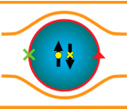


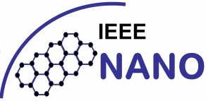


MTT-S Representation in 7 IEEE Councils

Slide 5
MTT-S Tech. Committee on Design Automation
MTT-S has 29 technical committees (TC)
The MTT-S Technical Committee on Design Automation (TC-2) is the closest to CEDA; it focuses on:
  Modelling and simulation of devices, circuits, and systems
  Non-linear analysis
  Optimization techniques
  Multi-physics modelling
  Machine learning and artificial intelligence for design automation
MTT-2 regularly organizes technical events/initiatives on CAD and EDA

Slide 6
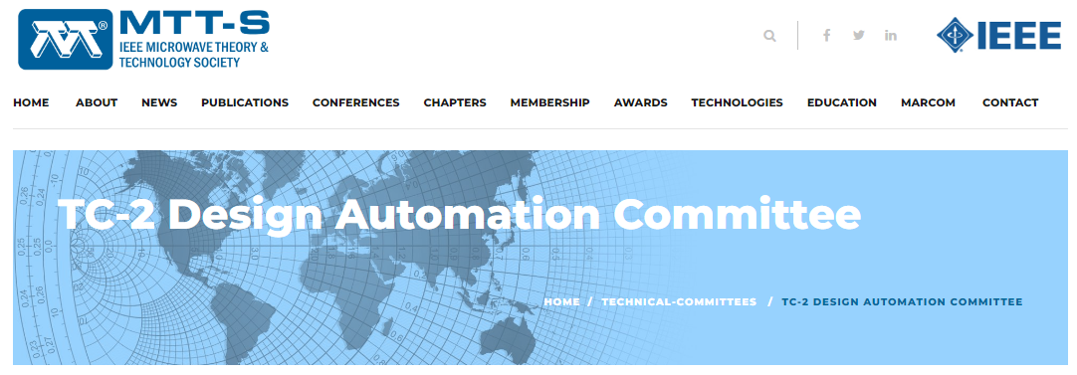
MTT-S Tech. Committee on Design Automation
https://mtt.org/technical-committees/tc-2-design-automation-committee/

Slide 7

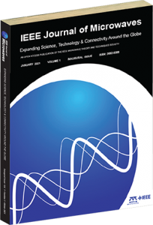
Recent TC-2 Invited Papers
MTT-S 70th Anniversary Issues:
January and April 2023

Slide 8
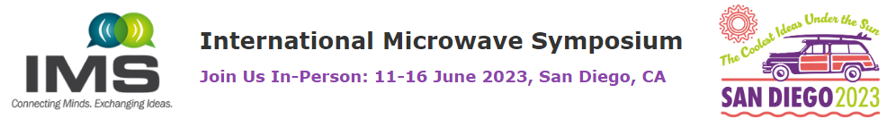
IMS-2023 Events on AI & ML
Three IMS Focus Sessions on AI/ML:
Artificial Intelligence and Machine Learning for Microwaves
Artificial Intelligence and Machine Learning for RF to mm-Wave Systems
Artificial Intelligence and Machine Learning Techniques for Signal/Power Integrity → CEDA BoG members participated

Slide 9
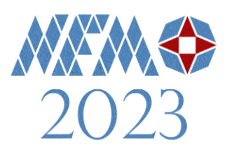
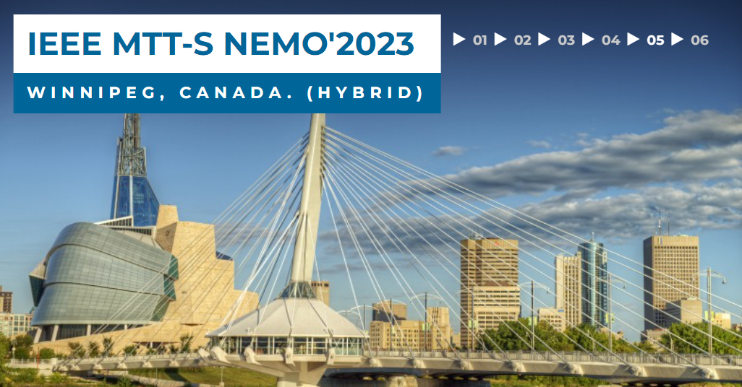
CEDA-related MTT-S Conferences
2023 IEEE MTT-S International Conference on Numerical Electromagnetic and Multiphysics Modeling and Optimization (NEMO'2023)
June 28 - 30, 2023, Winnipeg, Canada. (Hybrid)
http://nemo-ieee.org/

Slide 10

LAMC 2023: San Jose, Costa Rica, Dec. 6-8
Seven Main Technical Topics, one of them is on
CAD Techniques for RF and Microwave Engineering
Submissions from CEDA members are very welcome!
https://lamc-ieee.org/

Slide 11
Thanks
José Rayas-Sánchez
IEEE MTT-S Representative for CEDA

