Slide 1
Finance
Marina Zapater
July 10th 2022

Slide 2
Finances Overview
Expenses 2022
  Expenses ramping-up to pre-COVID levels
  Uncertainty about what will happen by end of the year (when winter comes)
Budget 2023
  Conservatively going back to pre-COVID budgets
IEEE NextGen platform for accounting fully deployed now
  Changes to procedures, cost center numbers and accounts to charge (GL codes)

Slide 3
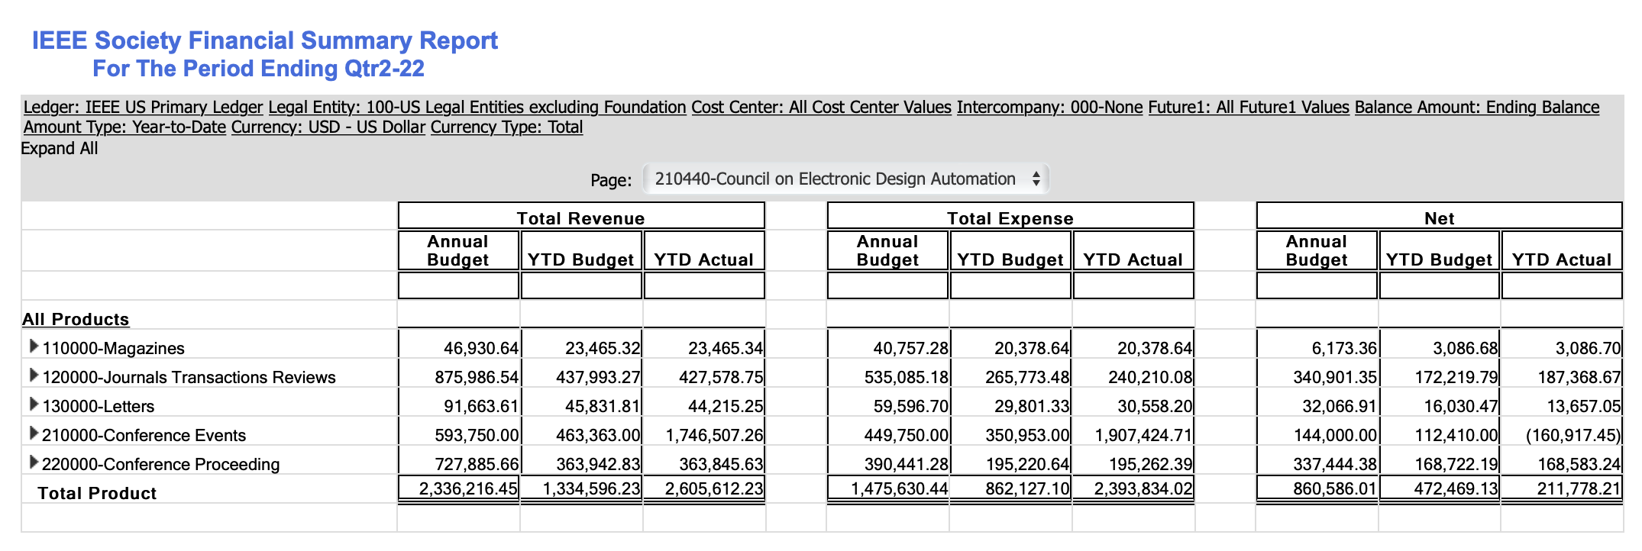
Current status Qtr2-22 (1/2)
Detailed real (not forecast) Financial Summary Report
  Ignore this slide and the next one if you don’t want the details!

Slide 4
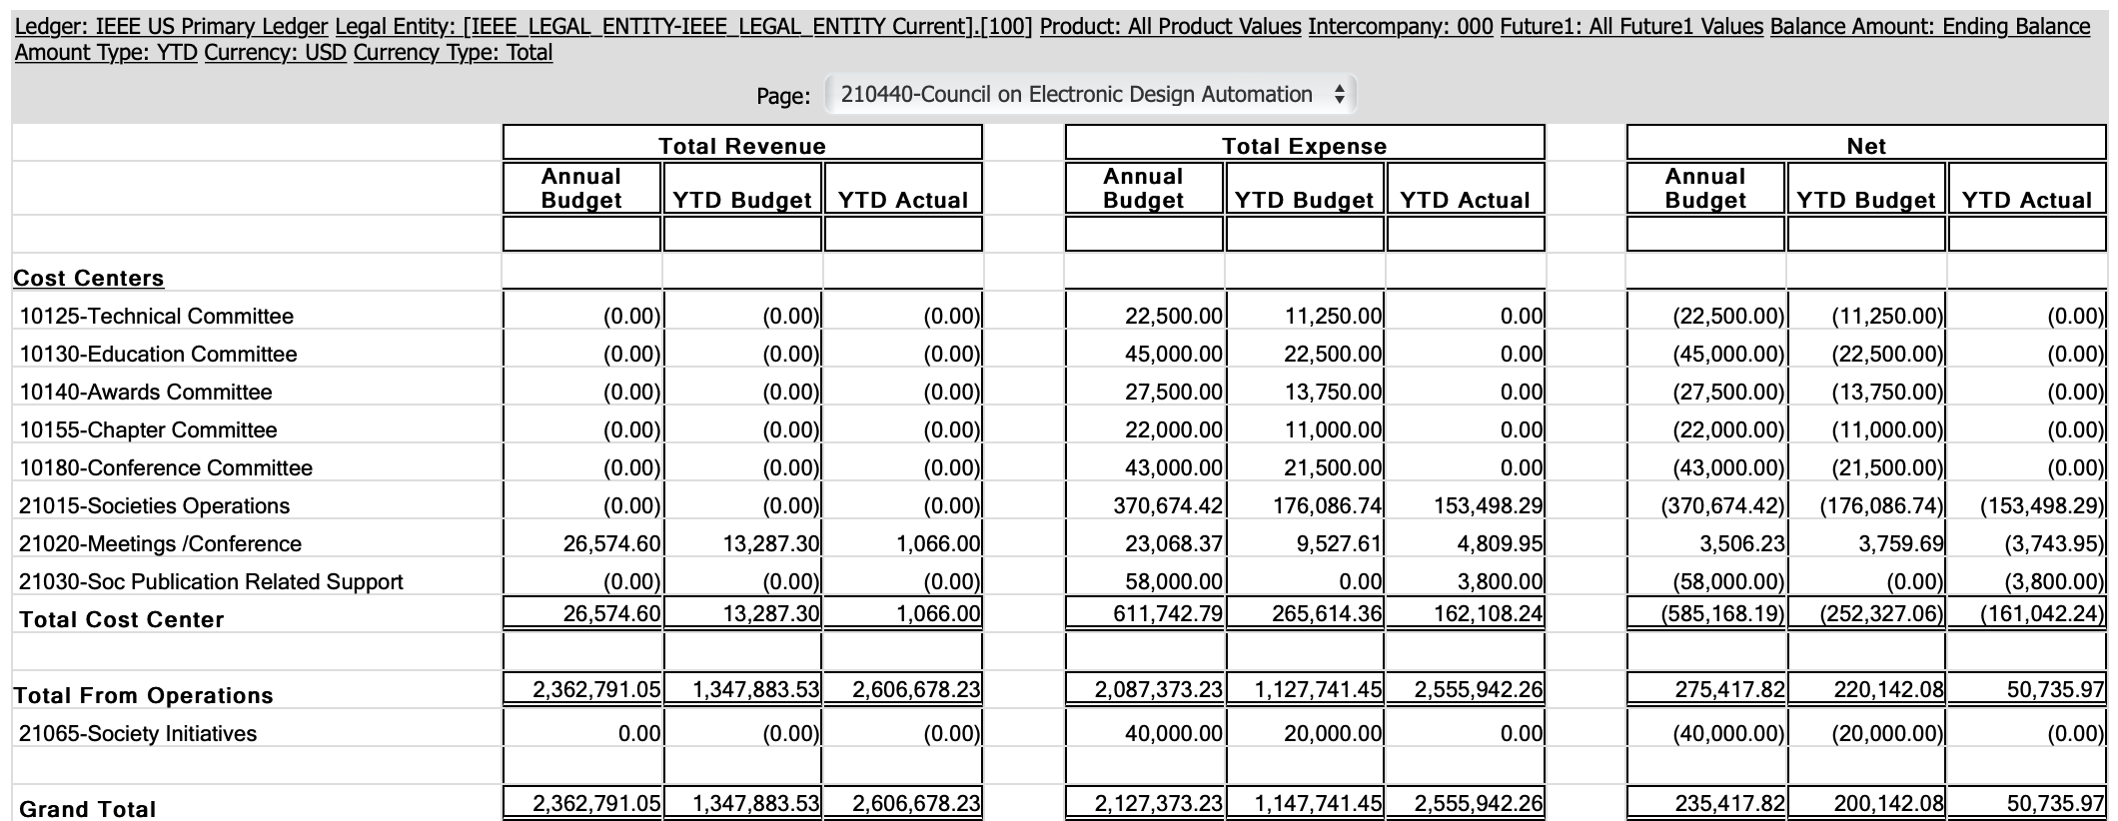
Current status Qtr2-22 (2/2)

Slide 5
Current status – 2022 – Highlights
Some conferences happening at end-of 2021 on the 2022 budget
(and still not closed)
Slowly recovering pre-COVID levels for meetings and conferences.
  CEDA/TAB meetings budget ”back to normal” levels
  Still conferences sponsorship lower than normal
  We’ll see what happens 2nd half of the year
Periodicals – increased page counts to be managed
Initiatives – Pending discussion on expected expenses for 2022 (and 2023)

Slide 6
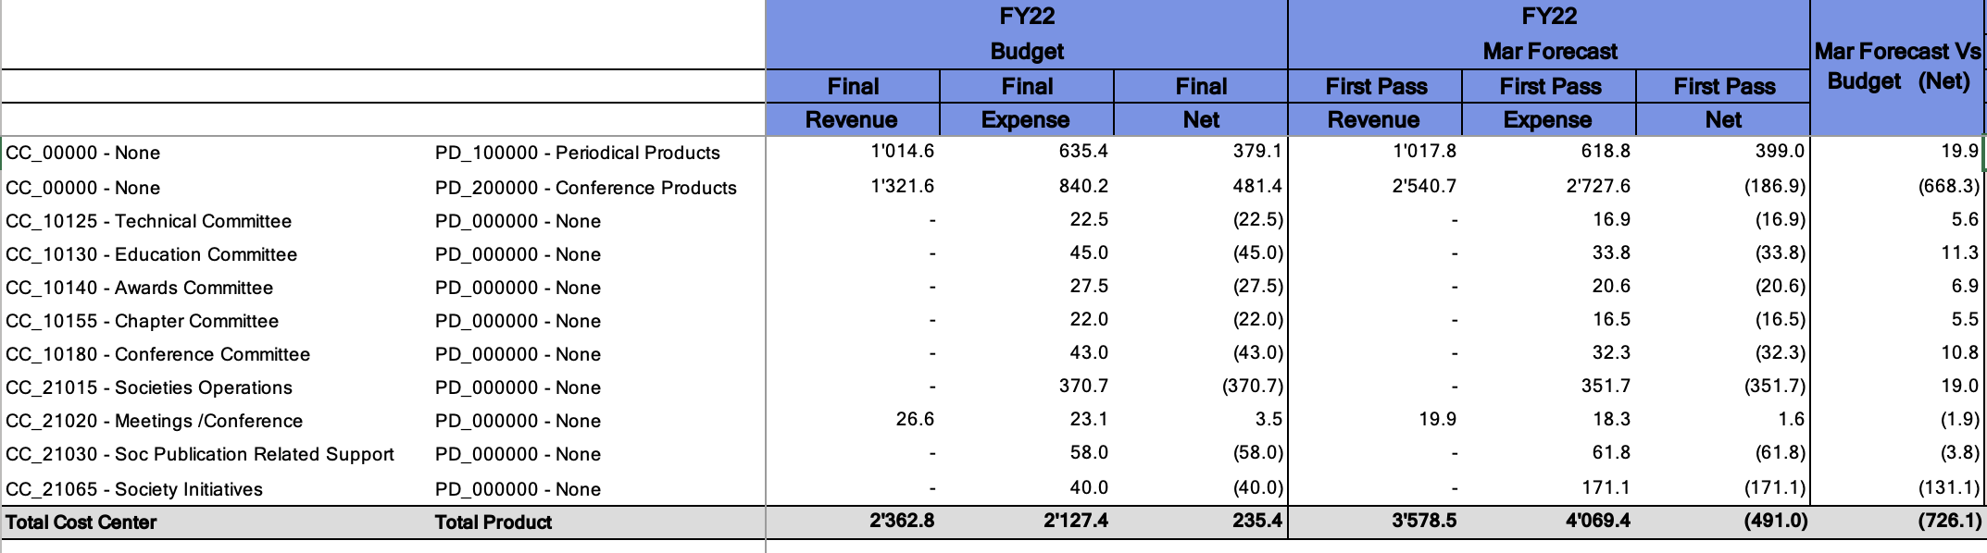
Forecast vs Budget (@april forecast)
Changes to be still incorporated:
  Increase in periodicals (TCAD pages from 3300 to 4200, ES and D&T equal).
  Conferences end-of 2021 still not closed (accounted on 2022)

Slide 7
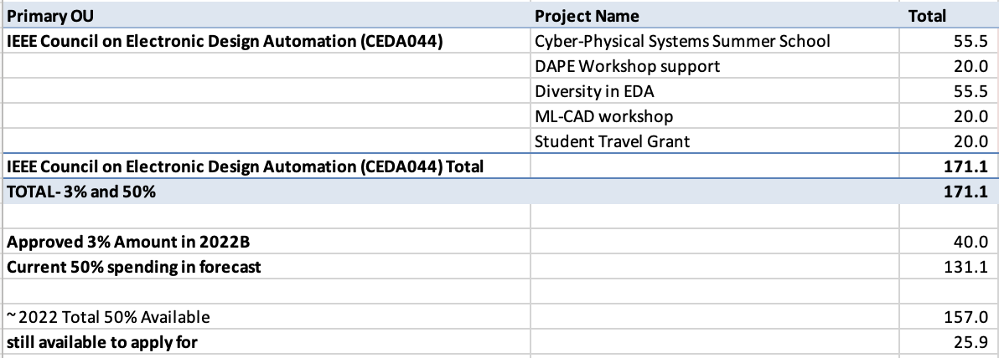
Forecast vs. Budget - Initiatives
Pending discussion on Initiatives

Slide 8
Budget 2023
Contractors (Editorial services): ~67K
Operational - Conference Catalyst: 62K (secretary) + 10K (web) + 2K (Zoom)
Meetings & accommodations : 10K
Volunteer travel : 40K
CEDA Luncheons ~ 43K
ASP-DAC, DATE, DAC, ICCAD
Distinguished Lecturer ~ 25K
Awards ~ 27K
Local Chapters 22K (even if expenses are lower at the moment)
Technical committee ~ 23K
DATC, SVDTC, TCCPS
Technical committee contests ~ 25K
DATE, DAC, ICCAD, SMACD, LPCV ..
Initiatives: 40K (to be discussed!)
Advertising: 25K (10K in 2022)

Slide 9
Budget 2023
Conservative, based on pre-COVID levels
(assuming 2022 is a ramp-up year)
Main changes / Discussion points:
  Periodicals : will be updated
  Initiatives!
  Everything else, just small increases / decreases

Slide 10
Motions
Approval of Budget 2023
  In preliminary version still until it is double-checked with IEEE
  And we have financial forecasts for increases in publications page counts

Slide 11
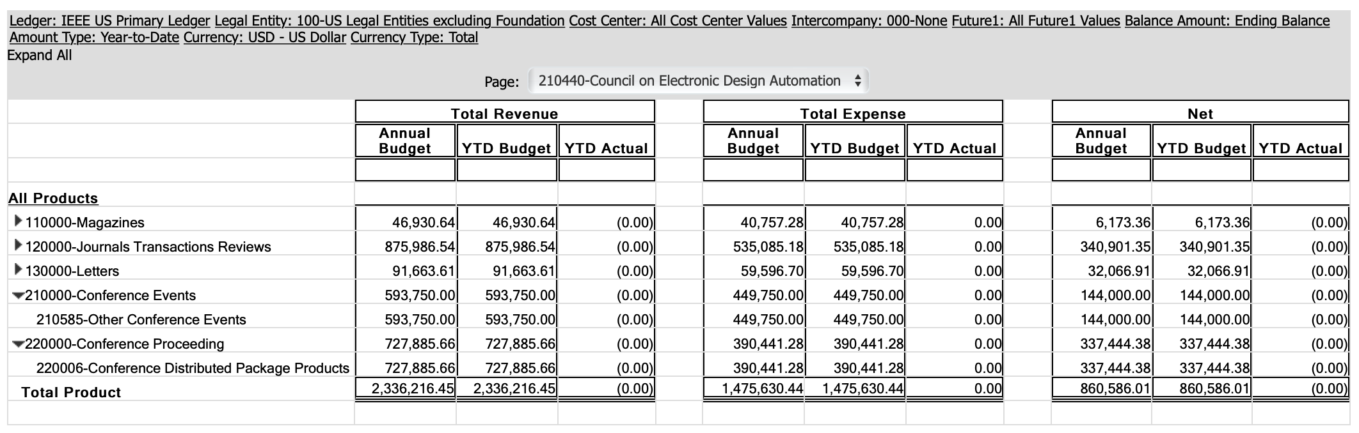
Budget 2022

Slide 12
