Slide 1
Initiatives
Ian O'Connor – Ecole Centrale Lyon, FR
Michael Orshansky – U Texas at Austin, US
July 10th 2022

Slide 2
Initiatives portfolio
represent CEDA in the various IEEE initiatives (and their flagship conferences) in which CEDA has interest:
Smart Cities : Theo Theocharides (U. Cyprus, CY)
Brain: Jose Ayala (U. Complutense, Madrid, ES)
IoT: Jorge Gomez Sanz (U. Complutense, Madrid, ES)
Task Force on Rebooting Computing: I. O'Connor (EC Lyon, FR) / Pierre-Emmanuel Gaillardon (U. Utah, US)
Future Networks: I. O'Connor (EC Lyon, FR)

Slide 3
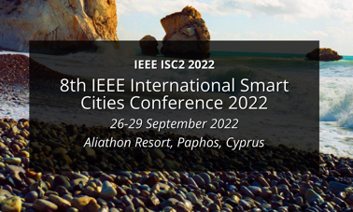
Status of Activity
Smart Cities Initiative (SCI)
Voting member, partner of SCI
Supporting International Smart Cities Conference (ISC2) 2022 (Paphos, Cyprus, 26-29 September 2022)
Supported decision to act as Pilot for TAB TC2.0
New focus and impetus
Nominated Theo Theocharides (U. Cyprus, CY) as CEDA representative

Slide 4
Status of Activity
IoT Initiative
De-facto voting member, major sponsor (not leading sponsor)
IoT Magazine requests contributions from societies
MoU renewed (Feb. 25th 2021)
Motion to approve status change to TAB TC2.0 – increased autonomy, possibility of moving budget from one year to another
WF-IoT 2022
Hybrid conference (Yokohama, November 2022)

Slide 5
Status of Activity
Task Force on Rebooting Computing (TFRC)
Following monthly meetings
Low-Power Computer Vision Challenge (LPCVC)
International Roadmap on Devices and Systems (IRDS) – contribution to Systems Architecture chapter
International Conference on Rebooting Computing (ICRC)

Slide 6
Status of Activity
Future Networks Initiative (FNI)
Possible actions
CEDA contribution to International Network Generations Roadmap (INGR)
Future Directions Committee
Sustainability
SustainableICT initiative https://sustainableict.ieee.org
Open-Source

Slide 7
Action Items
Initiate the co-organization of:
A special session at 5G World Forum (WF5G) – October 2022
A special session at ICRC – December 2022
A workshop on quantum computing EDA co-located with an EDA conference or as an independent event
Connect CEDA to the organization of International Smart Cities Conference

Slide 8
Motion(s)
To support the change of status of the IoT Initiative to TC2.0
IoT Initiative is pushing for this, for increased autonomy (see next slide), possibility of moving budget from one year to another
No financial implications

