Slide 1
President’s Report
Gi-Joon Nam
July 10 2022

Slide 2
2022 Priorities: Prioritize Strategic Discussion at EC and BoG Meetings
Presentations in EC & BoG meeting shorter to allow more time for discussion
for coming prepared

Slide 3
2022 Priorities: Cultivate New Opportunities and Collaboration
Increase engagement and participation of Vice Presidents at monthly virtual calls and in-person meetings
Increase engagement and participation of Member Societies and representatives
Create more formal process for appointing/reappointing Member Society, Member Technology, and Conference Representatives with term limits
Identify and Share Disruptive Technology through strategic initiative projects

Slide 4
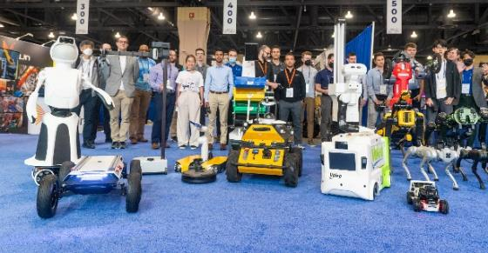
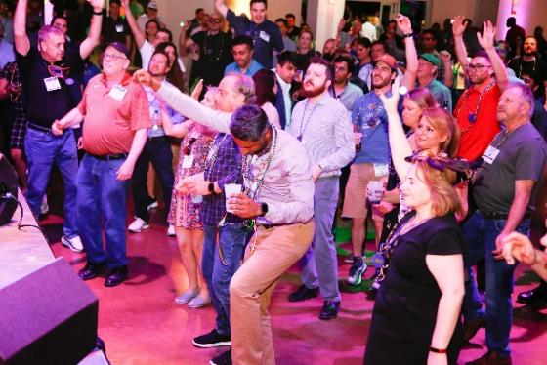
Enthusiastic Return to In-Person Conferences
Feeling inspired in 2022
IEEE Conferences are returning in-person with impressive attendance, strong revenue, & vibrant exhibit halls indicating a strong appetite for face-to-face engagement & immersive experiences.
IEEE International Conference on Robotics and Automation
IEEE MTT-S International Microwave Symposium
IEEE PES T&D Conference & Exposition
7.8K+ participants from 97 countries
64% 1st-time attendees
96 exhibitors
5.6K+ total participants (including technical, exhibitors, & exhibits-only participants)
2.2K+ technical participants
450+ exhibitors
10K+ participants
Highest IEEE event attendance since 2019
650+ exhibitors
Photo credit: ICRA
Photo credit: IEEE PES T&D, [@IEEETandD]. (15 June 2022). Twitter

Slide 5
Special Topic for Today: SEMI & CEDA Reps for DAC
After 2023, DAC will NOT co-locate with SEMI
The ESDA’s new proposal on Kaufman Award (Bob Smith’s email)
ESDA is a part of SEMI
ESPD wants to fully lead the dinner event planning
CEDA representatives for DAC
Currently president elect and past president serve for 2 years
The current scheme guarantees ”No” continuity

Slide 6
Appendix

Slide 7
2022 Outstanding Positions and Appointments
Member Society Reps (2022-2023) - from Society Presidents
APS - Quan Xue (2015-2020)
CAS - Ricardo Reis (2020-2021)
Computer - Dimitrios Serpanos (2020-2021)
EDS - vacant, but communicated with the EDS president
EPS - José Schutt-Ainé (2021-2022)
MTTS - Jose E Rayas-Sanchez (2020-2021)
SSCS - Vivek Tiwari (2020-2021)

Slide 8
2022 Outstanding Positions and Appointments
Member Technology Organization Reps (2022)
DATC - Jinwook Jung (2021-2022)
HSTTC - Gang Qu, Yier Jin (2020-2021)
SVDTC - Chinna Prudvi (2019-2020)
TTTC - Peilin Song (2022-2023)
TCCPS – Shiyan Hu

Slide 9
2022 Outstanding Positions and Appointments
Conference Reps (2022)
DAC - President-Elect (Miguel) and Past-President (Yao-Wen) (2022-2023)
ASP-DAC - Kazutoshi Wakabayashi (2020-2021)
DATE – Donatella Sciuto (2021)
ICCAD – Tsung-Yi Ho (2021)
ESWEEK? –

Slide 10
2022 Outstanding Positions and Appointments
Presidential Appointments
Diversity and Inclusion - Shao-Yung Fang (2021)
WIE - Shao-Yung Fang (2021)
Distinguished Lecturers Program Chair - Helen Li (2022-2023)
IoT - Jorge J. Gomez Sanz (2018)
Rebooting Computing - Ian O'Connor (2022)

Slide 11
2022 Outstanding Positions and Appointments
Presidential Appointments
TAB Awards and Recognition Committee (corresponding member) - Georges Gielen (2022)
TAB Conference Publications Committee (corresponding member) - Cristiana Bolchini (2022)
TAB Finance Committee (corresponding member) - Marina Zapater (2022)
TAB Periodicals Committee (corresponding member) - Joerg Henkel (2022)
TAB/PSPB Products and Services Committee (corresponding member) - Vasilis Pavlidis (2022)
TAB Strategic Planning Committee (corresponding member) - Enrico Macii (2022)
WIE Committee - Shao-Yun Fang (2022)
Diversity and Inclusion Chair/POC - Shao-Yun Fang (2022)
IEEE Future Networks Steering Committee - Ian O'Connor (2022)
IEEE History Committee Chair - Vasilis Pavlidis (2022)

