Slide 1
Publicity
Agnieszka Dubaj
07/10/2022

Slide 2
Current Status & Achievements
Newsletter – CEDA Currents
Community Calls
Website
Email distributions

Slide 3
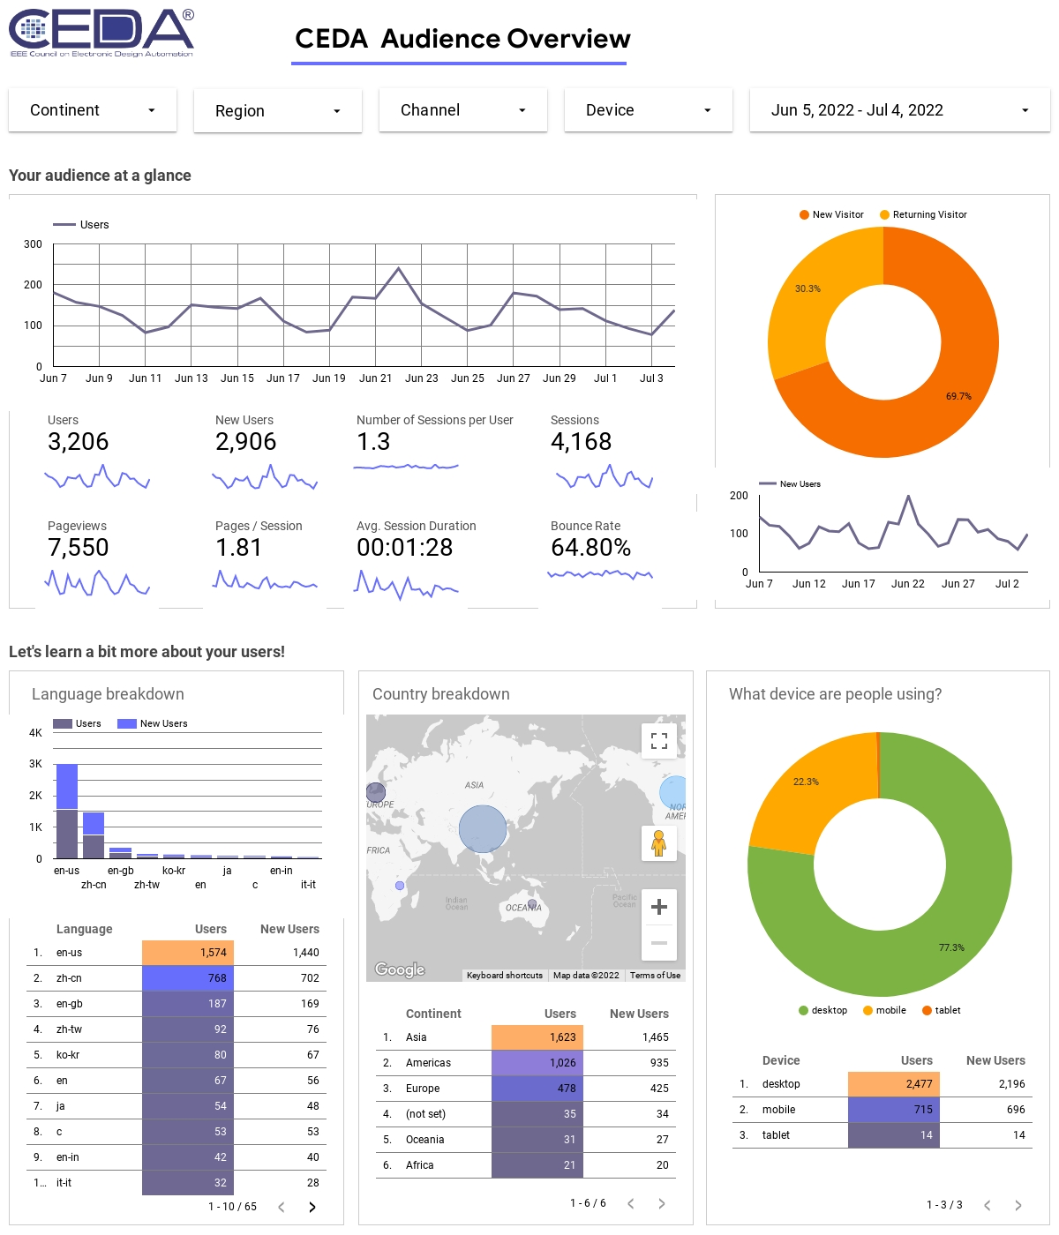
Monthly CEDA Website Report
In addition to audience overview report contains more details regarding content viewed, downloads, emails and outbound links

Slide 4
Challenges
Physical presence to events sponsored by CEDA
Website updates

Slide 5
Action Items
Work with the team to update website

