Slide 1
CEDA Standards Committee
Aparna Dey
10 July 2022

Slide 2
Mission /Objectives
Drive Standardization in advanced EDA topics involving “research” : leveraging CEDA Academic and Industry member participation
Collaborate w/ IEEE DASC and other outside Standardization committees – Joint sponsor
Collaborate w/ Industry Academic Network if possible

Slide 3
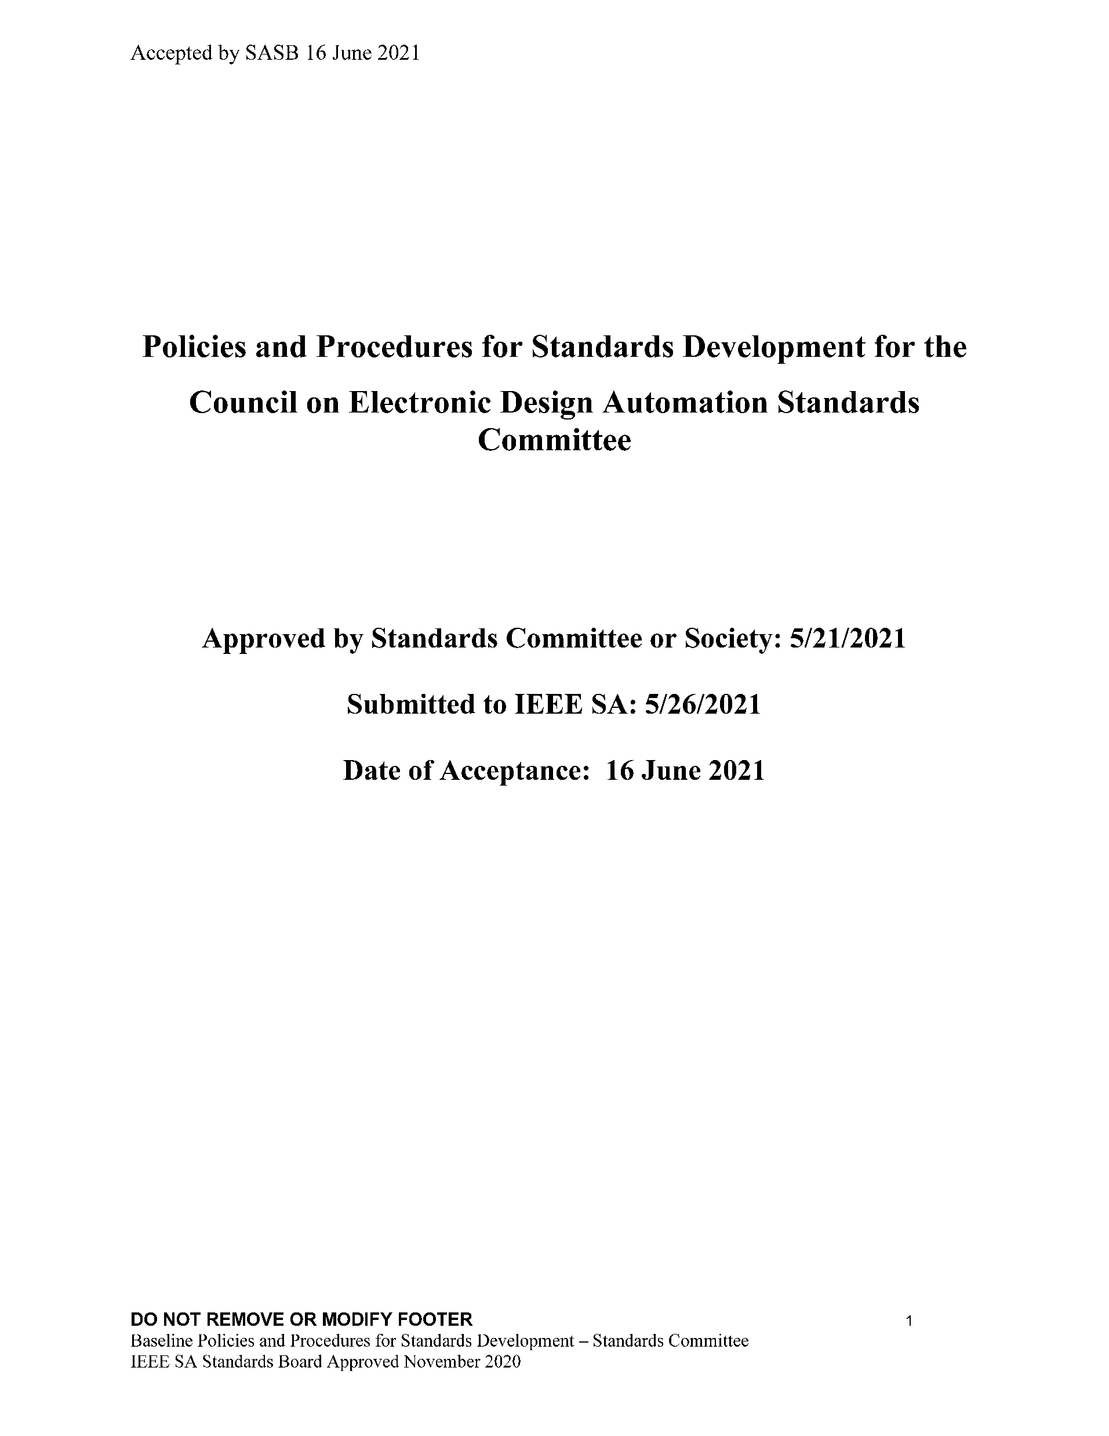
Current Status & Achievements
CEDA Standards Committee (CEDA SC) infra
CEDA SC public and Collab site - July-August
Mission Statement/ Objectives/P&P - August 2020
CEDA SC Leadership
Aparna Dey, chair (CEDA Standards VP)
Dennis Brophy, vice-chair
Yatin Trivedi, secretary
CEDA SC member drive
Present to various CEDA Chapters - Fall 2022
IEEE CEDA Events/ forums – Q3/Q4 2022
Industry Academic Networks?

Slide 4
Current Status & Achievements (2)
Plan to present CEDA Standards at IEEE EDPS conference - Oct 2022
Plan call for Proposals/ Study Groups – Q3/Q4
CEDA SC Open-Source Maintainer
Dennis Brophy

Slide 5
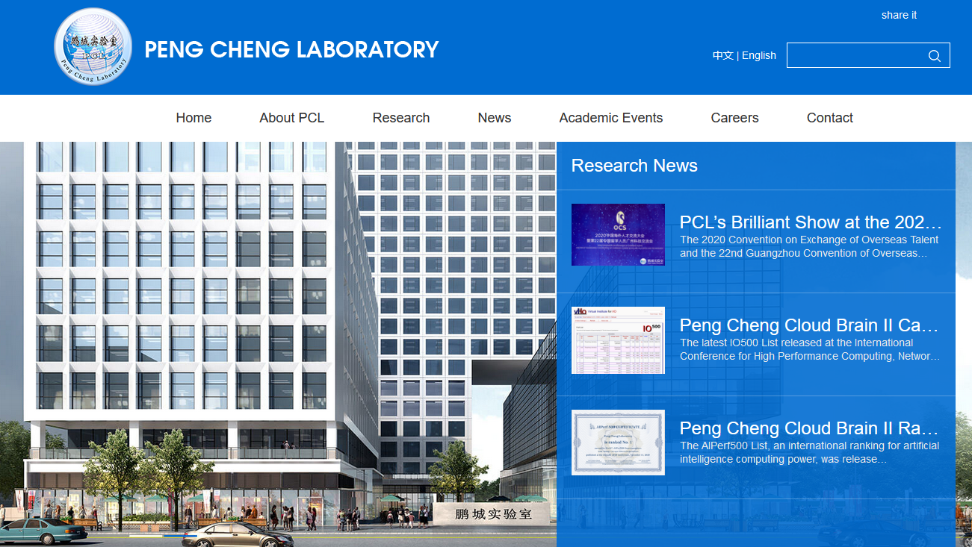
Challenges (1)
Peng Cheng Lab not member of IEEE SA
Informed DASC. Require follow up
Titled: “Semiconductor Devices Modeling & Measurements”
Initiated as an entity project by Xiaoxu Luan at Peng Cheng Laboratory (Shenzhen CN)

Slide 6
Challenges/Opportunities (2)
Aligning Membership recruitment w/ CEDA chapter meetings
Increasing CEDA/SC visibility with Industry & Academia
Attracting differentiated Standardization proposals/ study group in advanced topics
Not compete with DASC standards

Slide 7
Action Items
Complete CEDA/SC infrastructure /administrative tasks
Follow up w/ DASC on Compact Model PAR
Increase Membership/ Call for participation drive
Present CEDA/SC Mission @ CEDA Chapter meetings/events
Follow up on adoption of IEEE SA Open platform
Explore Industry Academic Networks if possible

Slide 8
Current Published DASC Standards
IEEE Standard | Approve | IEC Dual Logo
1076 VHDL | 2019 | D
1076.1 (VHDL AMS) | 2017 | D
1481 (OLA | 2019 | D
1647 (e language) | 2019
1666 (SystemC) | 2011 | D
1666.1 (SystemC AMS) | 2016 | D
1685 (IP-XACT) | 2014 | D
1734 (Quality IP) | 2011 | D
1735 (IP Encryption) | 2015
1800 (SystemVerilog) | 2017 | D
1800.2 (UVM) | 2020 | D
1801 (UPF) | 2018 | D
2401 (LSI Package Board) | 2019 | D
2416 (System Level Power) | 2019
2804 (SHIM) | 2019 | D

Slide 9
DASC Standards Transferred:
IEEE PAR | PAR Approved | Transfer Approved
P2851 (Functional Safety) | 2019 | 2021
Begin Revised:
IEEE PAR | PAR Approved | Ballot Expected
P1666 (SystemC) | 2018 | 2022
P1735 (IP encryption) | 2018 | 2022
P1800 (SystemVerilog) | 2019 | 2023
P1801 (UPF) | 2018 | 2022

Slide 10
Questions?

