Slide 1
Technical Activities
Tsung-Yi Ho/Vasilis Pavlidis
July 10, 2022

Slide 2
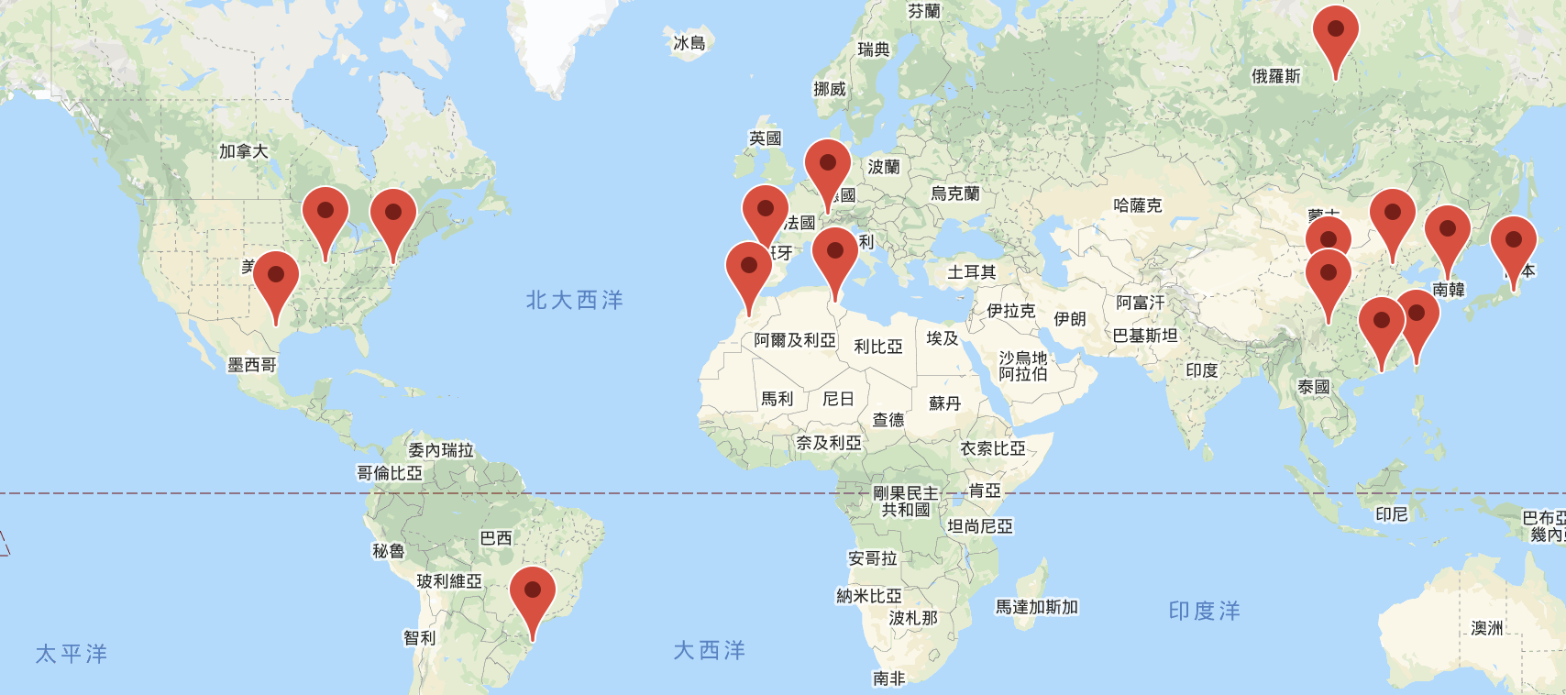
CEDA Chapters
16 Chapters
4 Student Chapters
Beijing
Central Illinois
Central Texas
Chengdu
Hong Kong
Japan
Montreal
Morocco
Pennsylvania
Seoul
Shanghai
South Brazil
Spain
Switzerland
Taipei
Tunisia

Slide 3
CEDA Technical Committees
DATC (Design Automation Technical Committee)
Chair: Jinwook Jung, IBM
SVDTC (System Validation and Debug Technology Committee)
Chair: Chinna Prudvi, Intel Inc.
TCCPS (Technical Committee on Cyber-Physical Systems)
Chair: Shiyan Hu, University of Southampton
TTTC (Test Technology Technical Council)
Chair: Peilin Song, IBM
Hardware Security and Trust Technical Committee (HSTTC)
Chair: Gang Qu, University of Maryland
Awards, Tools, Standards, Outreach, etc.

Slide 4
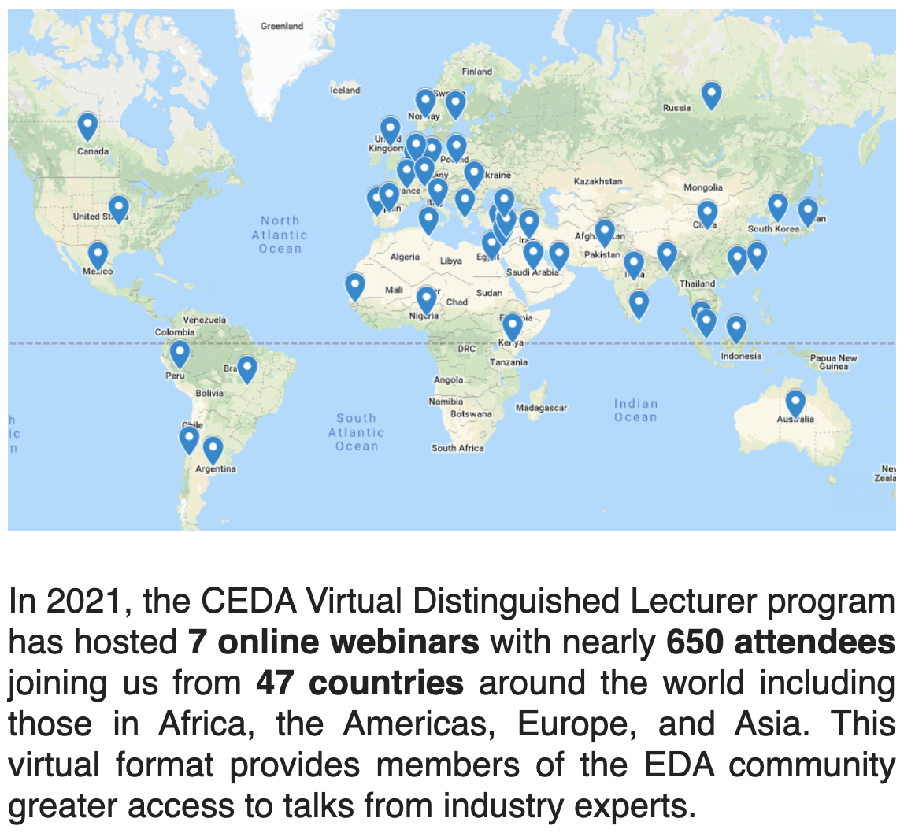
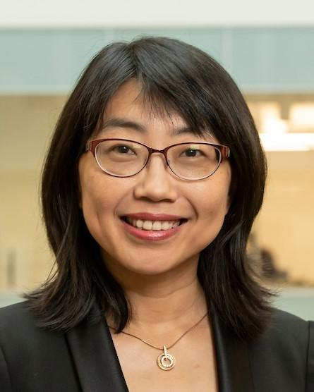
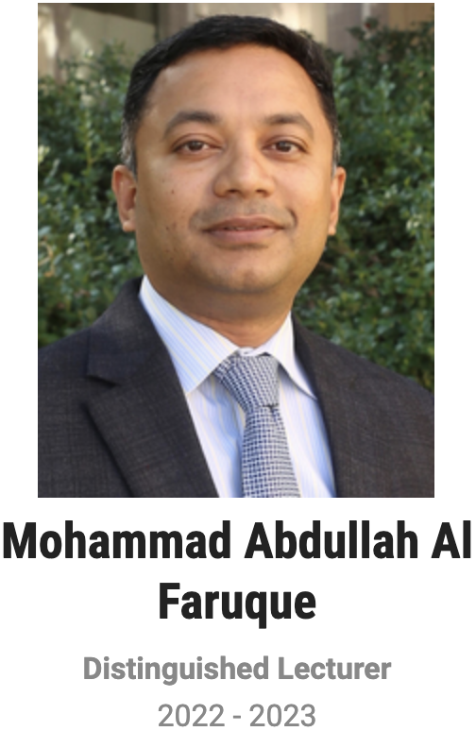
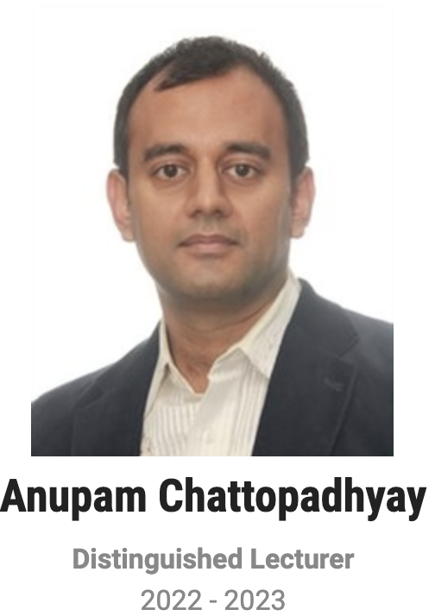
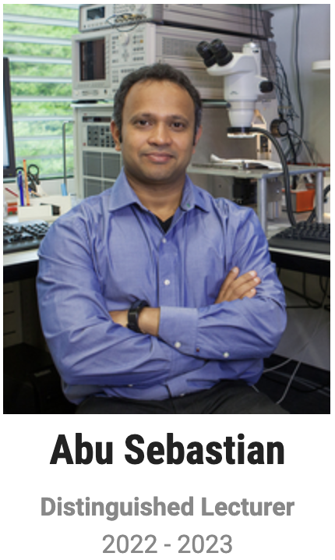
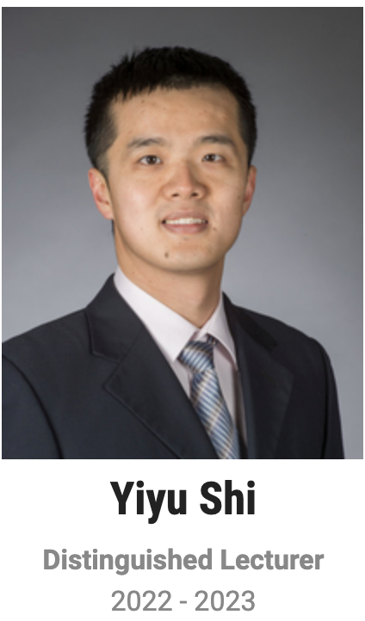
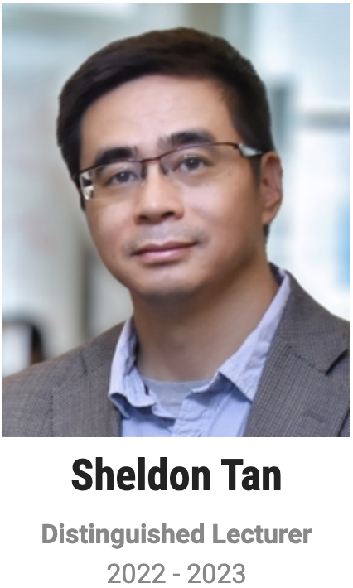
Current Status & Action Items
Distinguished Lecturer Program
Helen Li
2022-2023

Slide 5
Current Status & Action Items
CAD for Assurance Webinar
Design Automation Webinar (DAWN)
Job Fair@ICCAD
Open Source EDA Design Challenges
EDA Summer Camp (co-sponsor by Synopsys)

