Slide 1
Latest CASS Updates
Ricardo Reis

Slide 2
Latest CASS News
The new CASS website has launched: www.ieee-cas.org
CASS Pre-Doctoral Grants | Deadline: 15 July 2022
Call for Board of Governors (BoG) 2023-2025 term | Deadline: 19 July 2022
Call for Proposals of the CAS Emerging and Selected Topics for Industry Forums (CASIF) | Deadline: 31 July 2022
CASS Student Travel Grants | Deadline: 1 August 2022

Slide 3
Latest CASS News
Latest calls for CASS publications:
OJCAS - Call for Papers Special Section on Advanced Power Electronics Techniques for Smart Grid Applications | Deadline: 21 July 2022
TCSVT – Call for Papers Emerging Topics in all Areas Relevant to TCSVT | Deadline: 15 September 2022
JETCAS - Call for Papers Unconventional Computing Techniques for Emerging Technology Applications | Deadline: 1 October 2022
TBioCAS - Call for Papers Special Issue on Flexible Biomedical Sensors for Healthcare Applications | Deadline: 20 December 2022
For more information and the latest news on the IEEE Circuits and Systems Society, please visit: www.ieee-cas.org

Slide 4
New Journal
IEEE Transactions on AgriFood Electronics (TAFE)
submission portal will open in November 2022

Slide 5
Seasonal Schools
Call for Seasonal Schools
In Person or Hybrid Seasonal Schools can get a support of US$5000
Virtual ones can get US$ 2000
Book based on slides with comments
(see CASS webpage)

Slide 6
Upcoming CASS Flagship Conferences
Global Flagship
ISCAS 2023 | 21-25 May 2023 Monterey, California, USA International Symposium on Circuits and Systems (ISCAS)
Regional Flagship
APCCAS 2022 | 27-30 October 2022 Shenzen, China Asia Pacific Conference on Circuits and Systems (APCCAS, R10)
ICECS 2022 | 24-26 October 2022 Glasgow, United Kingdom International Conference on Electronics, Circuits, and Systems (ICECS, R8)
LASCAS 2023 | 28 February-3 March 2023 Quito, Ecuador Latin American Symposium on Circuits and Systems (LASCAS, R9)
MWSCAS 2022 | 7-10 August 2022 Fukuoka, Japan International Midwest Conference on Circuits and Systems (MWSCAS, R1-6)
NEWCAS 2023 | 19-22 June 2022 Edinburgh, Scotland IEEE Interregional NEWCAS Conference (NEWCAS, R7/9)
Premier Flagship
ISICAS 2022 | 20-21 October 2022 Bordeaux, France International Symposium on Integrated Circuits and Systems (ISICAS)
AICAS 2023 | Hangzhou, China International Conference on Artificial Intelligence Circuits and Systems (AICAS)

Slide 7
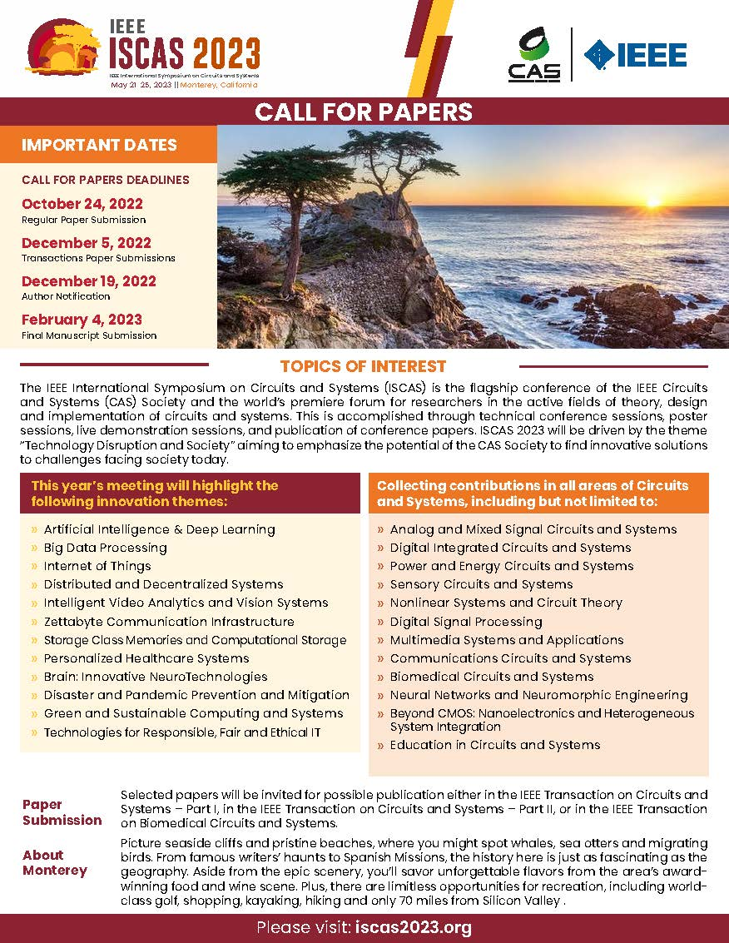
2023 International Symposium on Circuits and Systems (ISCAS)
Date and Location: 21-25 May 2023, Monterey, California, USA
Conference Theme: “Technology Disruption and Society”
Conference Venue: Monterey Convention Center
Call for Papers Deadline: 24 October 2022
Planned Conference Events:
Welcome Reception 22 May, Monterey Bay Aquarium
Gala Dinner 24 May, Monterey Beach House

Slide 8
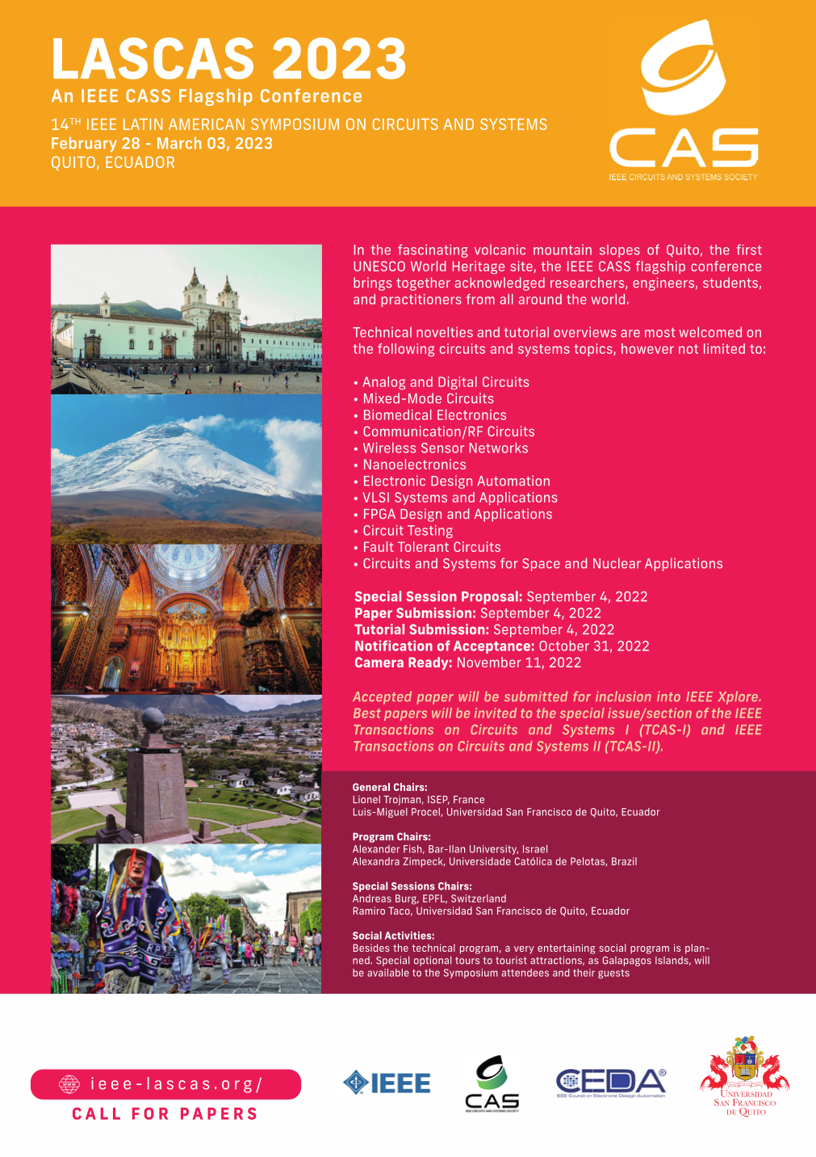
2023 Latin American Symposium on Circuits and Systems (LASCAS, R9)
Date and Location: 28 February-3 March 2023 Quito, Ecuador
Call for Papers Deadline: 24 October 2022
Best papers selected to TCAS 2 and TCAS 1

Slide 9
CASS TALKS
Organized by CASS Rio Grande do Sul Chapter
Each Friday, 1:30 PM
presentations are realtime
YouTube Live @ IEEE CASS Rio Grande do Sul Chapter
https://www.youtube.com/cassriograndedosul

Slide 10
STUDENT DESIGN COMPETITION
The IEEE Circuits and Systems Society (CASS) invites you to participate in the 5th CASS Student Design Competition. The CASS Student Design Competition is a worldwide competition where undergraduate students will suggest and execute projects on Electrical Engineering, Computer Engineering and related areas. The focus should be on finding a solution to a real-life problem based on circuits and systems.
Three phases:
1st at chapter level
2nd at regional level
Final competition during ISCAS, in Monterey, USA, May 21 - 25, 2023
CASS supports travel of up to 3 members of each of the finalist teams to present their work during ISCAS.
Detailed information on http://ieee-cas.org/
Prepare your team for the 2022/2023 edition

Slide 11
For more information, please visit: www.ieee-cas.org
Thank you!

