Slide 1
Conferences
Cristiana Bolchini
July 10 2022

Slide 2
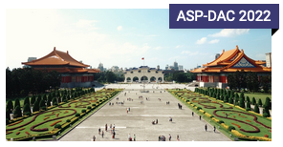
Current status
March/April, Europe
5 FLAGSHIP CONFERENCES
January, Asia & South Pacific
June/July, USA
October/November, USA
September/October, AoE

Slide 3
Current status | 2
28 sponsored conferences/symposium/workshops
18 financial & technical sponsorship
10 technical sponsorship
for the flagship conferences also additional activities are technically/financially sponsored
due to virtual formats it is difficult to distribute conferences through the world regions

Slide 4
Notes:
(taken from slide shown at June IEE TAB meeting; this is confidential, perhaps omit from PDF)

Slide 5
Looking forward
still a lot of uncertainty on the upcoming events
new formats and new strategies to engage participants are being explored
attract younger scientistis
trying to cope with new habits, new media and new communication means

Slide 6
DAC
2022
Luis Miguel Silveira

Slide 7
DAC is back in-person!!!
Conference and Exhibition, Moscone West, usual structure
Collocated with SEMI for another year
But still allowing for some “hybridness”
Notes:
It became clear earlier in the year that speakers from certain countries/regions might not be able/allowed to come, so provisions were put in place
One of the authors should come present the paper
If none could present, record presentation and be present during session for Q&A

Slide 8
Navigating the times
DAC 2021 was in December, hybrid format
Despite all estimations, it was financially profitable (net +118k)
2021 Hybrid Conference Content
HYBRID (Virtual Registration, included in Full Conference Registration) Live & Virtual Component
Research Papers*
Research Panels
Research WIP Posters
Late Breaking Results*
Workshops
Tutorials
Research Invited Talks
Research Best Paper
Training Day Sessions
Industry Presentations*
Industry Posters
Industry Panels
Industry Invited Talks*
Networking
Keynotes
SKYtalks (Short Keynotes)
Pavilion TechTalks
Industry Analyst Reviews
Industry Focused Best Paper
* Virtual Research Papers
* Virtual DIET Presentations
Notes:
Original estimation was a loss ($193k). Net results was +$118k. Revenue was $2,473k
Registration income lower than expected: expected 60% of usual, got 40%
Exhibit income: on budget but much lower than usual
Really cut down on costs

Slide 9
2022 Live Conference
Standard elements
Keynotes, SkyTalks (shorter keynotes) and TechTalks (eng)
Exhibition
Analysts presentations
Research papers
Special sessions
Panels, posters, etc

Slide 10
2022 Live Conference
New elements:

Slide 11
2022 Live Conference
FULL CONFERENCE
Research Focused
Research Papers
Research Panels
Research WIP Posters
Late Breaking Results
Workshops
Tutorials
Keynotes
SKYtalks (Short Keynotes)
Pavilion TechTalks
Industry Analyst Reviews
IEngineering Focused Best Paper
Engineering Presentations
Engineering Posters
Engineering Panels
Engineering Invited Talks
IP
OpenSource
Networking
Research Invited Talks
Research Best Paper
Training Day Sessions
ENGINEERING TRACKS
Industry/Practicioner Focused

Slide 12
Still navigating the times
Tough year with shorter preparation time and still uncertain times
People individually might be anxious for networking (affects registration and overall attendance)
Companies still somewhat cautious (affects exhibits and overall attendance)
Revenue estimated as a slight growth over 2021 (cautious!)
Registration doing well and on track with estimates (2019 levels)
Booth/Exhibition recovering but still lagging pre-Covid (2019) times
Expenses in general, and the Moscone in particular, sky-rocketed above inflation
scrambling to reduce expenses
Post-Covid rebound is visible but still lagging
Might be looking at a small loss, but still early to tell
Notes:
(slide was made with information from mid June, still one month to go at that time)

Slide 13
ICCAD
2022
Tsung-Yi Ho

Slide 14
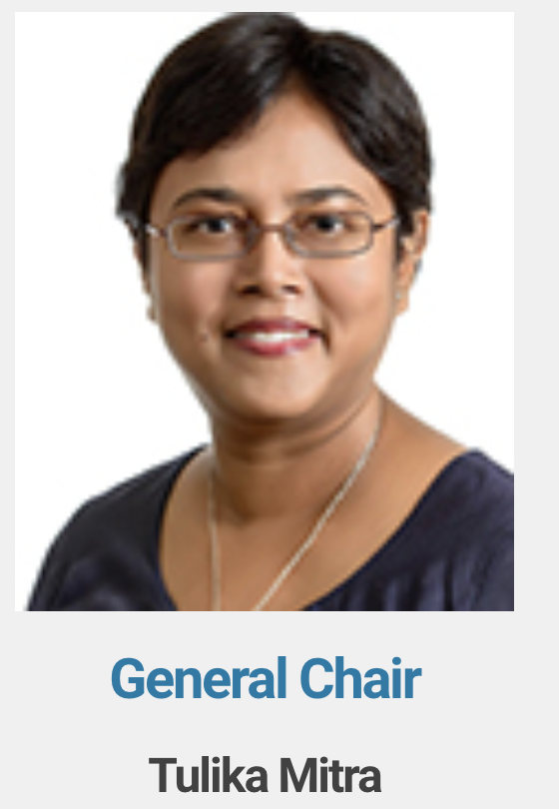
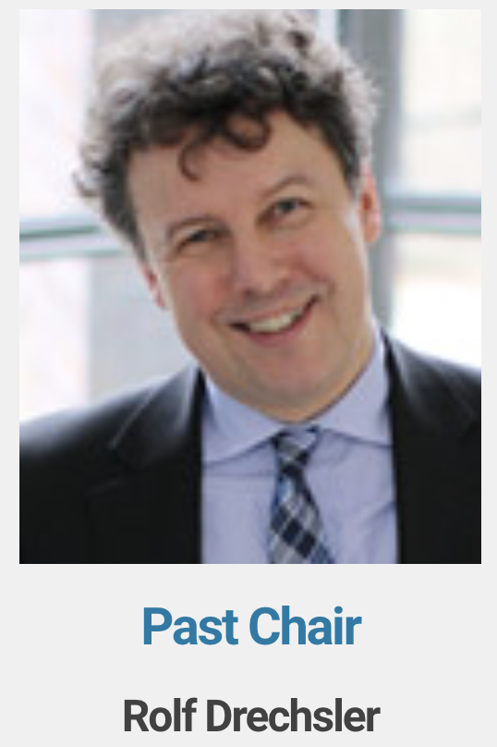
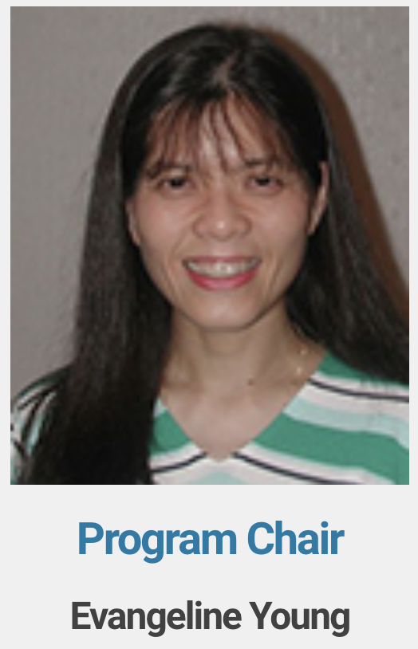
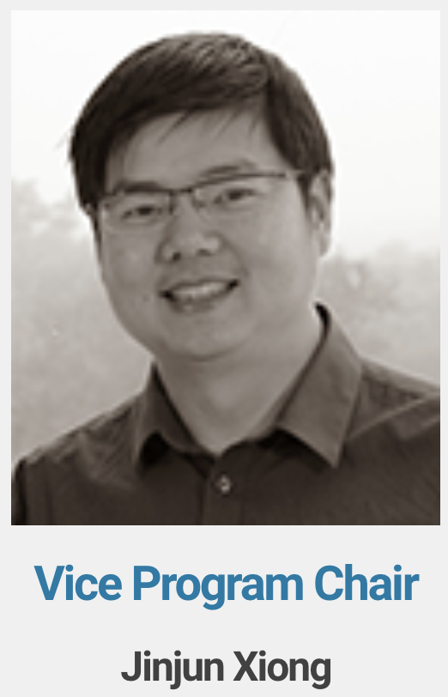
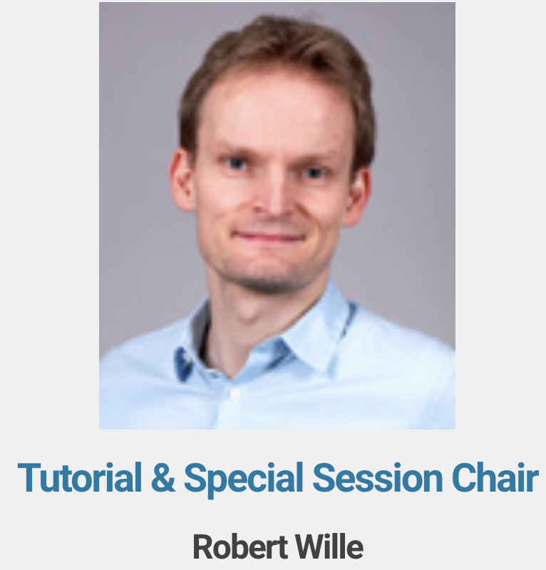
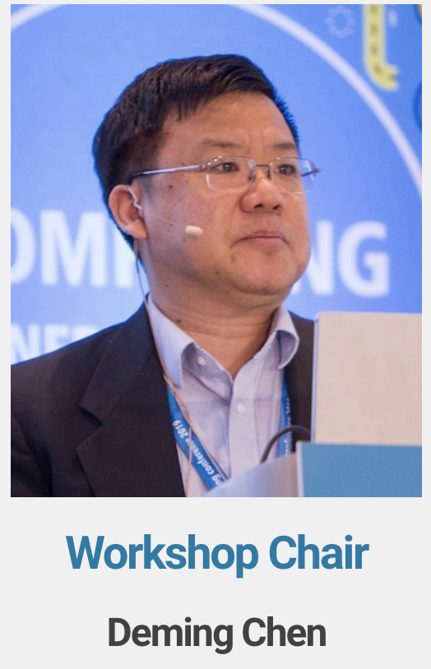
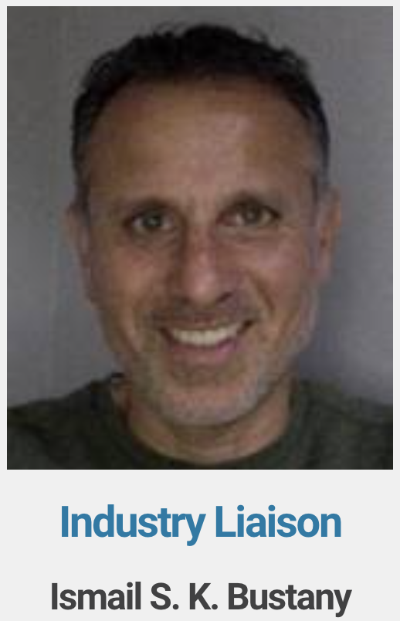
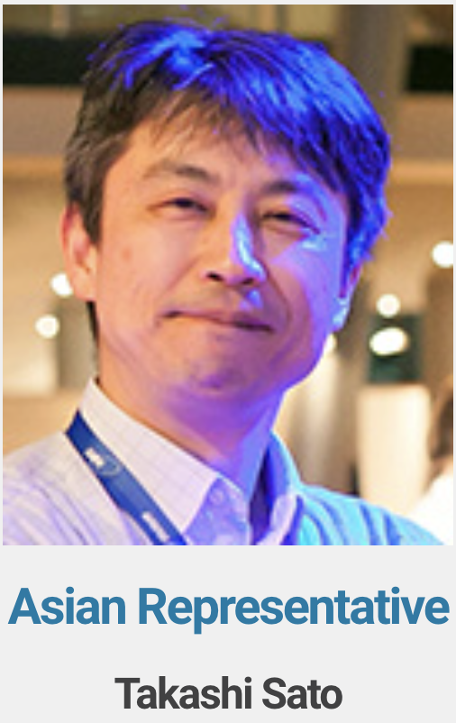
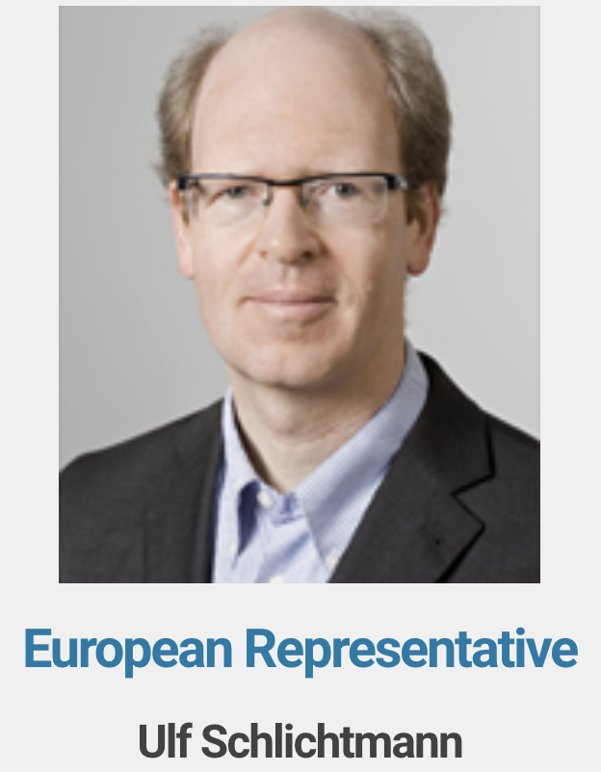
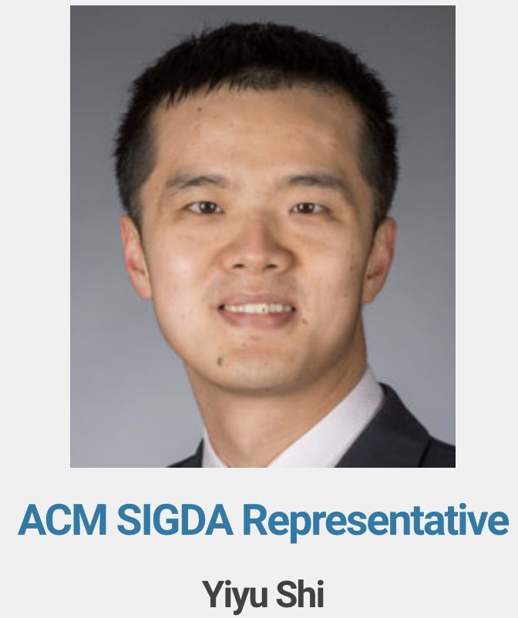
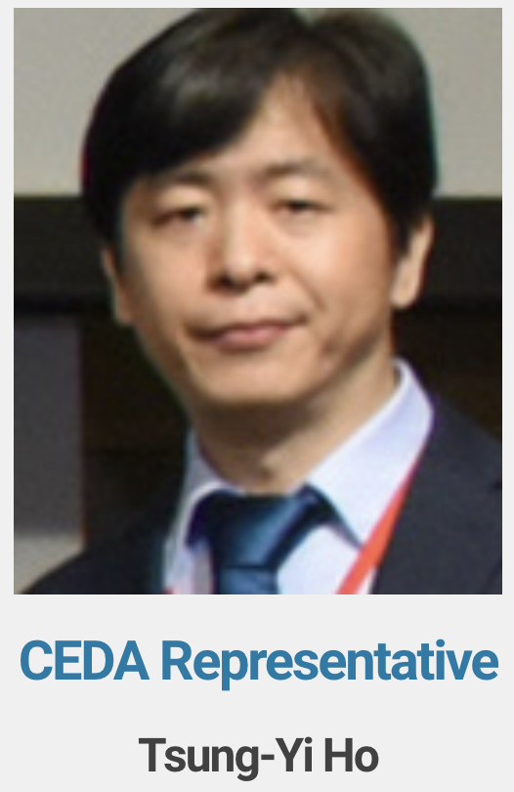
Executive Committee

Slide 15
ICCAD Strengths
High quality content
Thorough reviews by well-known experts and post-acceptance review of final versions
Regular presentations reviewed by the moderators
TPC: 203 members, 16 subcommittees (2 subcommittees for Neural network and deep learning)
16 asynchronous track internal meetings plus 3 meetings with track chairs only
Four reviews per paper (min 3) intended, completed 3.95 reviews/paper (average)
Strict COI rules: no submissions allowed from TPC chair/vice chair; special handling of track chairs’ submissions
Forward-looking & relevant
Addressing current challenges via regular papers
Addressing future directions through special sessions and tutorials
Focused in-depth topics in the workshop program

Slide 16
Statistics
586 papers reviewed 766 abstracts, 595 full papers (9 withdrawn or desk reject)
12% increase over 2021 and 23% increase over 2020
2314 reviews written
131 regular papers accepted
22% acceptance rate
48 sessions
36 regular paper sessions
9 special sessions
3 embedded tutorials
Year | Total Attendees
2017 | 415
2018 | 418
2019 | 391
2020 | 799
2021 | 459

Slide 17
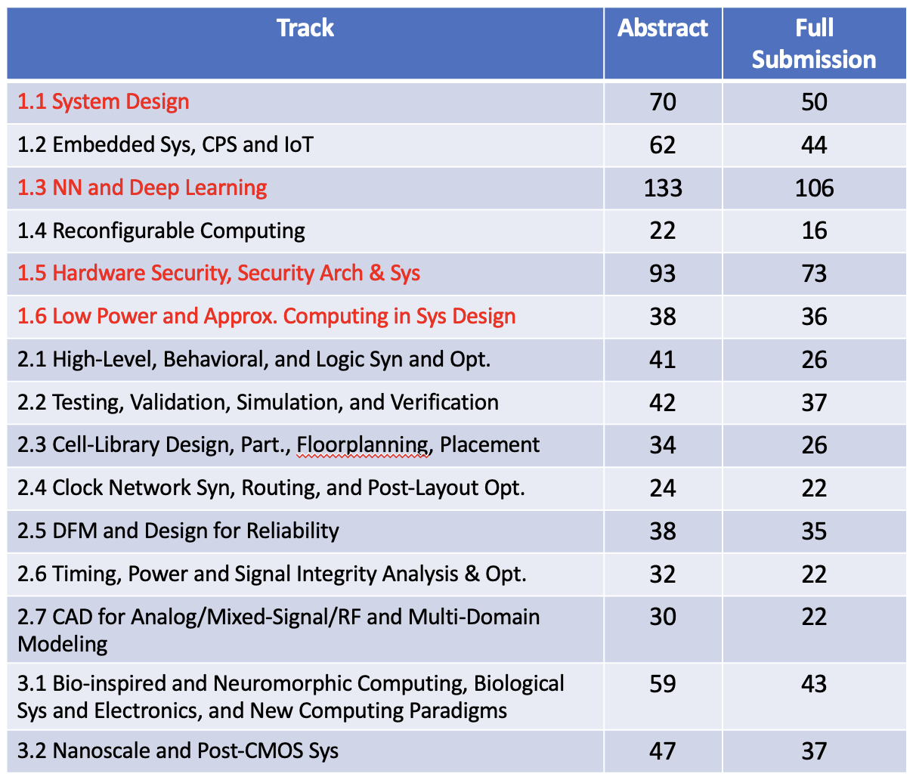
Submissions per track
Highlighted tracks had significant increase in submissions w.r.t. 2021

Slide 18
ASP-DAC
2022 > 2023
Kazutoshi Wakabayashi

Slide 19
Conference overview
Considering the continued COVID-19 pandemic situation, ASP-DAC 2022 was held as a fully virtual conference
Date: January 17-20, 2022
Original plan: @Taiwan
Live sessions + pre-recorded videos for on-demand access
Participants: 476
Academia: 405 (incl. 293 students), Industry: 71
International participation
Taiwan: 250, Overseas: 226

Slide 20
Submissions History
310

Slide 21
Selection results
Topic ID | Topic (subcommittee) Name | # of papers reviewed | Accepted
1 | System-Level Modeling and Design Methodologies | 25 | 7
2 | Embedded Systems and Cyberphysical Systems | 11 | 4
3 | Embedded Systems Software | 14 | 5
4 | Memory Architecture and Near/In Memory Computing | 24 | 9
5 | AI/ML System Designs | 40 | 16
6 | Photonic/RF/Analog-Mixed Signal Design | 16 | 6
7 | Approximate, Bio-inspired and Neuromorphic Computing | 17 | 6
8 | Logic/High-Level Synthesis and Optimizations | 15 | 6
9 | Physical Design | 22 | 7
10 | Design for Manufacturability and Reliability | 6 | 2
11 | Design and Analysis for Timing and Low Power | 13 | 5
12 | Testing, Validation, Simulation, and Verification | 12 | 4
13 | Hardware and Embedded Security | 20 | 7
14 | Emerging Devices, Technologies and Applications | 25 | 11
Total |  | 260 | 95
Acceptance ratio: 36.5%

Slide 22
ASP-DAC 2023
Jan. 16 – 19, 2023 @ Tokyo
The same venue as 2019
Probably hybrid format
Deadline for paper submission: July 24, 2022
coming soon

Slide 23
DATE
2022 > 2023
Donatella Sciuto

Slide 24
DATE 2022
on-line
Special Format
on-site

Slide 25
DATE 2022
The conference had been moved online at the end of 2021
Virtual DATE 2022 profit: 3.3K Euros (to be updated after audit)
DATE 2022 Registration numbers:
Conference: 627
Tutorials: 294
Workshops: 698
Others (Career Development & Networking & YPP): 75

Slide 26
DATE 2023
April 17-19, 2023 @ Antwerp
Rethinking as a 3-day event in presence
Focus on interaction, reinforcing and rebuilding links in the community
Submissions:
Regular submissions: 6 pages in the proceedings + 15' pre-recorded video to be viewed before during and after the conference + interactive technical sessions with poster discussions
Late-breaking results call
Overall activities
5 half-days workshops in parallel to the conference | 10 Focus sessions | 2 Executive sessions | 2 special days | 3 Lunchtime keynotes

