Slide 1
Design Automation Technical Committee
Jinwook Jung
IBM Research
IEEE CEDA BoG Meeting @ DAC 2022
July 10th, 2022

Slide 2
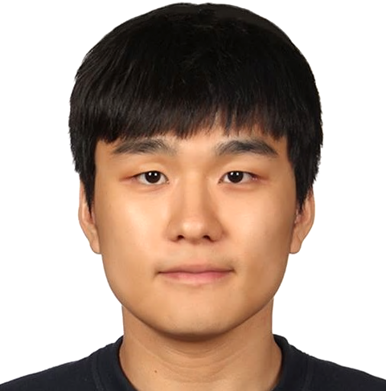
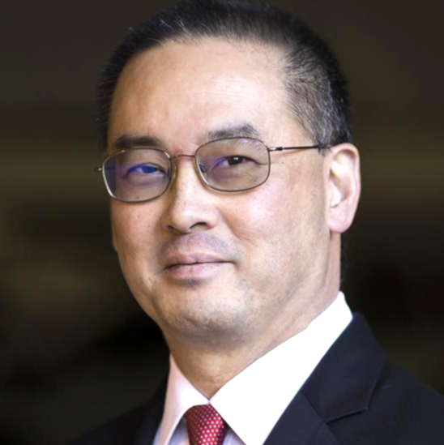
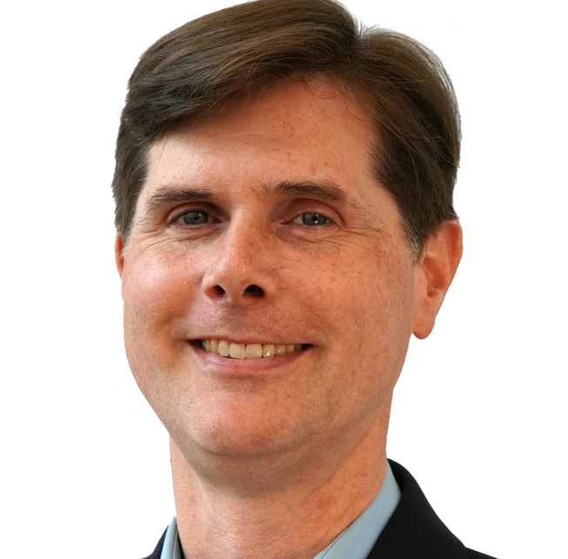
DATC Mission and Roster
Mission: Provide forum for discussing strategies/issues in DA
Current roster (as of July 1st, 2022):
TBD
Jinwook Jung (IBM)
Chair
Andrew B. Kahng (UCSD)
Co-Chair
Rhett Davis (NCSU)
New member
TBD

Slide 3
Our Goal Until 2021...
Establish academic reference design flow
  Preserve leading research codes in design flow
  Foster flow-scale and cross-stage optimization research
DATC Robust Design Flow
  Initiated 2016; latest release 2021
  Design flow built upon academic tools
  Also supports complete, industrial format-based
  RTL-to-GDS flow with OpenROAD
Component | Tool
RTL generator | Chisel/FIRRTL
RTL obfuscation | ASSURE
Logic synthesis | Yosys+ABC
DFT insertion | Fault
Floorplanning | TritonFP
Global placement | RePlAce, FZUplace, NTUPlace3, ComPLx, Eh?Placer, FastPlace3-GP
Detailed placement | OpenDP, MCHL, FastPlace3-DP
Flip-flop clustering | Mean-shift, FlopTray
Clock tree synthesis | TritonCTS
Global routing | FastRoute4-lefdef, NCTUgr, CUGR
Detailed routing | TritonRoute, NCTUdr, DrCU
Layout finishing | KLayout, Magic
Gate sizing | Resizer, TritonSizer
Parasitic extraction | OpenRCX
STA | OpenSTA, iTimerC
Integrated P&R app | OpenROAD
Database | OpenDB
Libraries/PDK | NanGate45, SKY130, ASAP7, NCTUcell
Benchmark conversion | RosettaStone

Slide 4
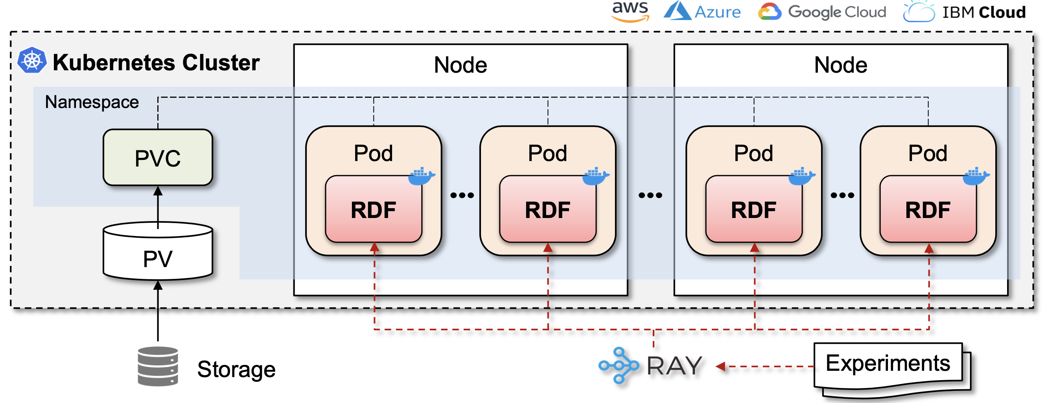
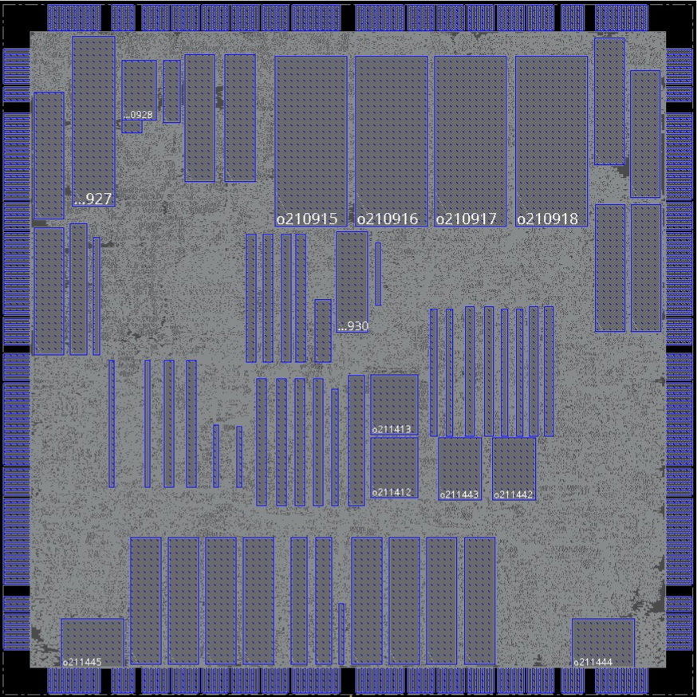
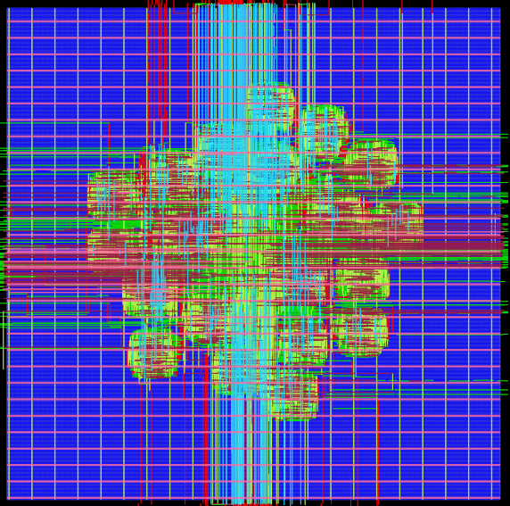
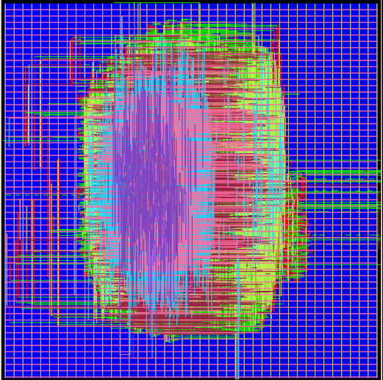
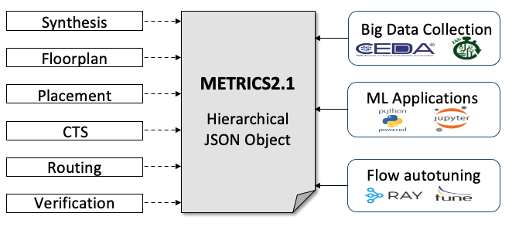
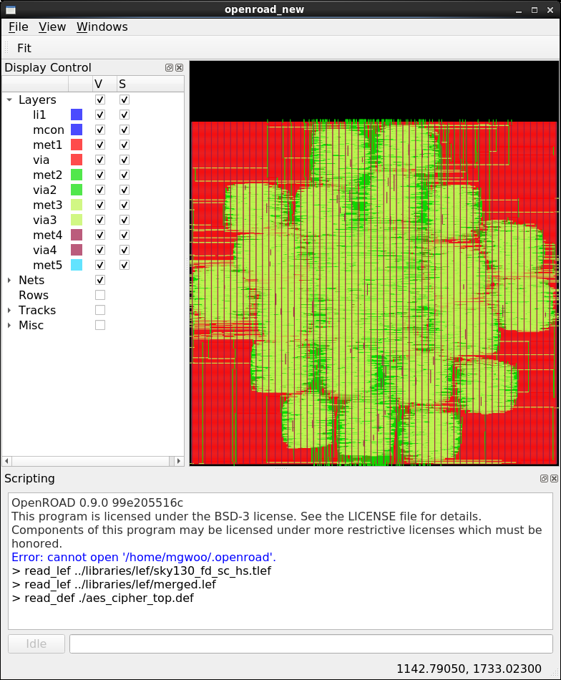
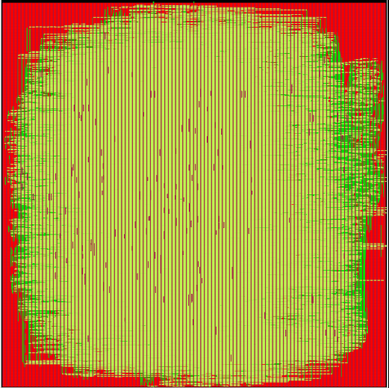
DATC Goal 2022 and Beyond
Research foundations for IC Physical Design and ML-Enabled EDA
  Modern and complete benchmarks for physical design
  Golden calibration datasets for electrical analysis and verification tasks
  Standardized metrics format for flow measurement
  Large-scale distributed design of experiments on cloud environment
adaptec
NanGate45
Calibration
Dataset

Slide 5
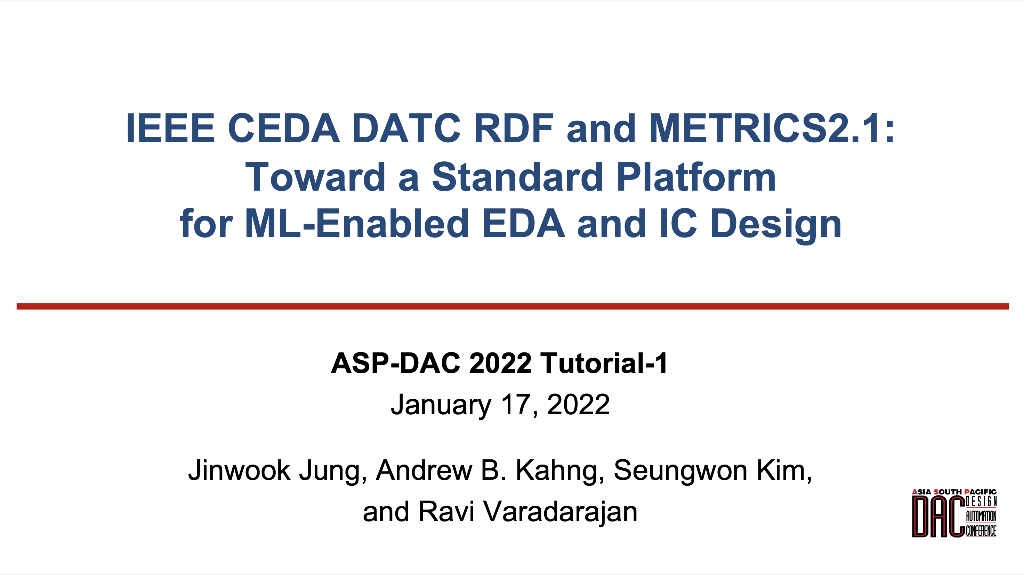
DATC Plans 2022
Tutorial at ASP-DAC 2022 (attracted >50 attendees)
Invited paper at ICCAD 2022 (TBD)
  Title: Expanding Research Foundations for IC Physical Design and ML-Enabled EDA
New industry committee members
Public code and data repositories
  Modern and complete benchmarks for physical design
  Golden calibration datasets for electrical analysis and verification tasks
  Standardized metrics format for flow measurement
  Large-scale distributed design of experiments on cloud environment

