Slide 1
Hardware Security and Trust Technical Committee (HSTTC) BoG Report
Gang Qu and Yier Jin
Hybrid @ DAC, San Francisco
July 10, 2022

Slide 2
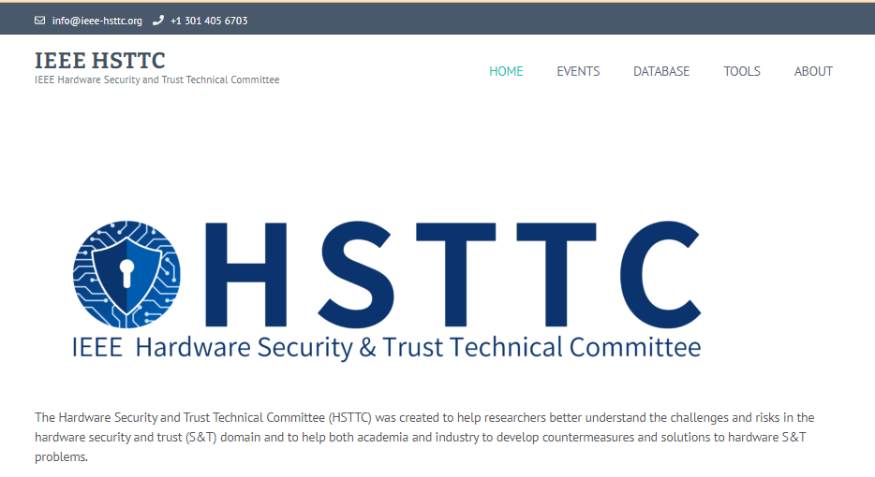
Missions and Goals
TC was formally launched in July 2020
https://www.ieee-hsttc.org/
Help researchers better understand the challenges and risks in the hardware security and trust domain
Help both academia and industry to develop countermeasures and solutions to hardware security and trust problems
Promote the design and distribution of open-source CAD for Assurance tools to academia, industry and government.

Slide 3
Current Status and Activities
Conferences
IEEE Asian Hardware Oriented Security and Trust Symposium (AsianHOST)
AsianHOST 2020 was held in Kolkata, India on Dec. 16-17, 2020 (>100 attendees).
AsianHOST 2021 was held in Shanghai, China (Hybrid) on Dec. 17-18, 2021 (>160 attendees).
AsianHOST 2022 will be held in Singapore on Dec. 14-16, 2022.
Top Picks in Hardware and Embedded Security (Top Picks)
Co-located with ICCAD, Nov. 4, 2021 (11 papers selected from 24 submissions)
Special sessions, tutorials, panels in: ITC-Asia’21, SOCC’21, ASPDAC’22, HOST’22.
CADforAssurance Webinars and Panels
Joint efforts with CADforAssurance.org (established in October 2020)
Online database of papers, benchmarks, and tools

Slide 4
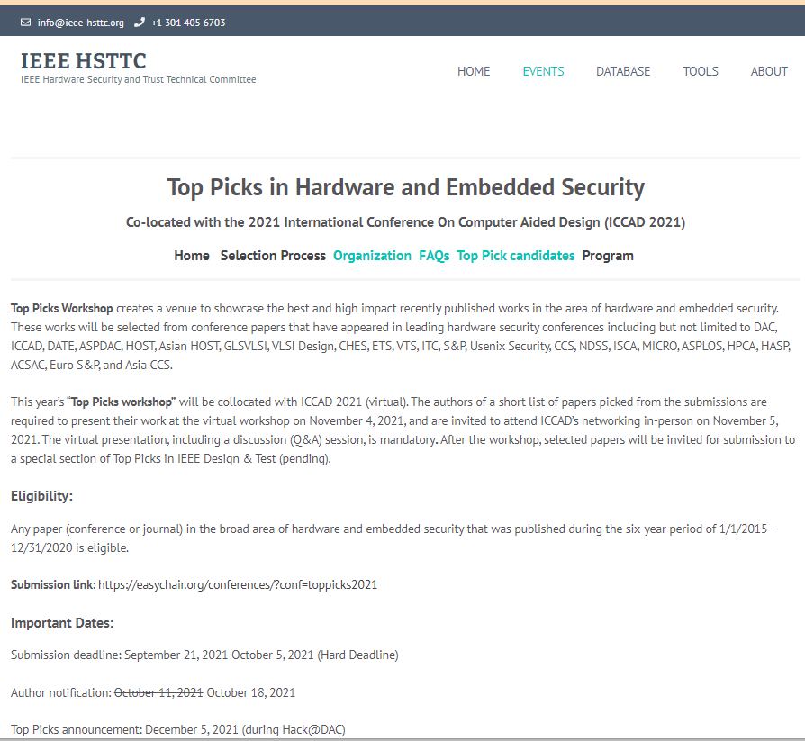

Slide 5
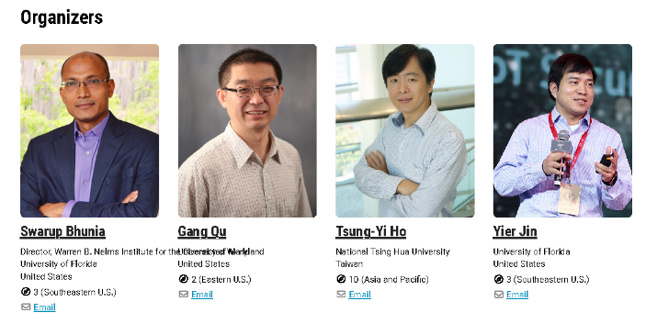
CADforAssurance.org: Hardware ASSURANCE TOOLS & BENCHMARKS WEB PORTAL
CADforAssurance.org established in October 2020, by members of HW Security community
Web portal created for academic dissemination w/ open-source tools, benchmarks, and metrics for assured systems and hardware
> 75 Contributors
>4400 Unique Visitors, >16,000 page views
16 tool demos (9 webinars), 1 course, 4 virtual panels since February 2021
1200 total attendees, 40+ countries and regions, ~60 minutes/event
Co-sponsored by IEEE CEDA, Nelms Institute, HSTTC, Mercury, HII, and NGC
https://cadforassurance.org/
https://ieee-ceda.org/cad-assurance

Slide 6
Challenges and Action Items
Lack of in person events
None due to the pandemic. AsianHOST 20/21 in-person/hybrid → 100% virtual
AsianHOST 2022 is planned a hybrid mode but in-person is encouraged for TC promotion.
Lack of journal publication venues
TCAD is ideal, but overcrowded; TIFS, TCAS-I and TCAS-II are not good matches.
SI of AsianHOST: TCAD (2019), TETC(2020), TCAS-I(2022, planned).
More volunteers
TC webpage developing and maintenance (need funding for dedicated maintainers)
Event organizing: tutorials, webinars, panels, special issues, Ph.D. forums, contests, …
Outreaching: other CEDA TCs, IEEE societies, ACM (SIGDA), universities, industry, …
Advisory board and TC officers

