Slide 1
MTT-S Report
José Rayas-Sánchez
July 10, 2022

Slide 2
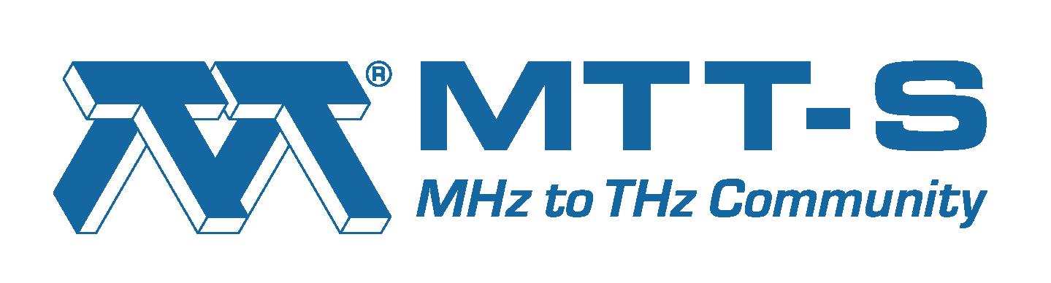
MTT-S Report
Society new name
MTT-S Inter-Society Committee
MTT-S Technical Committee on Design Automation (TC-2)
TC-2 contributed papers for the IEEE Journal of Microwaves
CEDA related MTT-S Conferences
AI & ML activities for the IMS-2023

Slide 3


Society New Name (from April 2022)
Microwave Theory and Techniques Society (MTT-S)
Microwave Theory and Technology Society (MTT-S)

Slide 4
MTT-S Inter-Society Committee
MTT-S Inter-Society Committee is in charge of cultivating relationships with IEEE Councils and other technical societies
Inter-Society Committee is aiming at encouraging a stronger participation of MTT-S in IEEE Councils
MTT-S currently has official representation in 7 councils

Slide 5

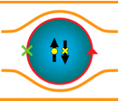
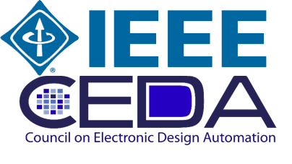
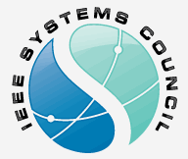
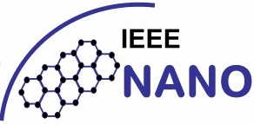


MTT-S Representation in 7 IEEE Councils

Slide 6
MTT-S Tech. Committee on Design Automation
MTT-S has 29 technical committees
The MTT-S Technical Committee on Design Automation (TC-2) is the closest to CEDA; it focuses on:
  Modelling and simulation of devices, circuits, and systems
  Non-linear analysis
  Optimization techniques
  Multi-physics modelling
  Machine learning and artificial intelligence for design automation
MTT-2 regularly organizes technical events/initiatives on CAD and EDA

Slide 7
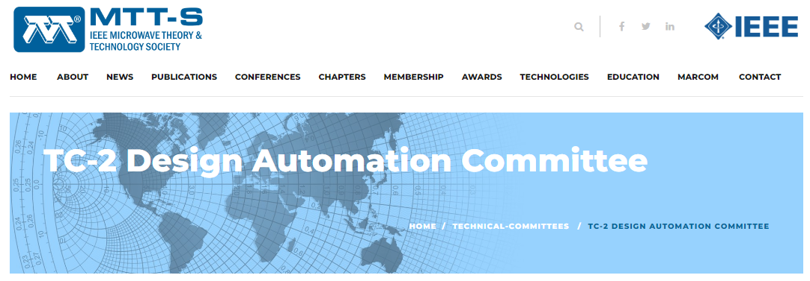
MTT-S Tech. Committee on Design Automation
https://mtt.org/technical-committees/tc-2-design-automation-committee/

Slide 8

Recent TC-2 Contributed Papers

Slide 9
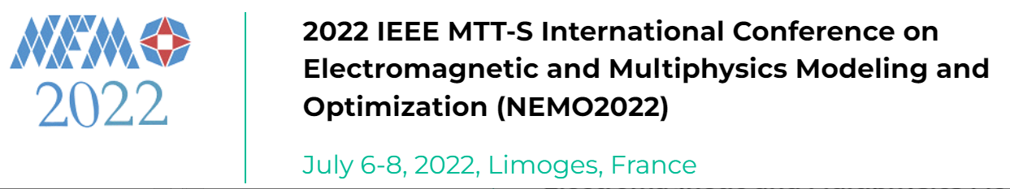
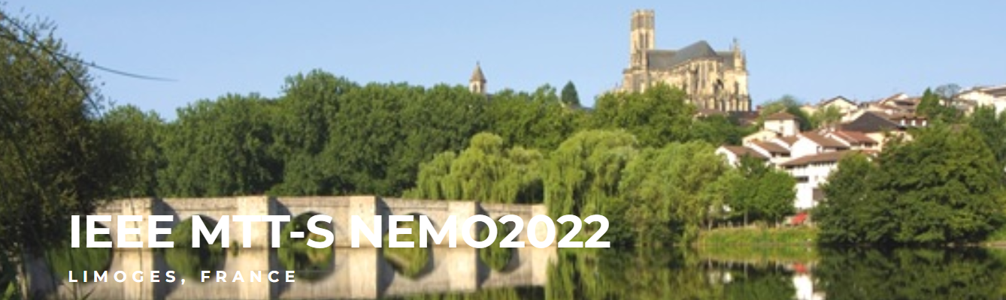
CEDA-related MTT-S Conferences
http://nemo-ieee.org/

Slide 10
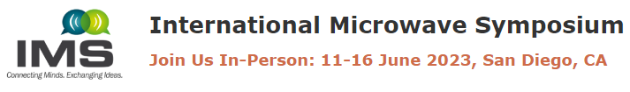

AI & ML Activities during IMS-2023
Workshops on AI/ML
Panel Sessions on AI/ML
Focus Sessions on AI/ML
Short Course (Bootcamp) “AI and Machine Learning 101”
Others (e.g., MicroApps, YP event, student competition)
Strong industry participation is encouraged
Proposals from CEDA members are very welcome!

Slide 11
Thanks
José Rayas-Sánchez
IEEE MTT-S Representative for CEDA

