Slide 1
Technical Activities
Tsung-Yi Ho/Vasilis Pavlidis
Krishnendu Chakrabarty, Yiran Chen, Ulf Schlichtmann, Evangeline Young
July 9, 2023

Slide 2
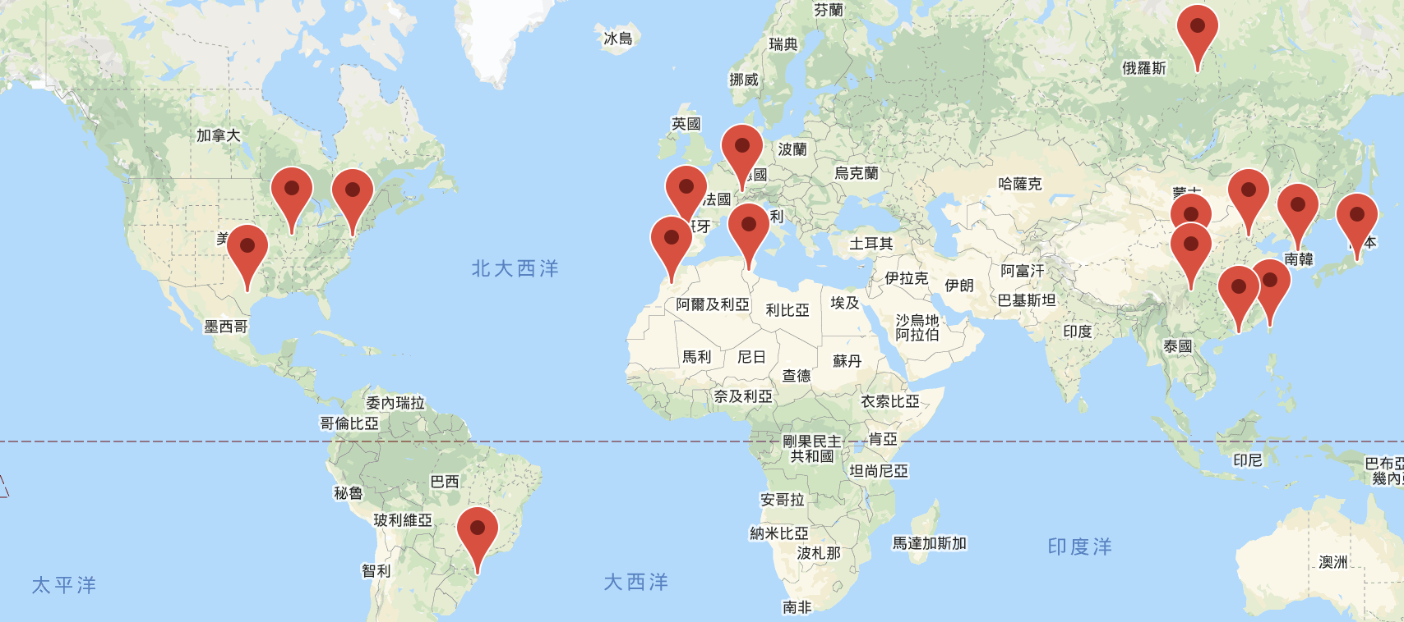
CEDA Chapters
16 Chapters
5 Student Chapters
Beijing
Central Illinois
Central Texas
Chengdu
Hong Kong
Japan
Montreal
Morocco
Pennsylvania
Seoul
Shanghai
South Brazil
Spain
Switzerland
Taipei
Tunisia
Austria
Southern California
UAE
Shenzhen

Slide 3
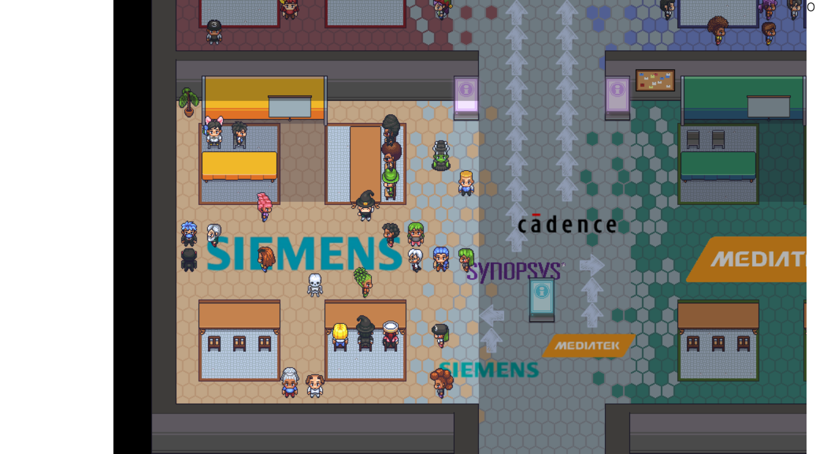
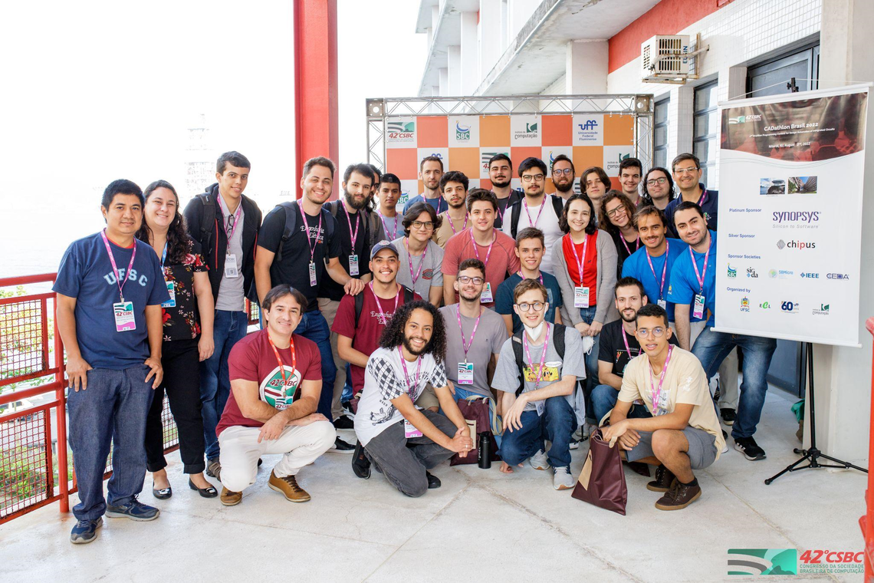
CEDA Chapter Meeting (March 15)
Chapter Report
Activity Planning
Signature event: contest, awards, etc.
General expense: banner, local travel, souvenir, etc.
Support 10 proposals (6 in 2022)
Call for Initiative (NIC)
Role Rotation
Chair, Vice Chair, Treasurer/Secretary
Term of service
Notes:
Brazil 1,5K Spain 1K Taipei 4K HK 1.95K Japan 1K Beijing 0.5K

Slide 4
CEDA Technical Committees
DATC (Design Automation Technical Committee)
Chair: Jinwook Jung, IBM
SVDTC (System Validation and Debug Technology Committee)
Chair: Chinna Prudvi, Intel Inc.
TCCPS (Technical Committee on Cyber-Physical Systems)
Chair: Shiyan Hu, University of Southampton
TTTC (Test Technology Technical Council)
Chair: Peilin Song, IBM
Hardware Security and Trust Technical Committee (HSTTC)
Chair: Gang Qu, University of Maryland
Awards, Tools, Standards, Outreach, etc.

Slide 5
CEDA Luncheon Talk
DAC 2023
Tulika Mitra, NUS
ICCAD 2023
Margaret Martonosi, Princeton
DATE 2024 (TBD)
Andrew Kahng
Albert Y. Zomaya
Donatella Sciuto (maybe about women in STEM?)
Sharon Hu

Slide 6
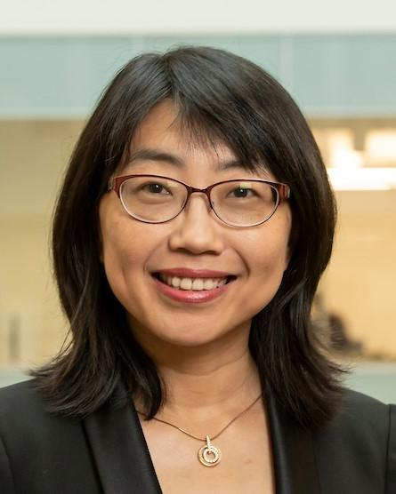
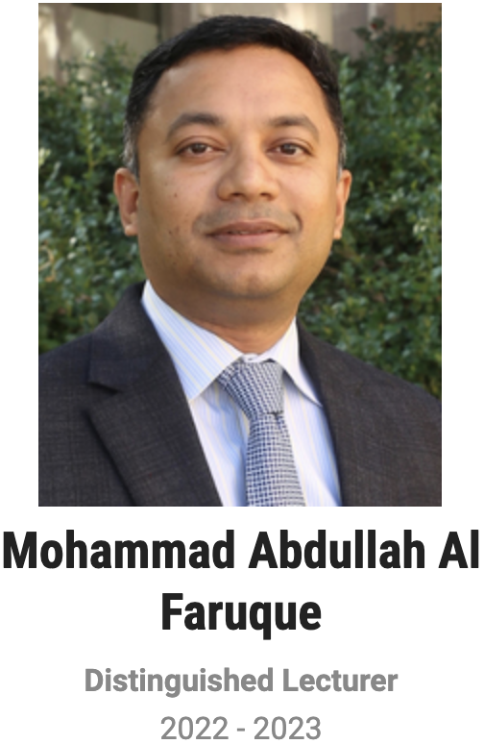
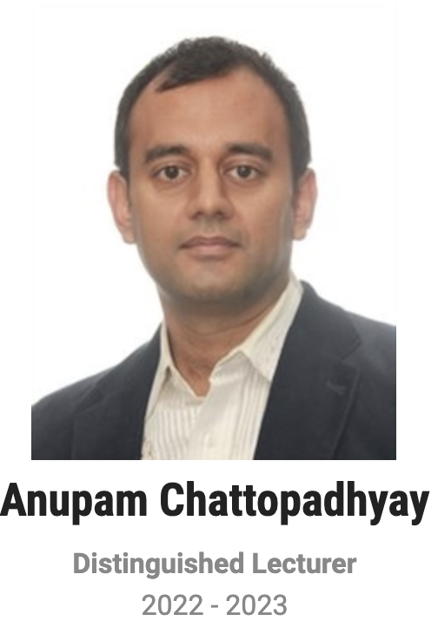
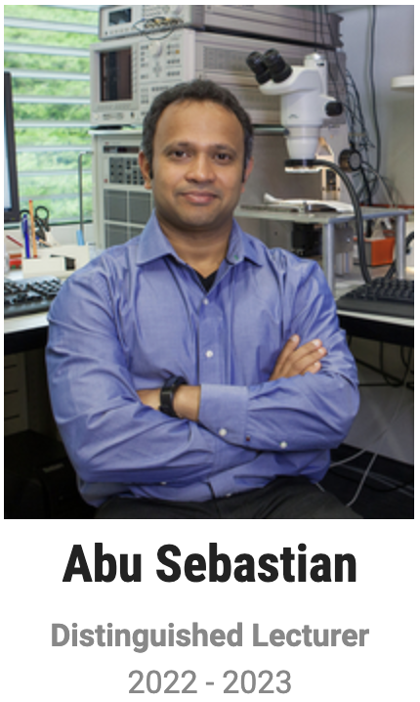
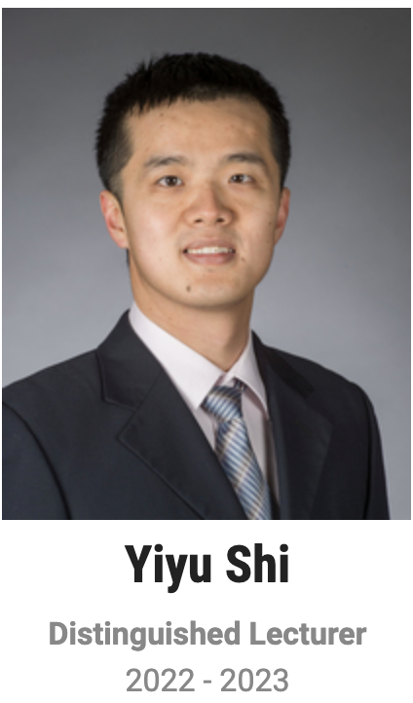
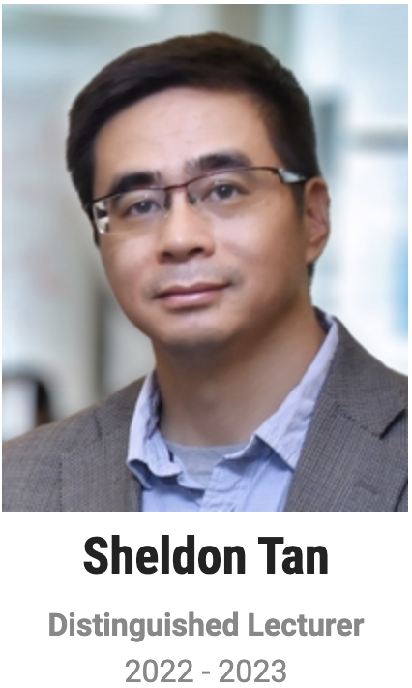
Distinguished Lecturer Program
Helen Li
2022-2023

Slide 7
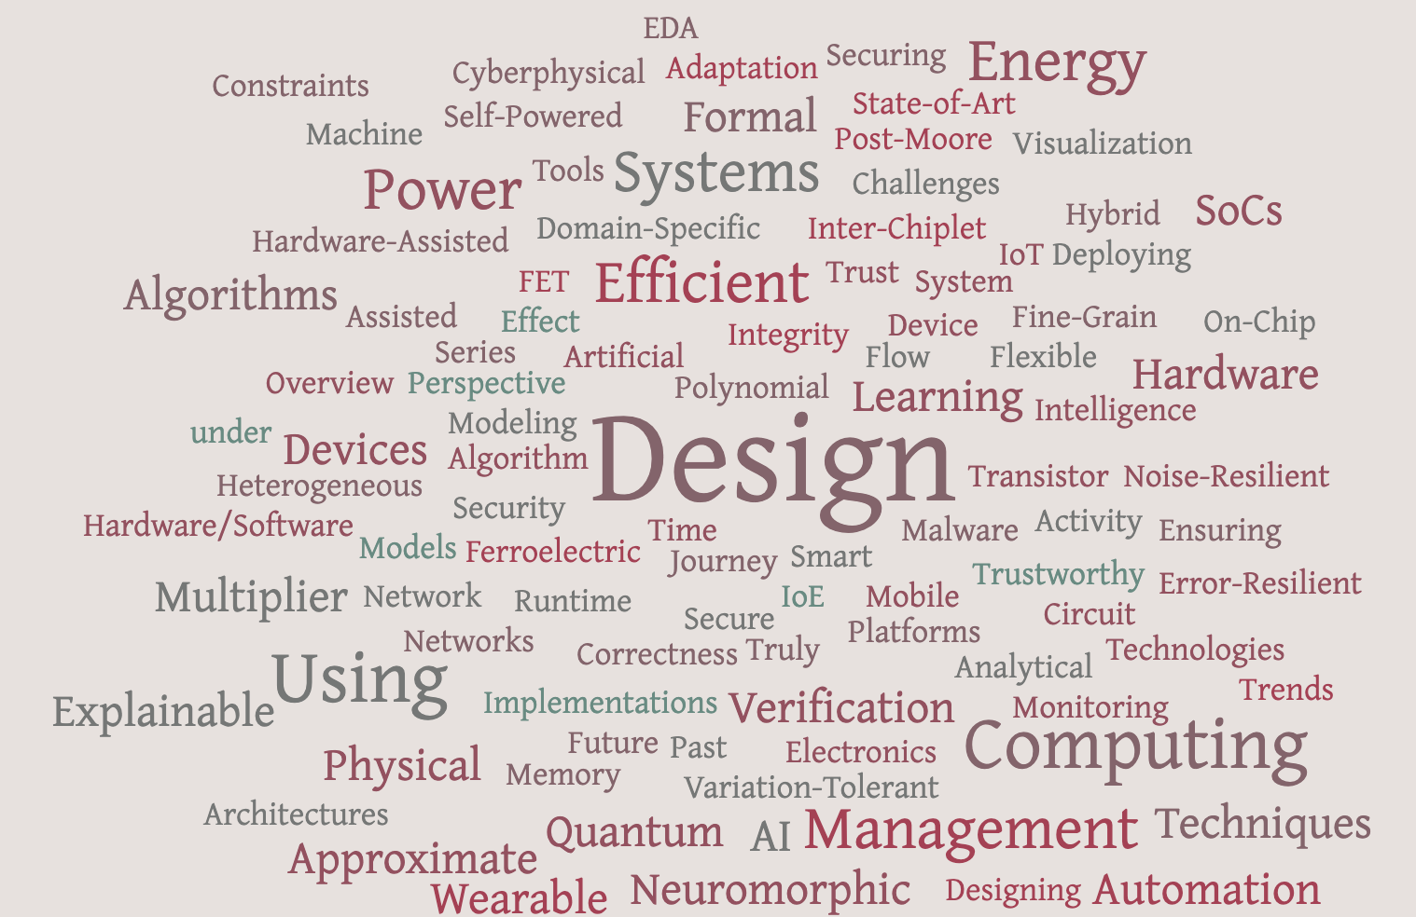
Motion: New Distinguished Lecturers
Committees:
Yiran Chen, Vasilis Pavlidis, Ulf Schlichtmann, Evangeline Young

