Slide 1
CEDA Standards Committee
Aparna Dey
9 July 2023

Slide 2
Standards Overview
Mission /Objective
Current Status & Achievements
Challenges /Opportunities
Action Items
Questions

Slide 3
Mission /Objectives
Drive Standardization in advanced EDA topics with focus on “research-based topics”
Proposals from Academia, and Industry Adv. Research groups
Collaborate/ Joint sponsor w/ IEEE DASC & other Industry Standards organizations/committees
Leverage CEDA Events/Network/site to increase Standards membership

Slide 4
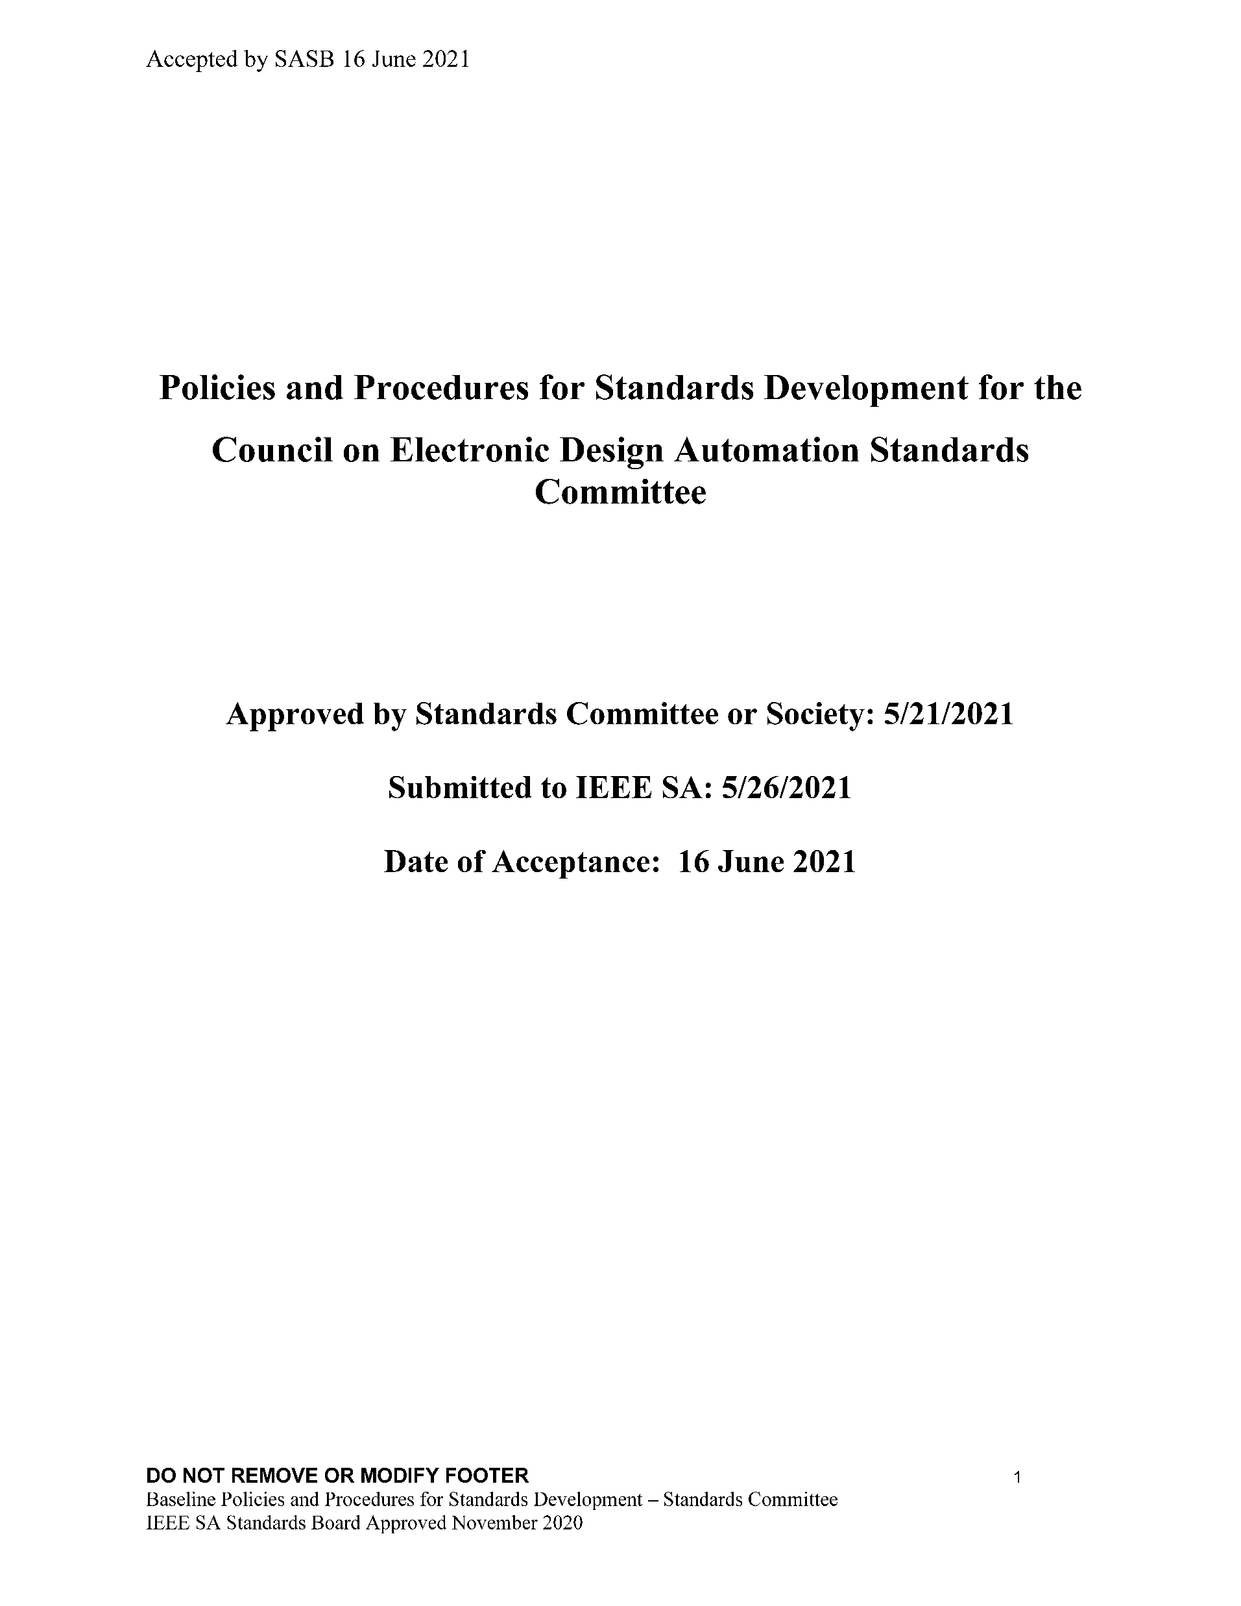
Current Status & Achievements
CEDA SC Leadership - meeting Quarterly
Aparna Dey, chair (CEDA- VP Standards )
Dennis Brophy, Vice-chair
Yatin Trivedi, Secretary
CEDA SC member drive –
Increased membership through new CEDA Standards site – 23 new members
Present to various CEDA Chapters – pending
IEEE CEDA Events/ forums –Q4/22, Q1/23, Q2/2023
CEDA (CEDA SC) infrastructure – completed
CEDA SC public and Collab site - done
Mission Statement/ Objectives/P&P – done

Slide 5
Current Status & Achievements (2)
CEDA Standards Committee infrastructure active/updated
https://ieee-sa.imeetcentral.com/ceda-sc/home
CEDA SC public site : https://sagroups.ieee.org/ceda-sc/
23 new members. 3 EDA companies, User companies –Intel, Qualcomm, Ericsson, 3 Universities, e.t.c
Planning Standards Kickoff meeting (~9/12/23 ) - critical mass and interest.
Agenda, Invitation to participate, Request for proposal for PAR or study group in key EDA areas
CEDA SC Open-Source Maintainer
Discuss possible use of SA Open-Source platform for standard development
Dennis Brophy

Slide 6
Challenges/Opportunities
Increasing relevant membership/participation from Academia and Industry
Promotion of Kickoff meeting with Agenda
Regular meeting schedule after kickoff meeting
Define scope and encourage study groups/white papers in new areas
Increasing CEDA/SC visibility with Industry & Academia
Present at Academic Network meetings
Promotions online and with other committees, industry events
Attracting differentiated Standardization proposals/ study group in advanced topics
Supporting valid differentiated proposals from current members
Potential for joint sponsorship with DASC and IEEE Standards Committee

Slide 7
Action Items
Planning/Agenda for Standards kick-off meeting ~9/12/23
Work w/ other IEEE SC and leverage Academic Networks
Keep CEDA/SC infrastructure sites current – update
Increase Membership/ Call for participation drive
Present CEDA/SC Mission @ CEDA Chapter meetings/events
Follow up on adoption of IEEE SA Open platform
Follow up on AMS and potential language Standards

Slide 8
Current Published DASC Standards
IEEE Standard | Approve | Voting Method | IEC Dual Logo
1076 VHDL | 2019 | Individual | D
1076.1 (VHDL AMS) | 2017 | Individual | D
1481 (OLA | 2019 | Individual | D
1647 (e language) | 2019 | Individual
1666 (SystemC) | 2023 | Entity
1666.1 (SystemC AMS) | 2016 | Entity | D
1685 (IP-XACT) | 2014 | Entity | D
1734 (Quality IP) | 2011 | Entity | D
1735 (IP Encryption) | 2015 | Entity
1800 (SystemVerilog) | 2017 | Entity | D
1800.2 (UVM) | 2020 | Entity | D
1801 (UPF) | 2018 | Entity | D
2401 (LSI Package Board) | 2019 | Entity | D
2416 (System Level Power) | 2019 | Entity
2804 (SHIM) | 2019 | Entity | D

Slide 9
DASC Standards Transferred
IEEE PAR | PAR Approved | Transfer Approved
P2851 (Functional Safety) | 2019 | 2021

Slide 10
DASC Standards Begin Revised
IEEE PAR | PAR Approved | Ballot Expected
P1666 (SystemC) | 2018 | 2023
P1735 (IP encryption) | 2018 | 2023
P1800 (SystemVerilog) | 2019 | 2023
P1801 (UPF) | 2018 | 2023

Slide 11
New DASC Standards
IEEE PAR | PAR Approved | Ballot Expected
P3164 (SA EDI*) | 2022 | 2024
*Security Annotation for Electronic Design Integration.
Scope: This standard addresses security concerns of electrical designs that are integrated into other circuits. The standard defines a methodology that:
(1) identifies elements, such as input or output ports, that can
influence the behavior of a critical section within the design, and
(2) associates known security weaknesses based on the type of
design and/or critical section.

Slide 12
Questions?

