Slide 1
IEEE CEDA Executive Committee & Annual Board of Governors’ Meetings at DAC 2021
Virtual
July, 2021

Slide 2
CEDA Brazil Chapter
José Luís Güntzel / UFSC ( j.guntzel@ufsc.br )
Past Chair: Ricardo Reis / UFRGS
Activities chair: José Nacif / UFV
Treasurer: Paulo Butzen / UFRGS

Slide 3
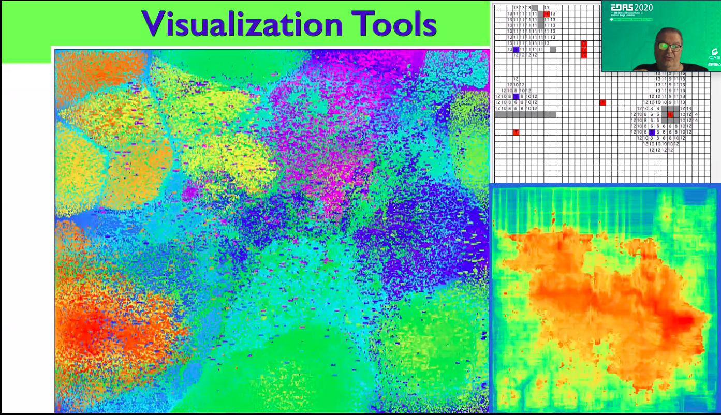
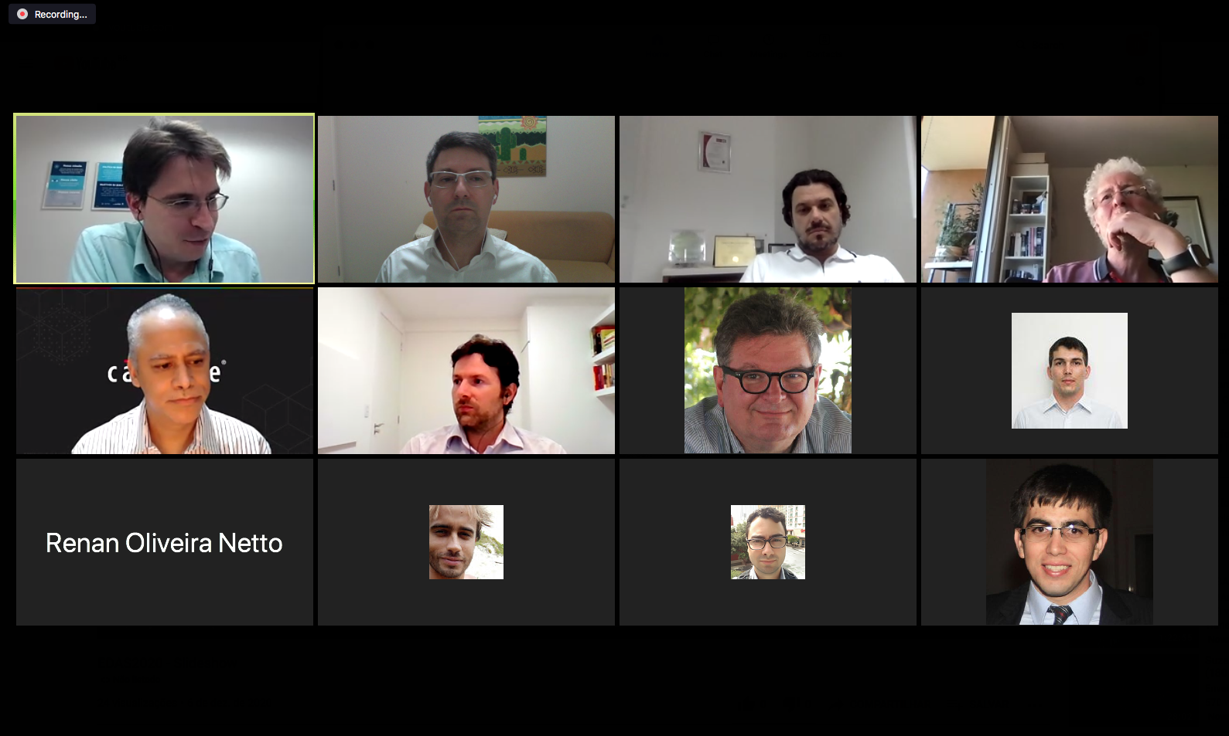
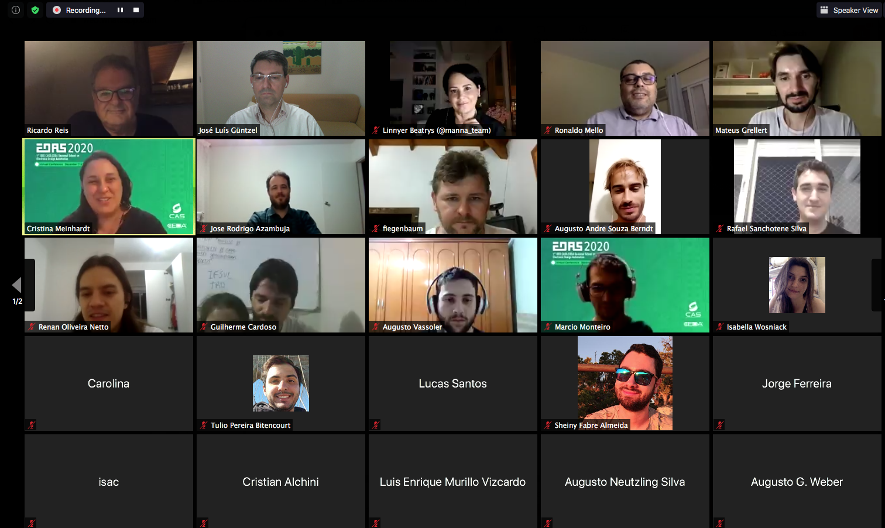
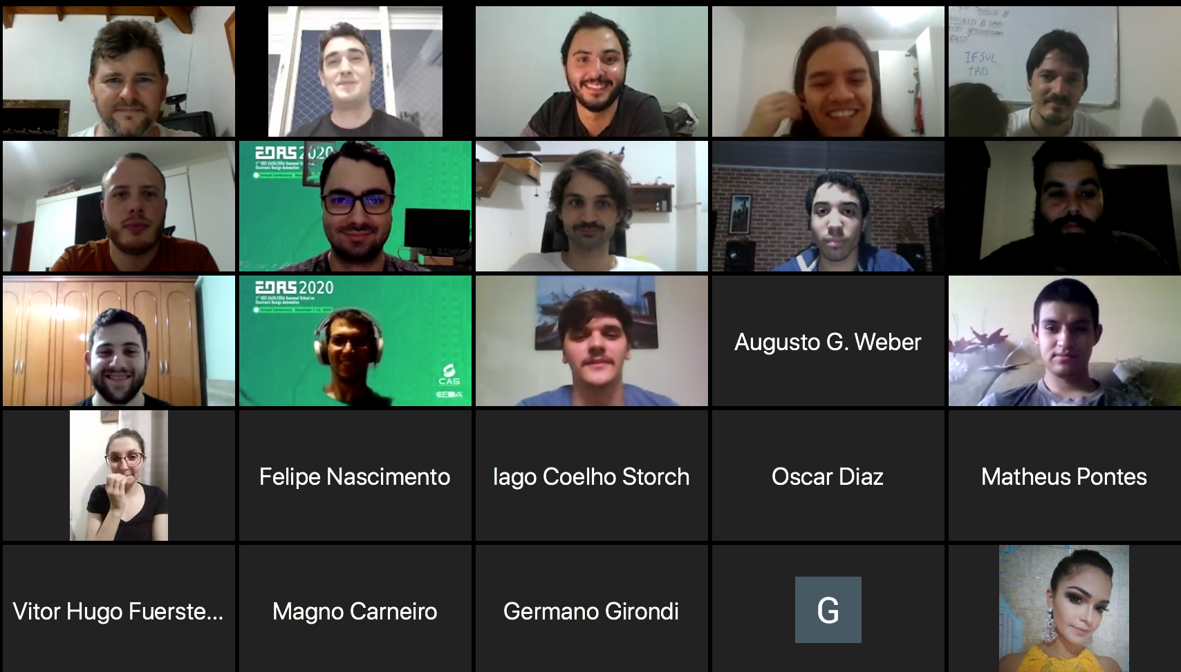
2020-2021 Activities
Support to
IEEE CASS/CEDA Seasonal School on Electronic Design Automation (EDAS 2020)
Virtual, December 7-11, 2020
200+ participants
22 courses and tutorials
40+ hours of content
11 poster presentations
3 panels
Introduction to Electronic Design Automation | Ricardo Reis (UFRGS) and José Luis Güntzel (UFSC)
Introduction to the Modern Design Flow | Mateus Fogaça (Cadence Design Systems)
Logic Synthesis | Augusto Neutzling Silva (Cadence Design Systems) and Jody Matos (Silvaco)
Challenges on Logic Synthesis and Modern solutions on Logic Synthesis - Part 1 | Vinicius Callegaro (Mentor Graphics)
Challenges on Logic Synthesis and Modern solutions on Logic Synthesis - Part 2 | Vinicius Possani (Synopsys Inc)
Global Placement | Paulo Butzen (UFRGS)
Placement Legalization | Jucemar Monteiro
Detailed Placement | Sheiny Fabre (UFSC) and Cristina Meinhardt (UFSC)
Physically-aware synthesis | Guilherme Flach (Synopsys Inc)
Automatic Cell Generation | Ricardo Reis (UFRGS)
Global Routing | Renato Hentschke (Synopsys Inc)
Detailed Routing | Gracieli Posser (Cadence Design Systems)
Routing with cell Movement and other Challenges | Tiago Fontana (UFSC) and José Luis Güntzel (UFSC)
Timing Optimization | Vinícius Livramento
Gate Sizing | Marcelo Johann (UFRGS)
Visualization Tools | Ricardo Reis (UFRGS)
Clock Synthesis | Gustavo Wilke (Synopsys Inc)
Synthesis of Quantum Circuits | Calebe Micael de Oliveira Conceição (IFSul)
Synthesis of NML Circuits | Omar Paranaiba Vilela Neto (UFMG) and José Augusto Nacif (UFV)
Synthesis of 3D Circuits | Carolina Metzler and Ricardo Reis (UFRGS)
Machine Learning application on EDA | Renan Oliveira Netto (UFSC) and Mateus Grellert (UFSC)

Slide 4
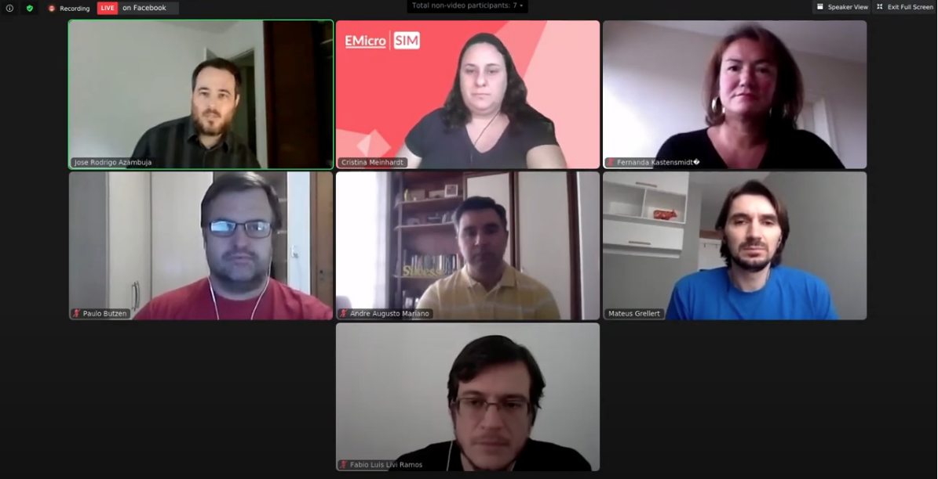
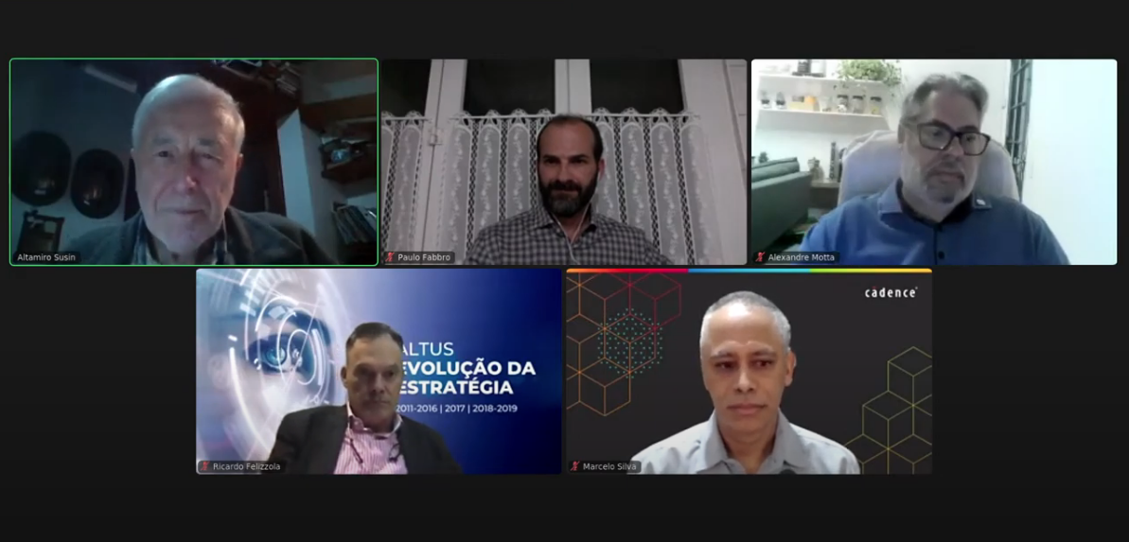
2020-2021 Activities
Support to
Microelectronics School (Emicro 2021)
South Symposium on Microelectronics (SIM 2021)
Virtual, April 26-30, 2020
https://www.ufrgs.br/emicro/
740 people registered
Up to 200 people attending daily
21 Lectures
Alessandro Girardi (Unipampa, Brazil)
Alexandra Zimpeck (UCPel, Brazil)
Andrei Legg (UFSM, Brazil)
Bernardo Leite (UFPR, Brazil)
Cesar Zeferino (UNIVALI, Brazil)
Calebe Conceição (IFSUL, Brazil)
Fábio Benevenuti (UFRGS, Brazil)
Fernanda Kastensmidt (UFRGS, Brazil)
Fernando Moraes (PUCRS, Brazil)
João Baptista Martins (UFSM, Brazil)
Volnei Pedroni (UTFPR, Brazil)
José Luís Güntzel (UFSC, Brazil)
José R. Azambuja (UFRGS, Brazil)
Leomar da Rosa (UFPel, Brazil)
Luciano Agostini (UFPel, Brazil)
Luis Lolis (UFPR, Brazil)
Marcelo Johann (UFRGS, Brazil)
Paulo Butzen (UFRGS, Brazil)
Renato Ribas (UFRGS, Brazil)
Ricardo Reis (UFRGS, Brazil)
Sergio Bampi (UFRGS, Brazil)
3 Panels
IoT Contest
52 Technical Presentations of Students’ works

Slide 5
2020-2021 Activities
Support to the
IEEE CASS-RS/SSCS-EDS-RS/CEDA-Brazil
Industrial Talks 2021
Youtube Live @ CASS Rio Grande do Sul Chapter
www.youtube.com/cassriograndedosul/

